Slide 1
Process Mapping For Requirements Analysis
Adaeze Badipe

Slide 2

Learning Objectives
Understand The ‘Helicopter View’
Processes, Input and Output
Identify and Define Activities:
And their connections
Identify Roles/Actors/Users

Slide 3
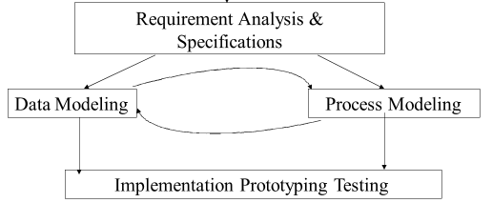
Why Do We Need Business Process Mapping?

Slide 4
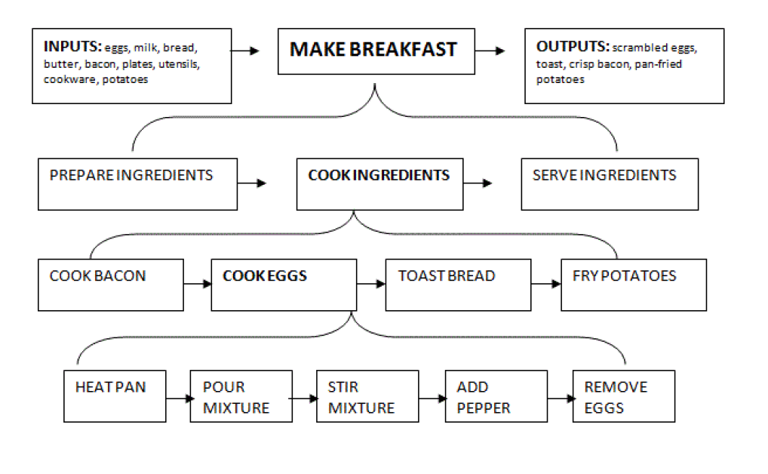
Some Examples

Slide 5
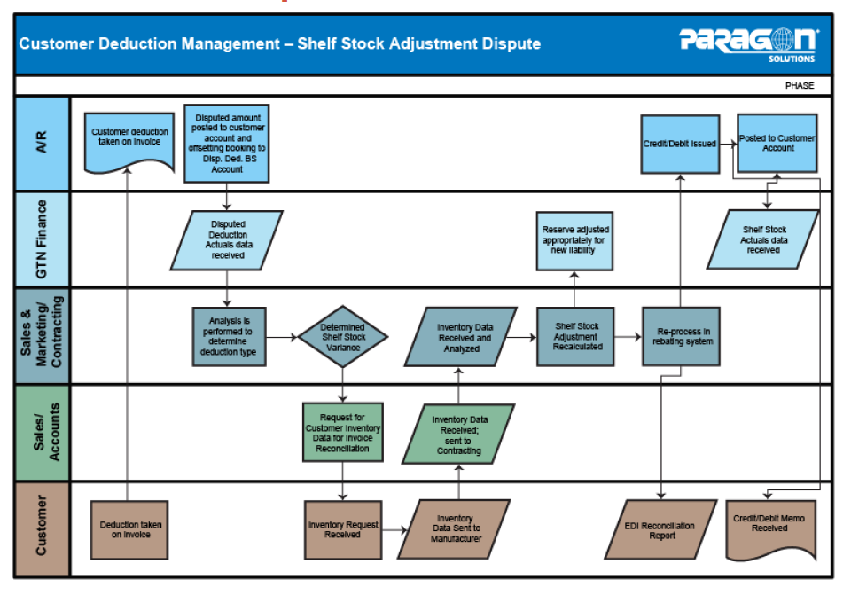
Some Examples

Slide 6
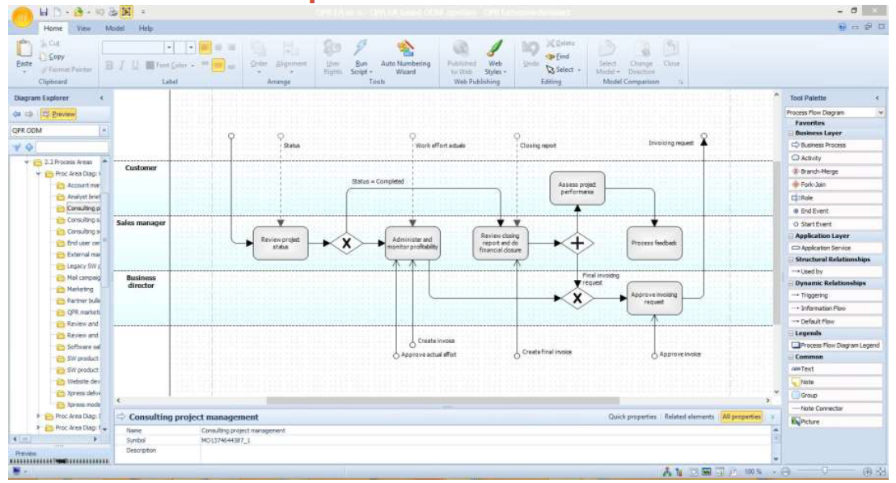
Some Examples

Slide 7
Flow Chart Symbols
Study the ‘ Lucid Chart Flow Chart Symbols Explianed’ PDF
**Symbols may differ when using other flow-charting software such as Microsoft Visio, etc.
However, symbols are generally similar and align with to standardised principles

Slide 8
Activity
Let’s practice

Slide 9
Bean and Brew Process Drawing Activity
This Exercise is on Teams in a PDF format.
You can use either:
Lucid Chart
Microsoft Visio
Or any other Software that you find helpful

