Slide 1
Shopping List
Michael Kashkov & Ian McConaghy

Slide 2

Why we chose this app?
Used on a weekly basis
Example of training and using model in a real application with user interface vs command line

Slide 3
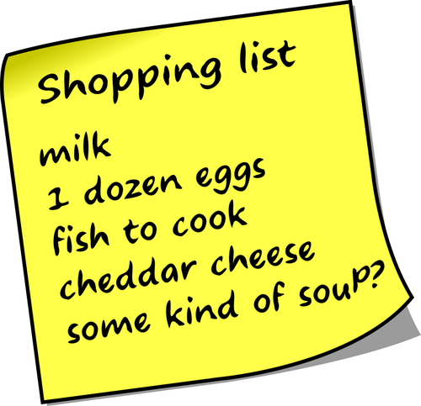
MVP Features
Type a shopping item
Drawing a quantity number

Slide 4
Demo

Slide 5

Challenges
Needed Canvas but didn’t work well in modern frameworks - > JQuery
Development Environment: Python + FastAPI - > Linux VM
Backend - Libraries too big for Heroku

Slide 6

What we learned
How to create a model
How to train model
How to use Libraries and packages
Where to look for resources
How to use AI in a real App

Slide 7
Q&A

Slide 8
References
Tutorials:
https://machinelearningmastery.com/how-to-develop-a-convolutional-neural-network-from-scratch-for-mnist-handwritten-digit-classification/
https://www.analyticsvidhya.com/blog/2021/11/newbies-deep-learning-project-to-recognize-handwritten-digit/
https://docs-snaplogic.atlassian.net/wiki/spaces/SD/pages/479264770/Handwritten+Digit+Recognition+using+Convolutional+Neural+Networks
Keras:
https://keras.io/api/datasets/mnist/
Sequential Model:
https://keras.io/guides/sequential_model/

