Slide 1



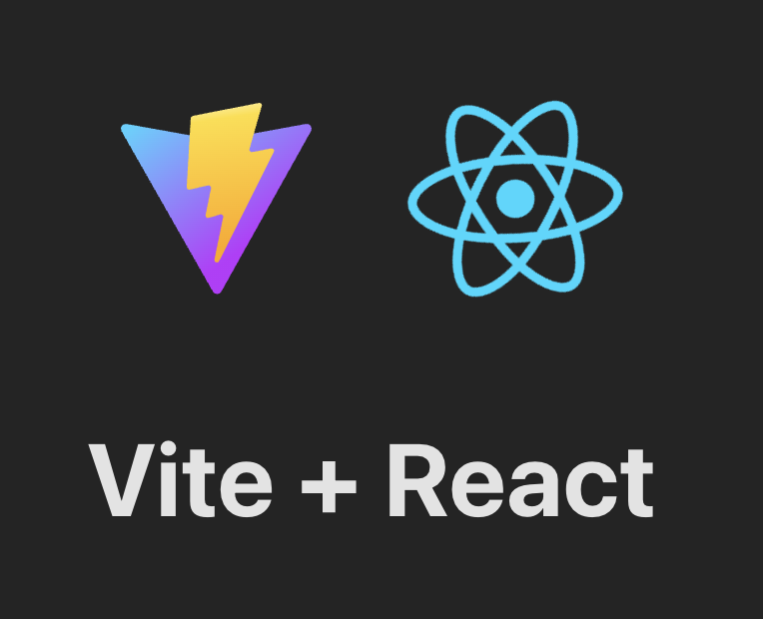
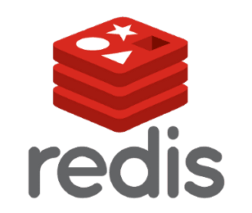

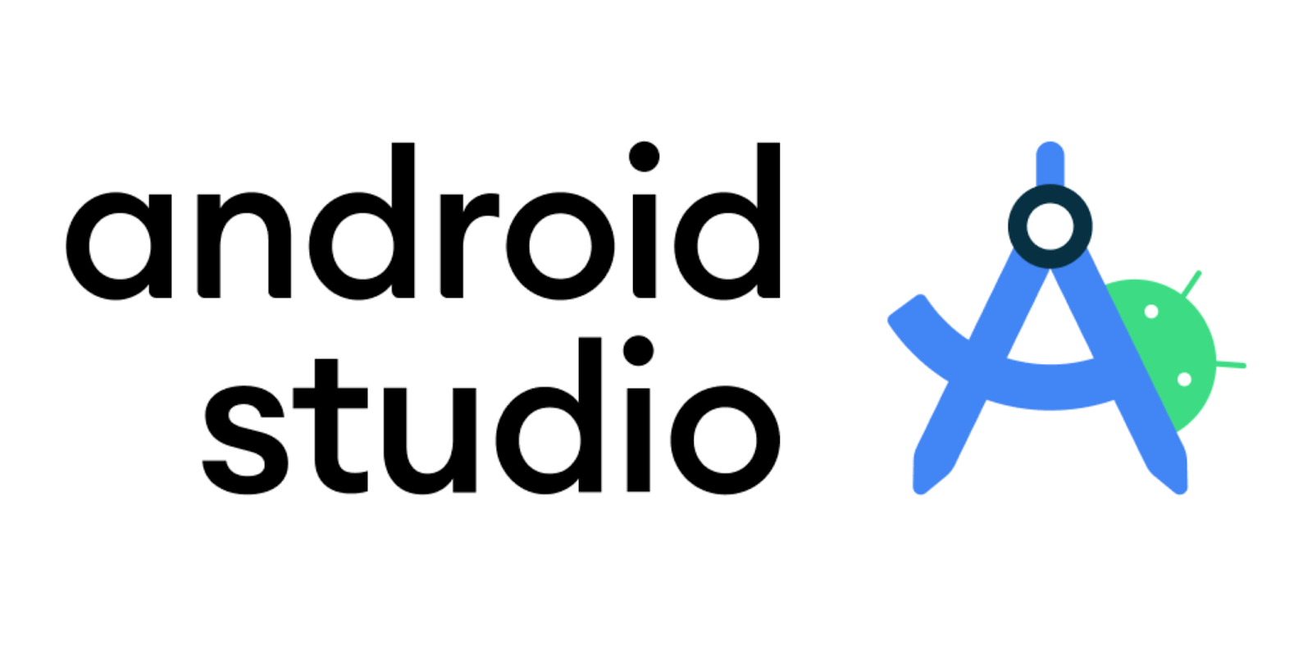


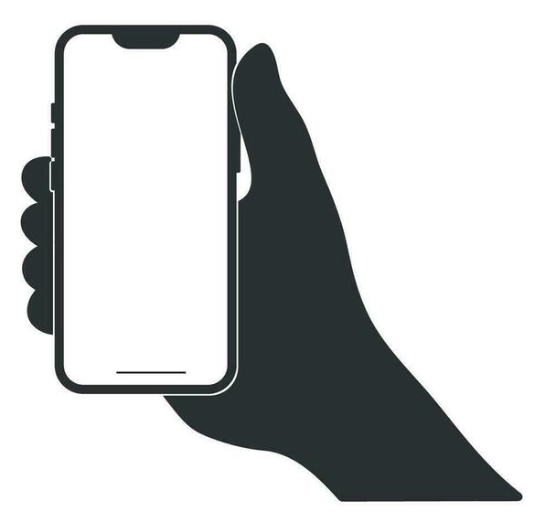
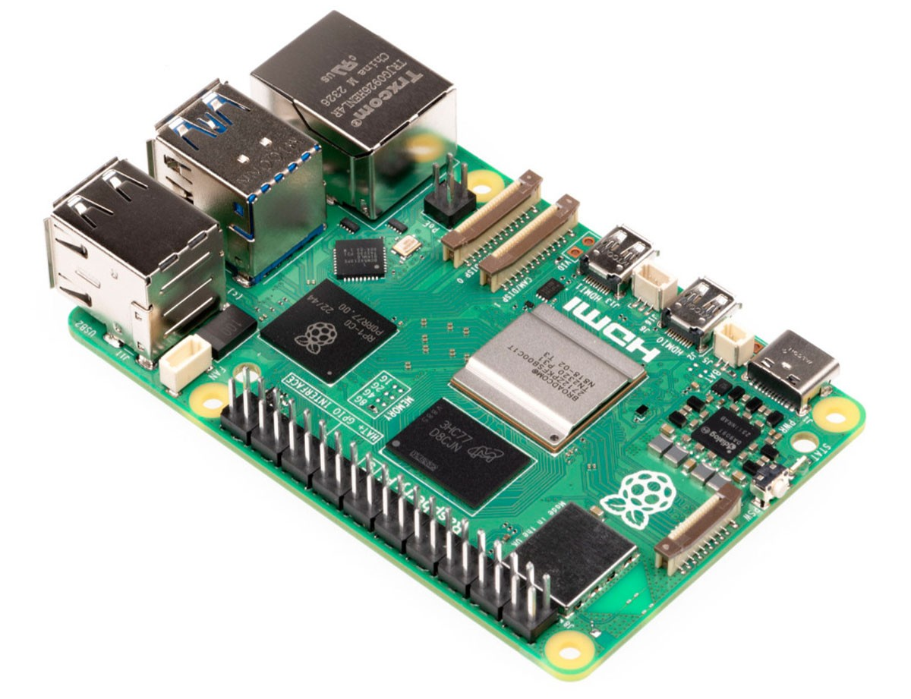
Neo Training Server – Tech Stack
External API
Login with Google
External API
ChatBot
DataBase
Tech: DB MySQL
Running on: Docker
Auth Service
Tech: C# .NET Service
Running on: PC
Login Controller:
Create Acount
Login (2FA)
Logout
Auth User
Autorize User
Expire Tokens
Rotate Tokens
Google
DB Controller:
Handle DB
WebSite
Tech: React
Running on: PC
Functions:
UI / UX
API Calls
FrontEnd
Functions:
UI / UX
Mobile APP
Tech: Kotlin
Running on: Android
Functions:
UI / UX
Redis DB
Tech: DB
Running on: Docker

Slide 2
Neo Training Server - MicroServices Hell Tech Stack
Auth Service
Tech: C# .NET Service
Running on: PC
Functions:
Create Acount
Login (2FA)
Logout
Auth User
Autorize User
Expire Tokens
Rotate Tokens
Google / Facebook
WebSite
Tech: React
Running on: PC
Functions:
UI / UX
Login/logout
Redis DB
Tech: DB
Running on: Docker
Auth/Autorize
FrontEnd
Functions:
UI / UX
DataBase
Tech: DB MySQL
Running on: Docker
External API
Login com Google/Facebook
Mobile APP
Tech: Kotlin
Running on: Android
Functions:
UI / UX
RestAPI (BD <=> User)
Tech: C# .NET
Running on: PC
Functions:
Handle DB
External API
ChatBot

Slide 3
(Sistema de Informação) – The Monolith Tech Stack
Auth Service
Tech: (??)
Running on: (??)
Functions:
Create Acount
Login (2FA)
Logout
Auth User
Expire Tokens
Rotate Tokens
Google / Facebook
DataBase
Tech: DB MySQL
Running on: Docker
External API
Login com Google/Facebook
Redis DB
Tech: DB
Running on: Docker
BackEnd (Proxy ISH)
Tech: C# .NET
Running on: PC
Functions:
Login / Logout
Auth / Autorize
Handle DB
FrontEnd
Tech: React
Running on: PC
Functions:
UI / UX
External API
ChatBot

