Slide 1
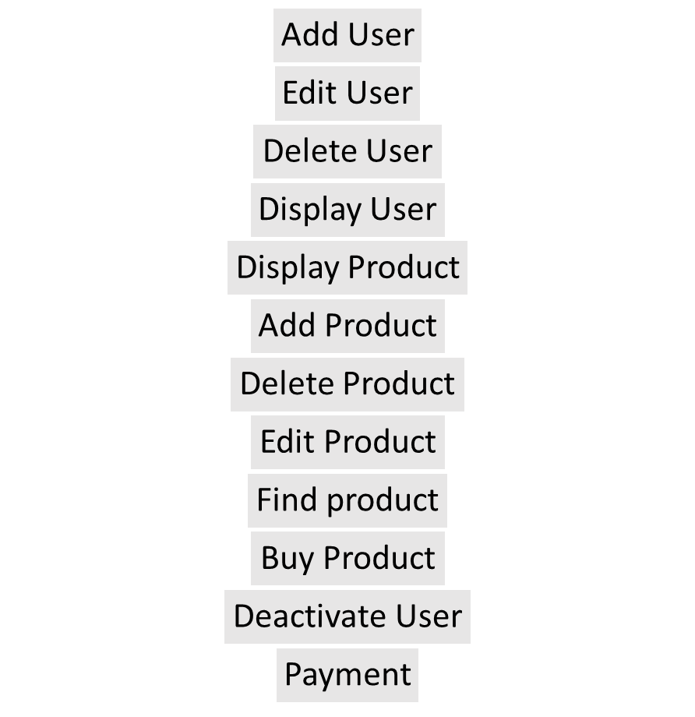
Client
Admin
Payment Service /Cashier

