Slide 1

Razzaz Tours
Supervised by: Dr. Essam Eliwa Supervising Assistant: Eng. Nada Ayman
Ammar Ahmed, Karim Yasser, Mohammed Tarek & Mostafa Khaled

Slide 2
Agenda:
Introduction
Problem statement
Project overview
Use cases (main use cases)
Functional requirements
Non functional requirements
Class Descriptions
Database
Class diagram
GUI
Live Demo

Slide 3
Introduction

Slide 4
Introduction:
A lot of people and tourists worldwide wants to travel to many countries and visit the monuments.
Egypt is one of the oldest and culturally rich civilizations so it has many civilizations to show.
There is many Tourism Agency that can help people but not many Web Application.
Razzaz Tours web application will help tourists to find the best trip, hotels and museums easily.

Slide 5
Problem Statement

Slide 6
Problem Statement:
Egypt have much civilizations attraction, hotels, museums and cruises and much mores beautiful places and its deficult to any tourism booking from the agency itself before he/she coming to Egypt.

Slide 7
Project Overview

Slide 8
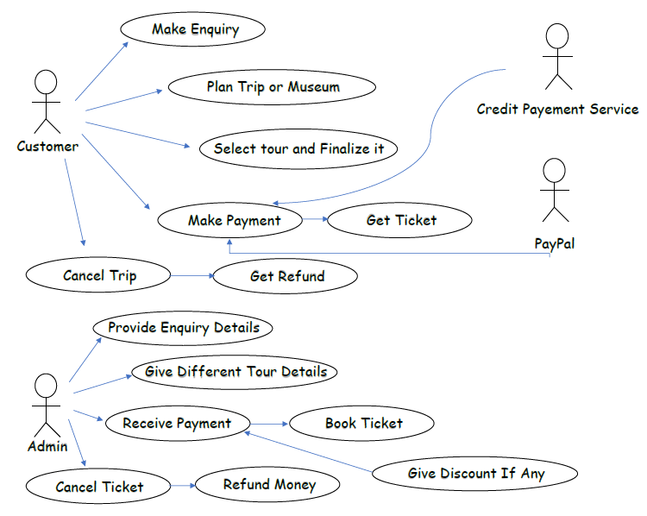

Slide 9
Use Cases

Slide 10
Use cases:
The people lost or the confused travellers who face a lot of difficulties.
Help them budget their trips, which can be difficult to do yourself if you’re not a frequent traveller.
Business travellers, who travel often and need to keep detailed records of working spending versus personal spending.

Slide 11
Functional Requirements

Slide 12
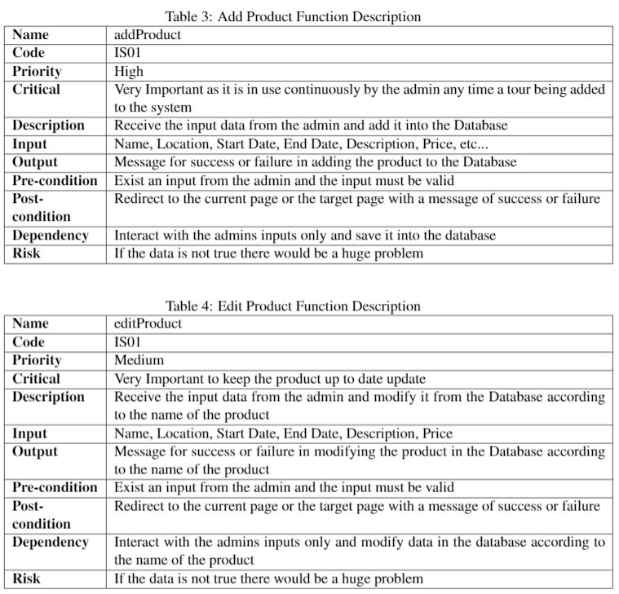
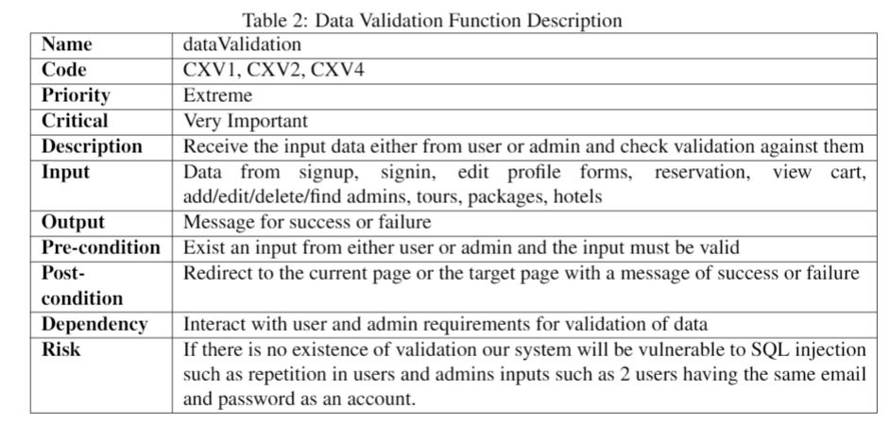
Functional Requirements:

Slide 13
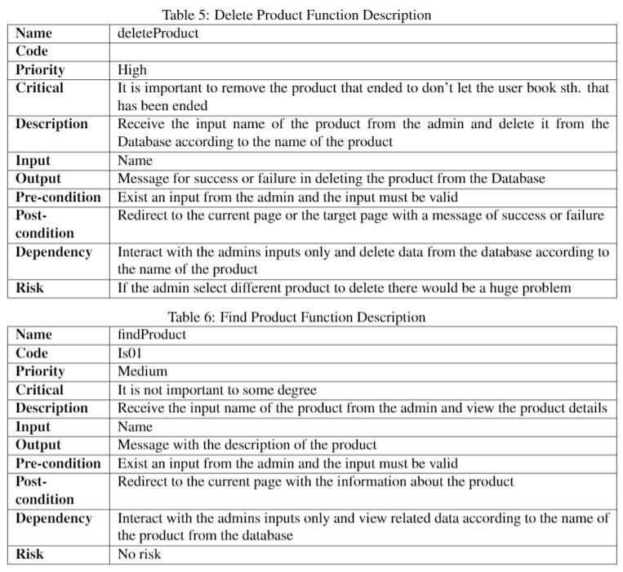
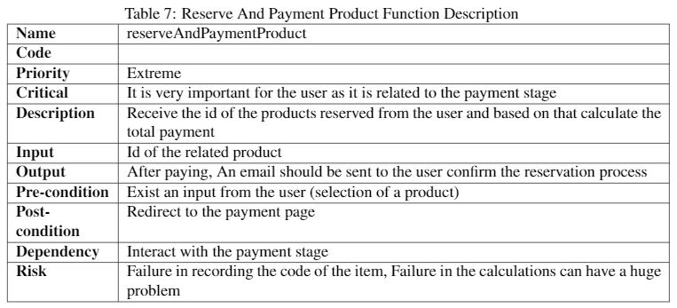

Slide 14
Class Descriptions

Slide 15
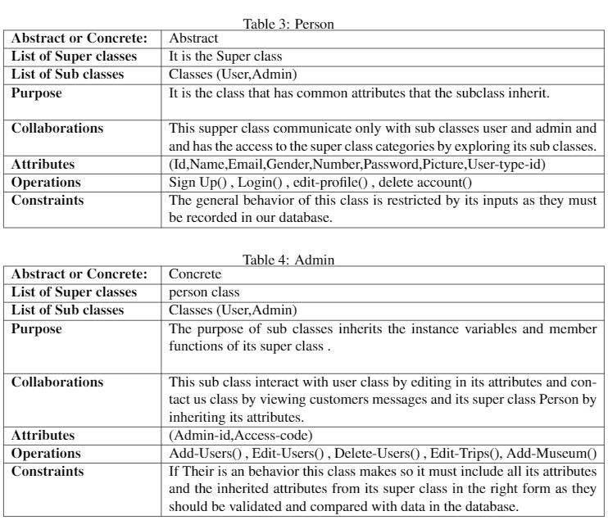
Class Descriptions:

Slide 16
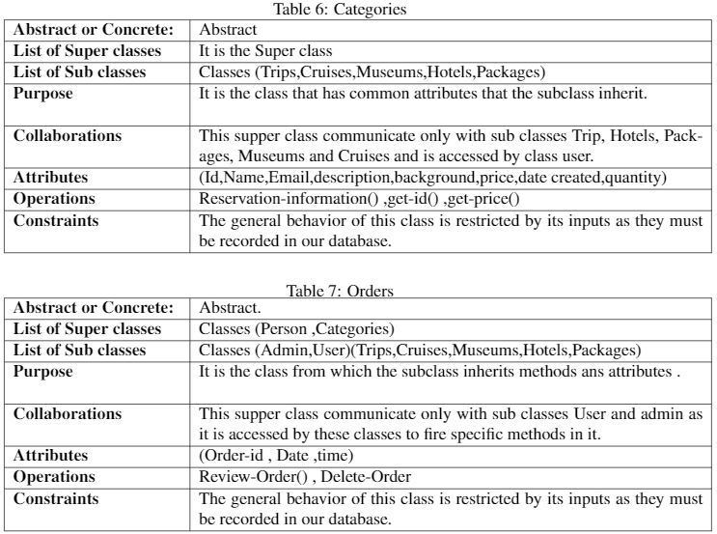

Slide 17
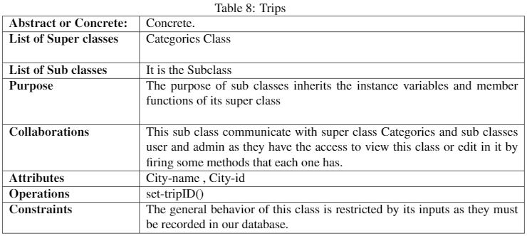
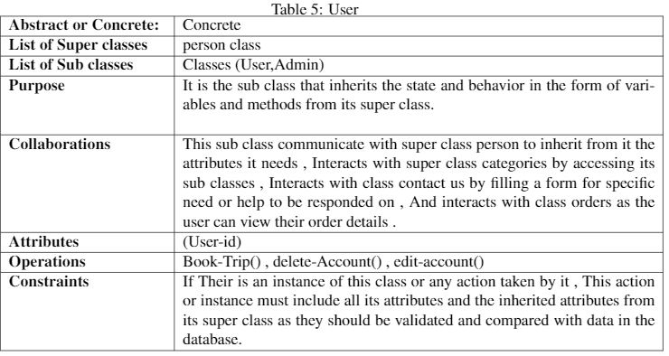

Slide 18
Database

Slide 19
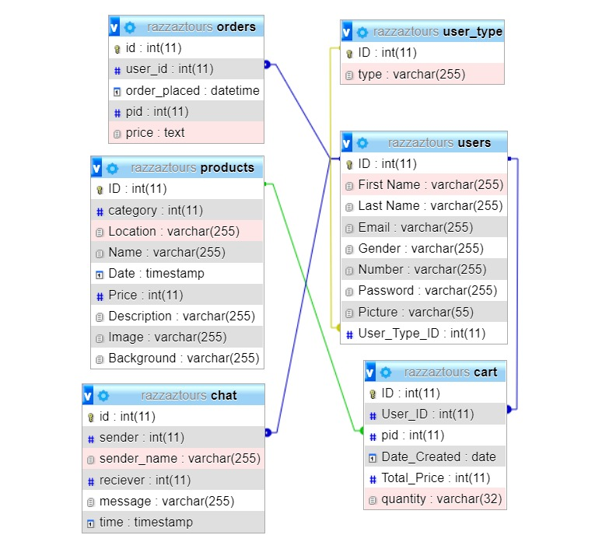
Database:

Slide 20
Class Diagram

Slide 21
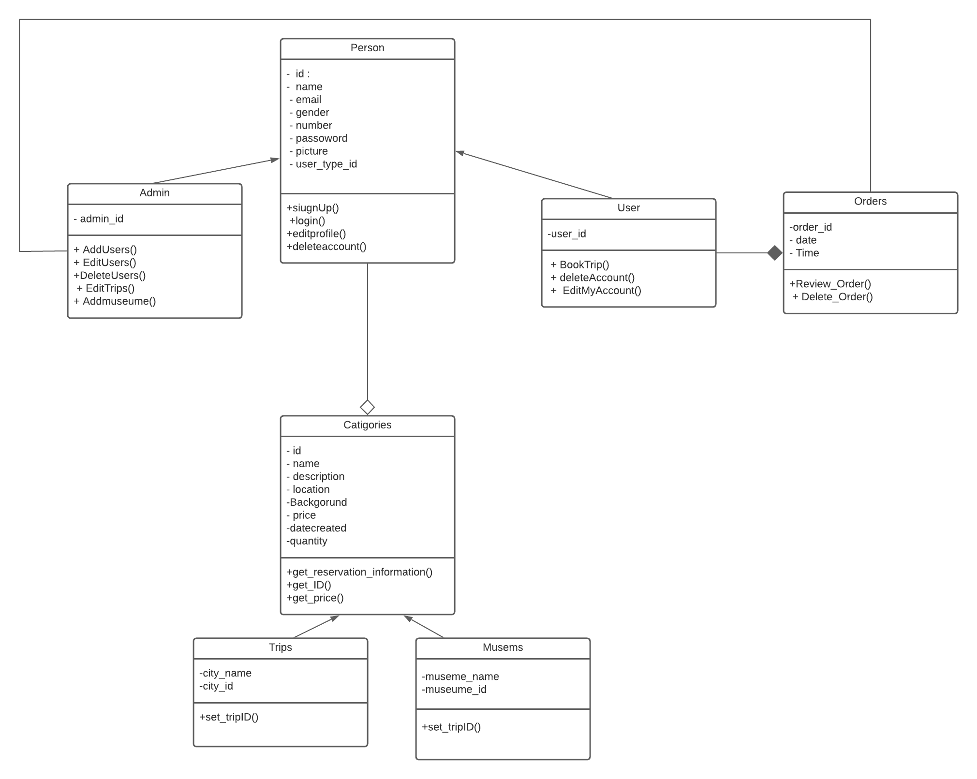
Class Diagram:

Slide 22
GUI

Slide 23
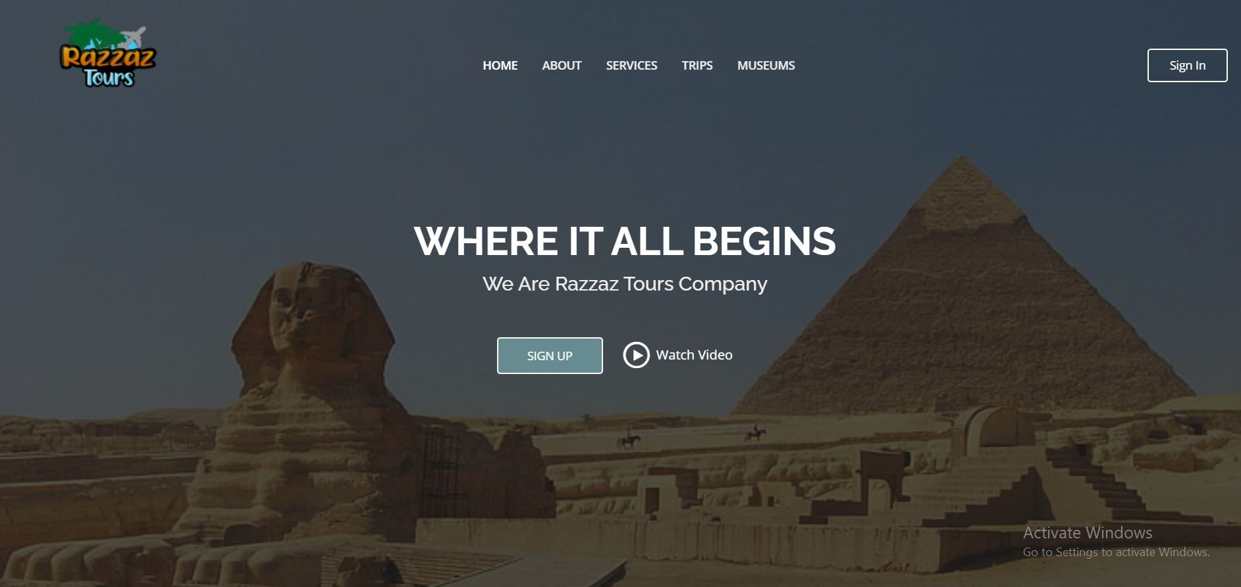
GUI:

Slide 24
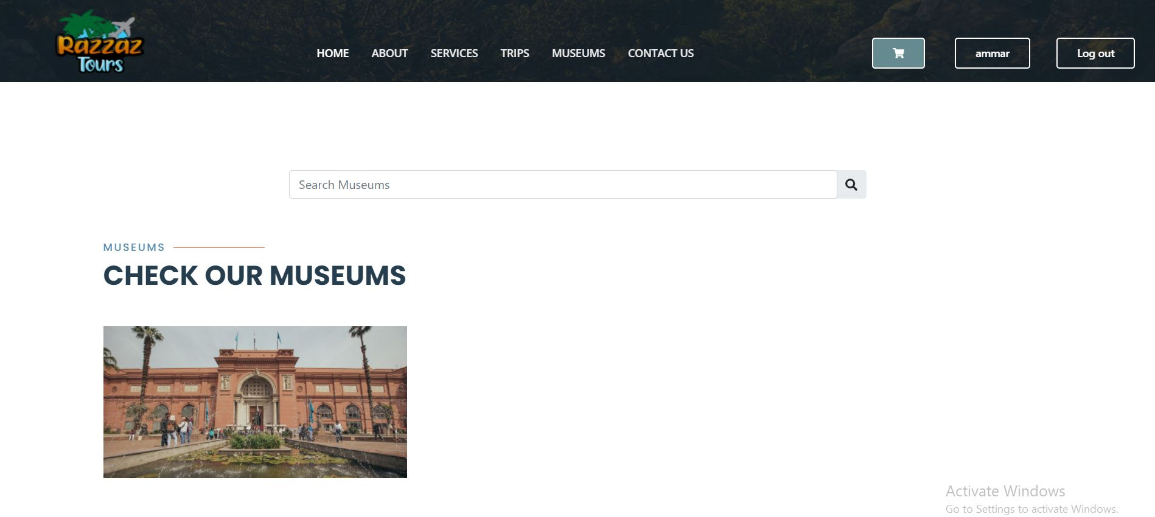

Slide 25
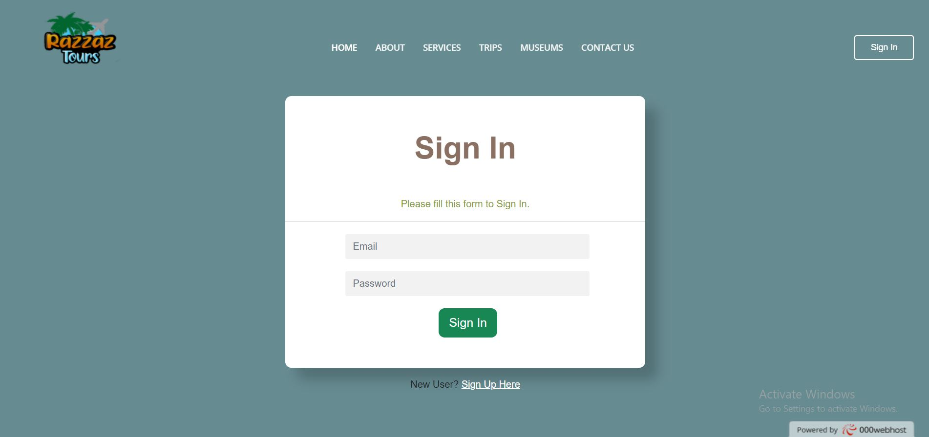

Slide 26
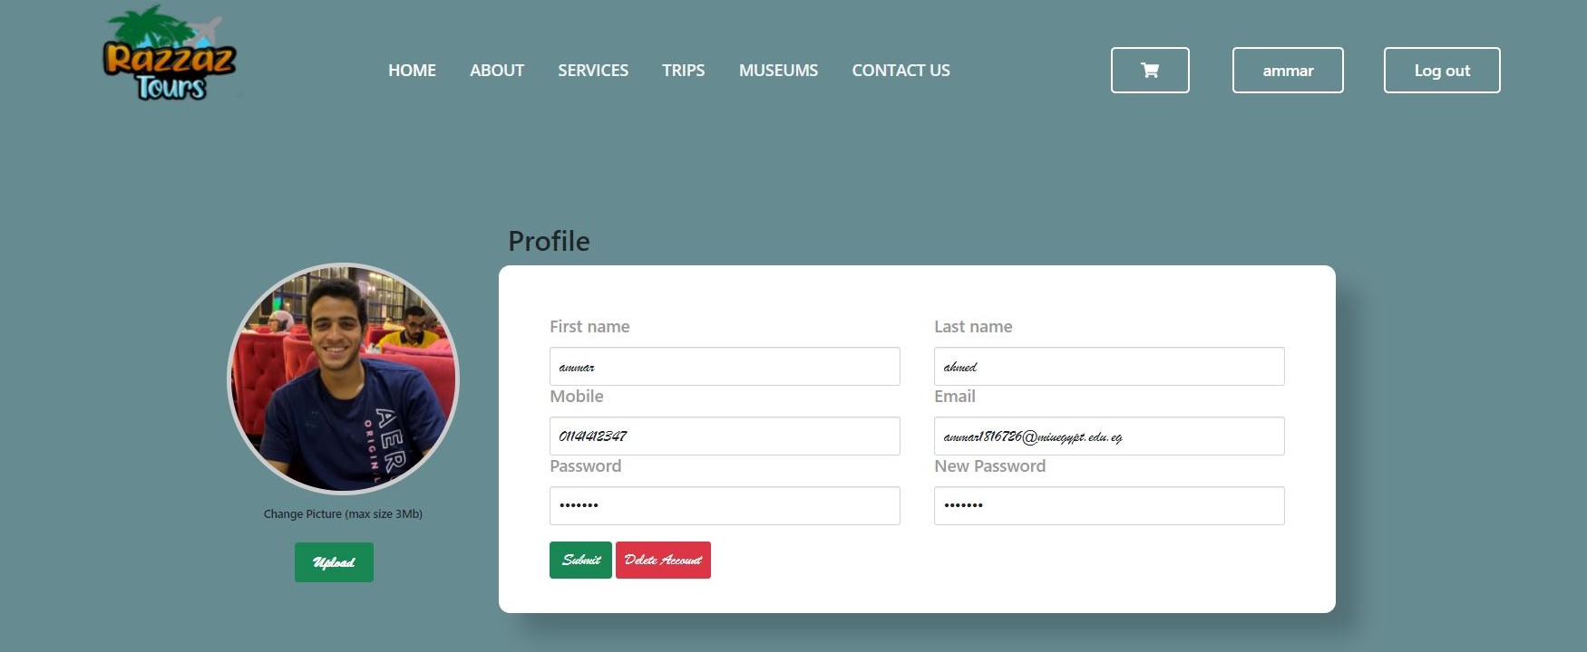

Slide 27
Live Demo

Slide 28
Razzaz Tours URL:
https://razzaztours.000webhostapp.com/index.php

Slide 29
Any Questions ?
THANK YOU!

