Slide 1

HOTEL BOOKINGS CITY vs RESORT
Project Members: (Group 18)
Kannekanti, Gayatri
Yellapragada, Alekhya Sri
Madiraju, Venkata Sai Manoj Kumar
Challa, Chandra

Slide 2
INTRODUCTION
In this project, we delve into a comprehensive analysis of hotel bookings data spanning from July 2015 to August 2017.
The primary objectives of our analysis revolve around employing statistical and machine learning models to uncover insights into the factors influencing like the Average Daily Rate (ADR) and booking dynamics.
This project aims to provide actionable insights for stakeholders in the hospitality industry, assisting them in making informed decisions based on a comprehensive understanding of the factors that influence hotel bookings and Average Daily Rates.

Slide 3
OBJECTIVES
One-way ANOVA for Monthly/Seasonal Preference:
Determine the impact of arrival_date_month on the average daily rate (ADR) for both resort and city hotels.
Two-way ANOVA for Country of Origin and Hotel Type:
Investigate how the country of origin and hotel type jointly affect the ADR.
Linear Regression for Lead-time Analysis:
Examine the relationship between lead-time and ADR.
Logistic Regression for Room Type and Booking Cancellation:
Investigate whether reserved_room_type and assigned_room_type impact the probability of booking cancellation.
Linear Regression for ADR Trends Over Years and Hotel Types:
Understand how ADR changes for both resort and city hotels over the years.

Slide 4
DATA COLLECTION & DATA PREPROCESSING
Name of the Data Set:
Hotel bookings data from July 2015 to August 2017.
Data Description:
The dataset comprises 32 variables (features) and more than 119,391 records.
Types of Variables:
The dataset includes several types of variables, such as:
Categorical variables
Binary variables
Numerical data
Preprocessing includes,
Importing Libraries
Reading Data
Checking and Handling Null Values

Slide 5

ONE- WAY ANOVA MODEL
ANOVA is a statistical method used to compare means between two or more groups to determine if there are any statistically significant differences among them.
Specifically, it conducts an ANOVA analysis to examine whether statistically significant differences exist in the average daily rate ('adr') based on various levels of the categorical variable 'arrival_date_month'.
These values help assess the statistical significance of the impact of 'arrival_date_month' on the 'adr' variable.

Slide 6
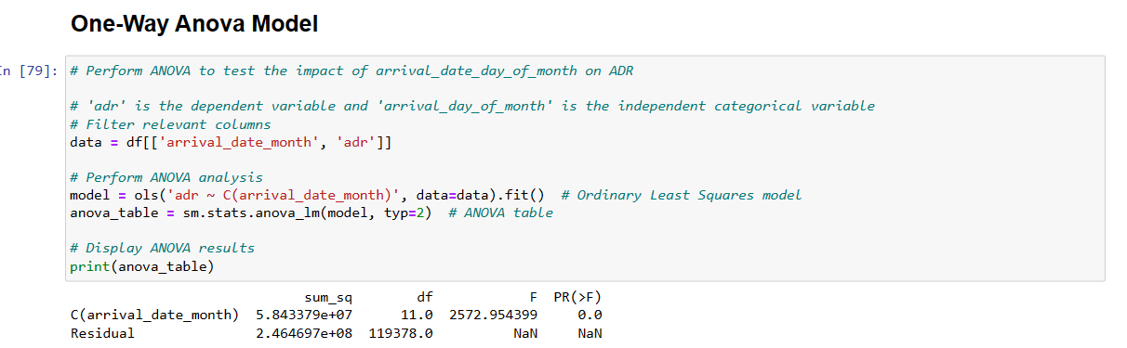
CODE

Slide 7
INTERPRETATION
The F-statistic is a measure of the ratio of the variance between groups to the variance within groups.
In this case, a high F-statistic (2572.95) indicates that there are significant differences in ADR across different arrival date months.
The p-value (0.0) is less than the typical significance level of 0.05, suggesting strong evidence against the null hypothesis.
Therefore, you can reject the null hypothesis that the means of ADR are equal across different arrival date months.
In conclusion, there is evidence to suggest that the arrival date month has a significant impact on the Average Daily Rate.

Slide 8
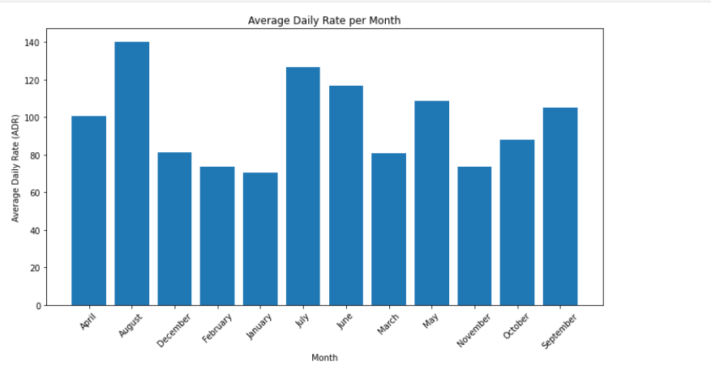
GRAPHICAL REPRESENTATION

Slide 9
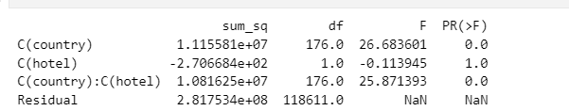
TWO-WAY ANOVA MODEL
Analysis of Variance (ANOVA) for Assessing the Impact of 'Country' and 'Hotel' on Average Daily Rate (ADR) using Ordinary Least Squares (OLS) Method
In this analysis, we employ the Analysis of Variance (ANOVA) technique to evaluate the influence of both the 'country' and 'hotel' variables on the Average Daily Rate (ADR), denoted by 'adr'.
The model encompasses a two-way interaction between 'country' and 'hotel', aiming to explore the joint effects of these factors.

Slide 10
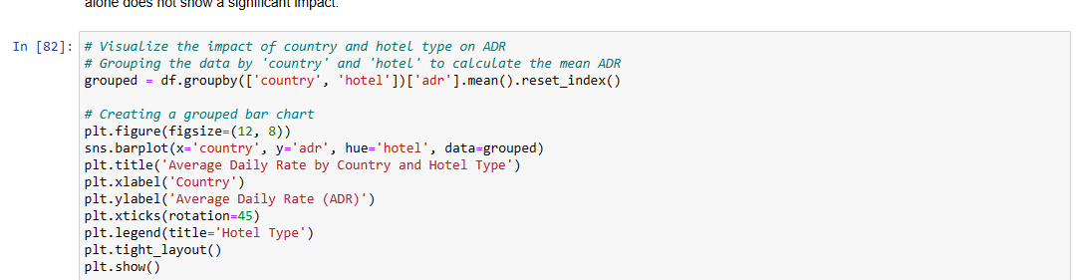
CODE

Slide 11
INTERPRETATION
C(country): The 'country' variable shows a statistically significant impact on Average Daily Rate (ADR) with a sum of squares of 1.115581e+07, 176 degrees of freedom, an F-statistic of 26.6836, and a p-value less than 0.05 (p < 0.05).
C(hotel): The 'hotel' variable does not show a statistically significant impact on ADR, as the sum of squares is negative (-2.706684e+02), the F-statistic is close to zero (-0.1139), and the p-value is greater than 0.05 (p > 0.05).
C(country):C(hotel): The interaction between 'country' and 'hotel' is statistically significant, with a sum of squares of 1.081625e+07, 176 degrees of freedom, an F-statistic of 25.8714, and a p-value less than 0.05 (p < 0.05).
Residual: The residual sum of squares is 2.817534e+08 with 118611 degrees of freedom. NaN values for F and p-value indicate that these are not applicable for the residual.

Slide 12
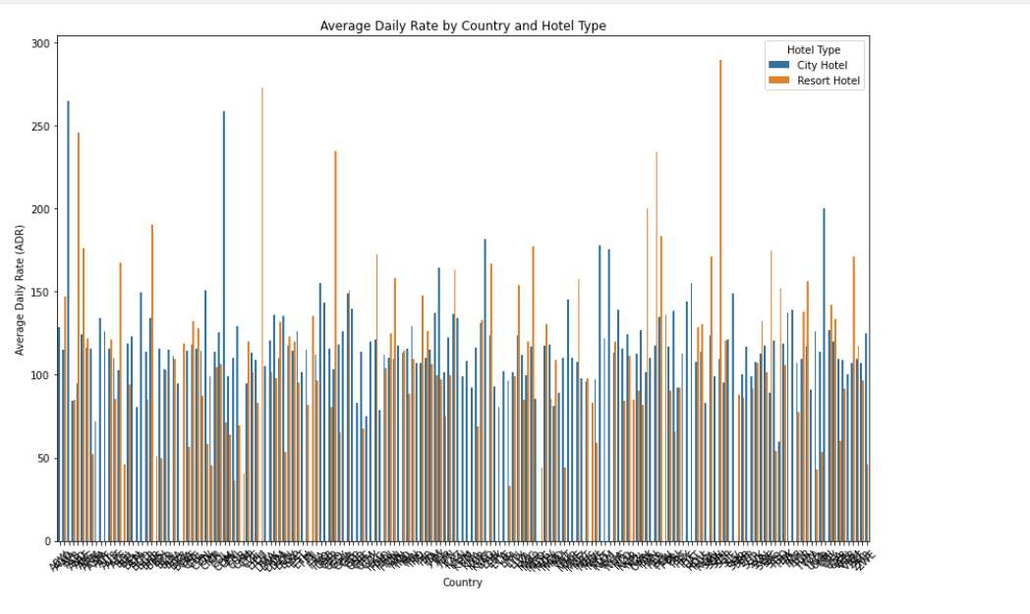
GRAPHICAL REPRESENTATION

Slide 13
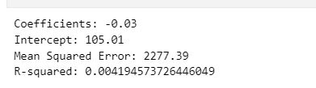
LINEAR REGRESSION MODEL - 1
This simple linear regression model analyzes the impact of lead time on the Average Daily Rate (ADR) in a dataset.
Simple linear regression model is used to identify the relationship between one dependent variable and one independent variable.
The code essentially builds a linear regression model, trains it on a subset of the data, predicts ADR values on another subset, and evaluates the model's performance using coefficients, intercept, Mean Squared Error, and R-squared.

Slide 14
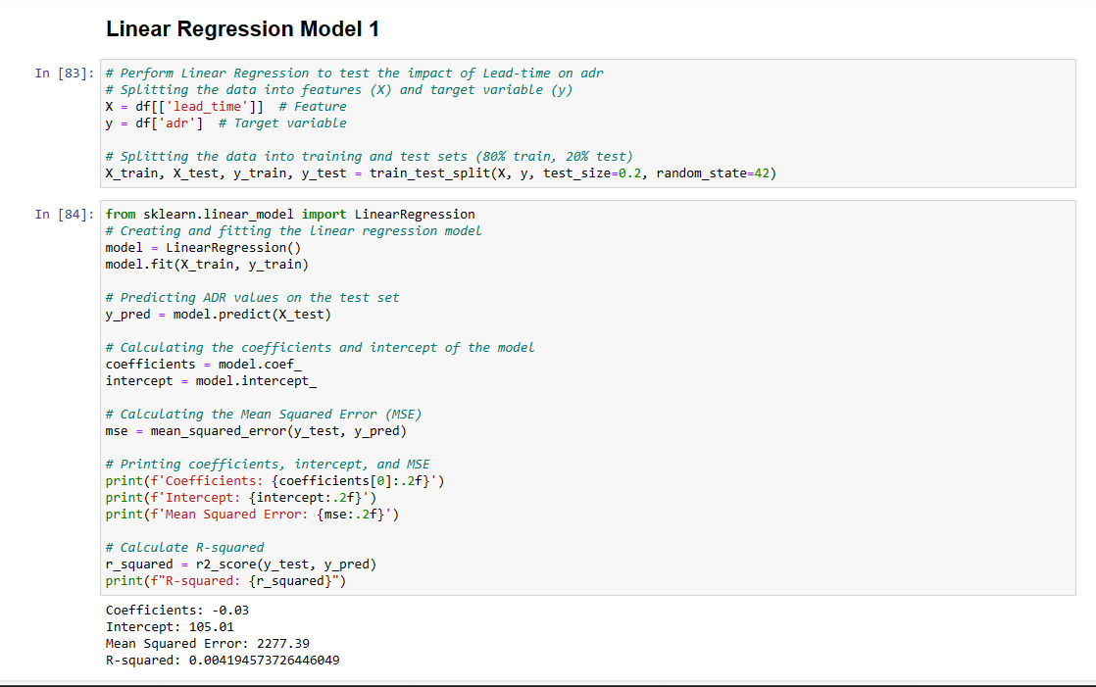
CODE

Slide 15
INTERPRETATION
Coefficients: The coefficient of -0.03 suggests that, on average, for each unit increase in the lead time, the Average Daily Rate (ADR) decreases by 0.03 units.
Intercept: The intercept of 105.01 represents the estimated ADR when the lead time is zero.
Mean Squared Error: The Mean Squared Error of 2277.39 provides a measure of the average squared difference between predicted ADR values and actual ADR values. Lower values indicate better model performance.
R-squared: The R-squared value of 0.0042 indicates that the linear regression model explains only a small proportion of the variance in the ADR. It suggests that the model may not be a strong predictor, as it explains a very limited portion of the variability in the target variable.

Slide 16
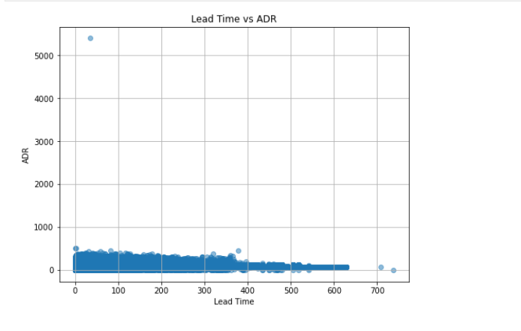
GRAPHICAL REPRESENTATION

Slide 17
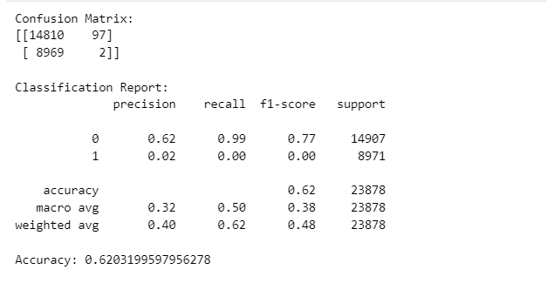
LOGISTIC REGRESSION
This logistic regression model assesses the impact of 'reserved_room_type' and 'assigned_room_type' on the probability of a booking being canceled.
In this approach, the dependent variable is is_cancelled and has only two possible outcomes either 0 or 1.
The results include the confusion matrix, providing insights into true positives, true negatives, false positives, and false negatives. Additionally, the classification report presents precision, recall, F1-score, and support for each class.
The overall accuracy of the model is also displayed. Essentially, the aim is to model and evaluate the relationship between room types and the likelihood of booking cancellations using logistic regression.
Generally, confusion matrix used to define the performance of classification algorithm.

Slide 18
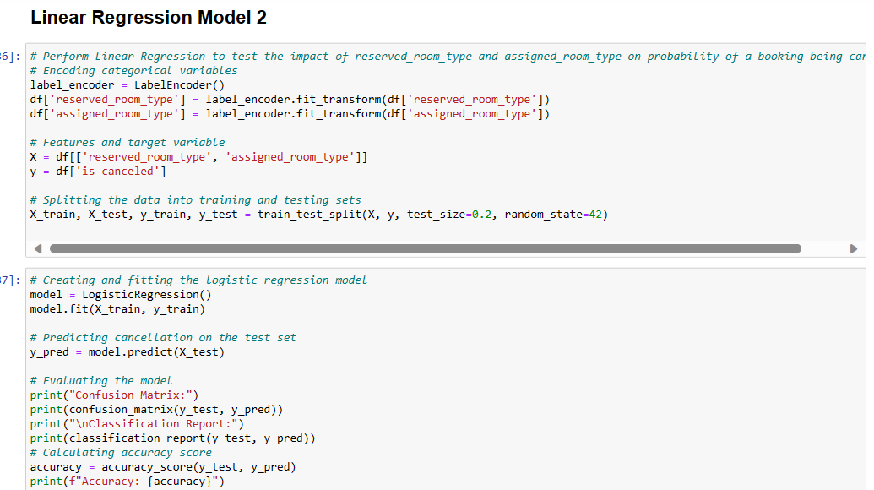
CODE
LOGISTIC REGRESSION MODEL

Slide 19
INTERPRETATION
Overall accuracy of the model: 62.03%.
Model achieved high accuracy in predicting non-cancelled bookings (class 0).
But performed poorly in predicting cancelled bookings (class 1), which is evident from the low precision, recall, and F1-score for class 1.
This discrepancy suggests that the model might not effectively capture the patterns associated with cancelled bookings.
Further feature engineering or model refinement might be necessary to improve predictions for cancellations.

Slide 20
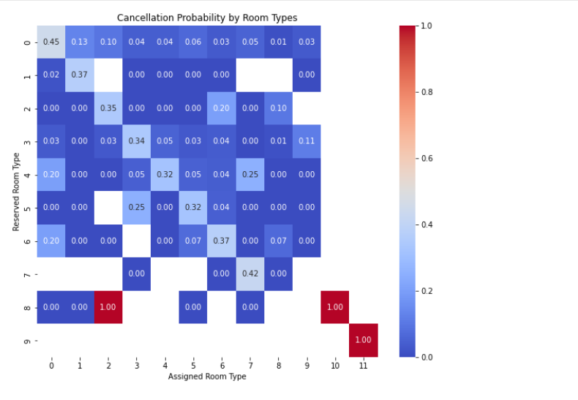
GRAPHICAL REPRESENTATION

Slide 21
LINEAR REGRESSION MODEL- 2
This linear regression model explores how the Average Daily Rate (ADR) changes over the years for resort and city hotels.
It also provides a visual representation of how the ADR changes over the years for resort and city hotels and prints the regression coefficients and intercepts for each hotel type.
This enables an understanding of the trend and relationship between 'arrival_date_year' and 'adr' for the specified hotel types.

Slide 22
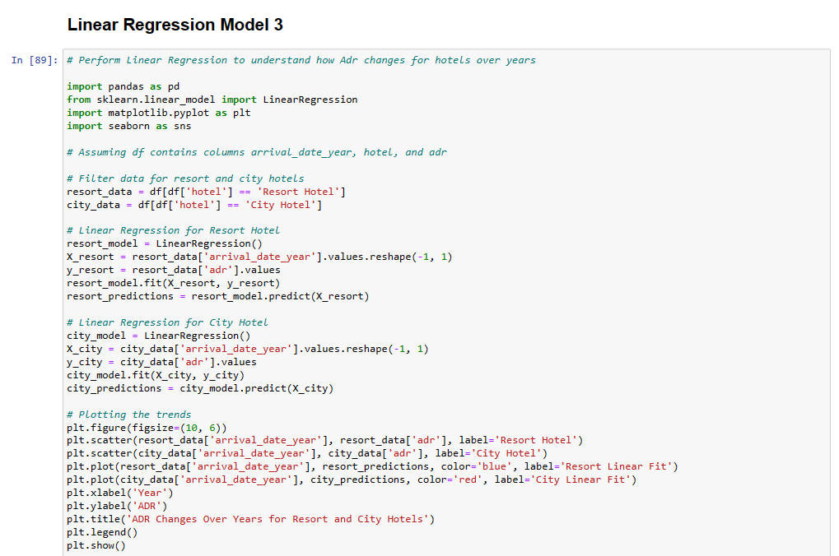
CODE

Slide 23
INTERPRETATION
Resort Hotel:
Coefficient: 10.87
Intercept: -21819.90
City Hotel:
Coefficient:15.51
Intercept: -31172.02
These coefficients indicate the changing in ADR concerning each year for each hotel type.
For instance,for the city hotel,the ADR tends to increase by approximately 15.51 units per year,and the initial ADR at year 0(intercept) is around -31172.02.
Similary,for the resort hotel,the ADR tends to increase by approximately 10.87 units per year,with an initial ADR at year 0 of around -21819.90.

Slide 24
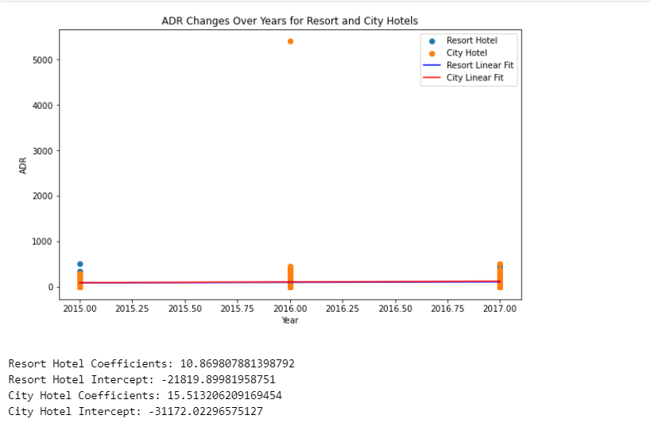
GRAPHICAL REPRESENTATION

Slide 25
CONCLUSION
In conclusion, our project employed diverse statistical models to scrutinize key facets of the dataset.
One-way ANOVA underscored the substantial impact of arrival date month on Average Daily Rate (ADR).
The Two-way ANOVA model shed light on the influential role of 'country,' whereas 'hotel' did not significantly alter ADR. The interaction between 'country' and 'hotel' was also deemed significant.
Linear Regression Model-1 depicted a modest negative association between lead time and ADR, albeit with limited explanatory power.
Employing logistic regression, evaluated the influence of room types on booking cancellations, offering valuable insights via a confusion matrix and classification report.
Lastly, Linear Regression Model-2 delved into ADR trends over the years for resort and city hotels, uncovering ascending patterns for both.
These findings furnish valuable perspectives for decision-making within the hospitality industry.

Slide 26

THANK YOU

