Slide 1


Aircraft Risk Assessment for Business Expansion
Kelvin Mutua

Slide 2
Overview
As our company expands into the aviation industry, it is crucial to understand the risks associated with different aircraft. This analysis identifies the safest aircraft options for commercial and private operations, ensuring an informed investment strategy. Using historical accident data, we assess safety trends and provide actionable insights for the aviation division.

Slide 3
Business Understanding
With no prior experience in aviation, the company must evaluate the risks of different aircraft types before making purchasing decisions. By analyzing accident trends, we can determine which aircraft models have the lowest risk, helping minimize potential liabilities and ensuring a successful entry into the industry.

Slide 4
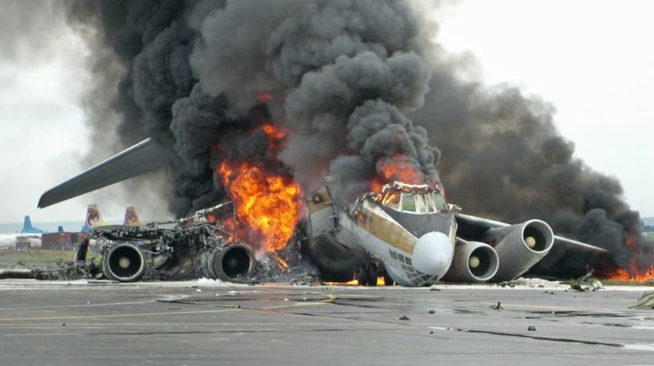
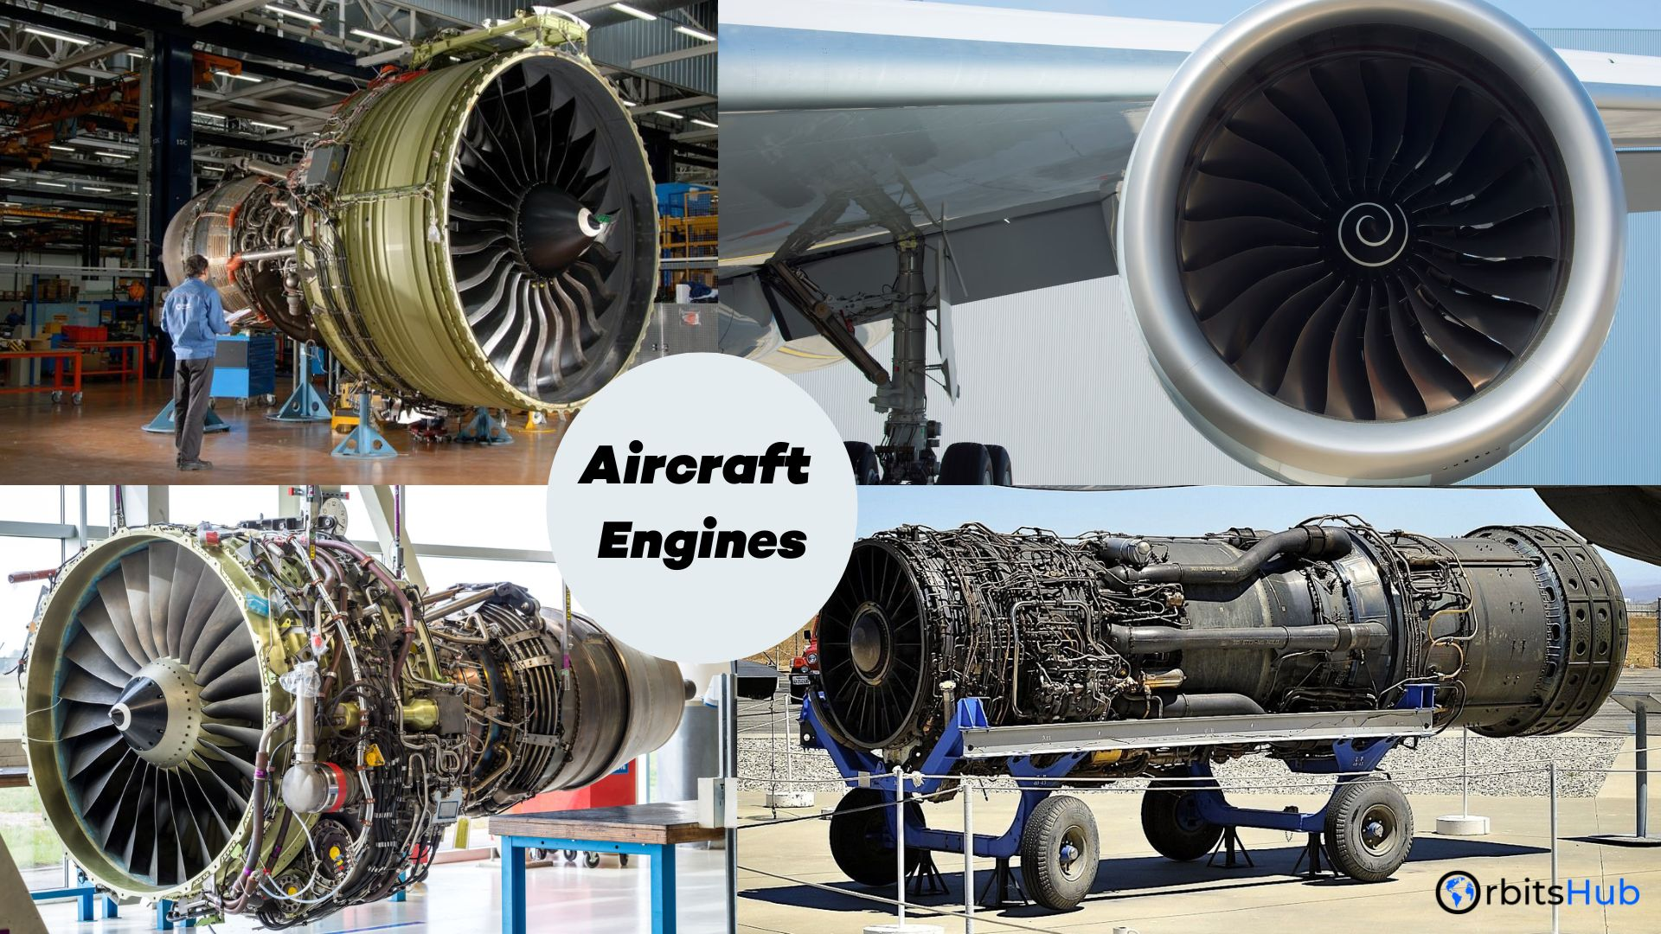
Data Understanding
The dataset includes historical aircraft accident data but the below areas stood out as key points of interest: aircraft category, engine type, accident phase, and fatalities.
Key attributes analyzed:
Aircraft type and make
Phase of flight during the accident
Fatalities over time
Injuries by aircraft engine type

Slide 5
Data Analysis & Insights
Serious Injuries by Aircraft Category
Observation: Airplanes report the highest number of serious injuries, followed by helicopters and ultralights.
Recommendation: Prioritize fixed-wing airplanes over ultralights and helicopters due to their stronger safety record and lower accident rates.
Accident Proportion by Aircraft Make
Observation: Cessna and Piper aircraft have a higher proportion of reported accidents.
Recommendation: Conduct detailed safety evaluations before purchasing Cessna or Piper models. Consider alternative manufacturers with better safety records.
Fatalities by Phase of Flight
Observation: The majority of fatalities occur during takeoff and landing.
Recommendation: Invest in aircraft with advanced safety technology for takeoff and landing, such as automated landing systems and reinforced landing gear.
Aircraft Fatalities Over Time
Observation: There have been fluctuations in fatalities over the decades, with noticeable peaks and declines.
Recommendation: Choose newer aircraft models that incorporate modern safety advancements and comply with updated aviation safety regulations.
Fatal Injuries by Aircraft Engine Type
Observation: Turboprop and reciprocating engines are associated with a higher proportion of fatal injuries compared to electric and hybrid engines.
Recommendation: Favor aircraft with turbine or hybrid engine systems that have demonstrated lower failure rates and improved safety performance.

Slide 6
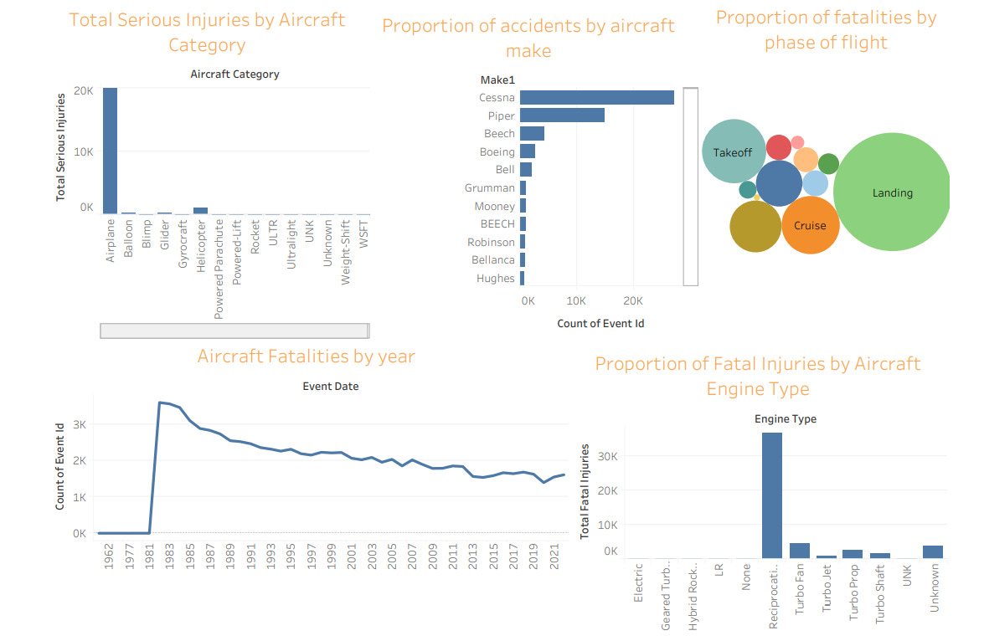
Diagrammatic representation the Data analysis,Insights and Visualizations

Slide 7
Recommendations
Select fixed-wing aircraft over helicopters and ultralights for lower risk.
Conduct in-depth safety assessments before purchasing Cessna or Piper aircraft.
Invest in aircraft with enhanced safety features for takeoff and landing.
Choose newer models that meet the latest safety regulations.
Prioritize aircraft with turbine or hybrid engines for lower fatality risk.
Further investigate specific aircraft models with the lowest accident rates.
Consult aviation safety experts for purchasing recommendations.
Implement a long-term monitoring strategy to track fleet safety performance.
Establish maintenance and training programs to minimize operational risks.

Slide 8
"Safety is not an option; it is the foundation of every successful flight."
- Mavyuva mavuti

