Slide 1

MAZERS
PGKPI - 2021

Slide 2
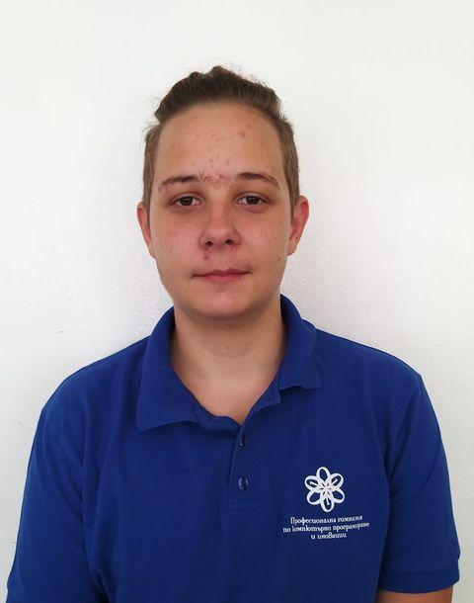
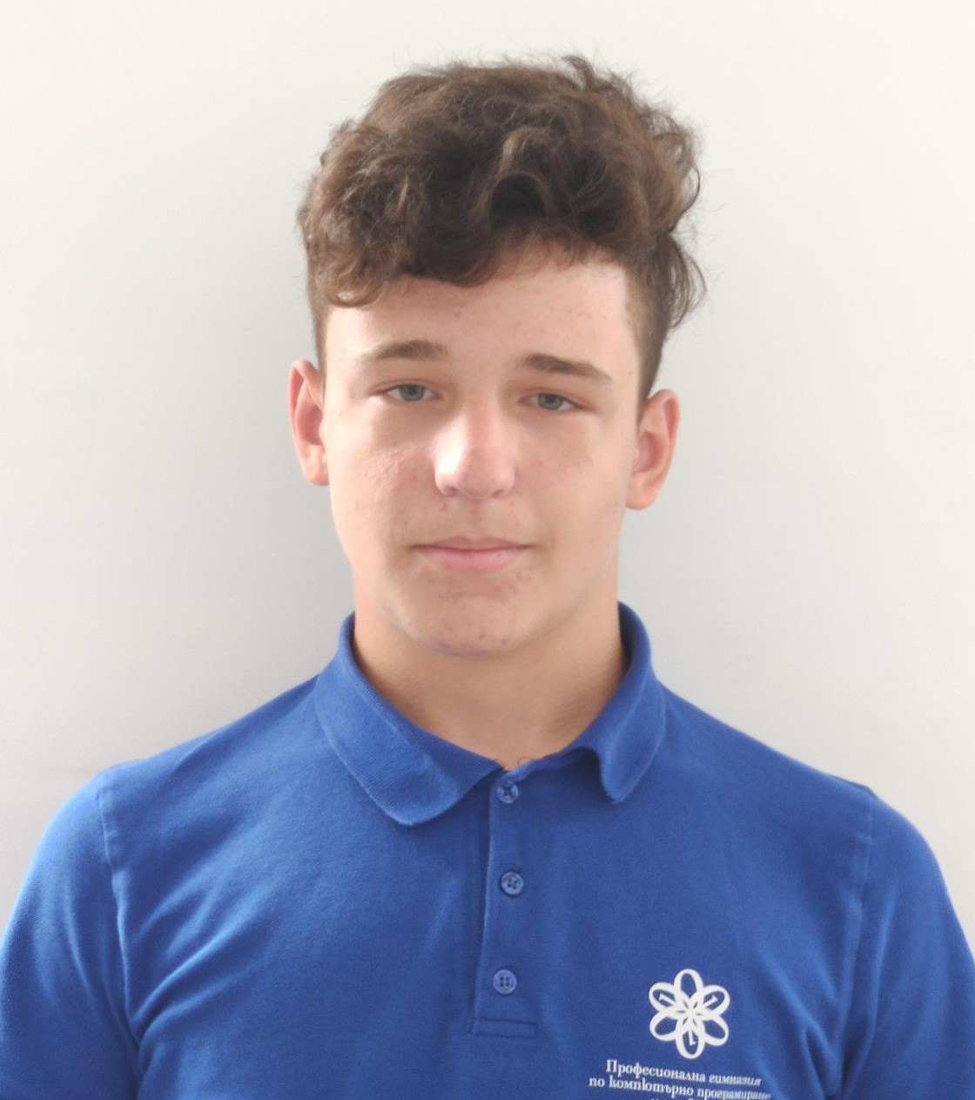


TEAM
Maksimiliyan
Dimov
Georgi
Trendafilov
Georgi
Hrisimov
Georgi
Ivanov
Scrum Trainer
Front-End
Back-End
QA Engineer

Slide 3
WORK STAGES
01
02
03
05
04
FORMING THE TEAM
IDEA
ORGANIZATION
REALIZATION
PRESENTING

Slide 4







USED TECHNOLOGY

Slide 5
FUTURE IDEAS

Slide 6
Now, to the code! ->

