Slide 1

Repository Selection:
Finding the Right Long-Term Home for Your Research Data
A STEP-UP workshop for researchers and digital research support professionals
Estimated duration: 2 x 2 hours, with a break in the middle
1
Notes:
Repository Selection - Finding the Right Long-Term Home for Your Research Data
Welcome participants and explain that the session is practical: by the end, they should be able to justify a repository choice for a real or plausible dataset.

Slide 2
Course overview
Course purpose
• Guide participants through a defensible repository selection process;
• Support longevity, accessibility, reuse and compliance;
• Connect repository choice to funder, publisher, institutional and disciplinary expectations;
• Produce a short, documented rationale suitable for a DMP or project record.
Overview
Why repository selection matters
When to start thinking about repository selection
Discovering repositories with re3data.org
Examining repository policies
Evaluating sustainability and certifications
Learning from peers and community practice
Making contact early
Making and documenting your decision
N.B. Today is the pilot delivery of this training. We will be very interested in your thoughts afterwards!
2
Notes:
Set expectations: this is not about finding a single perfect repository. It is about making and documenting a reasoned choice against clear criteria.

Slide 3
Course overview
Learning objectives
• Understand the benefits of planning for data archiving;
• Identify and evaluate repositories using discovery tools such as re3data;
• Assess repository policies, sustainability, trust signals and support;
• Learn from peer practice, community standards and repository norms;
• Recognise when to contact repository managers and what to ask.
3
Notes:
Read the objectives quickly and ask participants which objective is most relevant to their current work. Use their answers to tailor examples during discussion.

Slide 4
Course overview
Repository selection: the decision process
1
2
3
4
Plan early
Define data requirements
Discover candidates
Evaluate policies
8
7
6
5
Document decision
Contact repository staff
Benchmark peer practice
Check trust indicators
4
Notes:
Use the flow as an orientation device. Stress that repository selection is not a single search task: it combines requirements gathering, policy review, evidence of trustworthiness, peer practice and documentation.

Slide 5
1. Why repository selection matters
Preservation, FAIR-ness, reproducibility and compliance
5
Notes:
Introduce the problem: repository choice affects whether data can be found, understood, accessed appropriately and preserved beyond the project.

Slide 6
Why repository selection matters
Long-term preservation
• Research data represents a significant investment of time, expertise and funding;
• Data may retain value beyond the original project or publication;
• Preservation reduces the risk of data loss, corruption and technological obsolescence;
• Well-managed repositories protect institutional and disciplinary memory.
6
Notes:
Stress that preservation is active stewardship, not simply putting files online. Use examples such as obsolete file formats, lost project drives and inaccessible supplementary files.

Slide 7
Why repository selection matters
Supporting the FAIR principles
• Findable: persistent identifiers and rich metadata support discovery;
• Accessible: clear, standardised access procedures enable open or controlled access;
• Interoperable: standard formats and vocabularies help data work across systems;
• Reusable: documentation, licences and provenance make data usable in new contexts.
7
Notes:
Explain that repository selection is one of the practical mechanisms for meeting FAIR expectations. Emphasise that FAIR does not always mean fully open: restricted data can still have findable metadata and governed access.

Slide 8
Why repository selection matters
Reproducibility, transparency and compliance
• Access to underlying data supports verification of findings;
• Transparent data availability statements build confidence in the research process;
• Archived datasets can support meta-analysis, systematic review and secondary use;
• Repository choice helps meet funder, publisher and institutional requirements.
8
Notes:
Link this to the publication workflow: journals increasingly ask where data are held and under what access terms. Repository selection should prevent last-minute compliance problems.

Slide 9
Exercise
Why does repository choice matter?
• Identify one risk created by poor repository selection (or not using a repository);
• Discuss the implications for reuse, preservation or compliance;
• Share one example from your discipline or support role.
10 minutes (NB timings are approximate)
9
Notes:
Run this as a short paired discussion. Ask for two or three examples, then connect them to later criteria such as access controls, metadata and sustainability.

Slide 10
2. When to start thinking about repository selection
Plan early enough for repository requirements to shape the project
10
Notes:
The key message is early planning. Repository requirements can affect consent wording, formats, metadata capture, file organisation and budget.

Slide 11
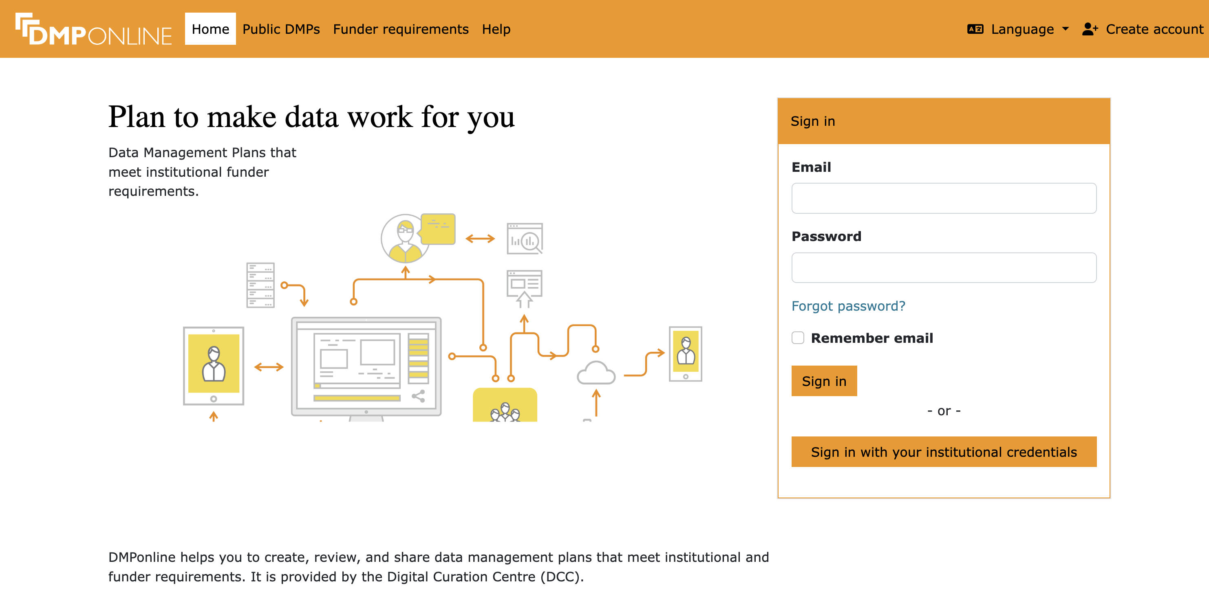
When to start thinking about repository selection
Project planning and DMPs
• Address repository selection in your Data Management Plan at the project’s inception;
• Identify data types, formats, volumes, sensitivity and access restrictions early;
• Build metadata and documentation requirements into project workflows;
• Budget for repository fees, storage costs or specialist support where applicable.
11
Notes:
Explain that the DMP is both a planning document and an audit trail. A provisional repository choice is useful even if it is refined later.

Slide 12
When to start thinking about repository selection
Grant preparation and data collection
• Review funder, publisher and institutional repository expectations before submission;
• Check whether specific repositories are preferred, required or inappropriate;
• Align consent, ethics and participant information with future data sharing plans;
• Collect data in formats and structures that the repository can accept.
12
Notes:
Use sensitive data as an example: repository options may depend on consent wording and whether controlled access is possible. Early decisions reduce rework.

Slide 13
When to start thinking about repository selection
Avoiding last-minute decisions
• Rushed choices can lead to poor disciplinary fit or inadequate access controls;
• Last-minute preparation often exposes missing metadata or documentation gaps;
• Repository review, curation and DOI assignment may take longer than expected;
• Early selection makes publication and project close-out smoother.
13
Notes:
Warn that repository deposit is not always instant. Some repositories curate submissions, check metadata or require staff consultation before accepting material.

Slide 14
Exercise
Review your timeline
• Map the major stages of a current or recent project;
• Identify the most suitable point for repository selection;
• Record one action to take before data collection or analysis ends.
10 minutes
14
Notes:
Ask participants to use a real project if possible. If not, use a hypothetical project from their discipline.

Slide 15
3. Discovering repositories with re3data.org
Build a candidate list before evaluating suitability
15
Notes:
Introduce discovery as an initial filtering step, not the final decision. Participants need candidate repositories to compare against project requirements.

Slide 16
Discovering repositories with re3data
Types of research data repository
Repository type
Strengths
Watch for
Institutional
Local support, often free for staff, aligned with institutional policy
May offer less discipline-specific discovery or metadata
Domain-specific
High visibility in the field, community standards, specialist curation
May impose strict scope, format or eligibility requirements
Generalist
Broad acceptance, quick deposit routes, often automatic DOI assignment
May have lower disciplinary visibility or weaker specialist support
16
Notes:
Use examples relevant to the audience, such as UCL Research Data Repository, UK Data Service, GenBank, Zenodo, Figshare or OSF. Stress that repository type is not a hierarchy: fit depends on the data and use case.

Slide 17
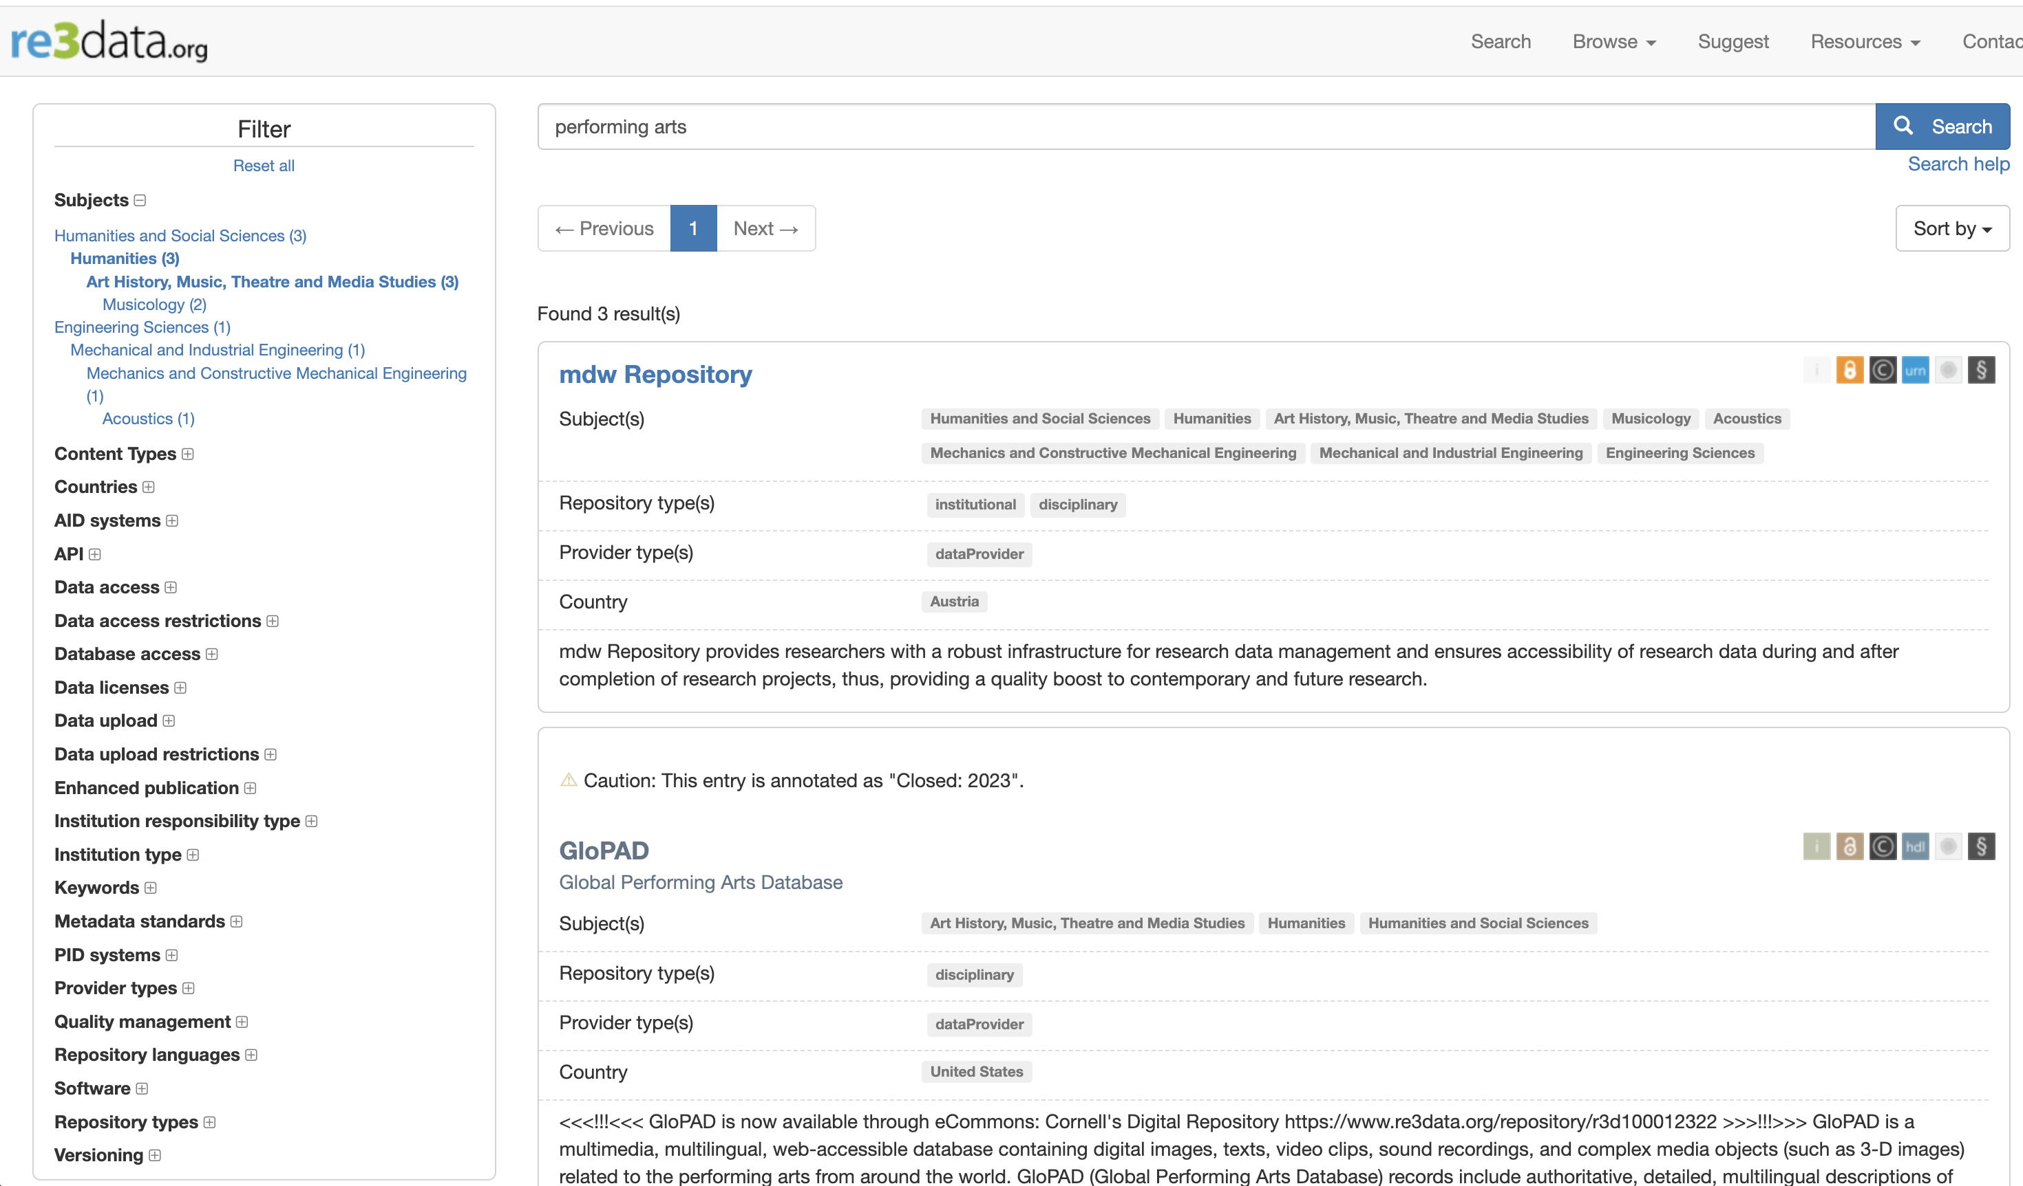
Discovering repositories with re3data
Using re3data
• Global registry of research data repositories across disciplines;
• Search by discipline, keyword, data type, country and repository feature;
• Use records to compare scope, access, metadata, identifiers and trust signals;
• Treat re3data as a discovery tool, then verify details on the repository site.
17
Notes:
Show a live or inserted screenshot of a re3data search. Demonstrate starting broad, then narrowing with filters. Make clear that registry metadata can lag behind repository policies, so verification is necessary.

Slide 18
Discovering repositories with re3data
Search strategies in re3data
• Start with subject area or discipline, then refine by data type;
• Use country or region filters when funder, legal or jurisdictional requirements matter;
• Filter for access conditions, licences, certification, persistent identifiers and repository type;
• Keep c. three plausible candidates for closer review.
18
Notes:
Suggest that participants search more than once using alternative terminology. Repository scope may be indexed under a broader discipline than expected.

Slide 19
Discovering repositories with re3data
Understanding repository records
• Check subject coverage, scope and accepted content types;
• Review access conditions, licensing options and metadata expectations;
• Look for DOI, Handle or other persistent identifier support;
• Check certification, stewardship, curation and contact information.
19
Notes:
Emphasise that repository records help structure evaluation. They do not replace reading the repository policy pages, especially for sensitive or large data.

Slide 20
Discovering repositories with re3data
Worked example: matching data to repository type
Scenario
Promising direction
Reasoning
Restricted social science survey data with personal information
Controlled-access repository such as UK Data Service
Ethical requirements, access review and governance are central
10 GB NetCDF climate model output from a UKRI-funded project
Domain repository such as a NERC data centre or CEDA Archive
Community visibility, accepted formats and funder expectations align
Small mixed-methods dataset with no obvious disciplinary repository
Institutional or generalist repository
Broad acceptance and DOI support may be sufficient
20
Notes:
Use this slide to model reasoning. Ask participants what additional information would be needed before making a final decision.

Slide 21
Exercise
Explore re3data
• Identify three candidate repositories for your own area of research;
• Compare scope, access model, persistent identifier support and certification;
• Record strengths, weaknesses and any questions requiring follow-up.
15 minutes
21
Notes:
Encourage participants to capture evidence rather than just repository names. They will reuse this information in later exercises.

Slide 22
Lunchtime!

Slide 23
4. Examining repository policies
Move from candidate discovery to suitability assessment
22
Notes:
Policy review is where participants test whether a repository can actually support their data, access requirements and funder obligations.

Slide 24
Examining repository policies
Access policies
• Open access makes data freely available to anyone;
• Restricted access requires registration, approval or a formal access request;
• Embargoed access delays data release for a defined period;
• Closed access may expose metadata while withholding the data files.
23
Notes:
Use examples: open data for non-sensitive outputs, controlled access for deidentified human participant data, embargoes for publication or commercial reasons.

Slide 25
Examining repository policies
Licensing and reuse terms
• Check whether the repository requires or recommends specific licences;
• Understand the difference between CC0, CC BY and more restrictive terms;
• Ensure licence choice is compatible with funder, collaborator and third-party obligations;
• Record the licence rationale so future users understand permitted reuse.
24
Notes:
Explain that a licence is not just a formality. It governs attribution, commercial reuse, derivatives and downstream clarity.

Slide 26
Examining repository policies
Metadata and documentation requirements
• Repositories usually require descriptive metadata about creators, methods, dates and subjects;
• Common schemas include DataCite, Dublin Core and discipline-specific standards;
• Quality metadata improves discovery, citation and reuse;
• Prepare README files, codebooks and provenance information alongside the data.
25
Notes:
Distinguish between repository metadata fields and dataset-level documentation. Both are needed for reuse.

Slide 27
Examining repository policies
Formats, volume and sensitive data
• Use open, non-proprietary and preservation-friendly formats where possible;
• Check file size, total volume and file number limits before deposit;
• Large or complex datasets may require special transfer arrangements;
• Sensitive or non-open data require repositories with appropriate access controls.
26
Notes:
Combine three practical constraints that often determine suitability. Invite participants to identify which one is most likely to affect their own data.

Slide 28
Examining repository policies
Versioning and persistent identifiers
• Persistent identifiers support stable citation and tracking;
• DOIs are the most common PID for research datasets;
• Versioning enables correction or extension while preserving prior releases;
• Check how the repository handles citations for new versions.
27
Notes:
Explain the difference between changing a deposited dataset and creating a new version. Citeability and reproducibility depend on this distinction.

Slide 29
Exercise
Compare repository policies
• Select two candidate repositories from your list;
• Compare access model, licences, metadata, formats and size limits;
• Decide whether either repository might be unsuitable and explain why.
15 minutes
28
Notes:
Ask participants to use repository policy pages, not just summaries. The aim is to eliminate weak candidates and capture the evidence.

Slide 30
5. Evaluating sustainability and certifications
Assess whether the repository is trustworthy enough for long-term stewardship
29
Notes:
This section moves from “can they take my data?” to “can I trust them to steward it?”.

Slide 31
Evaluating sustainability and certifications
Sustainability indicators
• Look for stable funding arrangements and institutional or national backing;
• Review explicit preservation commitments, backup arrangements and disaster recovery;
• Check whether the repository describes format migration or preservation planning;
• Assess longevity, dataset holdings and evidence of regular operation.
30
Notes:
Explain that no indicator guarantees permanence, but multiple positive indicators build confidence.

Slide 32
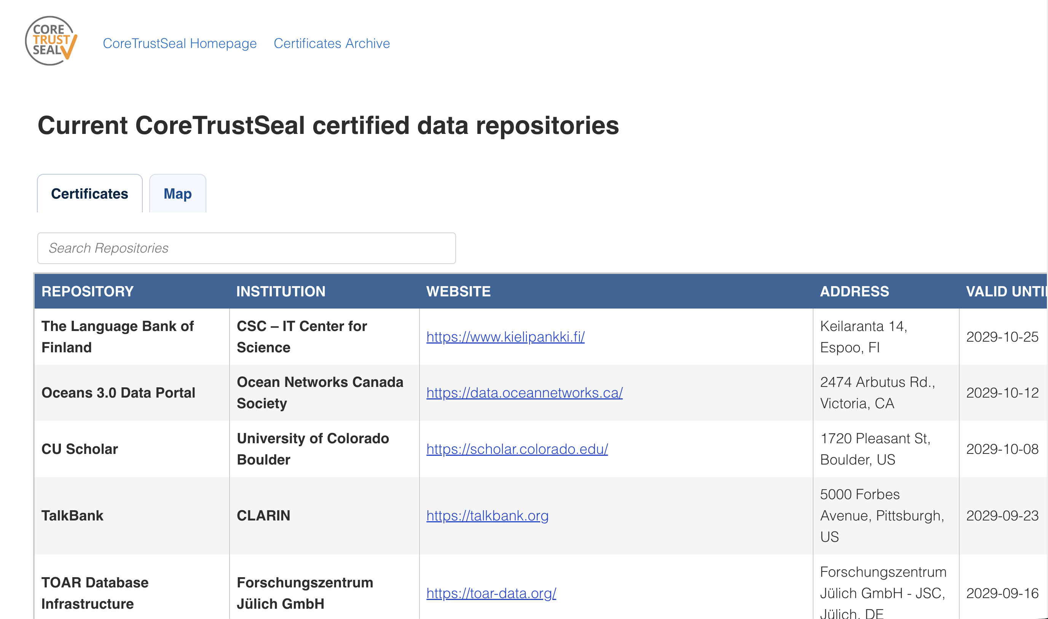
Evaluating sustainability and certifications
CoreTrustSeal and other trust indicators
• CoreTrustSeal certification demonstrates alignment with trusted digital repository requirements;
• Certification covers organisational, digital object and technical infrastructure aspects;
• Network participation such as DataCite or OpenAIRE can also signal commitment to standards.
31
Notes:
Use the screenshot to show how certification status can be checked.

Slide 33
Evaluating sustainability and certifications
Community trust and track record
• Consider how long the repository has operated and how widely it is used;
• Check whether journals, funders, societies or peers recommend it;
• Look for evidence of curation, support, clear governance and contact routes;
• Treat community confidence as supporting evidence, not the only criterion!
32
Notes:
Stress that community uptake matters because repository choice also affects discovery and credibility. Balance reputation with the concrete needs of the dataset.

Slide 34
Exercise
Assess trustworthiness
• Check certification status for your candidate repositories;
• Review preservation commitments and sustainability indicators;
• Record any risks, uncertainties or questions for repository staff.
10 minutes
33
Notes:
Use this as a quick evidence-gathering task. Remind participants to record URLs or policy titles if they will cite the evidence in a DMP.

Slide 35
6. Learning from peers and community practice
Use disciplinary norms as evidence without following them uncritically
34
Notes:
Peer practice helps participants avoid odd choices, but it should be combined with policy and sustainability review.

Slide 36
Learning from peers and community practice
Benchmarking with published examples
• Review recent publications in your field and target journals;
• Look for Data Availability Statements and supplementary materials sections;
• Identify repositories commonly used for similar data types;
• Note whether datasets are cited directly with DOIs or only mentioned informally.
35
Notes:
Demonstrate this with a sample article if possible. Ask participants to distinguish between good practice and merely common practice.

Slide 37
Learning from peers and community practice
Disciplinary norms and recommendations
• Many disciplines have established repository expectations;
• Community-standard repositories improve discovery by specialist users;
• Funders, journals and scientific societies may publish recommended repository lists;
• Following recognised norms can simplify review, publication and reuse.
36
Notes:
Use examples such as GenBank for sequence data or PDB for protein structures, adjusting to the audience.

Slide 38
Learning from peers and community practice
Institutional versus domain-specific options
• Institutional repositories offer local support and policy alignment;
• Domain repositories often provide better disciplinary visibility and specialist metadata;
• Generalist repositories can be appropriate when no strong domain option exists;
• Some projects may use more than one repository for different outputs.
37
Notes:
Explain that duplicate deposit is not automatically good or bad. It needs a clear purpose, such as domain discovery plus institutional recordkeeping.

Slide 39
Exercise
Review published examples
• Locate a few recent papers in your discipline or target journal(s);
• Identify where similar data are archived and how access is described;
• Discuss patterns, gaps and any examples of weak practice.
15 minutes
38
Notes:
Ask participants to bring findings back to the group. Capture repository names that recur across the room.

Slide 40
7. Making contact early
Use repository staff expertise before submission becomes urgent
39
Notes:
Repository staff can prevent avoidable problems, especially for sensitive, large or unusual datasets.

Slide 41
Making contact early
When and why to contact repository managers
• Contact staff before finalising the DMP if repository suitability is uncertain;
• Ask early when data are sensitive, large, complex or in unusual formats;
• Clarify curation, submission timelines, fees and technical requirements;
• Use the conversation to reduce the risk of failed or delayed submission.
40
Notes:
Position repository managers as partners in data stewardship. Early contact is especially valuable when ethics, file transfer or metadata requirements are unclear.

Slide 42
Making contact early
Questions to ask before submission
• What file formats, metadata schema and documentation do you require;
• Are there size limits, storage fees or special arrangements for large deposits;
• Do you provide DOIs, versioning, curation and quality checks;
• Can you support restricted access, embargoes or data access committees.
41
Notes:
Encourage participants to customise the questions rather than sending a generic message. Include enough dataset context for staff to answer usefully.

Slide 43
Making contact early
Curation, technical requirements and special cases
• Curation may include metadata enhancement, format validation and documentation review;
• Large transfers may require specific tools, timelines or staff coordination;
• Sensitive data may require deidentification, access review or additional governance;
• Relationships with curators can improve submissions and future data management practice.
42
Notes:
Explain that curation services vary widely. The best time to find out what is available is before the data are ready for final deposit.

Slide 44
Exercise
Draft or review a repository contact email
• Describe the dataset, project stage, funder context and target timeline;
• Ask relevant focused questions about suitability, access, formats, size and costs;
• Identify any missing information the repository would need to advise you on.
10 minutes
43
Notes:
Participants can draft their own email or critique a sample. Emphasise clarity, specificity and brevity.

Slide 45
8. Making and documenting your decision
Turn evidence into a defensible repository selection
44
Notes:
The final step is documentation: capture what was considered, what mattered most, and why the chosen option is appropriate.

Slide 46
Making and documenting your decision
Comparison matrix criteria
Criterion | Questions to ask | Source
Subject and data fit | Does the repository accept this data type and serve the likely reuse community? | Scope statement, examples, peer practice
Access and licensing | Can it support open, restricted, embargoed or closed access as required? | Policy pages, licence options
Metadata and identifiers | Does it provide adequate metadata, DOI support and versioning? | Repository record, submission guidance
Trust and sustainability | Is there certification, stable backing or preservation commitment? | CoreTrustSeal, policies, governance pages
Support and cost | What help, curation, timelines, limits and fees apply? | Repository staff, guidance pages
45
Notes:
Explain that criteria can be weighted. For sensitive data, access controls may outweigh ease of deposit. For disciplinary discovery, community uptake may matter strongly.

Slide 47
Making and documenting your decision
Weighing competing factors
• No repository will score perfectly on every criterion;
• Balance accessibility, preservation strength, cost, support and disciplinary visibility;
• Prioritise requirements that are mandatory, such as ethics, funder or publisher conditions;
• Use repository staff feedback to resolve uncertainties before finalising the choice.
46
Notes:
Give examples of trade-offs: a domain repository may be less convenient but more discoverable; an institutional repository may be easier but less specialised.

Slide 48
Making and documenting your decision
Backup, redundancy and multiple deposit routes
• Do not treat a repository deposit as the only copy of critical data during the project;
• Consider whether institutional and domain deposits serve different purposes;
• Avoid confusing duplicate public records unless there is a clear rationale;
• Document which version is authoritative and how it should be cited.
47
Notes:
Reinforce that redundancy is helpful only when it is controlled and documented. Otherwise it can create ambiguity about the authoritative dataset.

Slide 49
Making and documenting your decision
Documenting the decision
• Record the repositories considered and the evaluation criteria used;
• Summarise the evidence for suitability, access, sustainability and support;
• Reference any repository correspondence or policy pages consulted;
• Include the final rationale in the DMP, publication record or project documentation.
48
Notes:
End by linking the matrix back to the DMP. A short rationale is usually enough if it is specific and evidence-based.

Slide 50
Exercise
Complete a decision matrix
• Score your candidate repositories against the agreed criteria;
• Identify the preferred option and any remaining risks;
• Prepare a short justification suitable for a DMP or project record.
15 minutes
49
Notes:
Participants should leave with a concrete draft decision or a clear action list. Offer to discuss edge cases during the Q&A.

Slide 51
Wrap-up and resources
Key takeaways
• Plan early enough for repository requirements to shape the project;
• Use re3data and peer practice to build a candidate list;
• Evaluate policies, access, metadata, sustainability and support systematically;
• Contact repository staff when requirements, risks or costs are unclear;
• Document the selection rationale so the decision is transparent and reusable.
50
Notes:
Summarise the workshop as a chain of evidence. Invite participants to name one action they will take after the session.

Slide 52
Wrap-up and resources
Additional resources and next steps
• re3data.org for repository discovery and comparison;
• CoreTrustSeal for checking trusted digital repository certification;
• FAIR principles, DataCite and disciplinary repository guidance for standards context;
• Follow-up topics: preparing data, metadata, documentation and Data Availability Statements.
51
Notes:
Point participants to institutional support channels and any STEP-UP materials. Mention follow-up courses or consultations where relevant.

Slide 53
Q&A
Questions, comments and repository selection examples
Martin Donnelly
Principal Research Data Steward
University College London
martin.donnelly@ucl.ac.uk
https://step-up.ac.uk/
52

