Slide 1
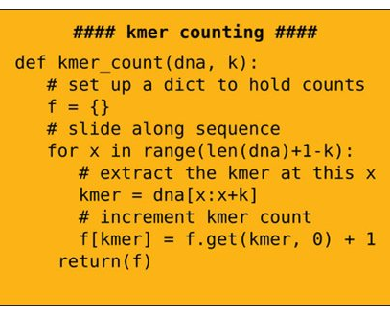
An Efficient Approach of K-mer Counting for Noisy Sequence Reads
Enamul Hassan
4th year going Student of CSE, SUST

Slide 2
NanoMapper: An Efficient Read Mapping Algorithm Using Gapped Minimizer and FM-indexing for Oxford Nanopore Long Noisy Reads

Slide 3


Supervisor
Md. Eamin Rahman
Assistant Professor
Department of CSE, SUST
Enamul Hassan
Student of 4th year 2nd Semester,
Department of CSE, SUST
Md. Khairullah Gaurab
Student of 4th year 2nd Semester,
Department of CSE, SUST

Slide 4
Skeleton
Human Cell To K-mer Counting
Definition, Process and Applications of K-mer Counting
Measurement Factors of K-mer Counting
Overview of the Existing Tools

Slide 5
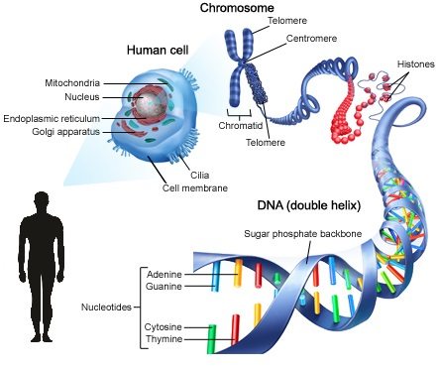
Human Cell To Mapper Tool

Slide 6
What is Mapper?
A string S having length n:
Unique substrings of length k are s₁, s₂, s₃ , … ,s_{m}
Counting the number of times each of these substrings occur in S.

Slide 7
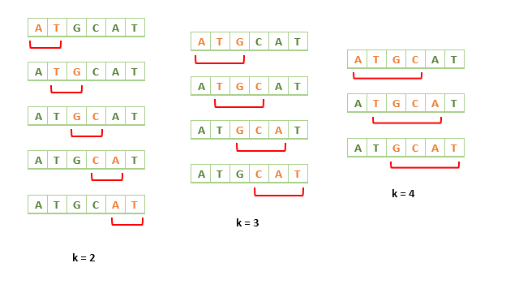
K-mer Counting Process for other ‘k’s

Slide 8
Applications of K-mer Counting
Developing de Bruijn graph
Fast multiple sequence alignment
Repeat detection
NGS data assembling
Read error correction
Transcriptome assembly
Metagenomic sequencing

Slide 9
Measurement Factors
Time Efficient Approach
Memory Efficient Approach
Time-Memory Trade of Approach
Huge Efficiency Gained by degrading Accuracy

Slide 10
Overview of Existing Tools
Tool Name | Main Feature | Published on
Tallymer | Enhanced Suffix Array | October 31, 2008
Jellyfish | Hash Table, Lock Free | January 07, 2011
BF Counter | Bloom Filter, Single Threaded | August 10, 2011
DSK | Disk-based algo, disk bucket | January 16, 2013
KMC | Disk-based algo, faster | May 16, 2013
KAnalyze | Load, Count, Store then Merge Technique | March 12, 2014
Turtle | Cache-friendly variant BF | April 02, 2014
KHmer | Count-Min Sketch | July 02, 2014
MSP Kmer Counter | Disk-based algo, minimizers | 2014
KMC 2 | Minimizers, Signatures | January 12, 2015

Slide 11
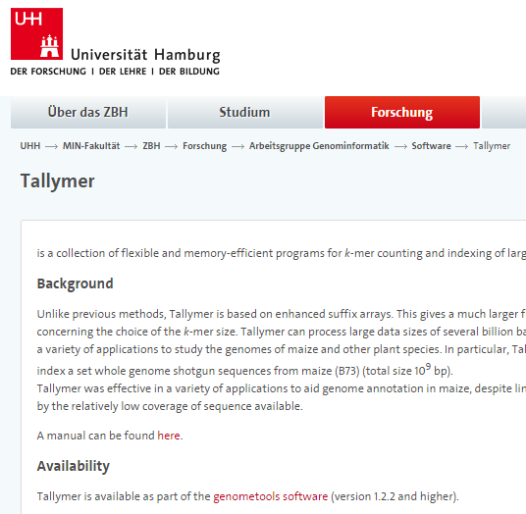
Overview of Existing Tools: Tallymer
Enhanced Suffix Array
Genome Annotation in Maize
Tested for k = 20
Does not work well for low coverage of sequence
In modern days, it takes too long time to process
Notes:
BMC Genomics
A new method to compute K-mer frequencies and its application to
annotate large repetitive plant genomes
Stefan Kurtz†1, Apurva Narechania†2,3, Joshua C Stein2 and Doreen Ware*2

Slide 12
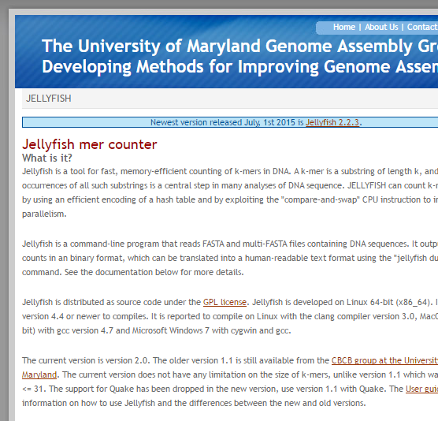
Overview of Existing Tools: Jellyfish
Lock Free Hash Table – Multithreaded
Memory Efficient
K ≤ 31
Modified Hash Table with CAS
Two Assumptions:
No Entry Deletion
Easy to Estimate Hash Table Size
Notes:
Two assumptions particular to k-mer counting simplify the design of the hash table:
First, no entry is ever deleted and there is no need to maintain special information about deleted keys.
Second, for k-mer counting the required size of the hash table should be easy to estimate or potentially the entire available memory is used. Hence, in the event that the hash table is full, it will be written to disk instead of doubling its size in memory.

Slide 13
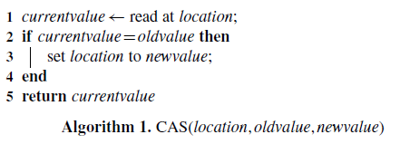
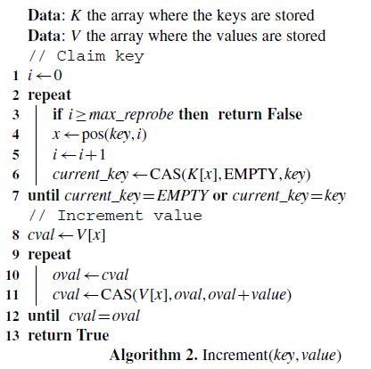

Overview of Existing Tools: Jellyfish(Cnt.)
Modification in Hashing:

Slide 14
Overview of Existing Tools: Jellyfish(Cnt.)
Tool Name | Main Feature | Published on
Tallymer | Enhanced Suffix Array | January 07, 2011
Meryl 5.4 | Celera Assembler – CABOG Old SW used in Sanger Sequencing | July 17, 2009
Meryl 6.1 |  | May 01, 2010

Slide 15
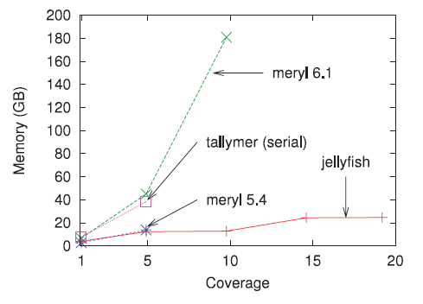
Overview of Existing Tools: Jellyfish(Cnt.)
Notes:
Memory usage for various levels of sequencing coverage on reads
generated during the Turkey genome project when counting 22-mers. Except
for Tallymer (which is inherently single threaded), all programs were run
using 32 threads. The memory usage for the serial and 32-thread versions of
Jellyfish is almost identical (results are shown using 32 threads)

Slide 16
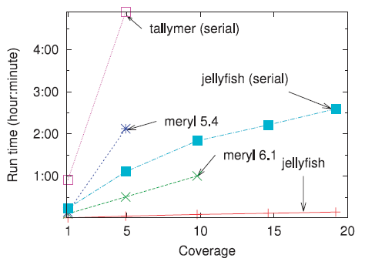
Overview of Existing Tools: Jellyfish(Cnt.)
Notes:
Computation time versus sequencing coverage on reads generated
during the Turkey genome project. Except as noted all programs were run
using 32 threads.

Slide 17
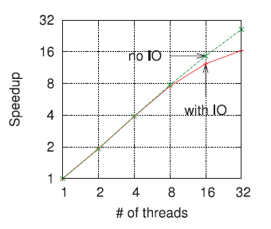
Overview of Existing Tools: Jellyfish(Cnt.)
Notes:
Speedup versus number of threads on coverage 5× of the Turkey
reads. On this log–log scale plot, a perfectly linear speedup would correspond
to a diagonal line. The ‘no IO’ curves includes only the initialization and
counting phase times. The curve marked ‘with IO’ counts the total runtime.

Slide 18
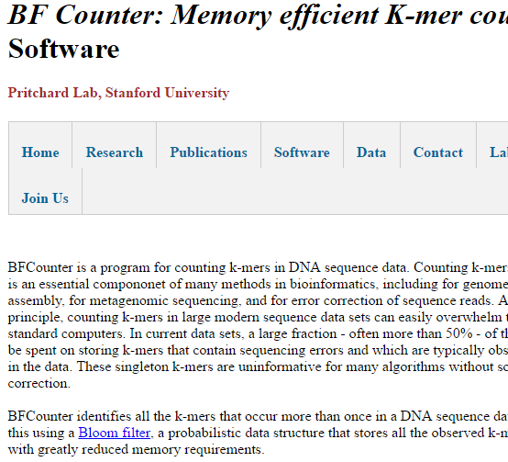
Overview of Existing Tools: BF Counter
Probabilistic Data Structure
Maintains Two Hash Arrays
Discounts k-mers having frequency less than two
Saving up to 50% memory usage
Notes:
Efficient counting of k-mers in DNA sequences using a bloom filter
Páll Melsted1* and Jonathan K Pritchard1,2 BMC Bioinformatics

Slide 19
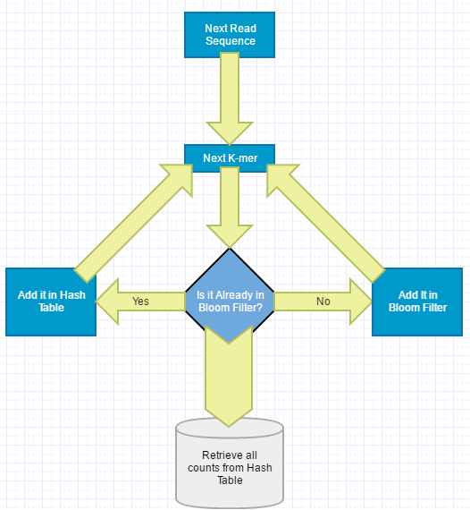
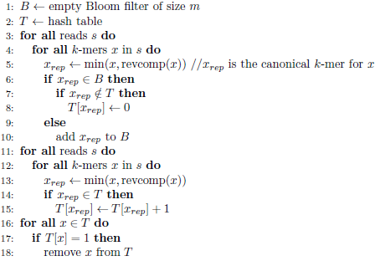
Overview of Existing Tools: BF Counter(Cnt.)
Notes:
Efficient counting of k-mers in DNA sequences using a bloom filter
Páll Melsted1* and Jonathan K Pritchard1,2 BMC Bioinformatics

Slide 20
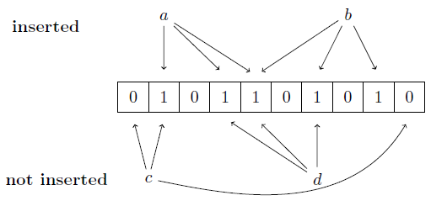
Overview of Existing Tools: BF Counter(Cnt.)
Notes:
Efficient counting of k-mers in DNA sequences using a bloom filter
Páll Melsted1* and Jonathan K Pritchard1,2 BMC Bioinformatics

Slide 21
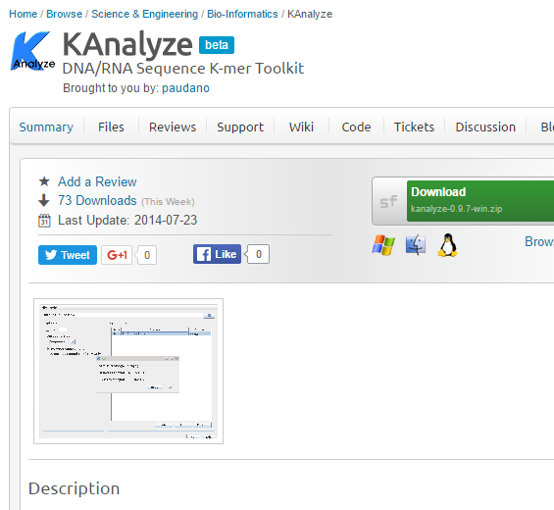
Overview of Existing Tools: KAnalyze
Used JAVA for the first time to count k-mers
Used JAVA’s Arrays.sort() Method -- dual-pivot quicksort algorithm.
Loads only small portion in memory at a time
Two steps: Split and Merge
Used JAVA’s Reflection API to dynamically load classes
Notes:
Bioinformatics
KAnalyze: a fast versatile pipelined K-mer toolkit
Peter Audano and Fredrik Vannberg*
School of Biology, Georgia Institute of Technology, Atlanta, GA 30332, USA

Slide 22
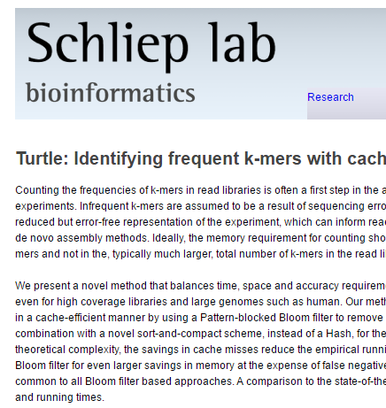
Overview of Existing Tools: Turtle
Another Bloom Filter Based Tool
Used Sort And Compress (SAC) method instead of Hash Table
Showed that SAC takes less time to insert/update than any types of Hashing, even Google Hash
Notes:
Bioinformatics
Turtle: Identifying frequent k-mers with cache-efficient algorithms
Rajat Shuvro Roy1,2,3,*, Debashish Bhattacharya2,3 and Alexander Schliep1,4,*
1Department of Computer Science, 2Department of Ecology, Evolution and Natural Resources, 3Institute

Slide 23
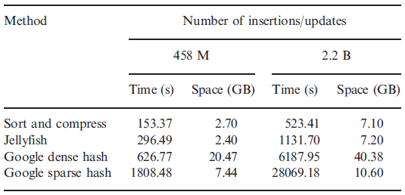
Overview of Existing Tools: Turtle (Cnt.)

Slide 24
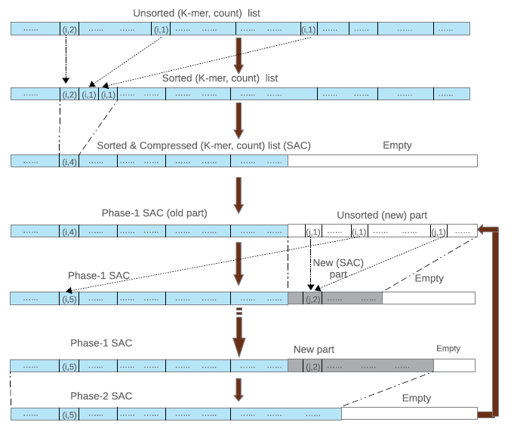
Overview of Existing Tools: Turtle (Cnt.)

Slide 25
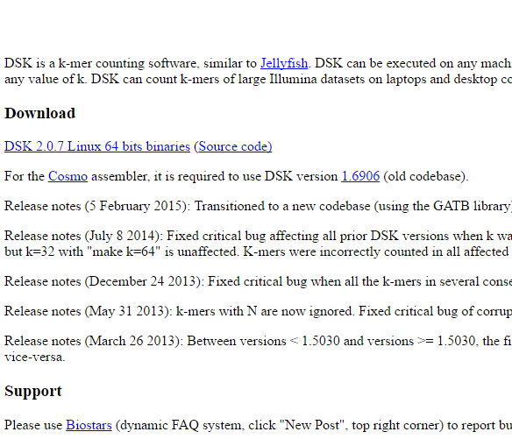
Overview of Existing Tools: DSK
Disk Streaming of K-mers.
First use of read partitioning.
Three steps to generate the histogram of K-mers.
Notes:
DSK: k-mer counting with very low memory usage Guillaume Rizk¹, Dominique Lavenier² and Rayan Chikhi²,*
^{BioInformatics}

Slide 26
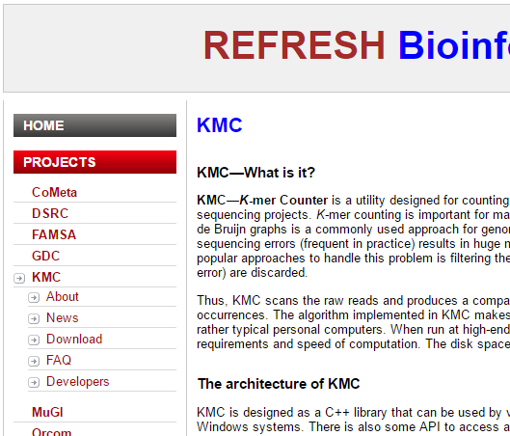
Overview of Existing Tools: KMC
Uses read partition technique
Sorting technique to count all the K-mers.

Slide 27

Overview of Existing Tools: KHmer
Uses Count-Min Sketch.
Three steps to generate the count of K-mers but only the counts not the K-mers.
Creation of Hash Table
Verification of K-mers
Count of K-mers

Slide 28
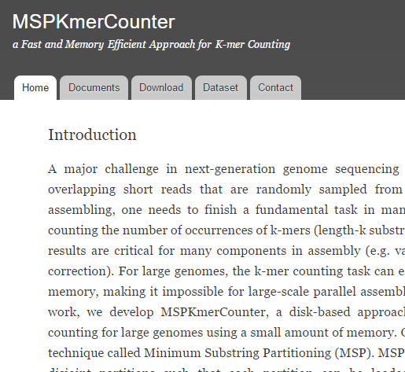
Overview of Existing Tools: MSPKmer Counter
Minimum Substring Partitioning technique used.
First use of minimizer in K-mer counting
Uses hash-table to store count of respective K-mers.

Slide 29
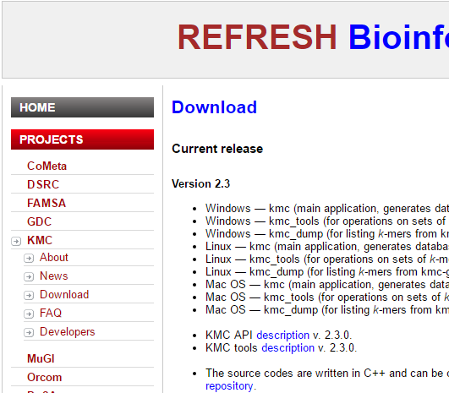
Overview of Existing Tools: KMC 2
Uses several features of its previous tools.
Minimizer like MSPKmerCounter
Sorting algorithm of KMC
Notes:
Deorowicz, S., Kokot, M., Grabowski, Sz., Debudaj-Grabysz, A., KMC 2: Fast and resource-frugal k-mer counting, Bioinformatics, 2015; doi: 10.1093/bioinformatics/btv022():

Slide 30
Challenges to glean K- Mer information from reads
K-Mer counting is one of the simplest tasks (both conceptually and programmatically) in computational Biology if we don’t care about efficiency.
Although destination of k – mers (hash table in Jellyfish, Bloom filter in BFCounter , disk in DSK and KMC 1) and other details differ in particular solutions, the main step is common.

Slide 31
Challenges to glean K- Mer information from reads
Process each read from left to right and extract all k-mers from them, one by one.
High redundancy as consecutive k-mers share k-characters.
Loading the whole read in the main memory and then computing k- mer information requires huge amount of main memory or RAM.

Slide 32
What KMC – 2 Offers
K – mer counting of large datasets at least twice faster than the strongest competitors (JellyFish 2, KMC 1) using about 12GB (or less) of RAM memory.
For example, KMC 2 allows to count the 28-mers of a human reads collection with 44-fold coverage (106 GB of compressed size) in about 20 minutes, on a 6-core Intel i7 PC with an SSD.

Slide 33
Minimizer and Super K - Mer
A minimizer of a k-mer is such of its m-mers (m < k) that no other lexicographically smaller m-mer can be found.
In read, contiguous areas containing k-mers having the same canonical signature are called as “super k-mers”.
Signatures of k-mers is a exclusive set of minimizer that allows all minimizers but only such that do not start with AAA, neither start with ACA, neither contain AA anywhere except at their beginning.

Slide 34
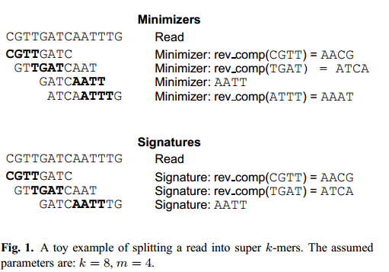
Minimizer and Super K - Mer

Slide 35
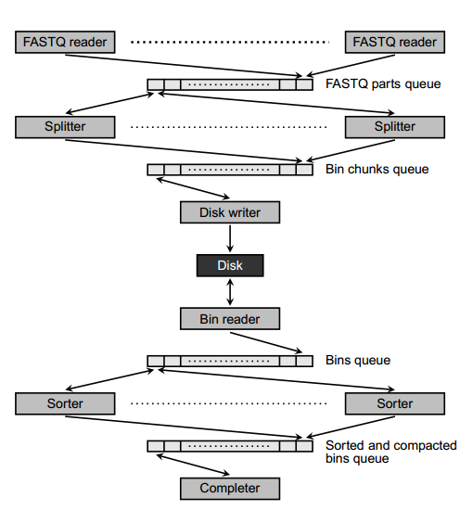
Sketch of the Algorithm

Slide 36
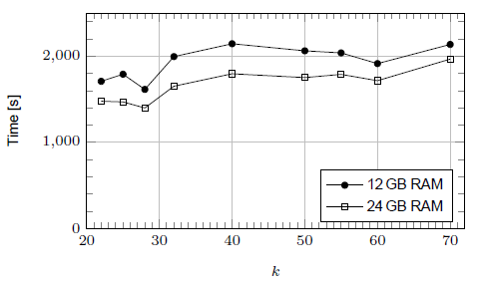
KMC – 2 Processing Time
Notes:
Dependence of KMC 2 processing time on k for H. sapiens 2 dataset
(k = 22, 25, 28, 32, 40, 50, 60, 70)

Slide 37
Scope of Improvement
Still, counting k-mers for k ≥ 32 is generally slower than for smaller values of k.
Ranged based k-mers finding options.
Have not been reliable for sequence read with error rate greater than average.

Slide 38
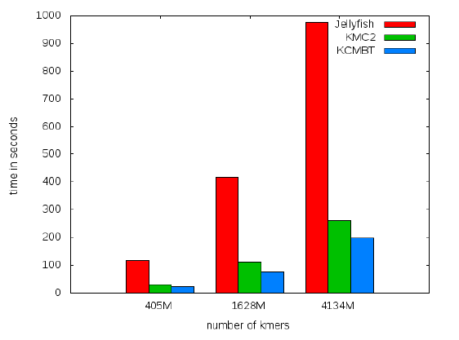
Overview of a Claimed Tool: KCMBT
Based on Multiple Burst Trees
Handles Caches very efficiently
Requires Disk Space Only for Compact Data
Notes:
IEEE Xplore Digital Library Efficient techniques for k-mer counting A. A. Mamun ; Dept. of Comput. Sci. & Eng., Univ. of Connecticut, Storrs, CT, USA ; S. Pal ; S. Rajasekaran
Most of the available memory-based algorithms suffer from many cache misses. Our implementation uses caches very efficiently. The algorithm keeps all of the temporary data in memory. It requires disk space only for compact output data.

Slide 39
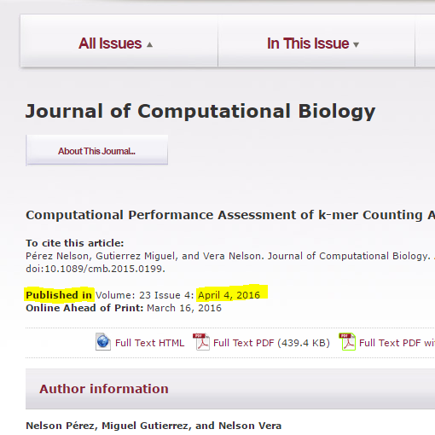
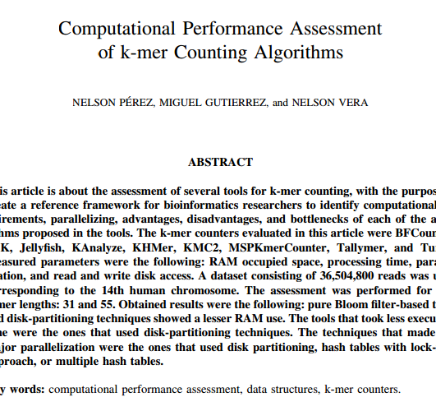
Assessment of Existing Tools
Notes:
Computational Performance Assessment of k-mer Counting Algorithms NELSON PE´REZ, MIGUEL GUTIERREZ, and NELSON VERA
JOURNAL OF COMPUTATIONAL BIOLOGY Volume 23, Number 4, 2016 # Mary Ann Liebert, Inc. Pp. 248–255 DOI: 10.1089/cmb.2015.0199

Slide 40
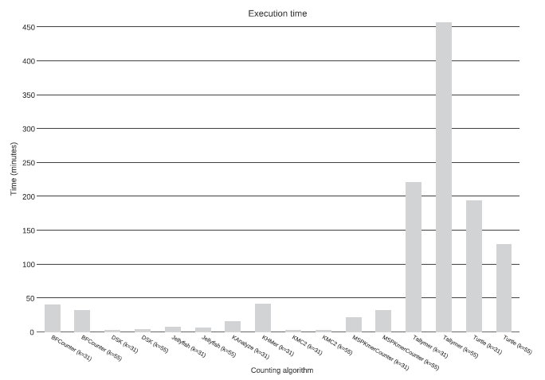
Assessment of Existing Tools (Cont.)
Notes:
Computational Performance Assessment of k-mer Counting Algorithms NELSON PE´REZ, MIGUEL GUTIERREZ, and NELSON VERA
JOURNAL OF COMPUTATIONAL BIOLOGY Volume 23, Number 4, 2016 # Mary Ann Liebert, Inc. Pp. 248–255 DOI: 10.1089/cmb.2015.0199

Slide 41
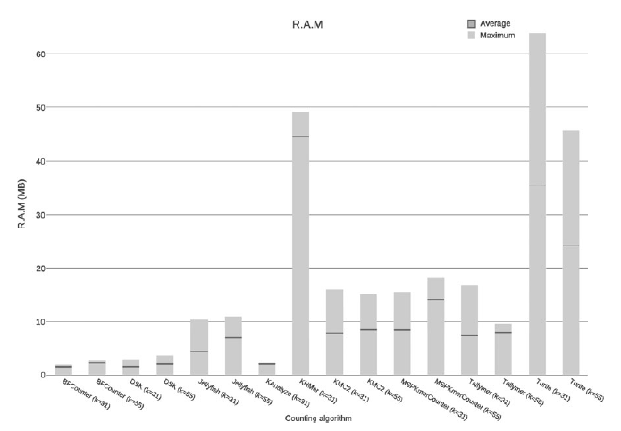
Assessment of Existing Tools (Cont.)
Notes:
Computational Performance Assessment of k-mer Counting Algorithms NELSON PE´REZ, MIGUEL GUTIERREZ, and NELSON VERA
JOURNAL OF COMPUTATIONAL BIOLOGY Volume 23, Number 4, 2016 # Mary Ann Liebert, Inc. Pp. 248–255 DOI: 10.1089/cmb.2015.0199

Slide 42
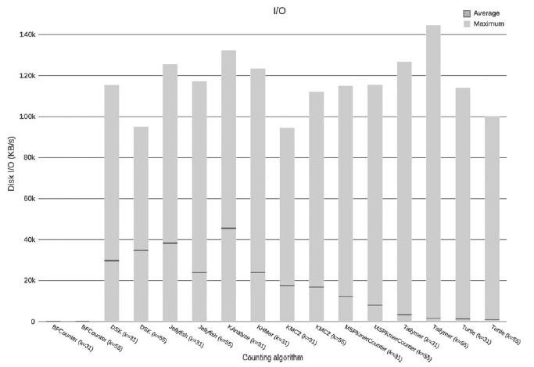
Assessment of Existing Tools (Cont.)
Notes:
Computational Performance Assessment of k-mer Counting Algorithms NELSON PE´REZ, MIGUEL GUTIERREZ, and NELSON VERA
JOURNAL OF COMPUTATIONAL BIOLOGY Volume 23, Number 4, 2016 # Mary Ann Liebert, Inc. Pp. 248–255 DOI: 10.1089/cmb.2015.0199

Slide 43
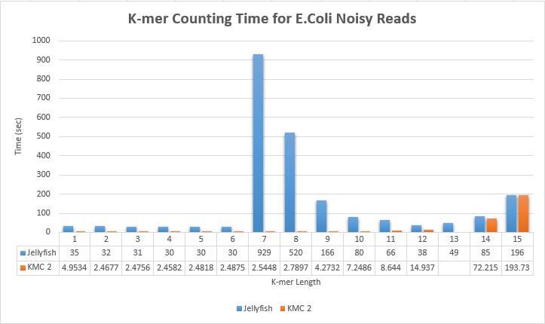
Our Assessment: Runtime
Notes:
Computational Performance Assessment of k-mer Counting Algorithms NELSON PE´REZ, MIGUEL GUTIERREZ, and NELSON VERA
JOURNAL OF COMPUTATIONAL BIOLOGY Volume 23, Number 4, 2016 # Mary Ann Liebert, Inc. Pp. 248–255 DOI: 10.1089/cmb.2015.0199

Slide 44
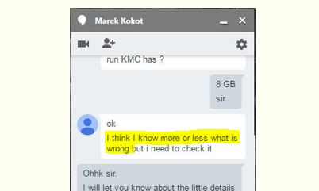
Fault of KMC 2 for k = 13
Notes:
Computational Performance Assessment of k-mer Counting Algorithms NELSON PE´REZ, MIGUEL GUTIERREZ, and NELSON VERA
JOURNAL OF COMPUTATIONAL BIOLOGY Volume 23, Number 4, 2016 # Mary Ann Liebert, Inc. Pp. 248–255 DOI: 10.1089/cmb.2015.0199

Slide 45
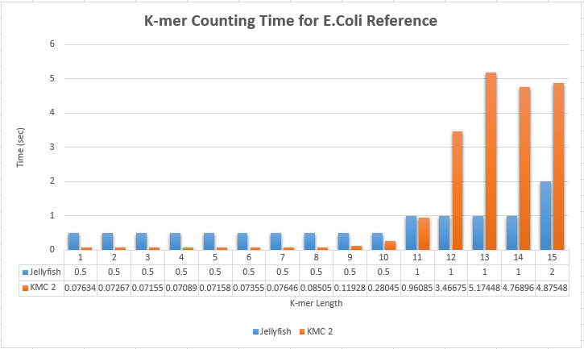
Our Assessment: Runtime (Cont.)
Notes:
Computational Performance Assessment of k-mer Counting Algorithms NELSON PE´REZ, MIGUEL GUTIERREZ, and NELSON VERA
JOURNAL OF COMPUTATIONAL BIOLOGY Volume 23, Number 4, 2016 # Mary Ann Liebert, Inc. Pp. 248–255 DOI: 10.1089/cmb.2015.0199

Slide 46
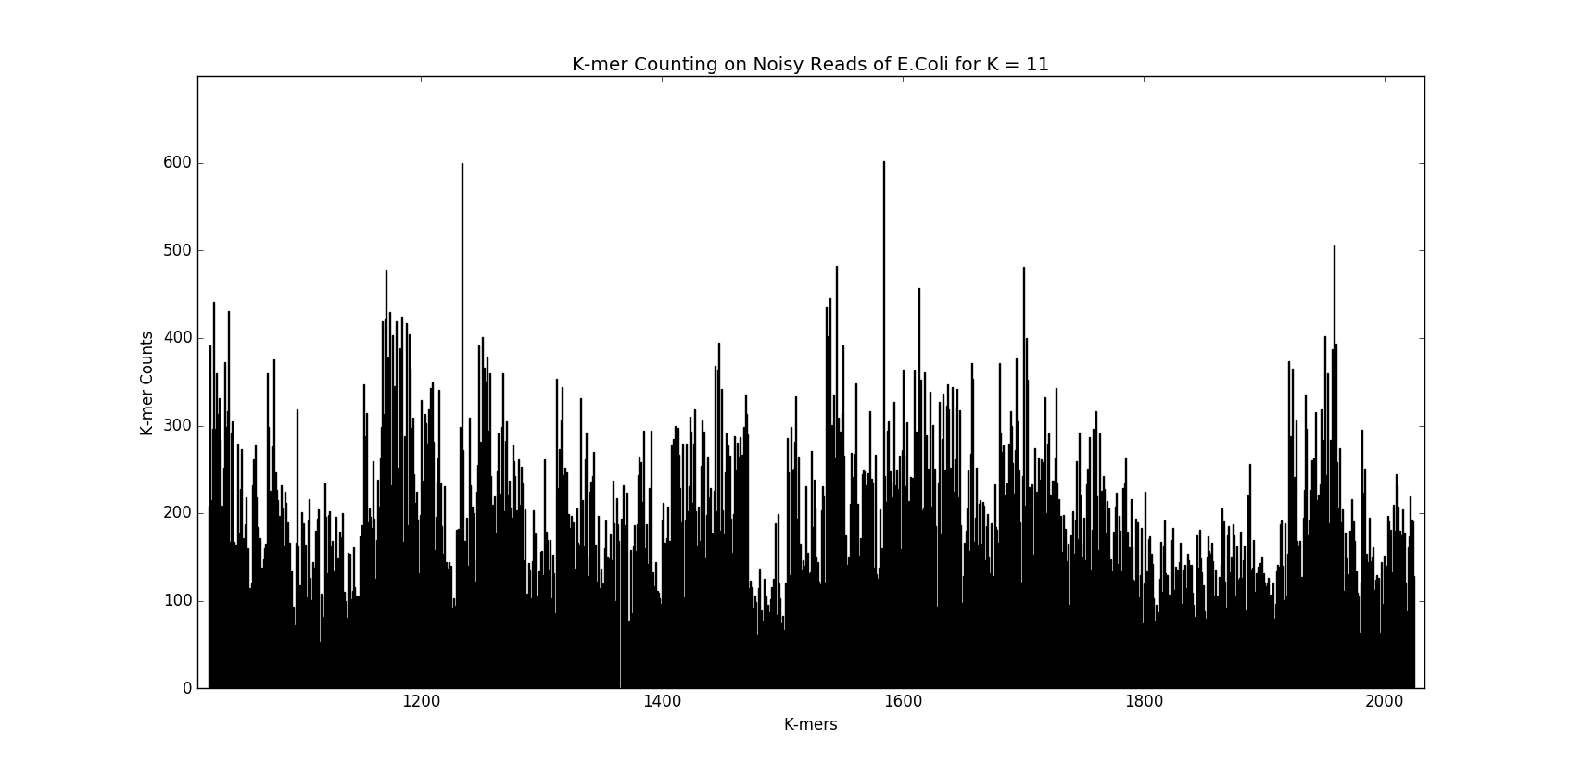
Noisy Data Reads (First 1000 11-mer)

Slide 47
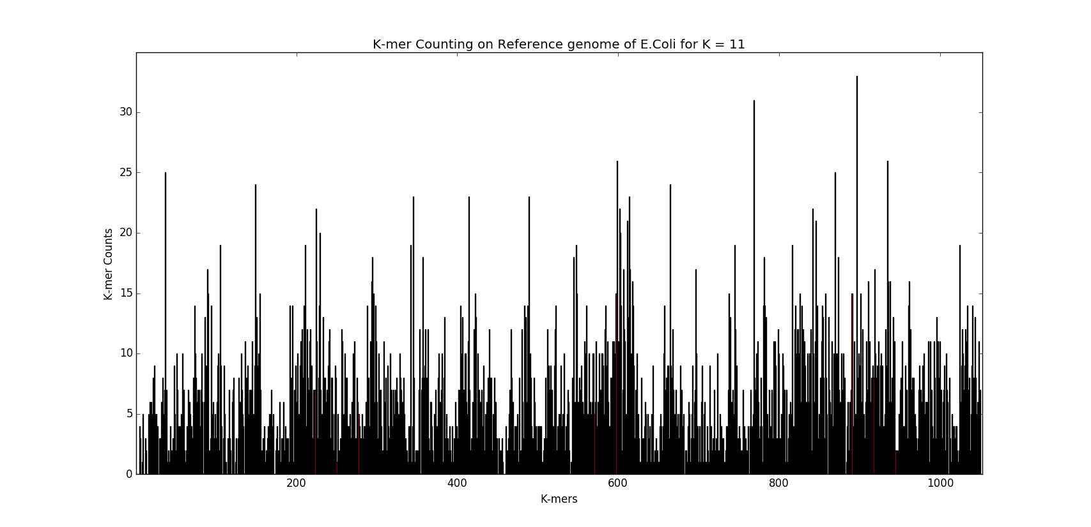
Reference Genome (First 1000 11-mer)

Slide 48
Minhashing
A technique for quickly estimating how similar two sets are.
To minhash a set represented by a column of the characteristics matrix, a permutation of the rows are taken.

Slide 49
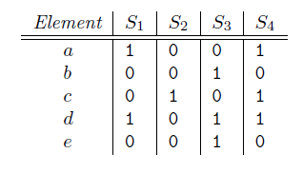
Minhashing : Example
Rows – Products
Columns – Customers
Sparse Matrix

Slide 50
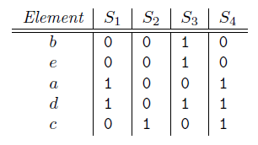
Minhashing : Example
Random Shuffle of rows

Slide 51
Minhashing : SIM(S₁,S₂)
Top to bottom traverse
Stop when at least one 1 meets.
Three classes:
Type X: rows have 1 in both columns.
Type Y: rows have 1 in one of the columns and 0 in the other
Type Z: rows have 0 in both columns.

Slide 52
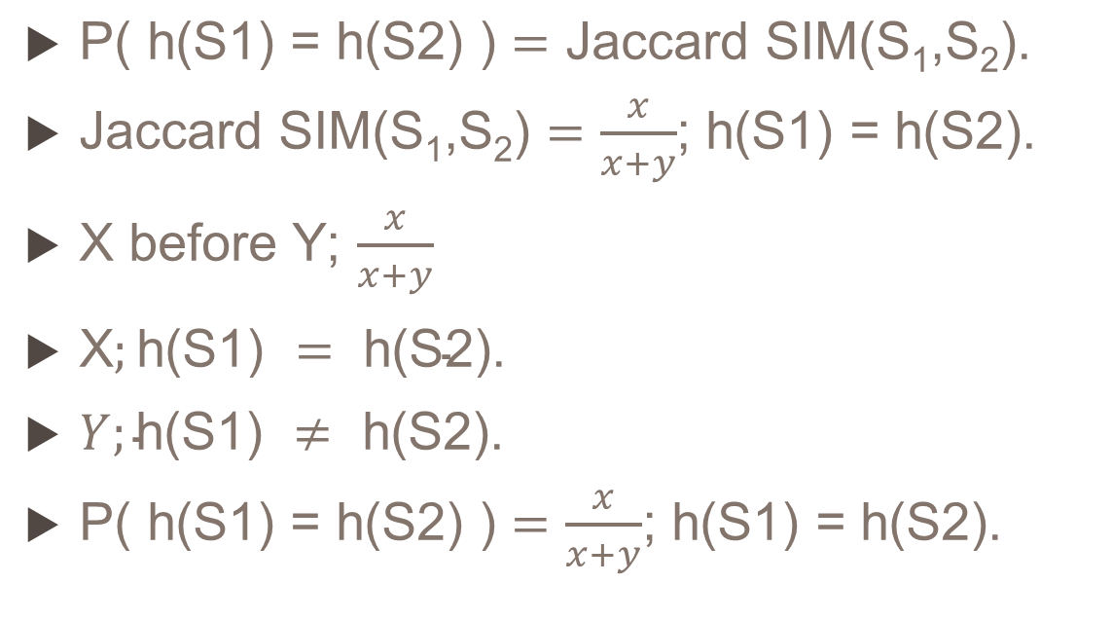
Minhashing = Jaccard SIM(S₁,S₂)
$\text{P}\text{( }\text{h}\text{(}\text{S}\text{1) = }\text{h}\text{(}\text{S}\text{2) )}=\text{Jaccard} \text{SIM}\text{(}\text{S}\text{1}\text{,}\text{S}\text{2}\text{).}$
$\text{Jaccard} \text{SIM}\text{(}\text{S}\text{1}\text{,}\text{S}\text{2}\text{)}=\frac{x}{x+y}$; h(S1) = h(S2).
X before Y; $\frac{x}{x+y}$
X$;\text{h}\text{(}\text{S}\text{1) }= \text{h}\text{(}\text{S}\text{2).}$
$Y;\text{h}\text{(}\text{S}\text{1) }≠ \text{h}\text{(}\text{S}\text{2).}$
$\text{P}\text{( }\text{h}\text{(}\text{S}\text{1) = }\text{h}\text{(}\text{S}\text{2) )}=\frac{x}{x+y}$; h(S1) = h(S2).
Three classes:
Type X: 1,1
Type Y: 1,0 or 0,1
Type Z: 0,0

Slide 53
Minhash Signature
Matrix M.
Some random number n of permutations of the rows of M. e.g.: 100
Permutations h₁, h₂, … , h_{n}
The column representing set S
The minhash signature for S, the vector [h₁(S), h₂(S), … , h_{n}(S)]
This list of hash-values goes to column

Slide 54
Computing Minhash Signatures
Not feasible to permute a large characteristic matrix explicitly
Conceptually appealing, are not implementable
Possible to simulate the effect of a random permutation by a random hash function that maps row numbers to as many buckets as there are rows.
picking n random permutations of rows
n randomly chosen hash functions h₁, h₂, … , h_{n} on the rows

Slide 55
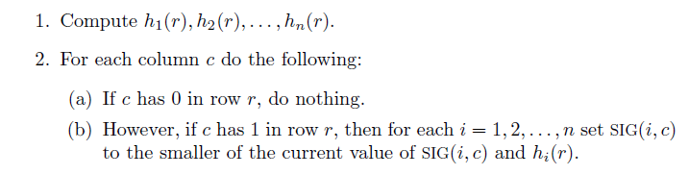
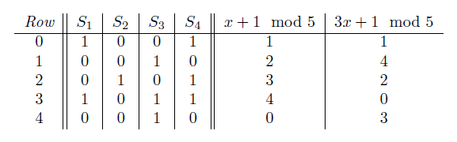
Building Signatures Matrix: Algo

Slide 56


Building Signatures Matrix: SIG(i,c)

Slide 57

Building Signatures Matrix: SIG(i,c) (Cont.)

Slide 58

Building Signatures Matrix: SIG(i,c) (Cont.)

Slide 59

Building Signatures Matrix: SIG(i,c) (Cont.)

Slide 60
Locality Sensitive Hashing
Reduces the dimensionality of high-dimensional data.
Hashes input items so that similar items map to the same “buckets” with high probability (the number of buckets being much smaller than the universe of possible input items)

Slide 61
Why LHS
Minhashing:
compress large documents into small signatures
preserve the expected similarity
It still may be impossible to find the pairs with greatest similarity efficiently.
Reason: the number of pairs of docs may be too large, even if there are not too many docs.

Slide 62
LHS to Minshash Signature
“hash” items several times, in such a way that similar items are more likely to be hashed to the same bucket than dissimilar items are.
Candidate Pair – hashed to the same bucket for any of the hashings.
Expecting only a small fraction of:
False Positive
False Negative

Slide 63
LHS: Main Idea
Have minhash signatures for the items
An effective way to choose the hashings is to divide the signature matrix into b bands consisting of r rows each.
For each band,
Vectors of r integers (the portion of one column within that band)
Hash function
Hashes them to some large number of buckets

Slide 64
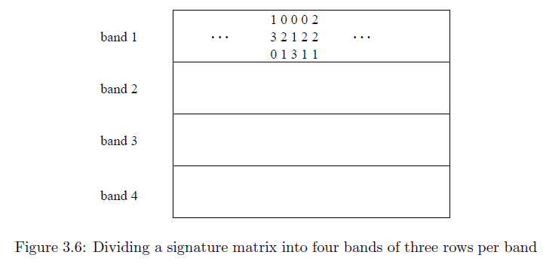
LHS: Example

Slide 65
Future Work
Developing a more efficient k-mer counting tool
Developing a relatively good tool to count k-mers for all types of files.

Slide 66
Q & A
Thanks

