Slide 1
The Firestarters
Fire Department Project by

Slide 2
Our team
Miriam Kostadinova Georgieva 9g – Scrum Trainer
Alexander Niels Boris Klingenberg 9a – Developer BackEnd
Teodor Toshkov Karchev 9b – Desinger
Tereza Nikolaeva Opanska 9v – Developer FrontEnd

Slide 3
Stages of realization
First stage -planning
Second stage - realization
Third stage - presentation

Slide 4
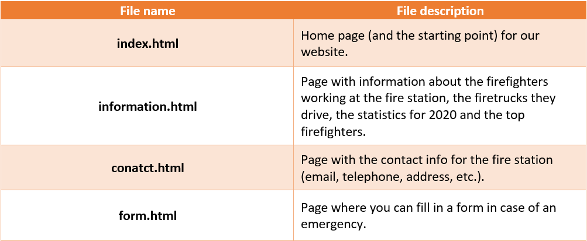
Site construction

Slide 5
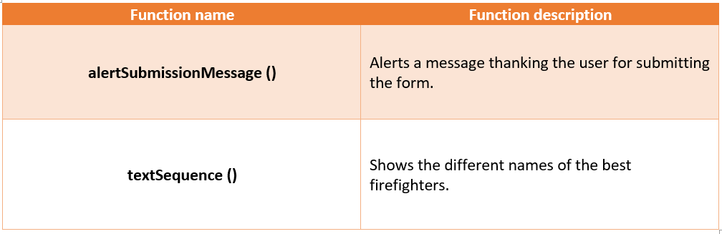
Functions

Slide 6









Programs we used

Slide 7
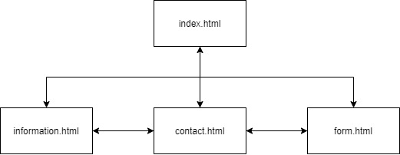
Flowchart of our site

Slide 8
Thank you for your attention!

