Slide 1
Genetics of a Foundation Tree Drives Lichen Interaction Networks
MK Lau, LJ Lamit, CA Gehring, RR Naesborg, TG Whitham

Slide 2
4 Papers?
Single garden genotype affects networks
Wild patterns of co-occurrence
Patterns garden vs wild
Patterns between gardens (GxE)

Slide 3
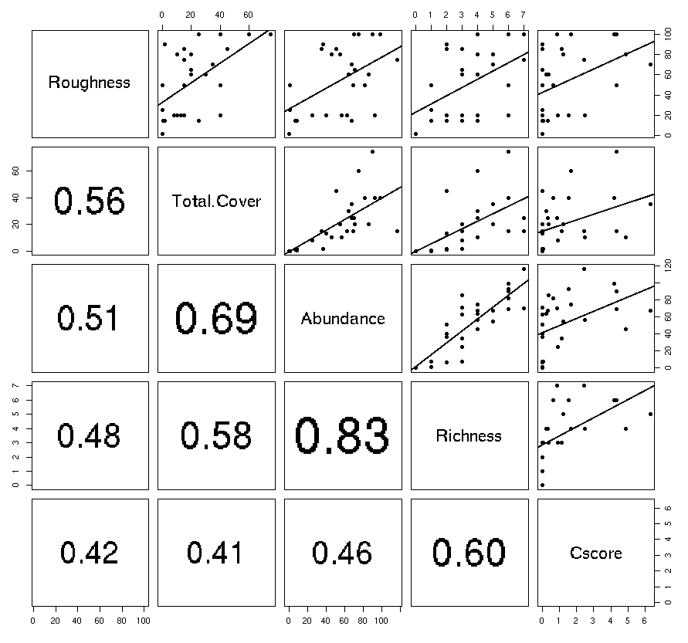
Ordination?
Bark Texture?
Figure 1. Roughness increases the abundance of lichen (Total.Cover and Abundance) which in turn increases both Richness and the frequency of co-occurrences.

Slide 4
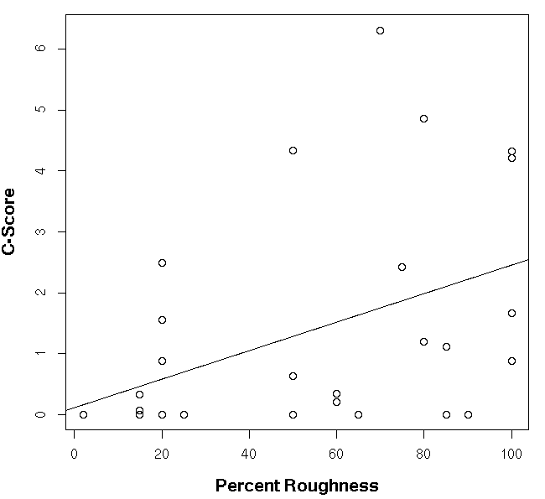
Figure 2. Co-occurrence patterns of lichen vary with Populus angusifolia bark roughness in a riparian forest.

Slide 5
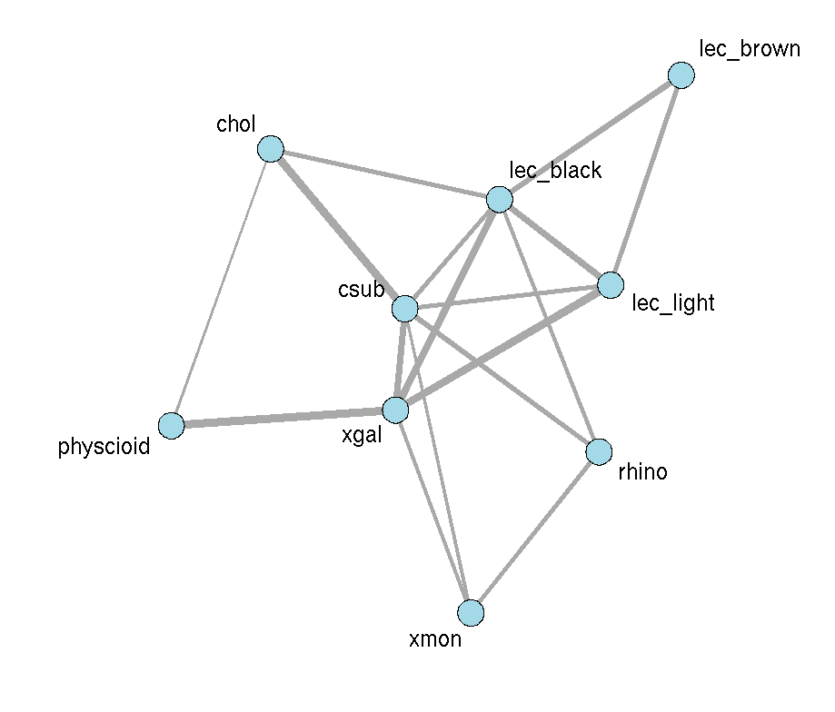
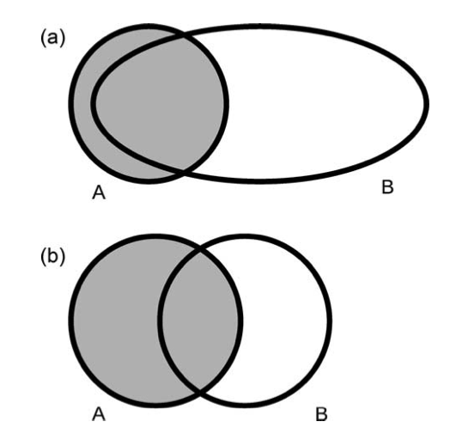
Wild Stand
Figure 3. Networks of co-occurrence patterns were generated using the methods of Araujo et al. 2011. Each link in a network is a significant co-occurrence between two species scaled by the magnitude of the dependency between two species. All co-occurrence patterns were associative (as opposed to repulsive).

Slide 6
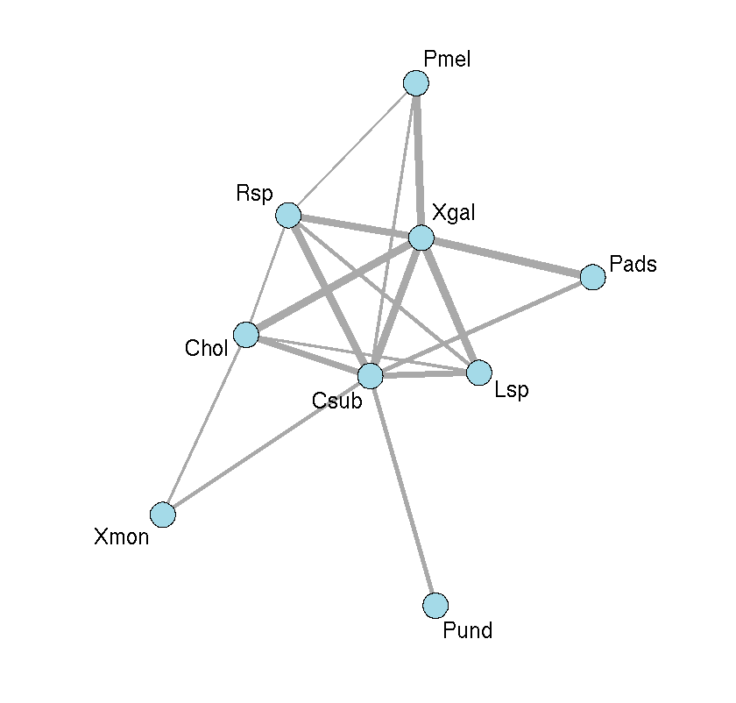
Wild Stand
ONC
Mantel?
Figure 4. Networks for the wild stand (left) and Ogden Nature Center (right) lichen communities showing similar structural patterns. In particular, both Xanthomendoza galericulata and Candelariella subdeflexa were central in both networks.

Slide 7
Genotype variation in network structure
Test in the common gardens both cscore and network similarity
Present both scales
Look at the extreme trees
Pattern suppoting facilitation
What is the correlation between the correlation in composition and interaction variation?

Slide 8
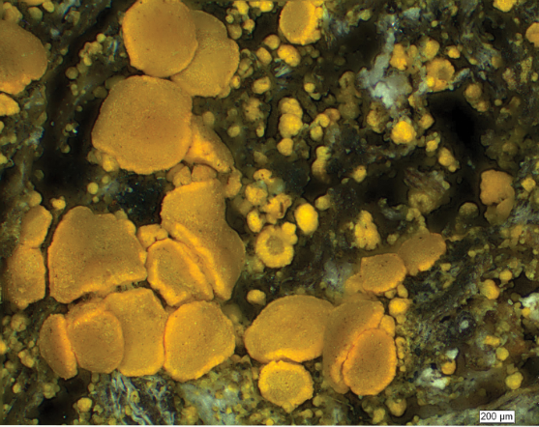
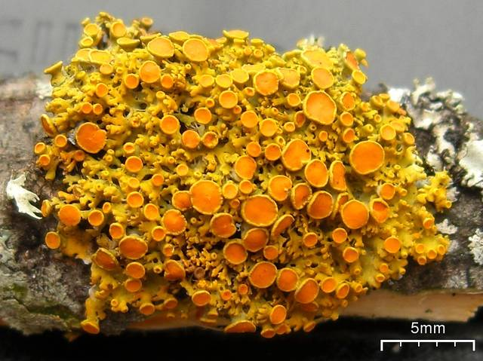
Figure 4 (continued). Networks for the wild stand (left) and Ogden Nature Center (right) lichen communities showing similar structural patterns. In particular, both Xanthomendoza galericulata and Candelariella subdeflexa were central in both networks.

Slide 9
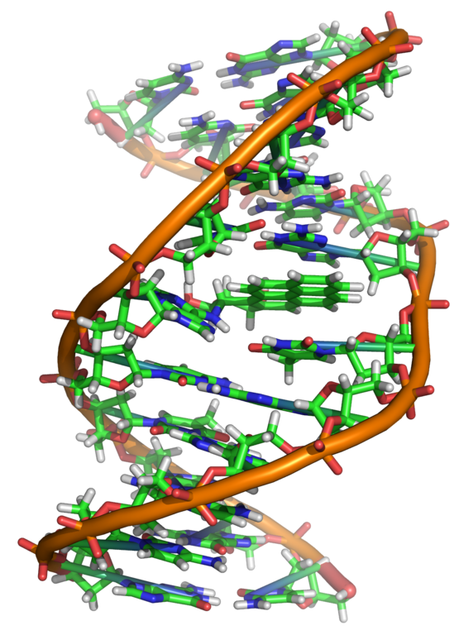
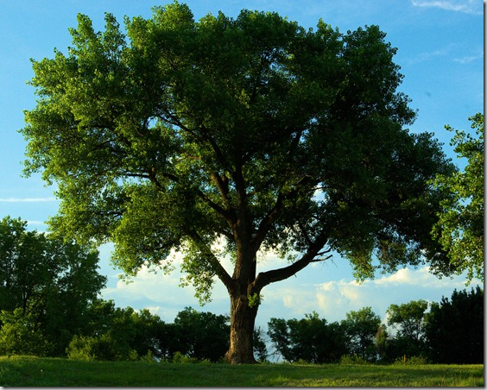
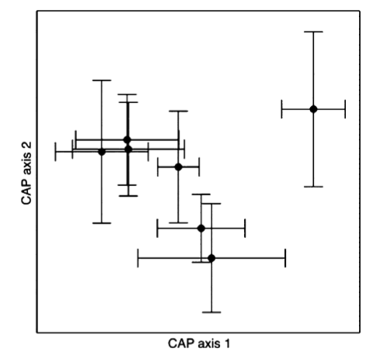
Genetic Variation
Phenotypic Variation
Community Variation
Interaction Variation
Time?

Slide 10
Thanks
Dr. Luke Evans
Dr. Matt Zinkgraf
Carly Van Camp
Becky Mau
Cameron Williams
Karla Kennedy
Liam
Many others

