Slide 1
Concept of Clean Architecture
Rafal Klimek

Slide 2


Why should we care?

Slide 3
Lines of Code per Release

Slide 4
Cost of Line of Code per Release

Slide 5
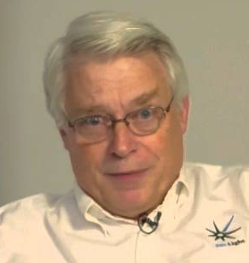
What can we do about it?

Slide 6
Coding according to rules
SOLID
GRASP
DRY
KISS
YAGNI

Slide 7

What are the rules for our components?

Slide 8

Reuse/Release Equivalence Principle
The unit of reuse is the unit of release. Effective reuse requires tracking of releases from a change control system. The package is the effective unit of reuse and release.

Slide 9
Common Closure Principle
Classes within a released component should share common closure. That is, if one needs to be changed, they all are likely to need to be changed. What affects one, affects all.

Slide 10
Common Reuse Principle
The classes in a package are reused together. If you reuse one of the classes in a package, you reuse them all.

Slide 11
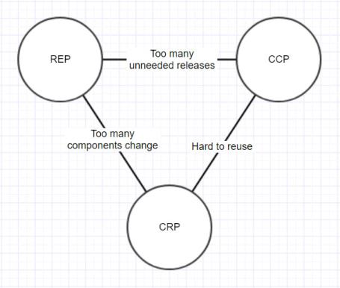
Tension Diagram

Slide 12
Acyclic Dependencies Principle
The dependency structure between packages must not contain cyclic dependencies.

Slide 13
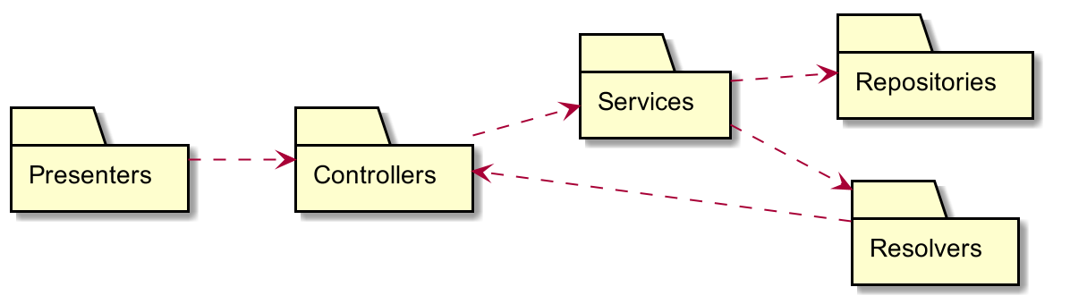
Acyclic Dependencies Principle

Slide 14
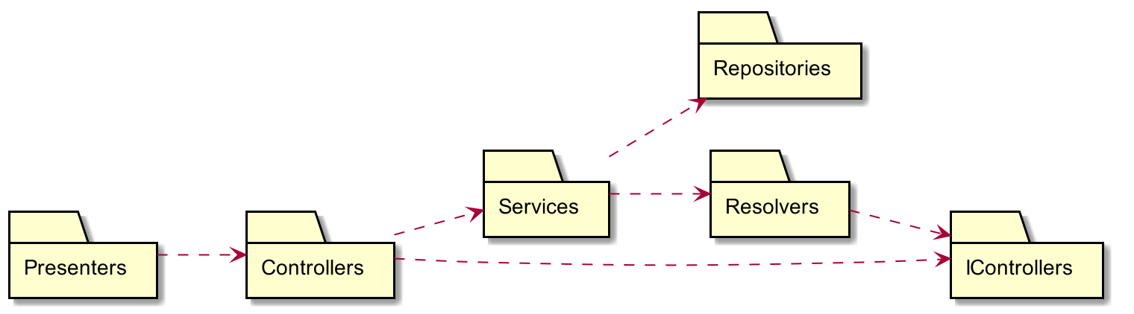
Acyclic Dependencies Principle

Slide 15
Stable Dependencies Principle
The dependencies between packages should be in the direction of the stability of the packages. A package should only depend upon packages that are more stable than it is.

Slide 16
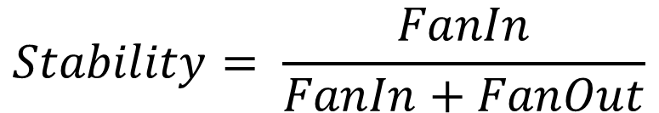
Stable Dependencies Principle
$$Stability= \frac{FanIn}{FanIn+FanOut}$$

Slide 17
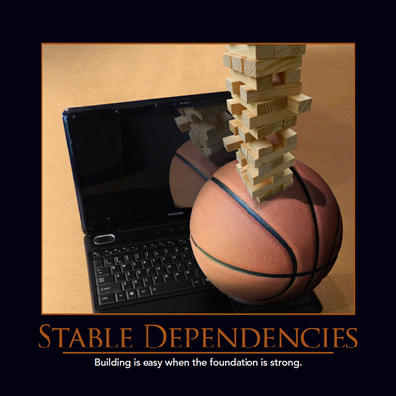
Stable Dependencies Principle

Slide 18
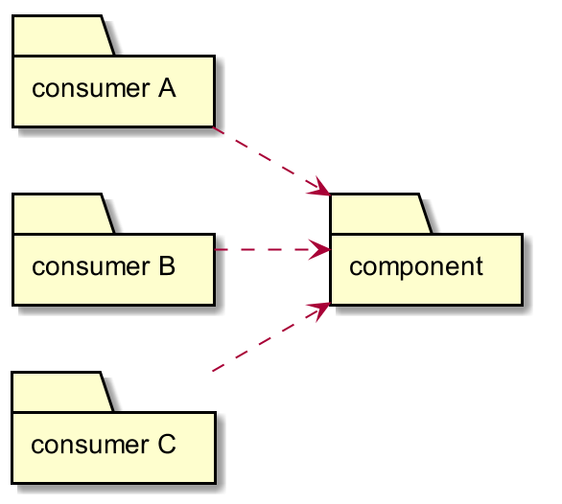
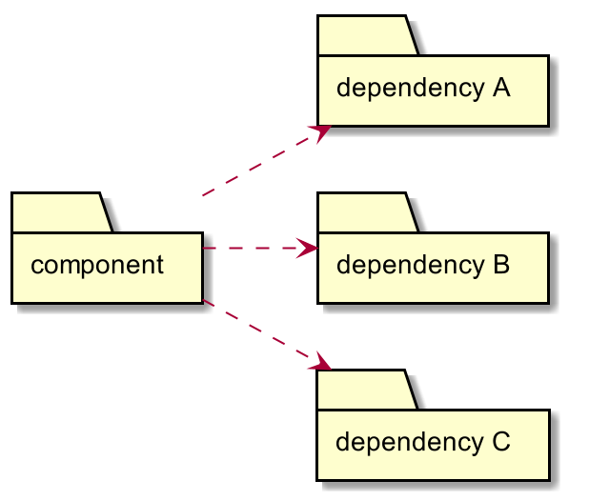
Stable Dependencies Principle

Slide 19
Stable Abstractions Principle
Packages that are maximally stable should be maximally abstract. Unstable packages should be concrete. The abstractness of a package should be in proportion to its stability.

Slide 20
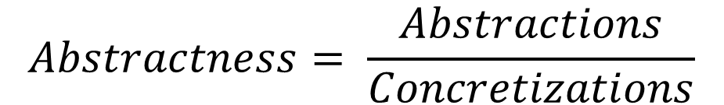
Stable Abstractions Principle
$$Abstractness= \frac{Abstractions}{Concretizations}$$

Slide 21
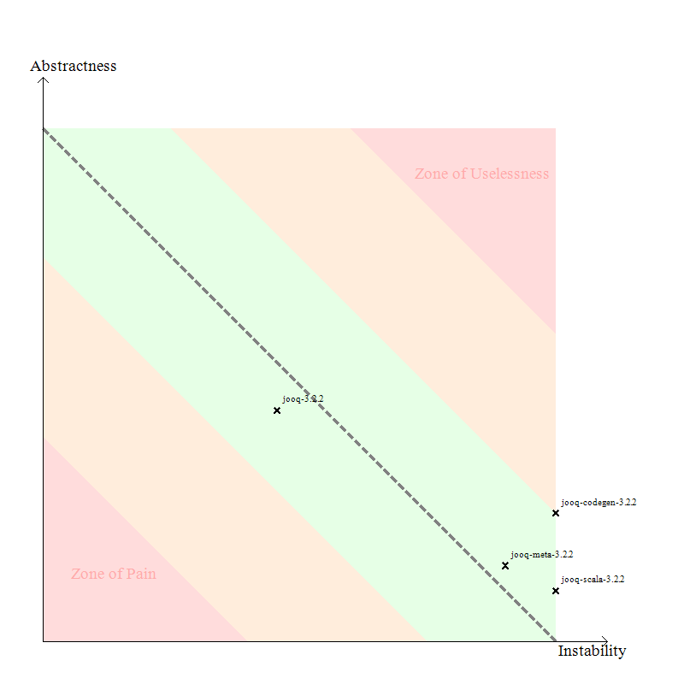
Stable Abstractions Principle

Slide 22

That's nice, how can we model our code then?

Slide 23

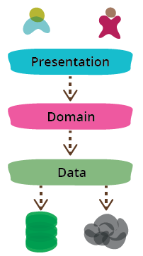
Martin Fowler's "Presentation Domain Data Layering"

Slide 24

Martin, you fool!

Slide 25
What in your applications is the least likely to be changed?

Slide 26
What in your applications is the least likely to be changed?
ENTITIES !!!

Slide 27
What defines functionalities of your application?

Slide 28
What defines functionalities of your application?
USE CASES AND DOMAIN LOGIC !!!

Slide 29
What about them?
Framework
Database
UI
Microservices vs. monolith

Slide 30
What about them?
Framework
Database
UI
Microservices vs. monolith
IMPLEMENTATION DETAILS

Slide 31
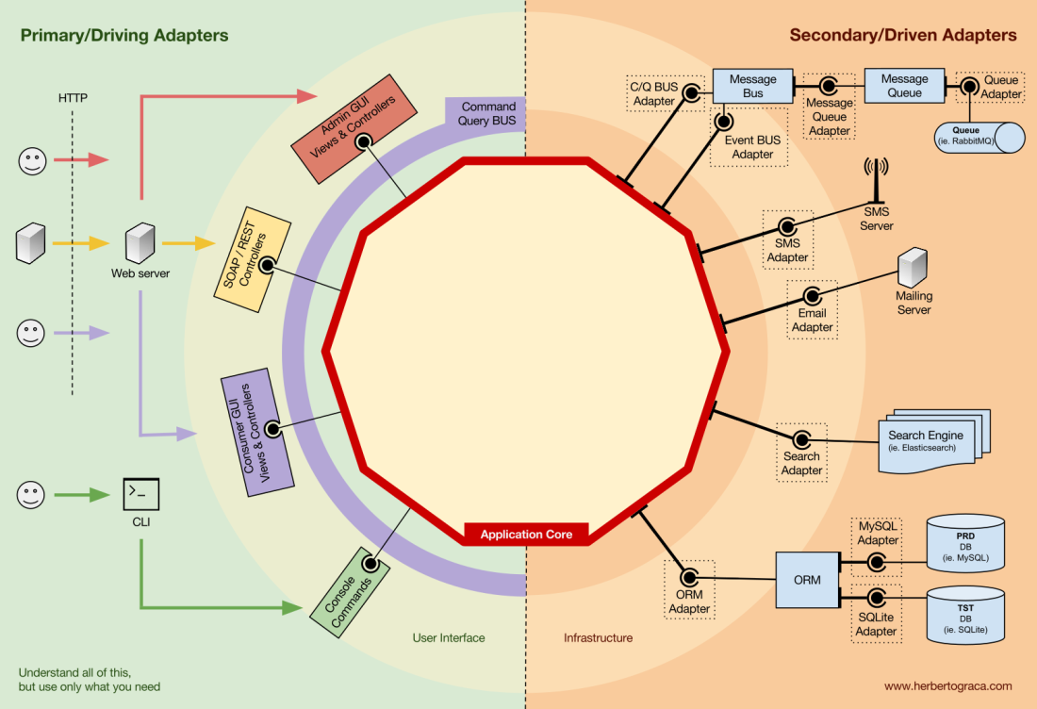
Hexagonal Architecture

Slide 32
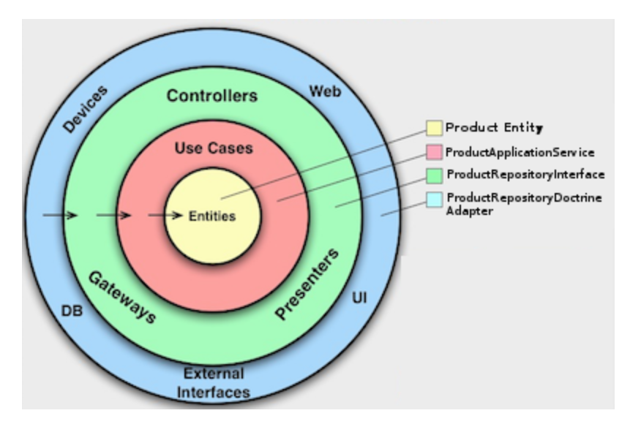
Hexagonal Architecture

Slide 33
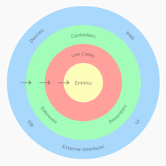
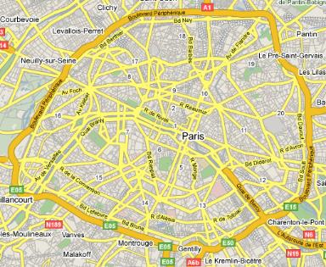
Peripherique antipattern

Slide 34
Thank You

