Slide 1
Practise of Clean Architecture
Rafal Klimek

Slide 2
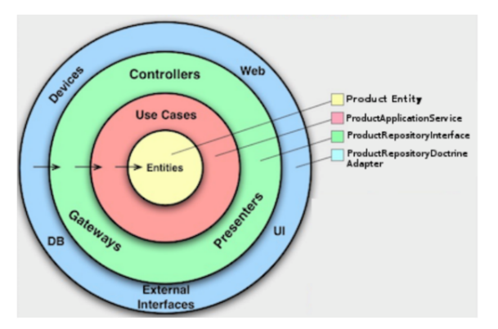
Hexagonial Architecture

Slide 3
What should be the first thing that newbie notice after opening the solution?

Slide 4
What should be the first thing that newbie notice after opening the solution?
DOMAIN AREA !!!

Slide 5
Screaming Architecture
Frameworks and Tools
Use cases and Domain Objects

Slide 6
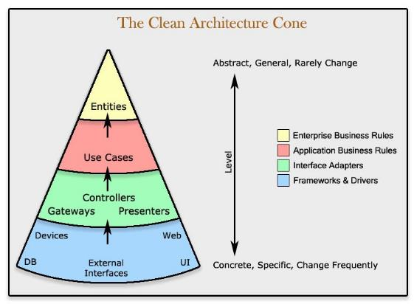
Hexagonial Architecture

Slide 7
Enterprise Layer
Aggregates
Value Objects
Entities
Policies
Repositories

Slide 8
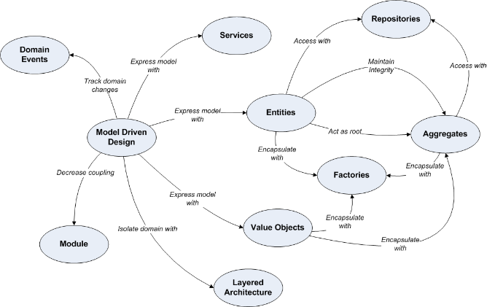
DDD Building Blocks

Slide 9
Application Layer
Use Cases
Commands/Queries

Slide 10
Adapter Layer
Entrypoints
Controllers
Presenters
Dataproviders
Readers/Writers
Event Emitters

Slide 11
Thank You

