Slide 1
mattrisASM: An Assembly Adventure
CS 2253 – Final Project
Matthew Kenneth Peterson (ID 3719754)

Slide 2

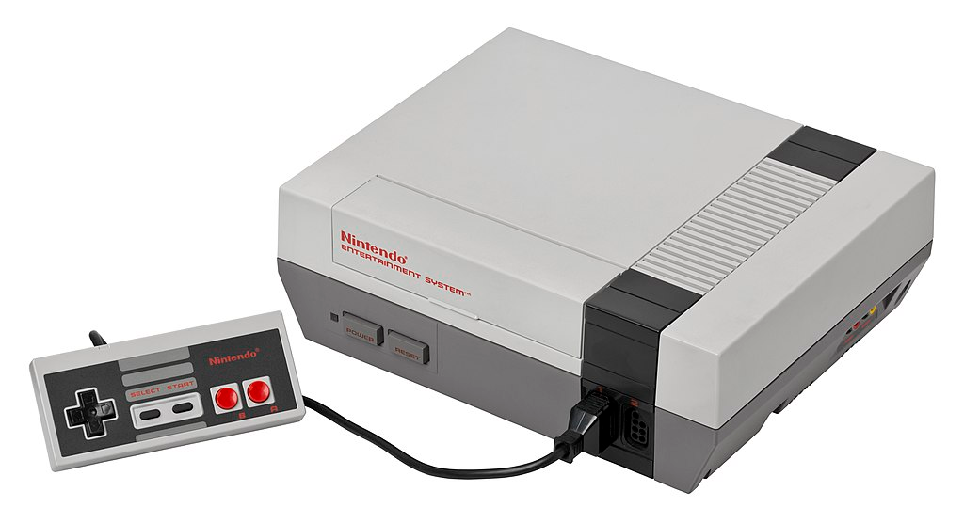
Idea
mattris.c
(silly Tetris clone from CS 2263)
Nintendo Entertainment System (NES)

Slide 3
Approach
Compile C directly for the NES, and pray it runs
X Bad Idea: cc6502 compiler is poorly optimized!
Suck it up and write it in 6502 assembly
X Bad Idea: I don’t know assembly yet, let alone for an ancient computer architecture!
Simplify first in C, convert to x86 assembly by hand under the guise of a productive school project, then finally tweak for 6502 assembly
Best idea I can come up with!

Slide 4
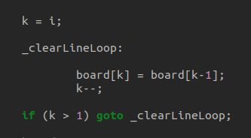

C Simplification Process
Use global variables and pointers
Trim “ncurses” calls
Implementing “goto” loops
“for” loop
“goto” loop

Slide 5
Another Problem: The NES is weak!
 | Average Personal Computer | NES
Instruction Set | Intel x86-64 | MOS Technologies 6502
Working Memory | 8589934592 bytes | 2048 bytes
Stack Space | As much as needed | Maximum 256 bytes
Processing Speed | 3.00 GHz | 0.001GHz
Processor Cores | 6 to 8 | 1
General Purpose Registers | 16 x 64-bit | 2 Logic, 1 Math, all 8-bit

Slide 6
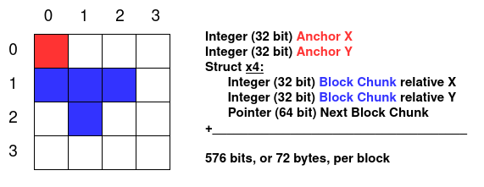
Optimizing: Focus on Memory
Old “mattris” represented block as a set of coordinate points
Example: T block

Slide 7
The “TetrInteger”
Because each relative block-chunk coordinate lies between 0 and 3, we can represent them with the binary numbers (00, 01, 10, 11).
By “packing” the converted result together, we get a single integer value which accounts for all of the important block data. This is effectively a custom data type.
Original pointers are now unnecessary as all of the data is kept together.

Slide 8
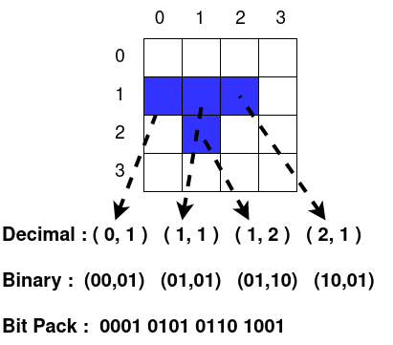
Example: T Block

Slide 9
Using the TetrInteger
The original implementation took 72 bytes per block. The new one only needs 3 unsigned 16-bit integers (2 for anchor point and 1 for block data), which is just 6 bytes! Much better for NES’ 256 bytes of working/stack memory.
Using bit-packing means that to access any data, one must use logical bitwise operations. This is perfect for an assembly oriented program
Allows for some interesting algorithmic approaches

Slide 10
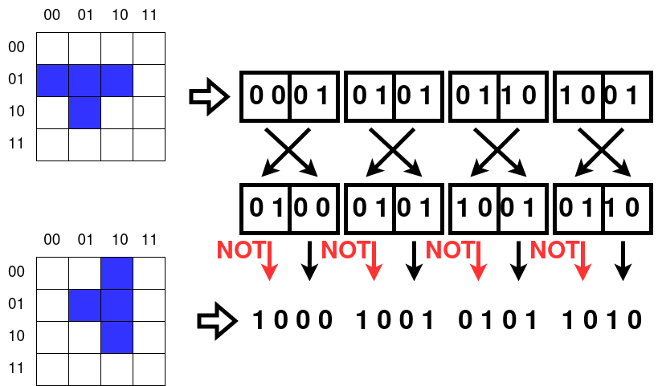
Algorithm Example: Block Rotation
90-degree coordinate rotation follows (x,y) -> (-y,x)

Slide 11
Assembly Re-Writes
Assembly code implementation in my program happened in tandem with the TetrInteger, due to the new techniques it allowed
Works great with inline as well as external assembly, both of which I have implemented
Not yet gotten to NES assembly, but that’s a journey for another day

Slide 12
Thank you for listening to me ramble :)
References:
Wikipedia for NES image
Microsoft Paint for diagrams
Dr. Kim for teaching me assembly
GCC documentation for inline-assembly related knowledge
Over-abundances of caffeine for the TetrInteger idea

