Slide 1


Area 09 Group Conscience in Preparation for the 2021 General Service Conference
Ed L, Mid-Southern California Area 09
Panel 70 delegate
msca09delegate70@yahoo.com
Cell: (760) 964-0012
https://www.dropbox.com/s/v2olzqfot8jb19r/%40Gathering%20Area%2009%20Group%20Conscience.3-7-2021.English.pdf?dl=0

Slide 2
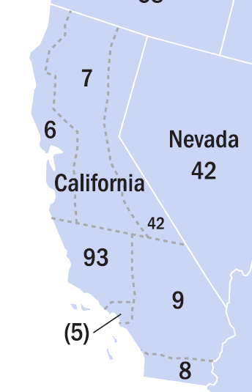
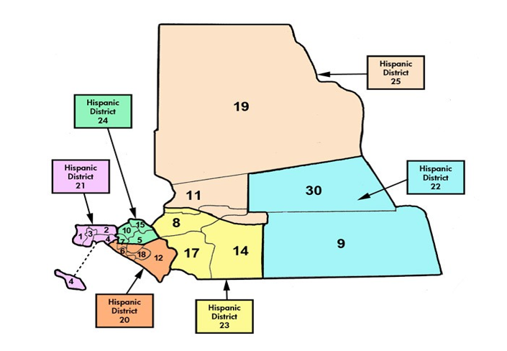
Area 09: Since 1958, 8th Conference
62,300 Members
2,003 Groups
24 Districts
6 Hispanic
1 Delegate
GSR!
???
Conference

Slide 3
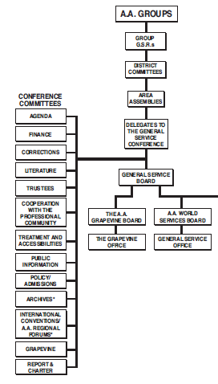
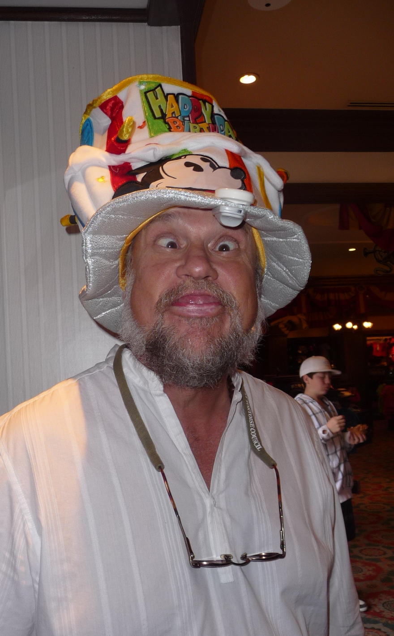
13 Conference Committees
Agenda = 10 Agenda Items
Cooperation with Professional Community = 4
Corrections = 3
110
Agenda Iems
Finance = 9
Grapevine & La Viña = 6
Literature = 37
Policy & Admissions = 10
Public Information = 10
Report & Charter = 5
Treatment & Accessibilities = 4
Trustees = 8
Archives = 2
International Conventions/Regional Forums = 2

Slide 4
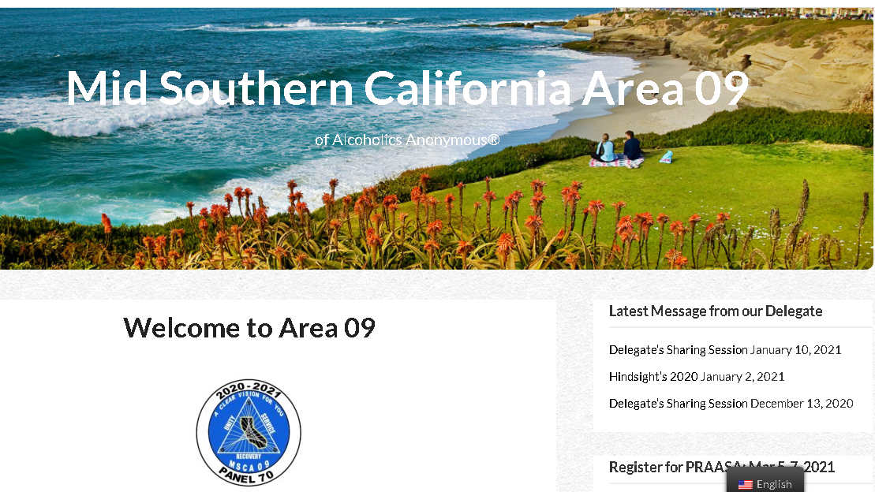

Communication by Website
msca09aa.org

Slide 5
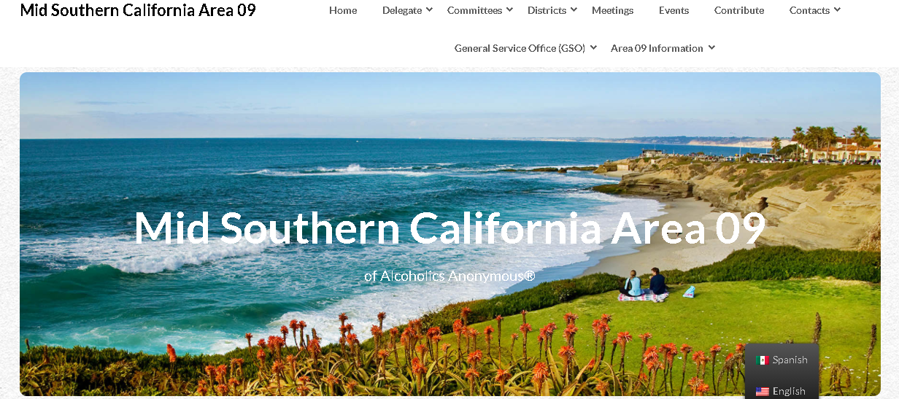

Accessing Final Agenda Items

Slide 6
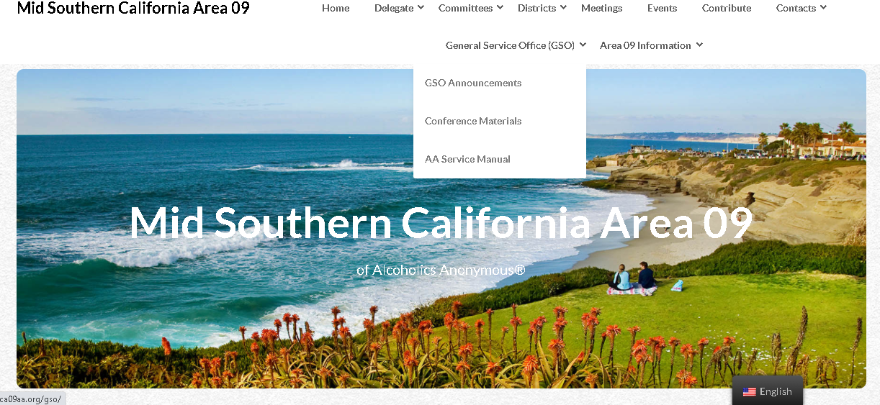
Agenda Items Publicly Available

Slide 7
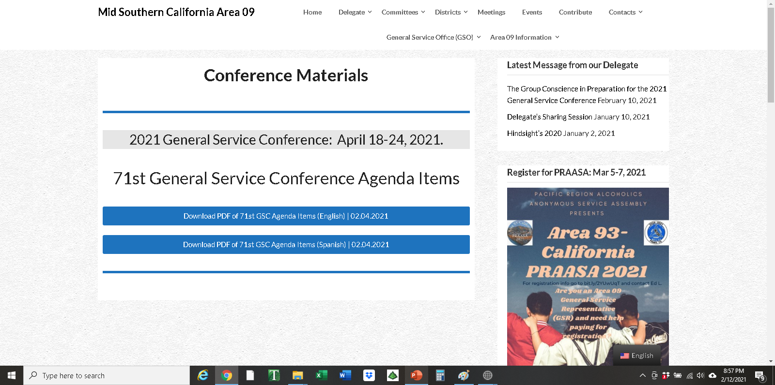
With and
Without input
https://www.dropbox.com/s/6xp5ur6xg1ymd8s/%2471st%20GSC%20Final%20List%20of%20Agenda%20Items%20with%20strikeout%20%28English%29.rtf?dl=0

Slide 8
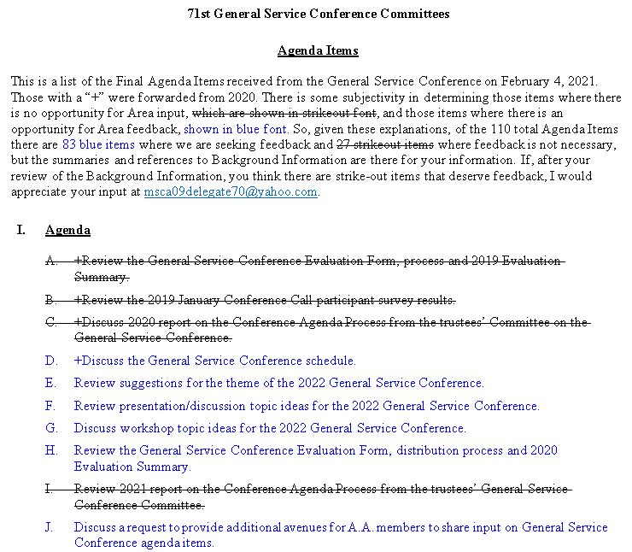
Agenda Items
Publicly
Available
With and
Without input
English
Spanish
https://www.dropbox.com/s/eye8jolsokfsx1m/%2471st%20GSC%20Final%20List%20of%20Agenda%20Items%20%28English%29.2-4-2021.pdf?dl=0
https://www.dropbox.com/s/cbdrvnvpxj50257/%2471st%20GSC%20Final%20List%20of%20Agenda%20Items%20%28Spanish%29.2-9-2021.pdf?dl=0

Slide 9
Confidential Resources
https://www.dropbox.com/s/lnwd48lrrk1y2sx/%232020%20Report%20Back%20Brainstorm.Final.July%207%2C2020.pdf?dl=0
2020 Report-back:
2020 Final Conference
Report:
English Background Information since February 15th
Spanish Background Information March 7th and 12th
Tabulated Summaries, pertinent questions on March 1st
Google Forms, primary feedback on March 6th
2021 Report-backs with faces, first one on May 4th
https://www.dropbox.com/s/mqzvloivktumsrs/%2370th%20GSC%20Final%20Report%20%28Anonymity%20Protected%29%20-%20English.pdf?dl=0

Slide 10
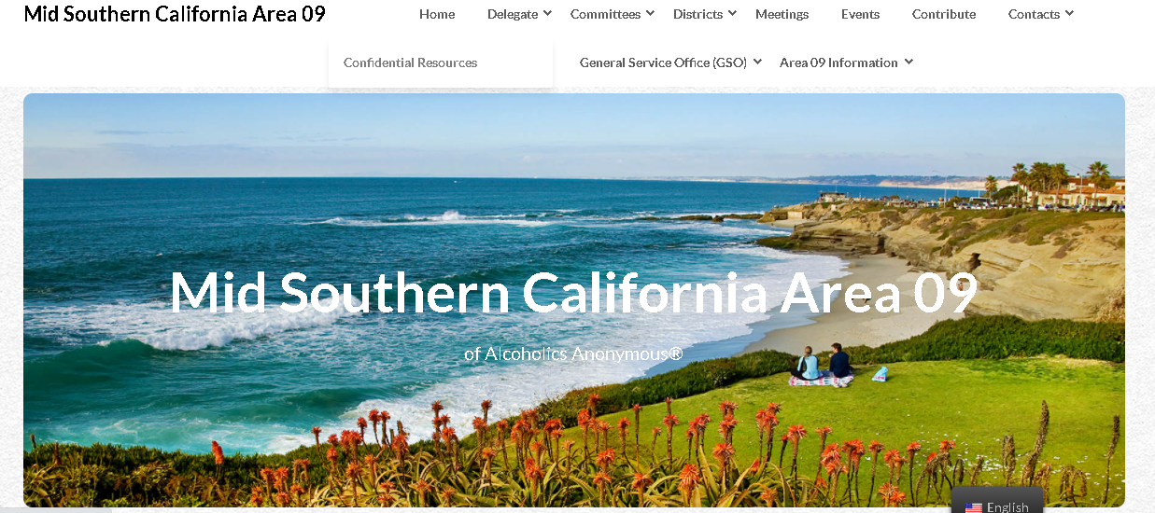
Accessing Confidential Items
Confidential Information

Slide 11
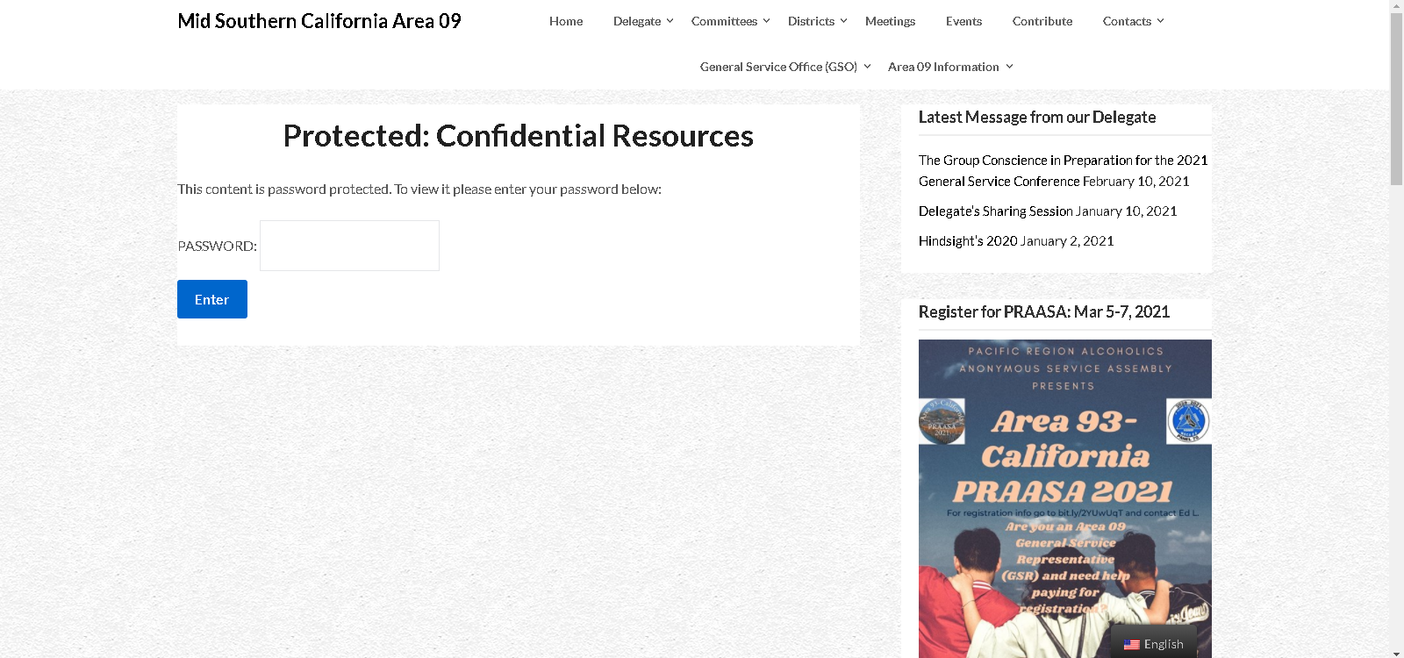
Accessing Confidential Information
area09Panel70

Slide 12
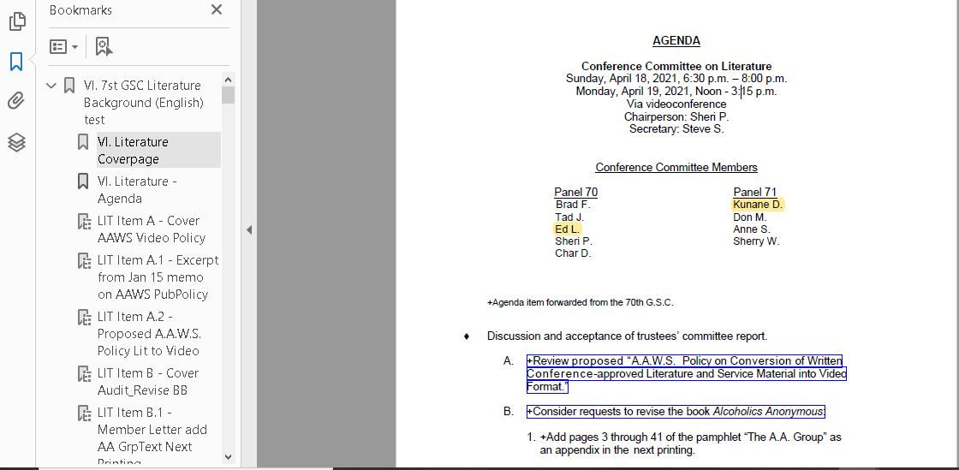
Navigating Background Information
Bookmarks to Documents
Links to 37
Agenda Items

Slide 13
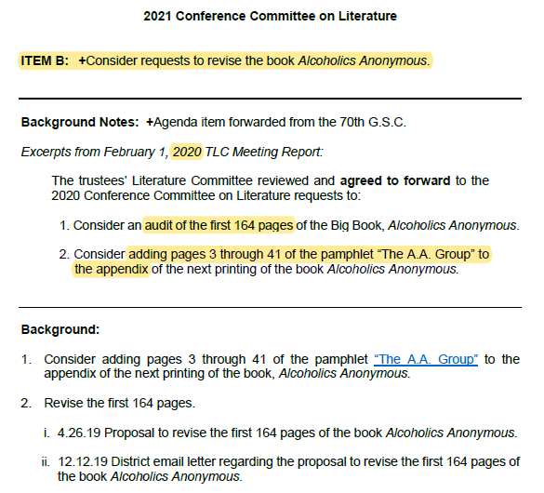
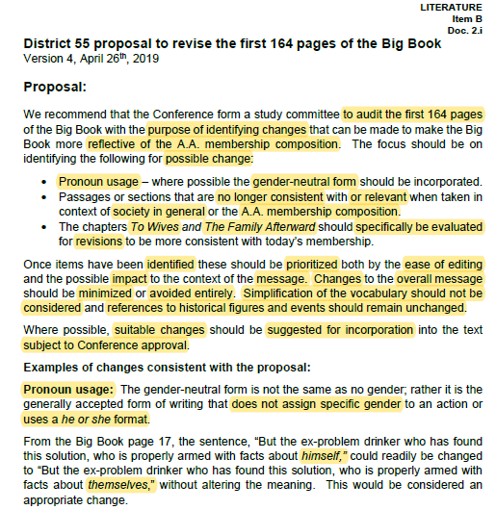
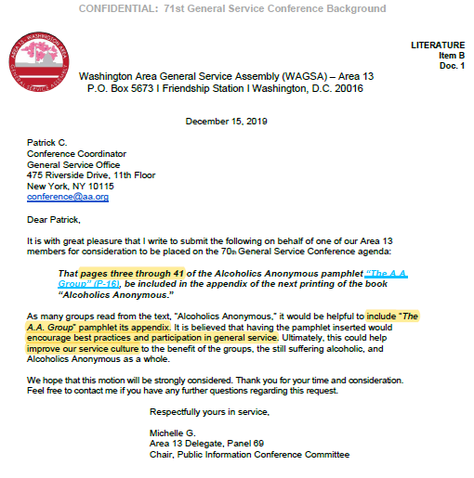
Background Information
Trustee Committee
deliberations
Letter(s) introducing
Agenda Items
Pertinent parts
highlighted to help you study info

Slide 14
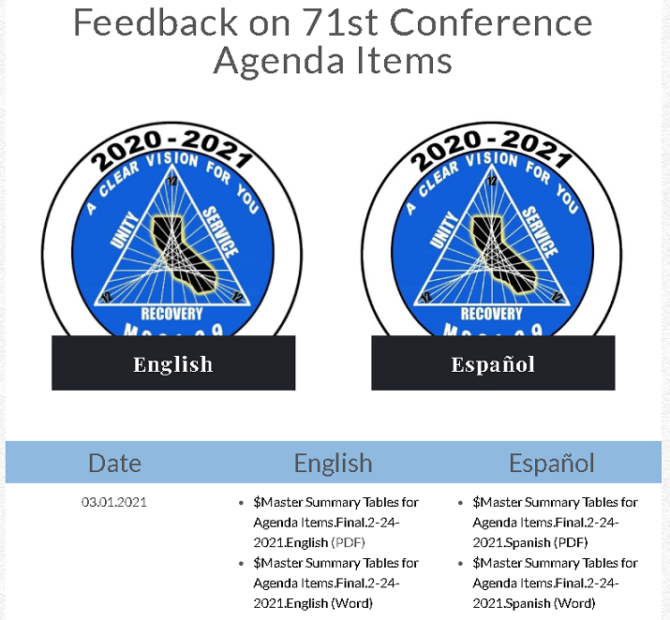
Gathering Feedback & Capturing Votes
Provide Feedback & Vote
Google Forms
BEST
Summary tables if you need to submit hardcopies

Slide 15
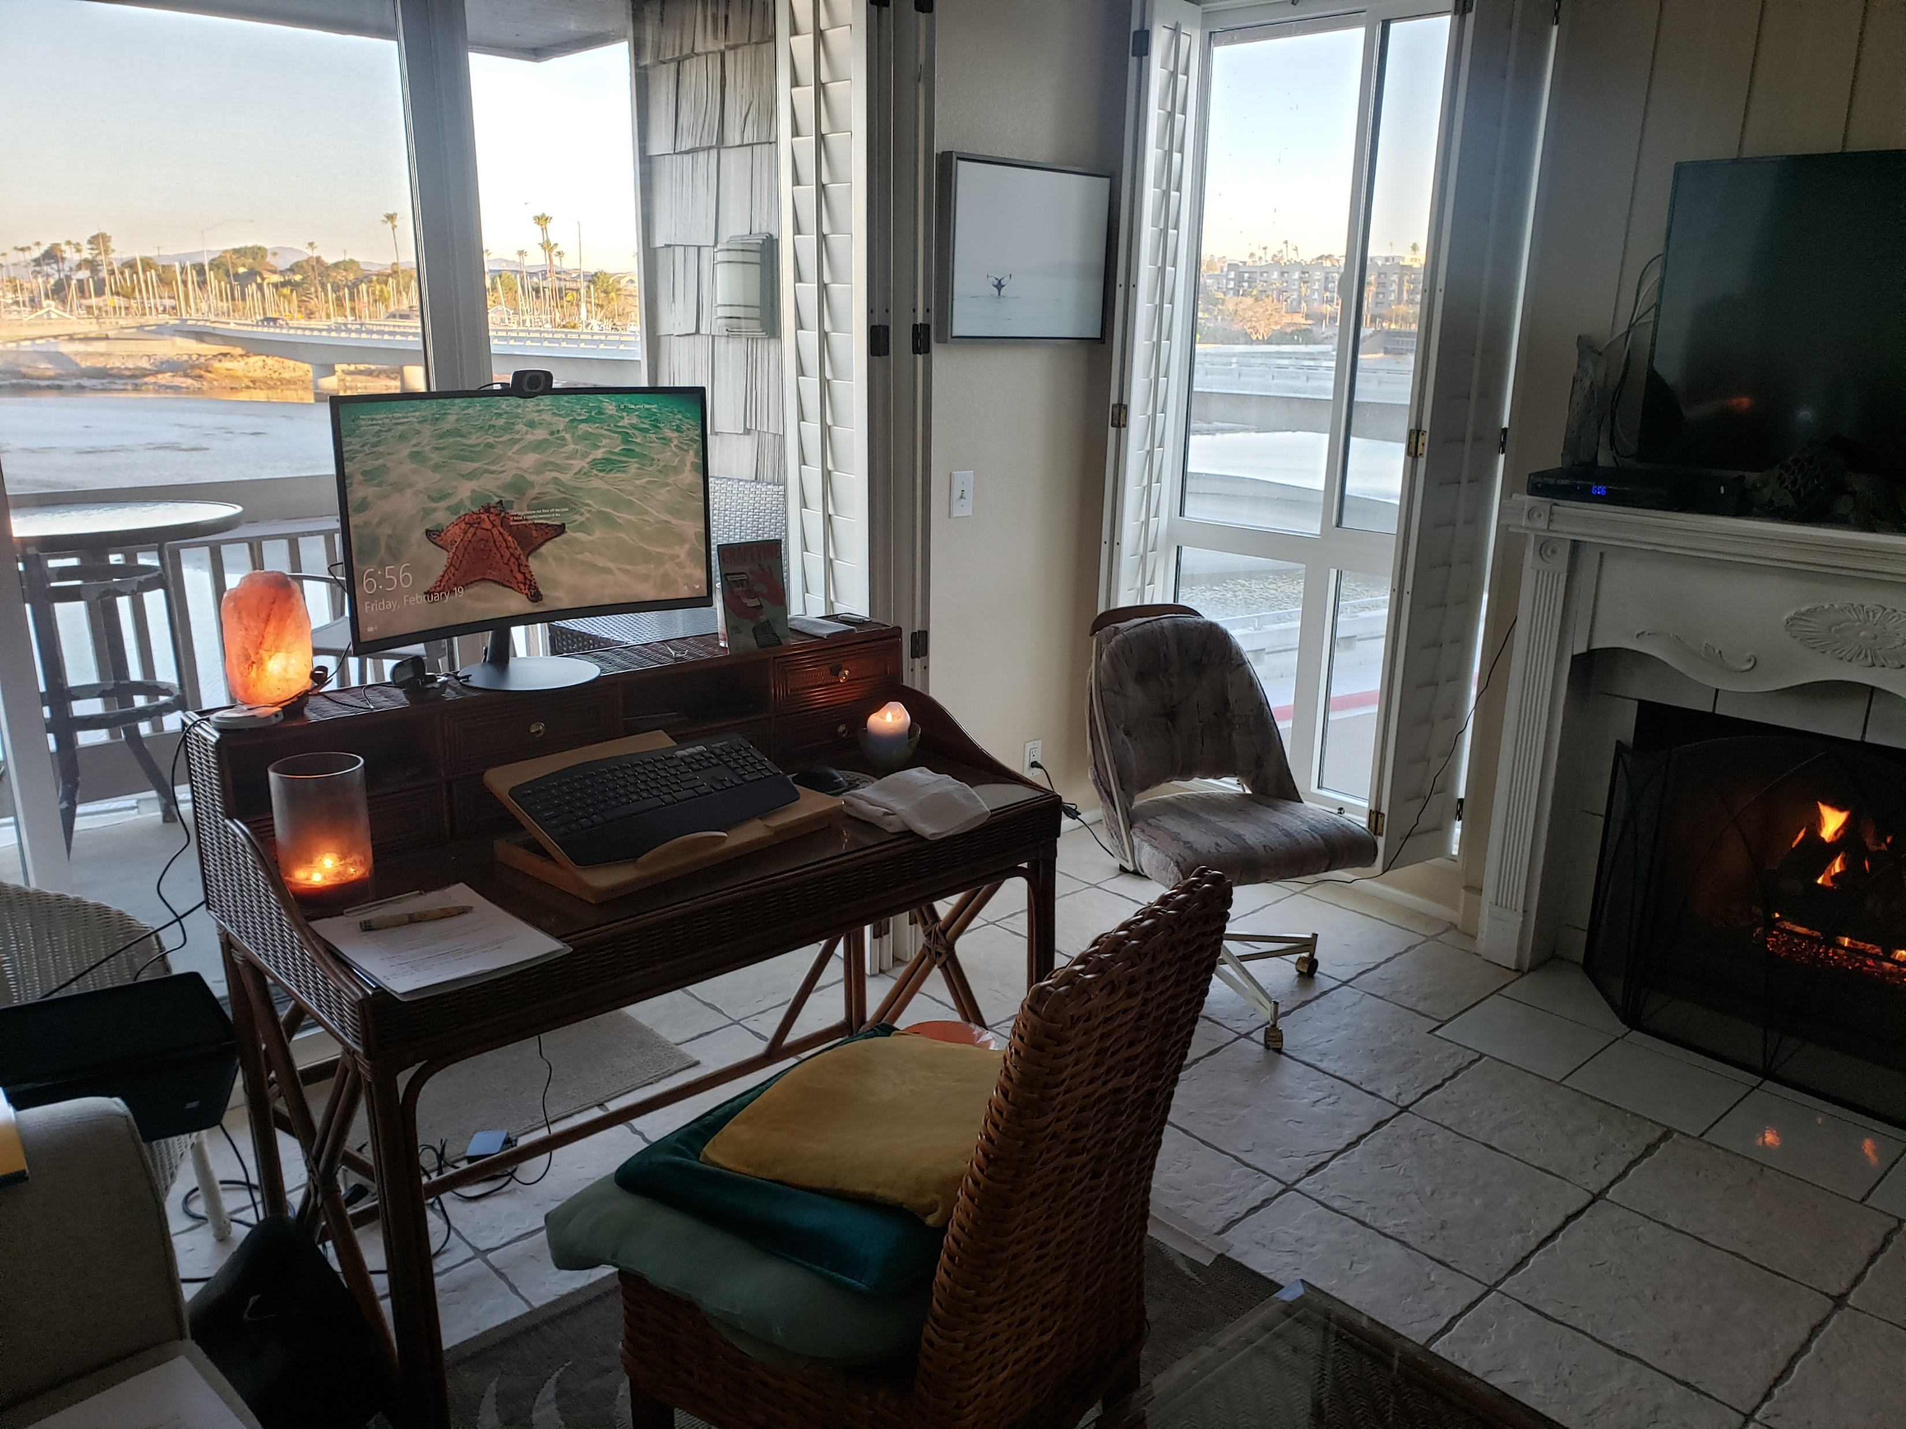
Summary Tables
Background Information
(2/16 to 2/25/2021):
44 hours summarizing
10 hrs tabulating
Spend as little or as much
time as You want to spend!

Slide 16
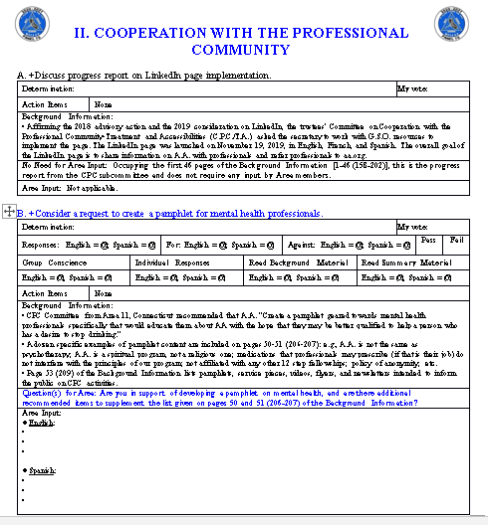
To Question or Not to Question
27 Agenda Items in Regular Font =
No opportunity for input
83 Agenda Items in Blue Font = Please provide input
ALL Agenda Items in Google Forms = Input

Slide 17
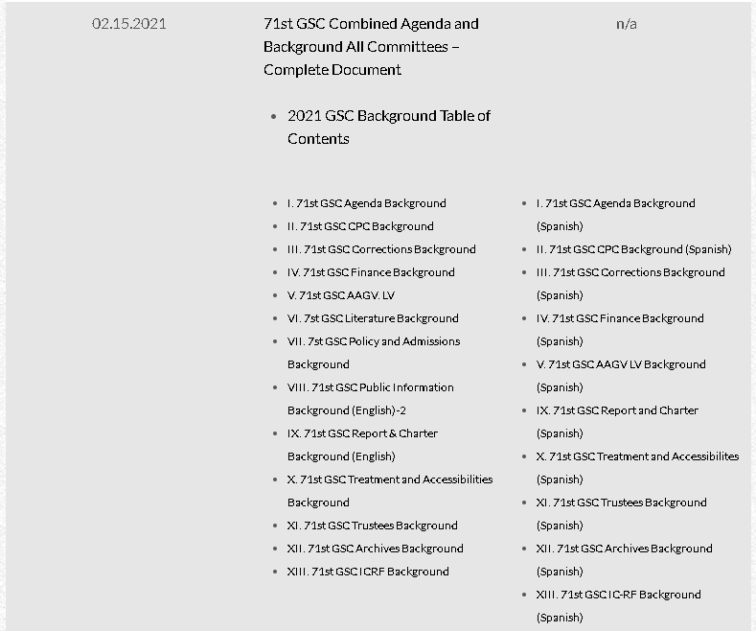
Multiple Page Numbers
1 file with everything
13 separate files
Summary Tables: Pages 1-438 (Pages 1-1,371)

Slide 18
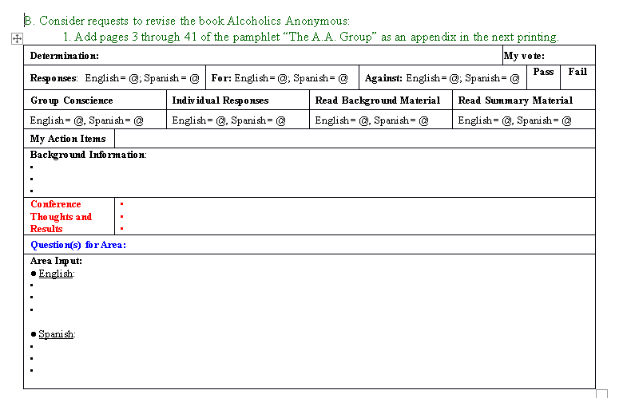
B. Consider requests to revise the book Alcoholics Anonymous:
2. Revise the first 164 pages.
Advisory Action, Additional Committee Consideration, Forwarded (2020)
Yes or No?
What do I (personally) need to read?
Background information summarized here
My notes during the Conference
Should we revise 164 pages of the Big Book? Why and How? Why Not?
https://www.dropbox.com/s/zi5l1g2e5xvadug/%24Master%20Summary%20Tables%20for%20Agenda%20Items.Final.2-24-2021.English.pdf?dl=0
Area input
captured here
https://www.dropbox.com/s/zr205ngvfghykmy/%24Master%20Summary%20Tables%20for%20Agenda%20Items.Final.2-24-2021.Spanish.pdf?dl=0

Slide 19
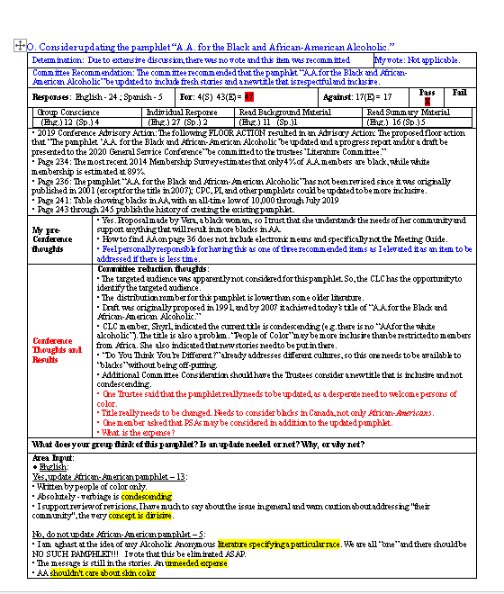
After the Conference
Conference Vote
MSCA 09
Input/Vote
Background
Notes: Before/During
Conference
Notes: Before/During
MSCA 09
Input

Slide 20
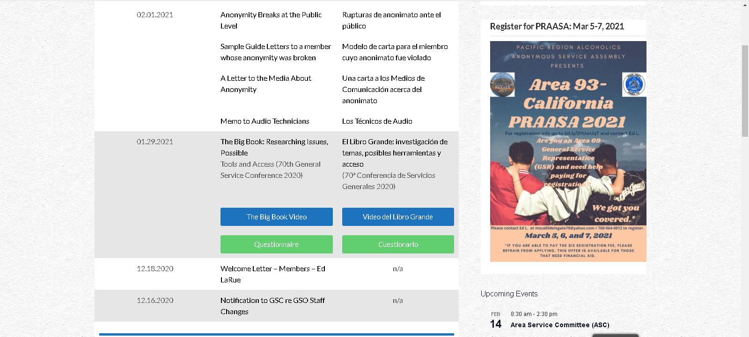
Accessing Google Forms

Slide 21
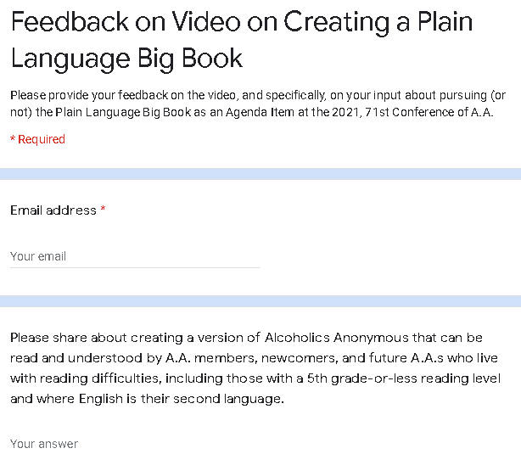
Google Forms
Current solicitation on Plain Language Big Book (Agenda Item U)
Yes/No okay, but
Why, Why Not is the Question!
https://vimeopro.com/user112910871/big-book-riptab/video/500617913
Input for every Agenda Item

Slide 22
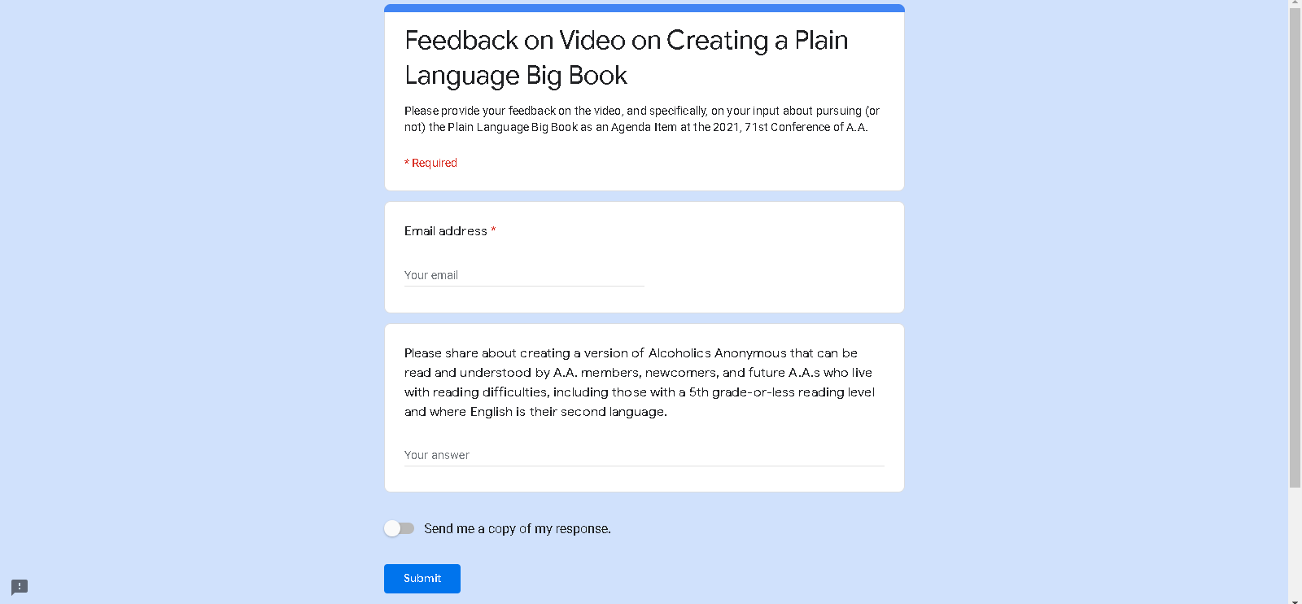
Completing Google Forms

Slide 23
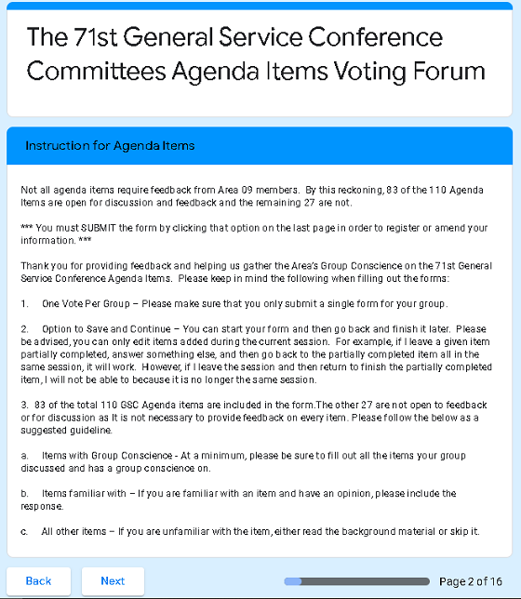
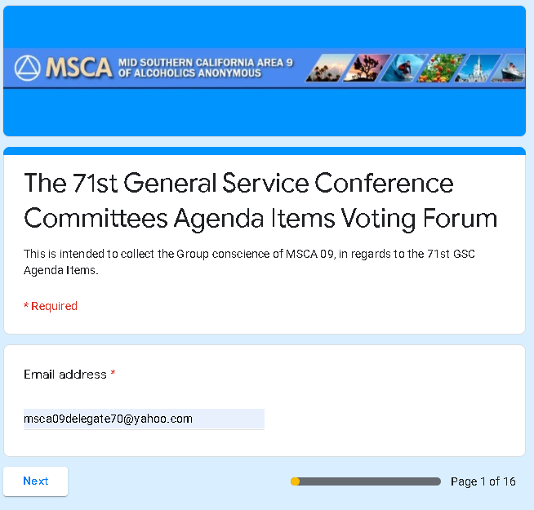
Google Forms
13 Committees
83 Agenda Items
where feedback will be useful

Slide 24
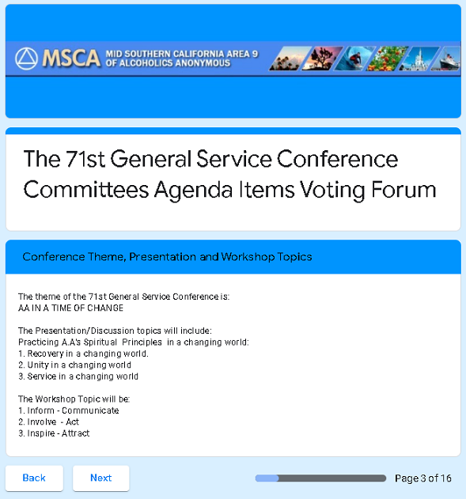

Slide 25
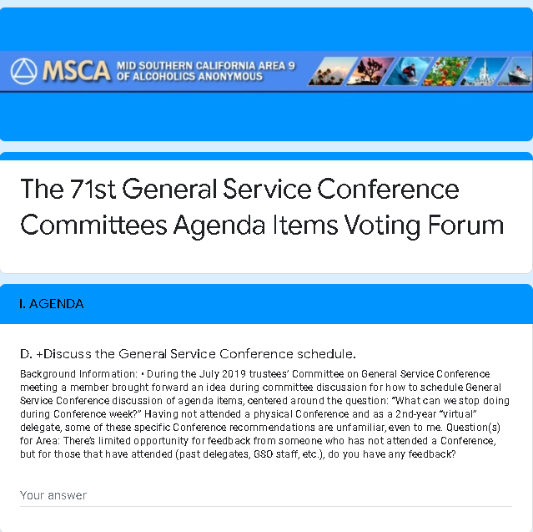
Why, Why Not!

Slide 26
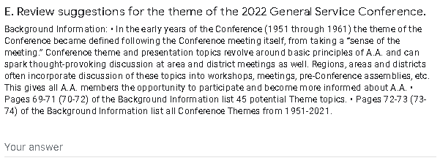
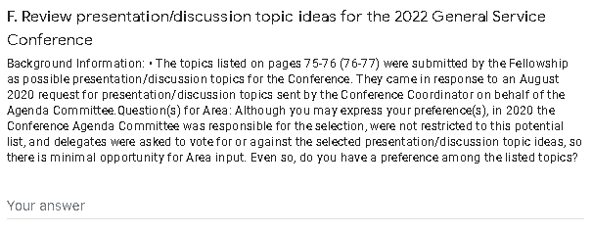
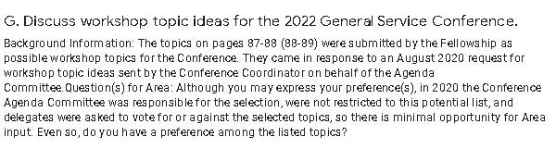
Scroll…
Scroll…

Slide 27
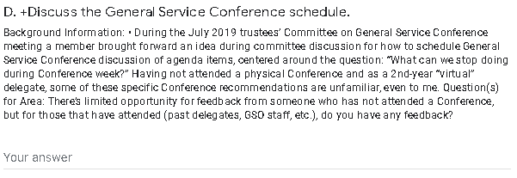
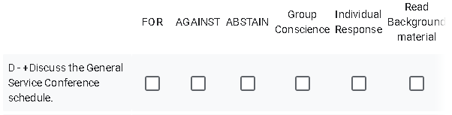
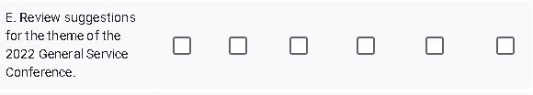
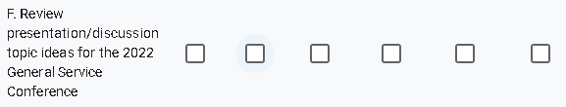

Why, Why Not!
Your preference: Why, Why Not!
Your preference: Why, Why Not!
Your preference: Why, Why Not!

Slide 28
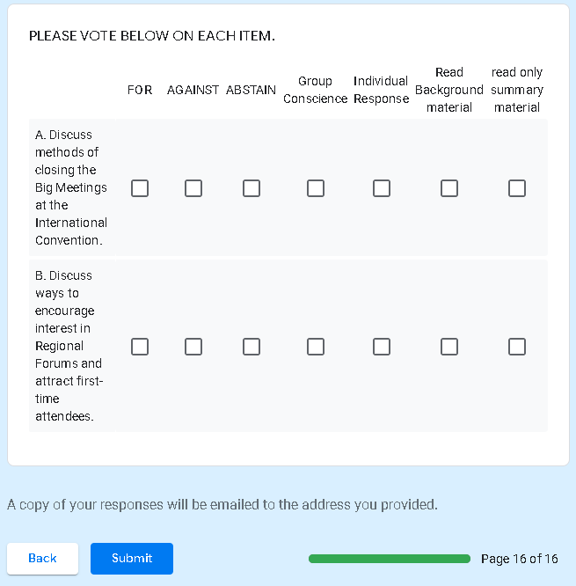

At the end of 13 Committees:

Slide 29
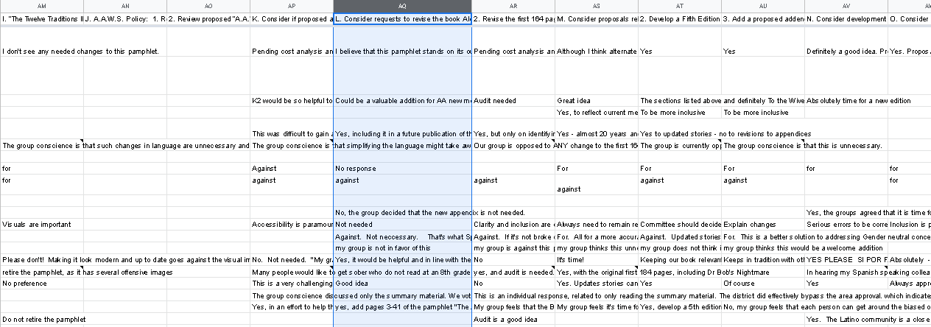
Automatically Uploaded to Excel

Slide 30
Preferences for Feedback:
Best = Google Forms Immediately uploaded Excel
Okay = Electronic Summary Tables Cut-and-paste
Least = Hardcopy Summary Tables Manual input
translations

Slide 31
Informed Group Conscience
March 20 – Districts host Pre-Conference Boot Camp
Have Google Forms ready, and vote during Boot Camp
April 5 – Deadline for feedback
April 11 – Area hosts Pre-Conference Workshop Roundtables, similar to Boot Camp format
Monthly – Hispanic Interdistrict Business Meetings with all 6 Districts – In Person!

Slide 32
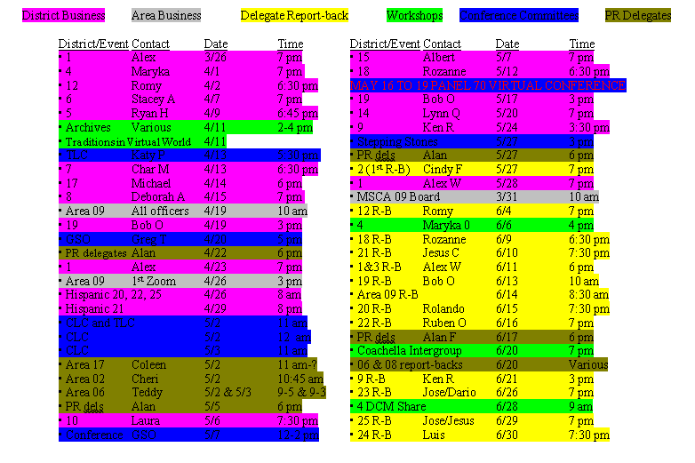
In 2020 General Service Colored My Life!

Slide 33
1st Virtual Viral COVID Conference
of the Pandemic Panel 70
Ed L, Mid-Southern California Area 09
Panel 70 delegate
msca09delegate70@yahoo.com
Cell: (760) 964-0012
Report-backs!
Report-backs!
https://www.dropbox.com/s/lnwd48lrrk1y2sx/%232020%20Report%20Back%20Brainstorm.Final.July%207%2C2020.pdf?dl=0

