Slide 1

Bobathon Grid Optimiser
Demand Spike Forecasting · Anomaly Detection · Operator Briefs with Bob AI
TEAM VRAM
15 SEPTEMBER 2026

Slide 2


The Problem: Grid Operators Are Flying Blind
Unpredictable Renewable Output
Sudden Demand Spikes
Rapid load changes strain the grid before operators can respond
Solar and wind variability creates gaps in supply that are hard to anticipate
Fragmented Signals
Telemetry, forecasts, and alerts live in separate systems — no unified view
Impact: Increased curtailment, load-shedding risk, and costly manual triage.

Slide 3

The Solution: End-to-End Pipeline
Raw grid telemetry flows through forecasting, anomaly detection, and optimization — then Bob AI generates a plain-language operator brief, all surfaced on a unified dashboard.
Anomaly Detection
Telemetry
Forecast
Optimiser
Bob AI Brief
Each stage builds on the last — from raw signal to operator-ready decision support.

Slide 4
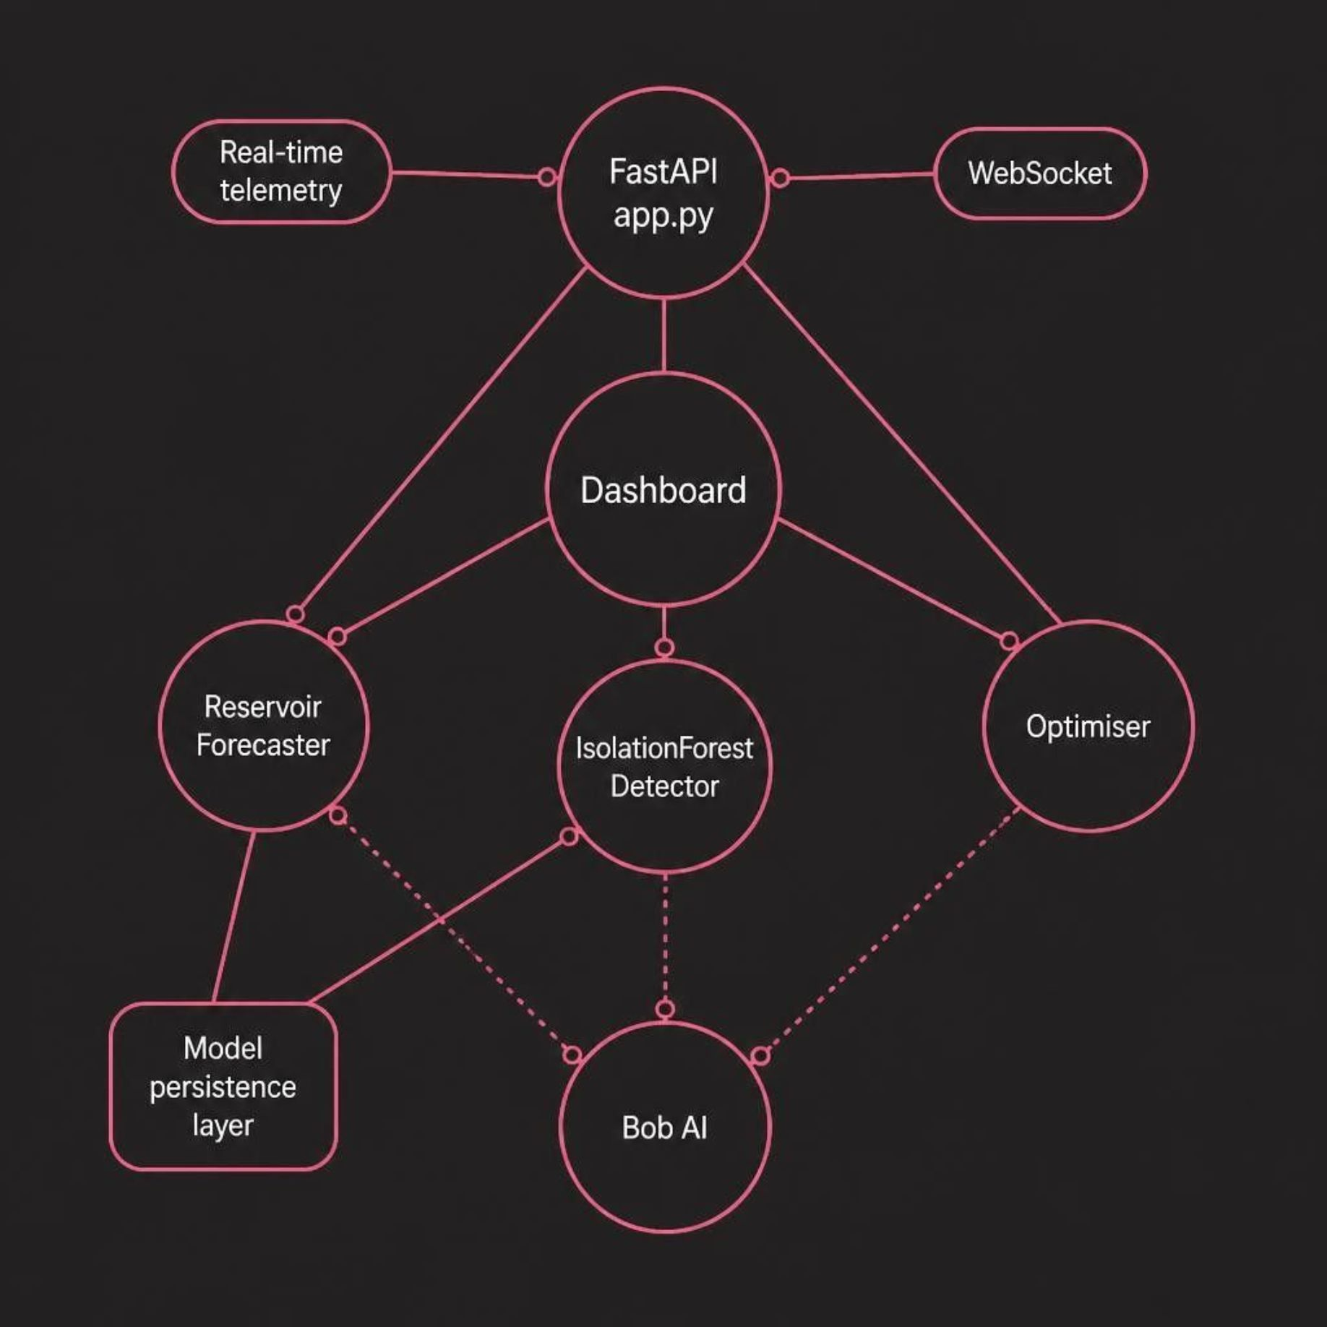

System Architecture
The pipeline is orchestrated through a FastAPI backend (app.py) that manages real-time telemetry via WebSocket, coordinates model inference, and persists trained models for low-latency serving.
Reservoir Forecaster
IsolationForest Detector
Bob AI Integration
Demand spike prediction from streaming telemetry
Unsupervised anomaly flagging on grid signals
bob_integration.py — briefs, fallbacks, diagnostics

Slide 5
Live Demo: Dashboard Walkthrough
Connect
1
Link real-time telemetry feed
Forecast
2
View predicted demand curve
Detect
3
Anomalies flagged automatically
Recommend
4
Optimizer suggests actions
Bob Brief
5
Plain-language operator summary

Slide 6
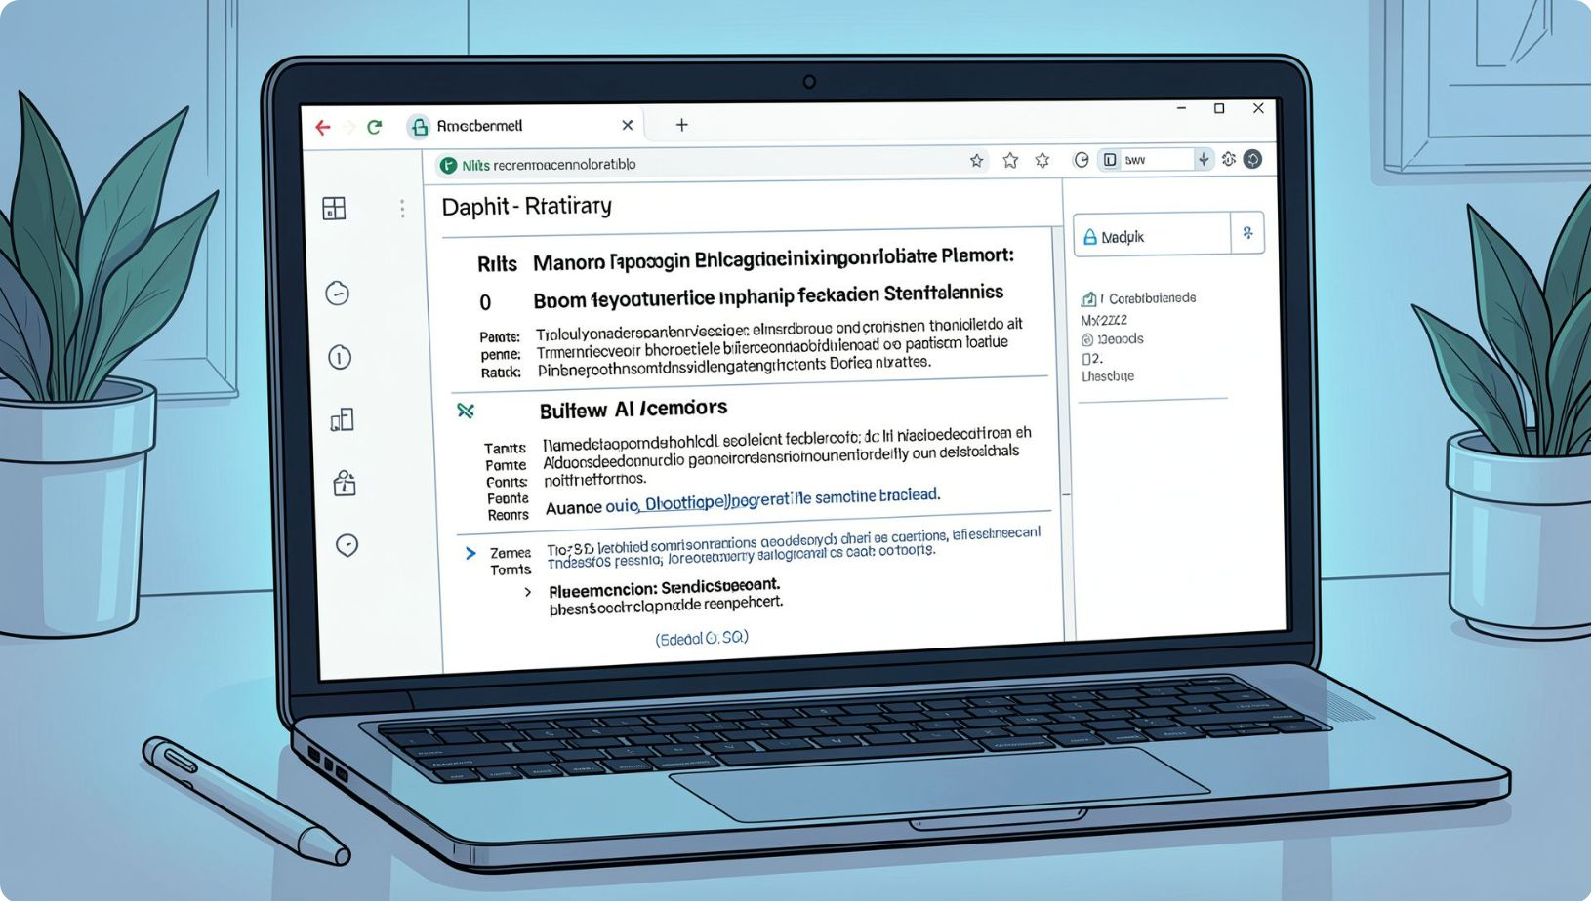

Bob AI: Operator Briefs That Explain Themselves
Bob AI translates model outputs into actionable operator briefs — explaining what happened, why it matters, and what to do next.
Contextual Explanations
Prioritized Actions
Resilient Integration
Briefs reference specific anomalies and forecast deviations
Recommendations ranked by urgency and impact
Fallback handling, diagnostics, and Cloudflare/API restriction management in bob_integration.py

Slide 7






Results & Impact
Forecast MAE
Note: Results are based on synthetic data. Real-world validation and safety constraints remain future work.
Evaluated on synthetic demand data to measure prediction accuracy
Inference Latency
End-to-end pipeline speed tested for real-time operator use
Anomaly Precision
IsolationForest evaluated for outlier detection quality
Faster Triage
Bob AI briefs reduce manual analysis time for operators
Reduced Curtailment
Forecasting enables proactive dispatch, lowering renewable curtailment potential

Slide 8

Team VRAM
Member 1 - Aastha Patel
Frontend & UI/UX
Member 2 - Meet K Patel
AI/ML & Forecasting
Member 3 - Ruchit Jivani
Anomaly Detection & Optimisation
Member 4 - Vaibhavi Bhatt
Bob AI & Backend
Forecast → Detect → Optimise → Explain
Thank You — Q&A

