Slide 1

Adhyayan NextGen Solutions Pvt. Ltd.
Internship Program Proposal
Empowering Students with Real-World Industry Experience
Presented by:
Adhyayan NextGen Solutions Pvt Ltd (An Industry-Oriented Software Solutions Company)
Company Details:
🌐 Website: www.adhyayan.online | www.angspl.com
📍 Location: Bhopal & Gurugram
📧 Email: info@adhyayan.online
📞 Contact: 9522933330
Proposal For:
Collaboration with Colleges/Institutes for Final Year & Pre-final Year Students (B.Tech CS/IT, BCA, MCA, M.Sc. IT/CS)

Slide 2
Adhyayan NextGen Solutions Pvt. Ltd.
Internship Overview
Duration: 60 Days
Mode: Online / Onsite
Eligibility: Final & Pre-final year
Certification: After Completion
Placement Support: Top performers offers job
Stipend: based on good performance

Slide 3
Adhyayan NextGen Solutions Pvt. Ltd.
Why Join the Program?
Work on Live Industry Projects
Learn UI, API, Database, DevOps, Cloud
Mentoring by industry experts
Job offers for top performers
Earn certificates
No fee for qualifying students

Slide 4
Adhyayan NextGen Solutions Pvt. Ltd.
Internship Phases
Phase 1 (Week 1-2): Orientation & Training
Phase 2 (Week 3-7): Live Projects
Phase 3 (Week 8): Evaluation & Certification
Notes:
-

Slide 5
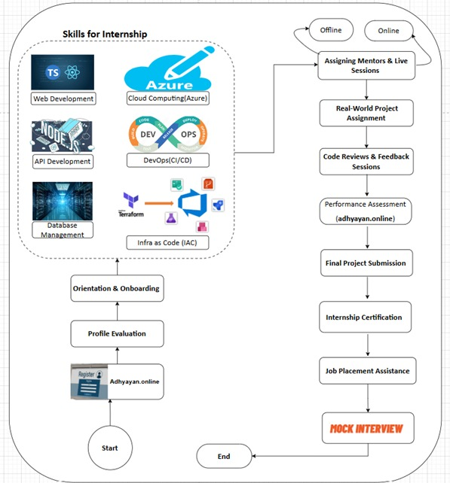
Adhyayan NextGen Solutions Pvt. Ltd.

Slide 6
Adhyayan NextGen Solutions Pvt. Ltd.
Technology Stack
UI: React.js, N TypeScript, CSS,
API: Node.js, .NET Core, C#
Database: PostgreSQL, MS SQL
DevOps: Azure DevOps, Docker, Kubernetes
Cloud: Microsoft Azure, AWS

Slide 7
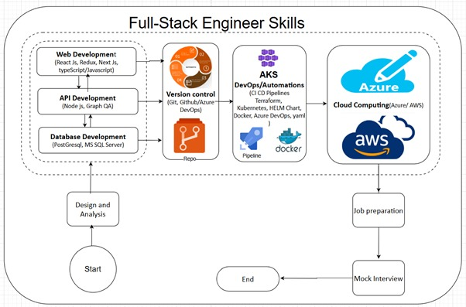
Adhyayan NextGen Solutions Pvt. Ltd.

Slide 8
Adhyayan NextGen Solutions Pvt. Ltd.
College Collaboration

Slide 9
Adhyayan NextGen Solutions Pvt. Ltd.
Let’s Connect!
info@adhyayan.online
9522933330
Schedule a meeting to discuss further

Slide 10

Adhyayan NextGen Solutions Pvt. Ltd.
Thank You

