Slide 1

Adhyayan NextGen Solutions Pvt. Ltd.
Expertise: Website & Software Development, Cloud Solutions, Cybersecurity
Office locations:
Head Office: Gurugram, Delhi
Branch Office: Neelbad, Bhopal
Services: School ERP |Inventory| CRM Software | Website & App Development

Slide 2


Adhyayan NextGen Solutions Pvt. Ltd.
Product overview
RE
Affiliate- Referrals
Affiliate- Analytical report
Admin- Review Affiliates
Admin- Referrals Report

Slide 3
Adhyayan NextGen Solutions Pvt. Ltd.
Why Choose Us?
Decades Of Experience In IT Solutions
Latest Technology and Tech Trends
Customize Solutions & User friendly
Consistent Update And Maintenance Services
Cloud Based ERP Software Services

Slide 4
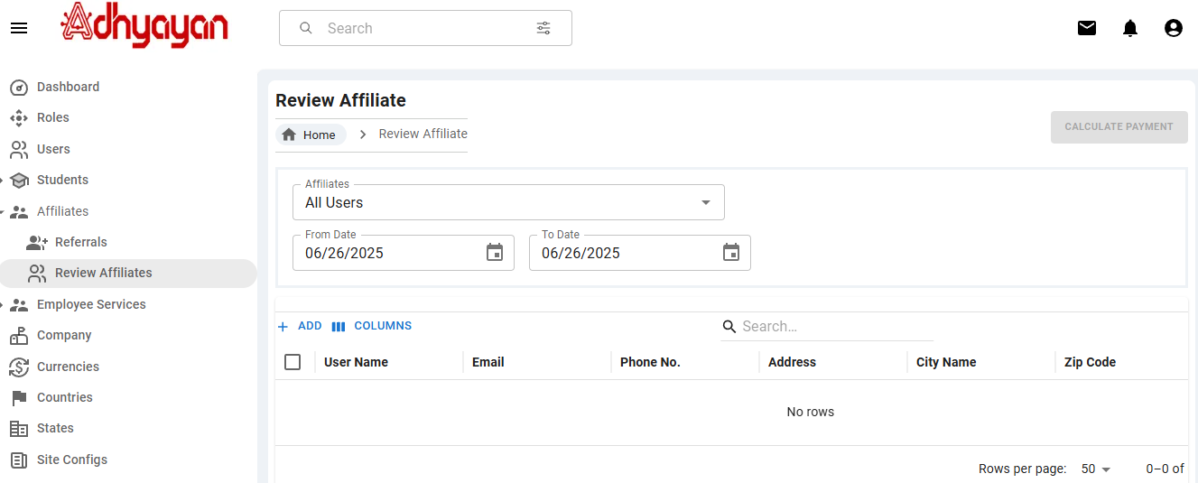
Adhyayan NextGen Solutions Pvt. Ltd.
Admin Review Affiliates

Slide 5
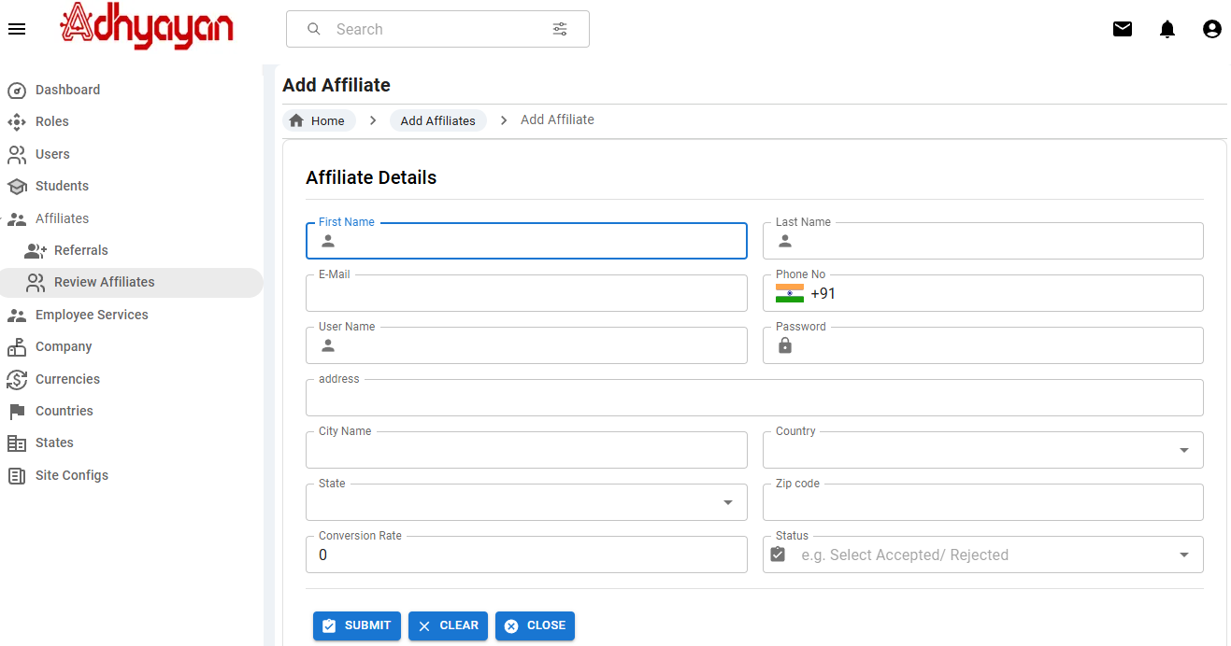
Adhyayan NextGen Solutions Pvt. Ltd.
Add Affiliates

Slide 6
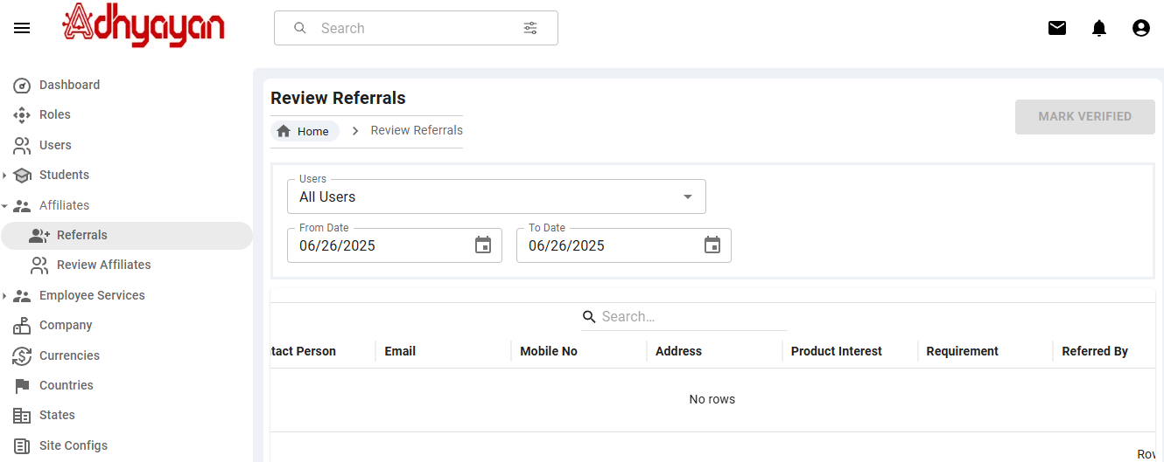
Adhyayan NextGen Solutions Pvt. Ltd.
Admin-Referrals Report

Slide 7
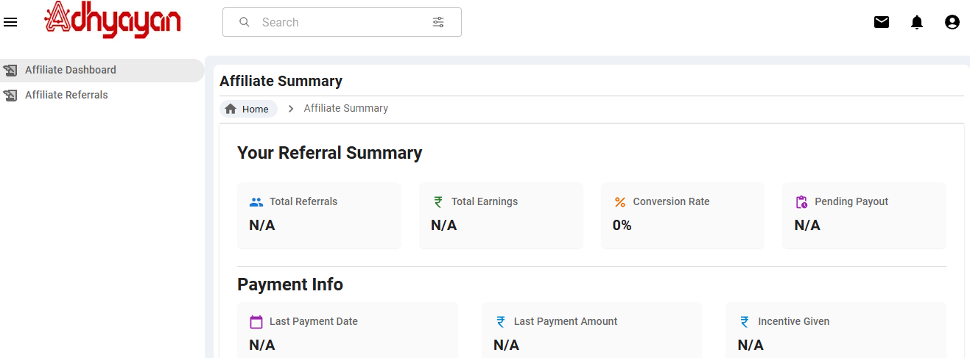
Adhyayan NextGen Solutions Pvt. Ltd.
Affiliate Dashboard

Slide 8
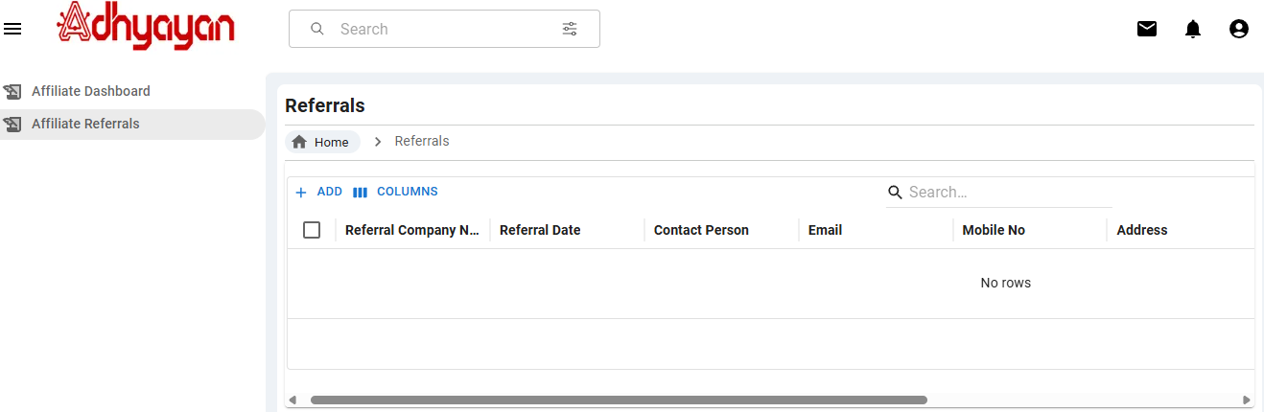
Adhyayan NextGen Solutions Pvt. Ltd.
Affiliate-Referrals

Slide 9
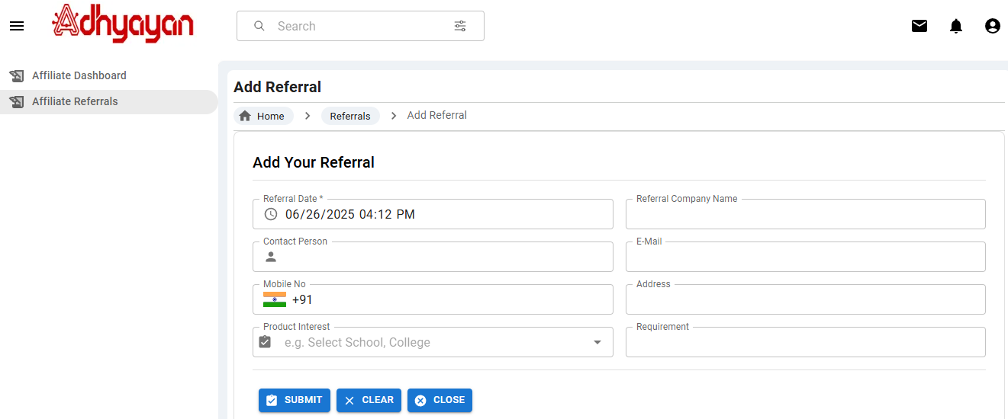
Adhyayan NextGen Solutions Pvt. Ltd.
Add Referrals

Slide 10
T
Adhyayan NextGen Solutions Pvt. Ltd.
Thank You

