Slide 1

Adhyayan NextGen Solutions Pvt. Ltd.
Expertise: Website & Software Development, Cloud Solutions, Cybersecurity
Service: School ERP |Inventory| CRM Software | Website & App Development
Office locations:
Head Office: Gurugram, Haryana
Branch Office: Neelbad, Bhopal

Slide 2
Adhyayan NextGen Solutions Pvt. Ltd.
Why Choose Us?
Decades Of Experience In IT Solutions
Latest Technology and Tech Trends
Customize Solutions
Consistent Update And Maintenance Services
Cloud Based ERP Software Services

Slide 3


Adhyayan NextGen Solutions Pvt. Ltd.
Product overview
Online Notes
Online test
Course Purchase
Video Lectures

Slide 4
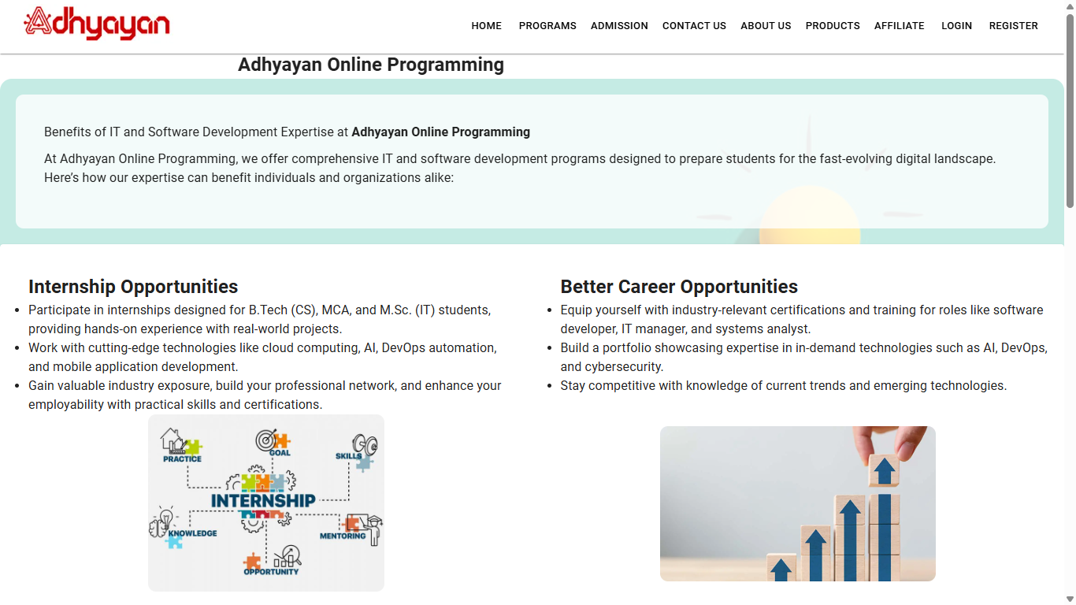
Adhyayan NextGen Solutions Pvt. Ltd.
Dynamic Website Features

Slide 5
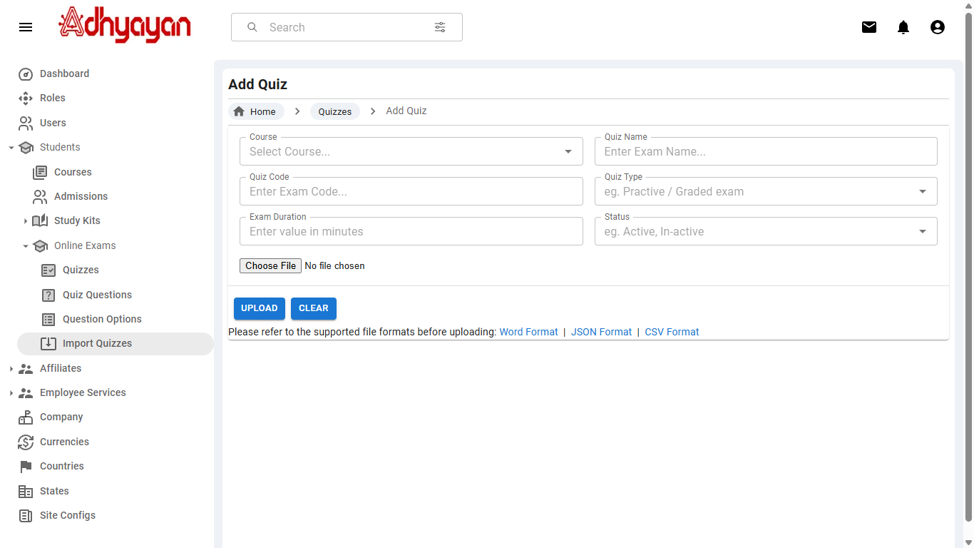
Adhyayan NextGen Solutions Pvt. Ltd.
Admin Dashboard-Upload Test

Slide 6
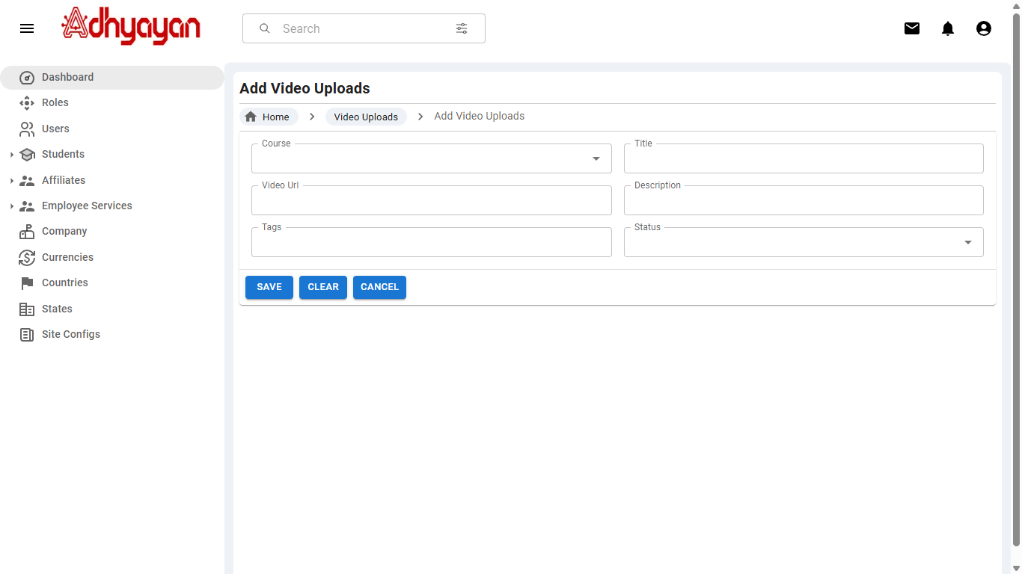
Adhyayan NextGen Solutions Pvt. Ltd.
Admin Dashboard-Upload videos

Slide 7
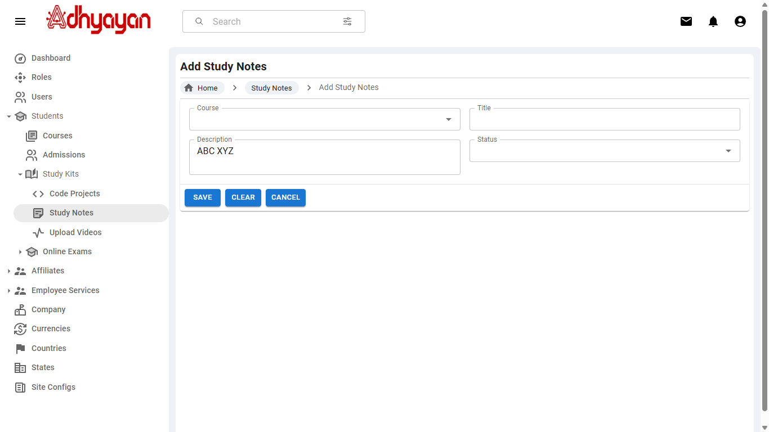
Adhyayan NextGen Solutions Pvt. Ltd.
Admin Dashboard-Upload Notes

Slide 8
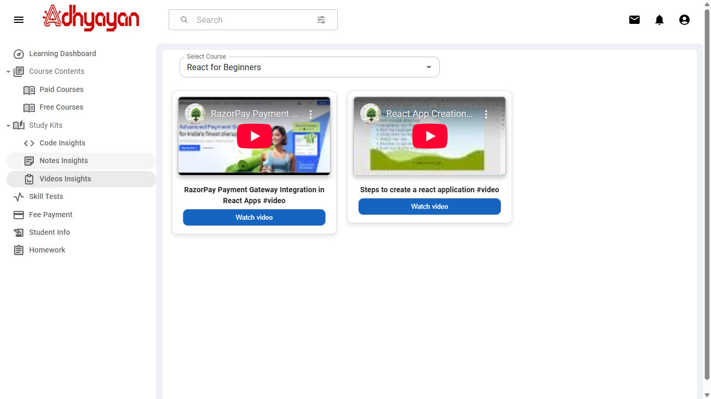
Adhyayan NextGen Solutions Pvt. Ltd.
Student Dashboard Features

Slide 9
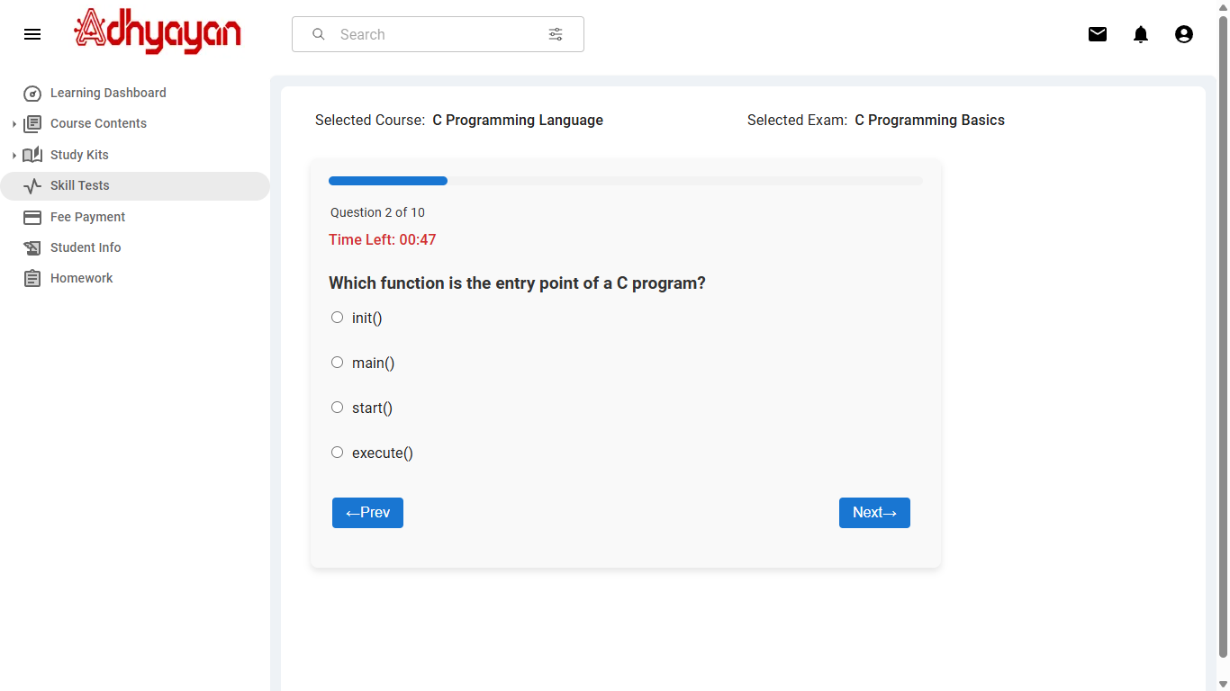
Adhyayan NextGen Solutions Pvt. Ltd.
Online Test

Slide 10
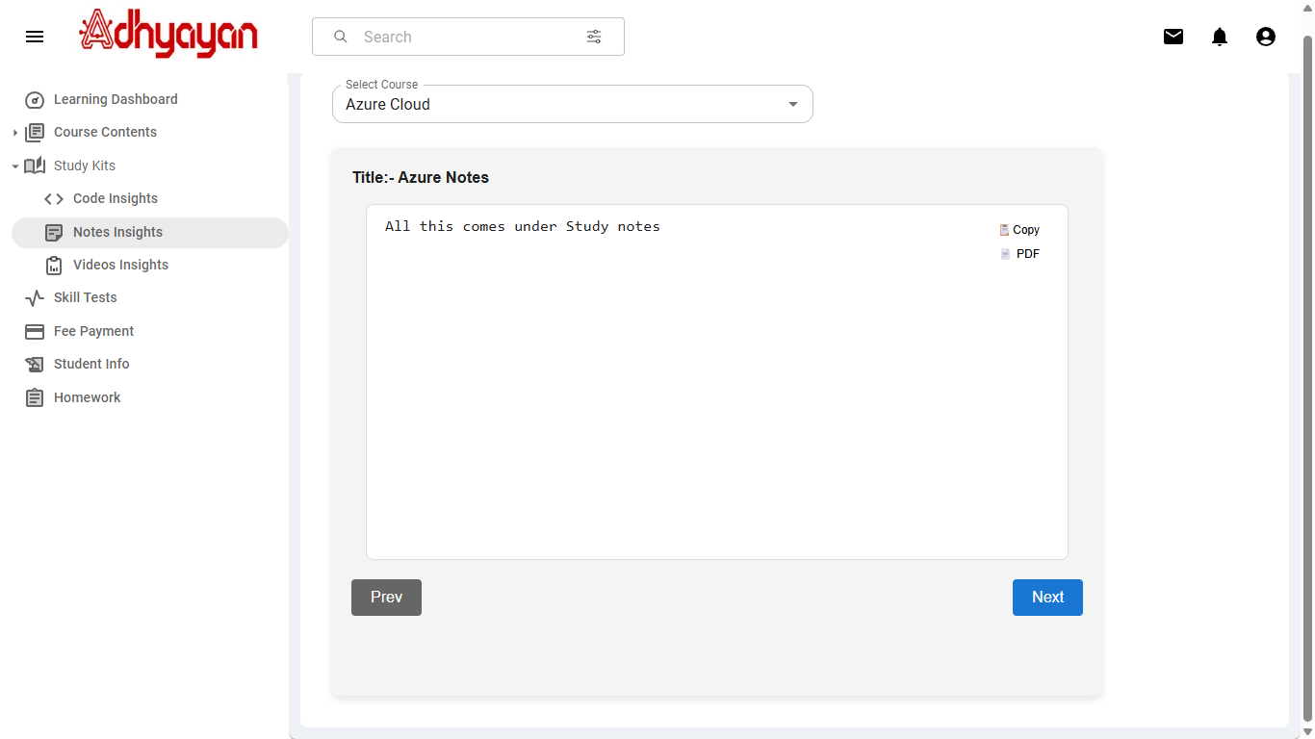
Adhyayan NextGen Solutions Pvt. Ltd.
Study Material Notes

Slide 11
Adhyayan NextGen Solutions Pvt. Ltd.
Thank You

