Slide 1
3/14 SWPP 실습
Python, Apache, Django 설치

Slide 2
Python 및 기본 라이브러리 설치
sudo apt-get install python3
sudo apt-get install python3-dev
sudo apt-get install python3-pip
sudo apt-get install libmemcached-dev zlib1g-dev libssl-dev
sudo apt-get install zlibc
sudo apt-get install libpcre3-dev

Slide 3
Apache 설치(apr-1.5.2)
Apache http://apr.apache.org/download.cgi 다운로드 링크
Unix source apr-1.5.2.tar.gz 링크 주소 복사
wget ctrl +v
tar zxvf apr-1.5.2.tar.gz
cd apr-1.5.2
./configure
Error : “rm –rf:cannot remove libtool” 시 cp -arp libtool libtoolT
make
sudo make install

Slide 4
Apache 설치(apr-util-1.5.4)
Unix source apr-util-1.5.4.tar.gz 링크 주소 복사
cd ..
wget ctrl+v
tar zxvf apr-util-1.5.4.tar.gz
cd apr-util-1.5.4
./configure --with-apr=/usr/local/apr
make
sudo make install

Slide 5
Apache 설치(httpd-2.4.25)
http://httpd.apache.org/download.cgi
Source : httpd-2.4.25.tar.gz 링크 복사
cd ..
wget ctrl+v
tar zxvf httpd-2.4.25.tar.gz
cd httpd-2.4.25
./configure -with-apr=/usr/local/apr
make
sudo make install

Slide 6
Mod_wsgi 설치
https://github.com/GrahamDumpleton/mod_wsgi/releases
source code tar.gz 링크 주소 복사
cd ..
wget ctrl +v
tar zxvf 4.5.15.tar.gz
cd mod_wsgi-4.5.15
./configure --with-apxs=/usr/local/apache/bin/apxs –with-python=/usr/local/bin/python
파이썬 경로가 달라서 위의 명령어가 안 될 시
./configure --with-apxs=/usr/local/apache/bin/apxs –with-python=/usr/bin/python3
make
sudo make install

Slide 7
Django 설치
cd ..
sudo install git
git clone git://github.com/django/django.git
pip3 install –e django
python3 –m django --version 으로 확인!
django-admin startproject mysite
cd mysite
python3 manage.py migrate
python3 manage.py runserver
https://docs.djangoproject.com/en/1.10/intro/tutorial01/

Slide 8
AWS 사용시 접속방법
Elastic ip 가 A.B.C.D이면 : A.B.C.D:8000 으로 웹브라우저에서접속
python manage.py runserver 0.0.0.0:8000
settings.py - “ALLOW_… = [‘A.B.C.D’]”

Slide 9
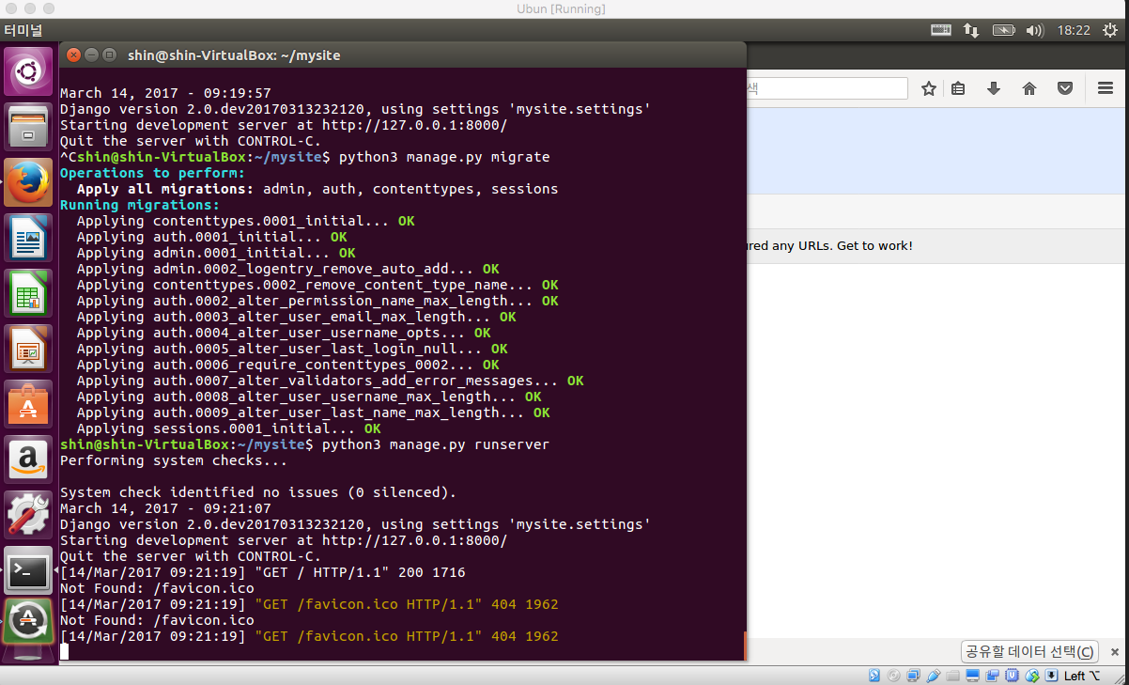
완료 화면

Slide 10
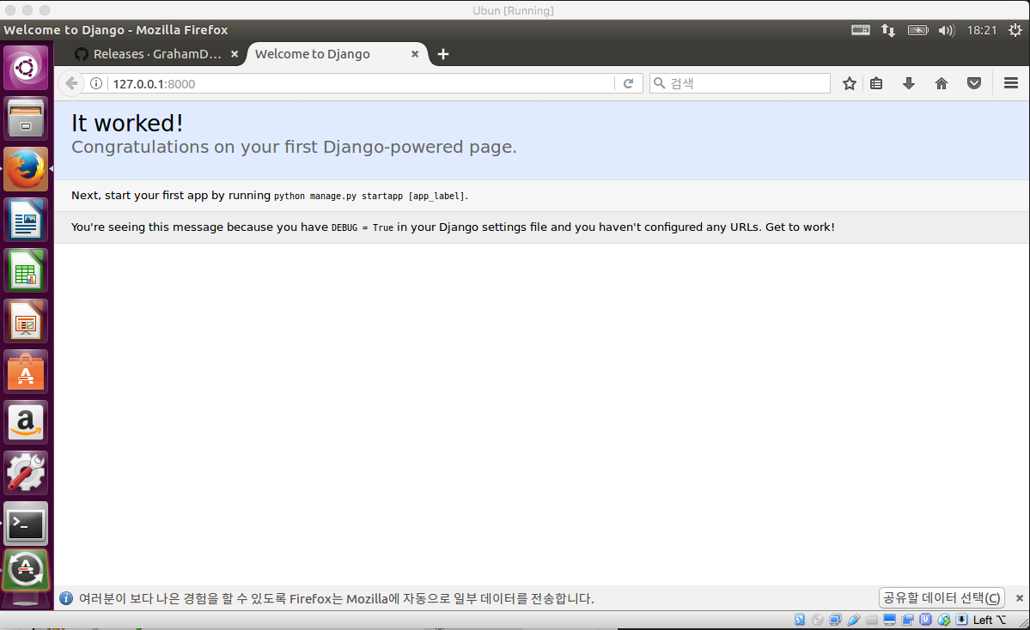
완료 화면

