Slide 1
IOT BASED HOME AUTOMATION
Name : SANJAIKUMAR.

Slide 2
REQUIREMENTS
C programming.
Arduino ide.
Pic sim lab simulator.
Blynk iot app.

Slide 3
ABSTRACT
The concept of home automation using IoT has gained popularity in recent years due to its ability to provide convenience, comfort, and energy efficiency. This presentation explores the use of an LDR sensor for garden light control, LED lights, temperature system, CLCD I2C display, PIC sim simulator for Arduino Uno, Ethernet shield, and Blynk IoT mobile app in creating a smart home system.
The use of C programming language is also discussed, as it is essential for programming the microcontrollers that control the devices in the home automation system. This presentation serves as an introduction to the technologies and concepts involved in creating a smart home system using IoT devices.

Slide 4
What is IoT?
IoT stands for the Internet of Things and refers to the network of physical devices, vehicles, home appliances, and other items that are embedded with sensors, software, and connectivity.
IOT devices can be controlled remotely and communicate with each other.

Slide 5
How does IoT Home Automation work?
IoT Home Automation works by using sensors to detect changes in the environment and micro controllers to process that information and control other devices.
Communication technologies such as Ethernet and Wi-Fi are used to connect these devices to the Internet, allowing them to be controlled remotely.

Slide 6
LDR Sensor for Garden Light Control
An LDR (Light Dependent Resistor) sensor is a type of photoresistor that can detect changes in light levels.
This sensor can be used to control garden lights, turning them on and off depending on the ambient light levels.
The LDR sensor can be connected to an Arduino Uno microcontroller, which can then control the garden lights through a present of sun light .

Slide 7
LED Lights
LED (Light Emitting Diode) lights are energy-efficient and long-lasting light sources.
They can be used for home automation, providing both functional and decorative lighting.
LED lights can be controlled using an Arduino Uno microcontroller, which can turn them on and off and adjust their brightness depend on LDR sensor .

Slide 8
Temperature System
A temperature system can be used to control heating and cooling systems in a home.
Temperature sensors can be used to detect changes in temperature, and an Arduino Uno microcontroller can then control a thermostat to maintain a desired temperature.
This can save energy and provide greater comfort and convenience.

Slide 9
CLCD I2C Display
A CLCD (Character Liquid Crystal Display) I2C display is a type of LCD screen that can display characters and graphics.
This type of display can be used to display information about the home automation system, such as temperature readings, light levels, and system status.
The display can be connected to an Arduino Uno microcontroller using the I2C communication protocol.

Slide 10
Ethernet Shield
An Ethernet shield is an add-on board for the Arduino Uno microcontroller that provides Ethernet connectivity.
This allows the Arduino Uno to connect to the Internet and communicate with other devices and services.
The Ethernet shield can be used to control the home automation system remotely using the Blynk IoT mobile app.

Slide 11
Serial Tank for Water Volume Checking and control inlet and outlet
A serial tank is a type of water tank that can be used to check the water volume in a tank.
The tank is equipped with a sensor that can detect changes in water level, and an Arduino Uno microcontroller can be used to process this information.
The microcontroller can then communicate the water level data to a remote device using a serial communication protocol such as UART.

Slide 12
About C Programming
C is a programming language that is widely used for embedded systems and microcontrollers.
Basic concepts include variables, data types, operators, and control structures.
Pointers and functions .

Slide 13
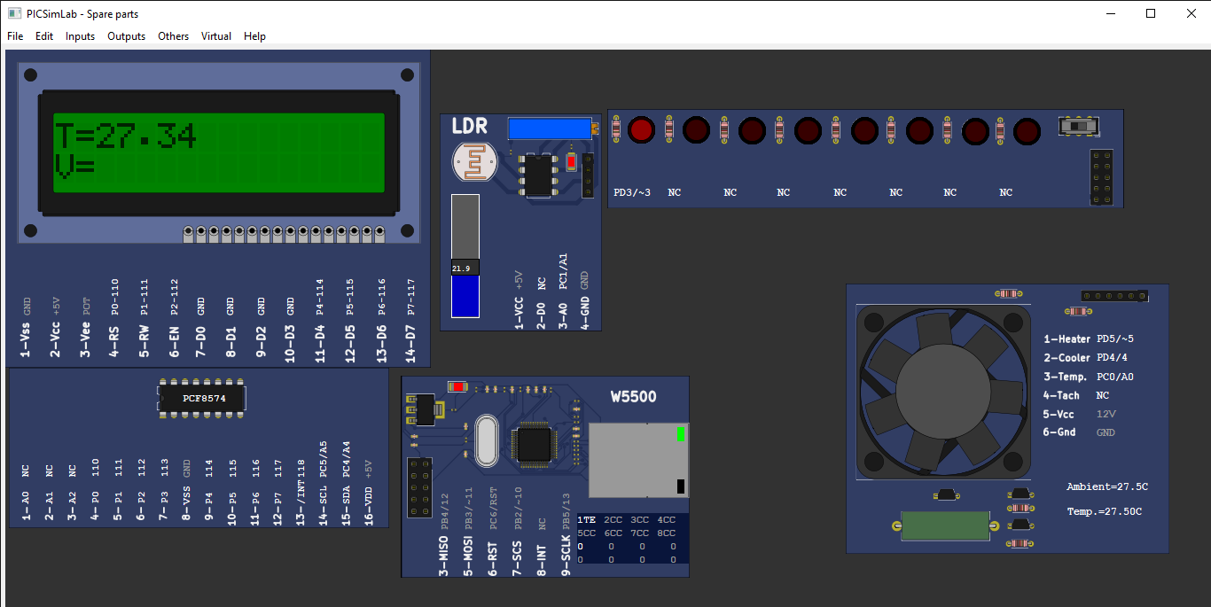
Include data in table and graphical form

Slide 14
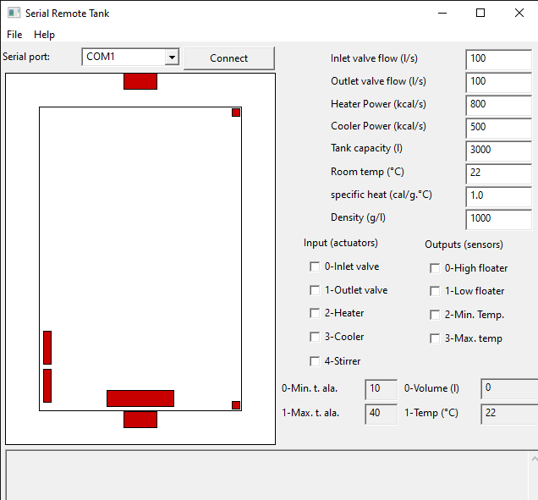
Sample serial tank
Include data in table and graphical form

Slide 15
CONCLUSION
Home automation using IoT is a rapidly growing field that offers many benefits, including convenience, comfort, energy efficiency, and increased security.
The use of sensors, microcontrollers, and communication protocols such as Ethernet and Wi-Fi enables devices to work together seamlessly to create a smart home system.

Slide 16
THANK YOU

