Slide 1
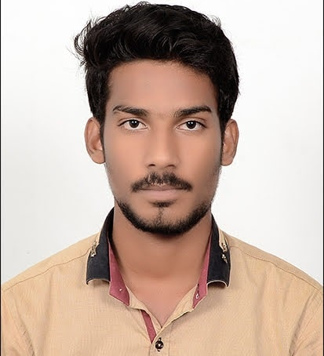
Manoj Kumar Kotte
Analyst/Software Engineer
Bachelor of Engineering
Electrical & Electronics : 2018 - 2021
Skills
Bengaluru
Java 8 /J2EE | Java Basics, OOPS, Generics, Collections, Arrays, Loops, Lambda Exp, Stream API Junit, Mockito.
Spring core | IOC & Dependency Injection, Autowire
Spring REST | REST controllers, Implementation of GET, POST, PUT & DELETE, Bean Validation & Exception Handling, Testing Services, Controller & Repository layer
Spring Boot | Spring Boot , annotations.
Database | Pg-Admin
Angular | Components, Services, Modules, Routing, Forms & Validation.
Add On skills | Communications, Team management. Peer learning
UI Tech | HTML 5 & CSS 3,JavaScript, ES6 & TypeScript Reusable templates, Optimized UI Designed
Tools | Git, Postman, Maven, IDE
manoj.kumar-kotte@capgemini.com
+91 9182243145
A4
Full Stack Developer
Hands on experience in creating microservices with Spring boot, Spring Cloud API Gateway, Eureka server.
Proficient in creating Single page Web Application in Angular with Angular reactive forms, angular routing, CSS.
Hands on experience in implementing unit testing using Junit in spring boot .
Agriculture Crop System Application
I have implemented end to end case study of the basic Agriculture Crop System Application along with backend testing using responsive UI with CSS and Angular used for user interface.

