Slide 1
Unify: All Access Key
Arijus Trakymas Sharva Darpan Thakur
Russel Tjahjadi Mohammad Zaid

Slide 2
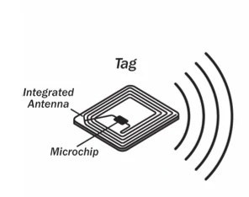
Overview
Unify is an application that gives you access to different entertainment, lifestyle, and other experiences using an RFID card which is the key to the places that you love such as the gym, grocery store, etc.
The app allows you to purchase experiences that you want, the card then becomes your key to those experiences.
It also has a social component where you can chat with people that are apart of the same communities.

Slide 3
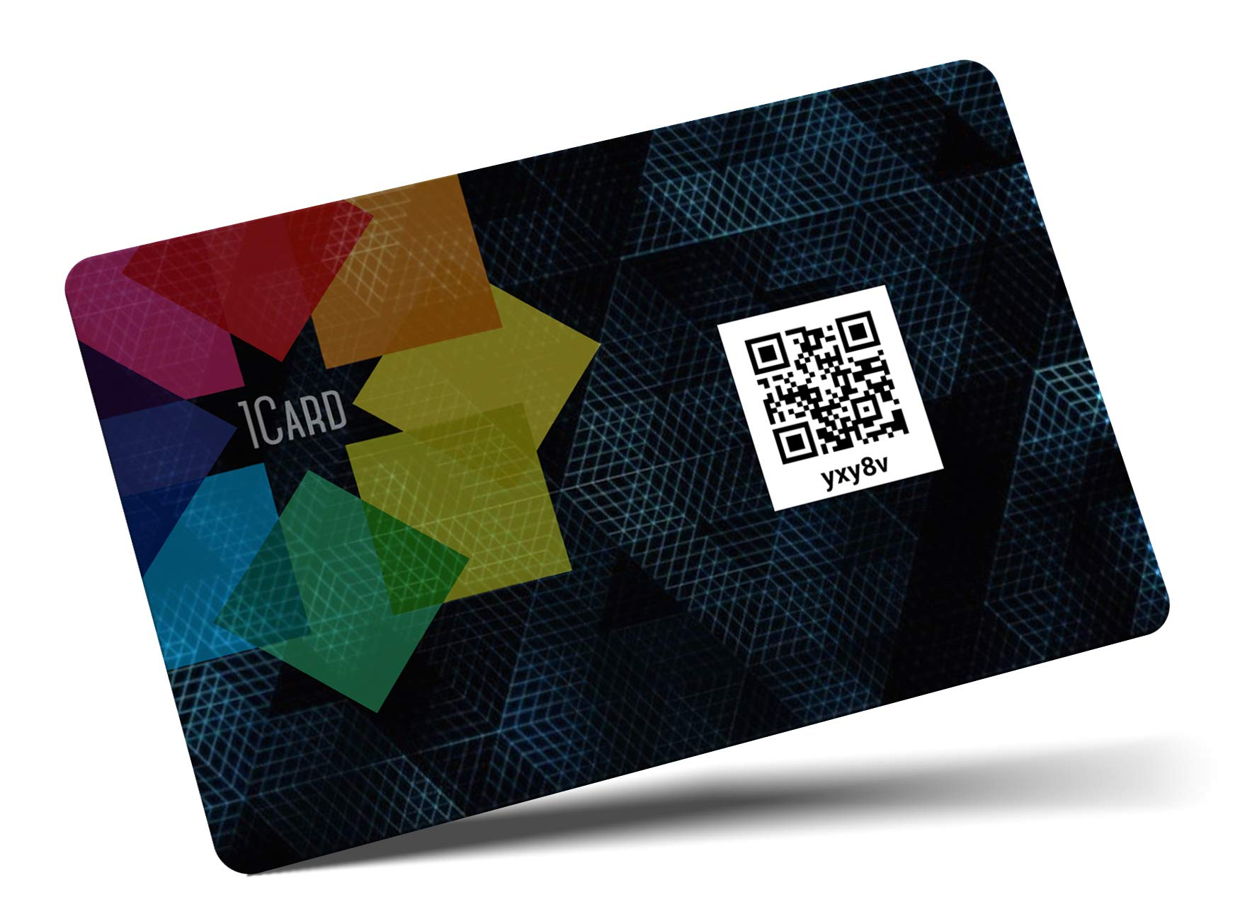
Users
The first group of users would be the actual people using the software with the app. They would use the application and card in their daily lives to simplify and make their life more hassle free and convenient.
The second group of users would be businesses that are providing experiences and/or memberships through the software with the app. Users can then purchase those experiences.

Slide 4
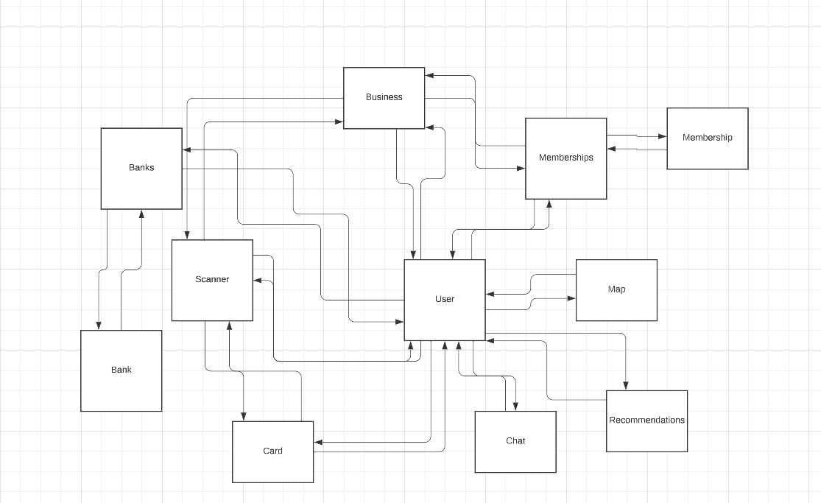
UML

Slide 5
Requirements
The user’s information must be encrypted since they are inputting their bank information.
The system shall also store the location records because there are only certain places that will use the Unify key cards as access entries.
The application will prevent fraud/unverified businesses from selling their services.
The app should not go down for longer than 60 minutes.

Slide 6
System Architecture
Proposed system architecture would be client-server for sending and receiving data.
Centralized server would contain user data.
User data is primarily account details and memberships / passes.

Slide 7
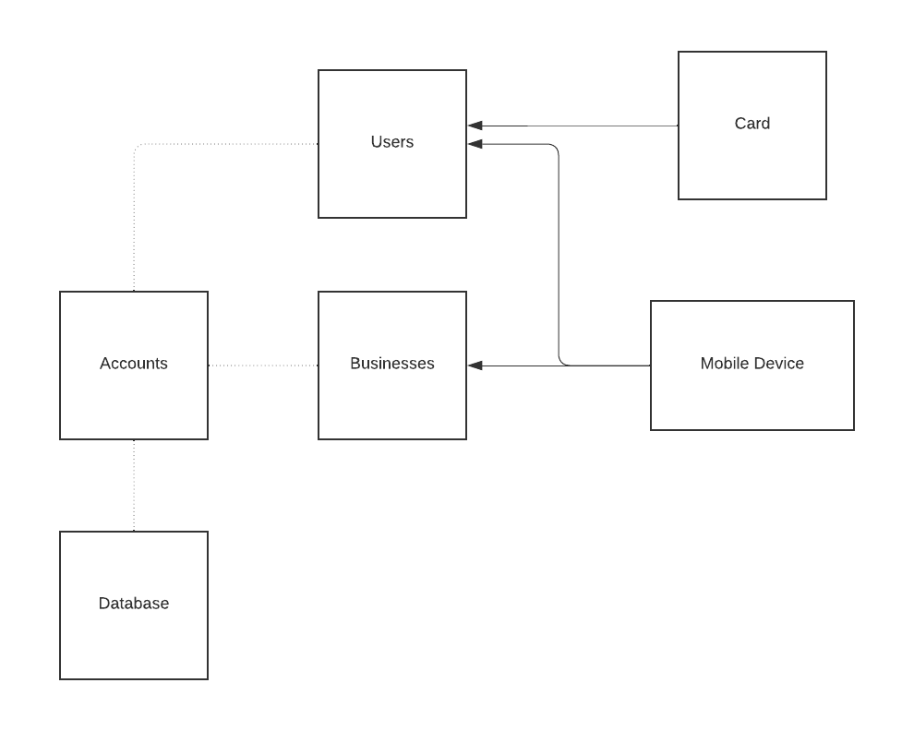
Hardware / Software Mapping
arrow: contains, dotted line: uses

Slide 8
Project Issues
Designing the physical card and getting it approved.
Dealing with fraudulent charges.
Partnering with businesses to offer their services.
Providing offline services on the application.

