Slide 1

Blockchain in IAM
Presented by : Mohamad AL Ammar

Slide 2
Outline
IAM
Blockchain Technology in IAM
Scenario
Conclusion
Introduction

Slide 3
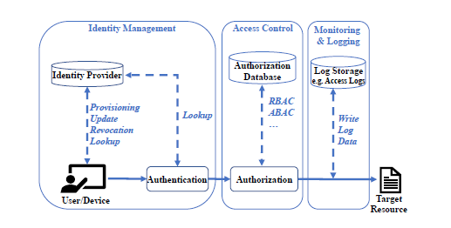
Introduction
Smart devices can intercat with services and participitate through IOT
Need of secure M2M communication
IAM provides three main componenets :
Identity Management
Access Control
Monitoring and logging
Introduction
IAM
Blockchain Technology in IAM
Conclusion

Slide 4



IAM
Identity Management
All communicating entities must be secured to prevent identity theft.
Monitoring & Logging
Storing and tracing critical information in a secure and auditable manner.
Access Control
Preventing unauthorized access to enterprise resources and confidential IoT data.
IAM
Introduction
Blockchain Technology in IAM
Conclusion

Slide 5

Questions to be Discussed
1. Which challenges faces IAM within an enterprise IoT environment?
2. Can blockchain technology be used as an enabler for IAM within enterprise
IoT and the corresponding challenges?
3. What is a realistic use case for blockchain-based IAM and enterprise IoT?.
Blockchain Technology in IAM
First Skill
Second Skill
Conclusion

Slide 6
IAM Challenges in Context of IOT
Physical Design Constraints: IOT devices do not have computational capacity and are low powered
Need of secure IAM mechanisms: ensuring that each device has a managed identity within an IAM platform and one can provide a comprehensive view on all
Variability of Identities: They are highly heterogeneous as they have different attributes which need to be managed correctly.
Network Scalability: Accompanying requirements for storage and network consumption.
Second Skill
First Skill
Third Skill
Conclusion

Slide 7
Blockchain Technology
Decentralized public distributed ledger
Used to record transactions
Bitcoin is a public blockchain
Blockchain Technology
First Skill
Second Skill
Conclusion

Slide 8
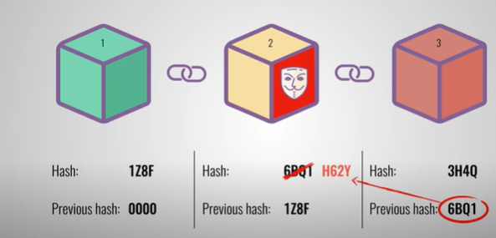
Blockchain Technology
Third Skill
Conclusion
First Skill
Second Skill

Slide 9
Blockchain Technology
Consensus mechanisms to prevent sibyl attacks in public blockchains
POW is one of them
Collisions can emerge in public blockchains due to network delays
Third Skill
Conclusion
First Skill
Second Skill

Slide 10
Blockchain Technology
In private blockchains all participants are known
Node Identity management :
Nodes must be authorized by a trusted authority
Private blockchains rely on consensus mechanisms
BFT protocol is one class of consensus mechanisms
Entity encapsulates request into a transaction to the blockchain
Contract rules : Smart Contracts

Slide 11
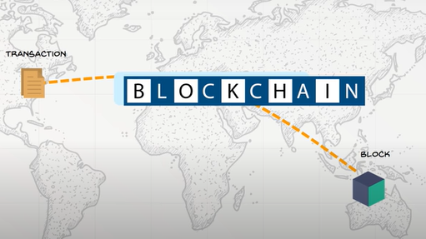
Blockchain Technology

Slide 12
Blockchain-based Enterprise IAM for IoT
Identity Management
Owners identities are held on blockchain an
Access Control
Access right to a specific resource
Storage and Monitoring
Where valid transactions are stored
Blockchain Technology
First Skill
Second Skill
Conclusion

Slide 13
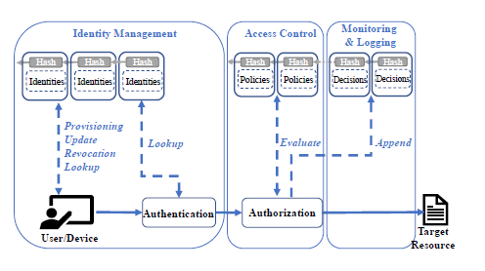
Blockchain Technology

Slide 14
Identity Management
Owners identities are held on a blockchain
Device identities contain the owners signature as an attribute
The owner identity is stored in the blockchain in a tamper-proof way

Slide 15
Access Control
Managing right to a specific recourses through storing them in “temper-proof” way
Policies consist of conditions defining a set of allowed values for attributes
Attributes are related to the resource or environment
Policies are defined through resource owner
Resource owner can change policies over time
All changes are timestamped and logged into blockchain
Policy authenticates the subject when receiving request and build XACML policy

Slide 16
Access Control (continued)
Owners can share data streams by issuing new transactions which holds identifier and service public key
Potential impact of node acting maliciously is limited

Slide 17
Storage and Monitoring
Attacker should forage a digital signature and gain control to alter information
Although storage is decentralized user can leave or join network at any time
Storing of a record containing link of data stored in external database
External database wouldn’t achieve availability
Easiest way rewriting them in numerical representations 0, 1

Slide 18
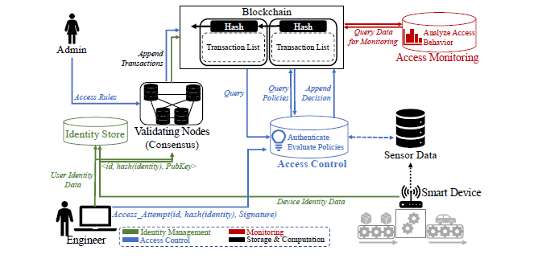
Application Scenario

Slide 19
Conclusion
Private blockchains provide much better scalability towards large numbers of clients and transactions than public blockchains
Private blockchains might still require a central trusted entity
Conclusion
First Skill
Second Skill
Blockchain Technology

