Slide 1

Project demo
Vilnius University – Faculty of Mathematics and Informatics
Matas Remeškevičius
Karolis Medekša
Vladas Zvonkus
Adomas Naus
Benas Žitkevičius
Paulius Mykolaitis
2019 – 01 – 16

Slide 2
About the project
WEB application
Migrate playlists from YouTube to Spotify and vice versa
Login with Google and Spotify credentials

Slide 3







Technologies – beginning

Slide 4


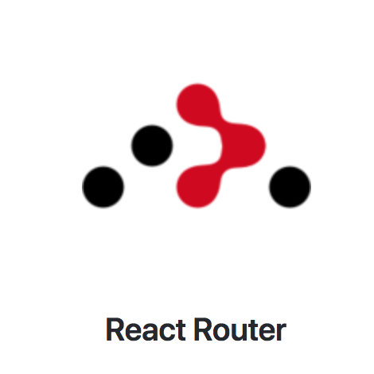
Technologies – endgame

Slide 5
Roles of the team
Karolis Medekša – team lead, front-end programming, design, documentation
Adomas Naus – front-end programming, design
Vladas Zvonkus – front-end programming, back-end programming
Matas Remeškevičius – back-end programming, testing, deployment
Paulius Mykolaitis – documentation
Benas Žitkevičius - documentation

Slide 6
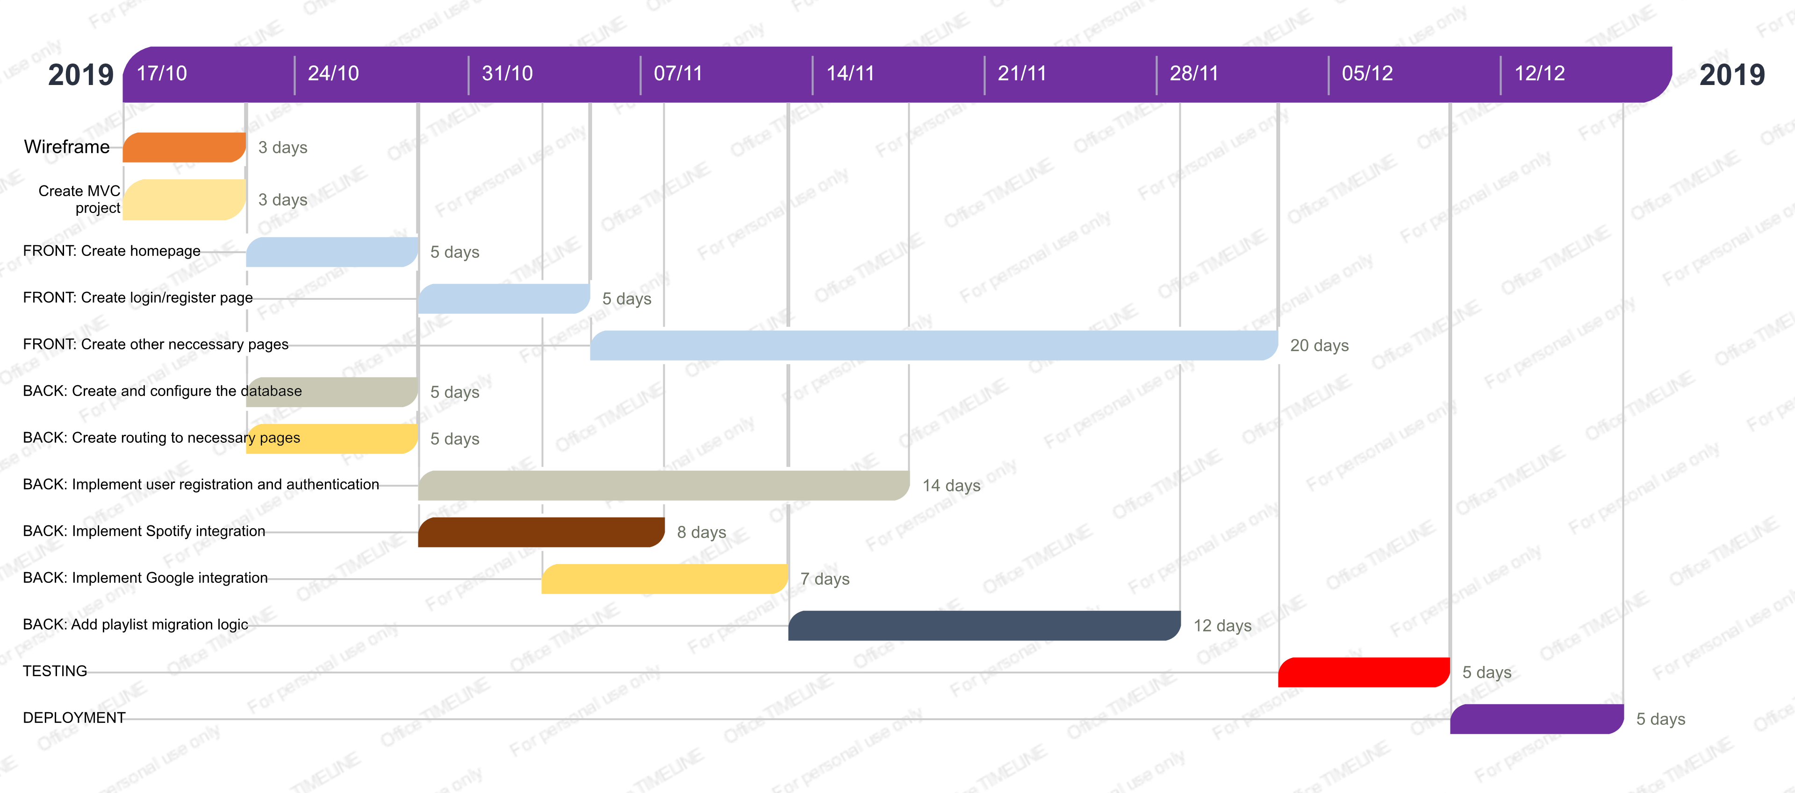
Roadmap – expectations

Slide 7
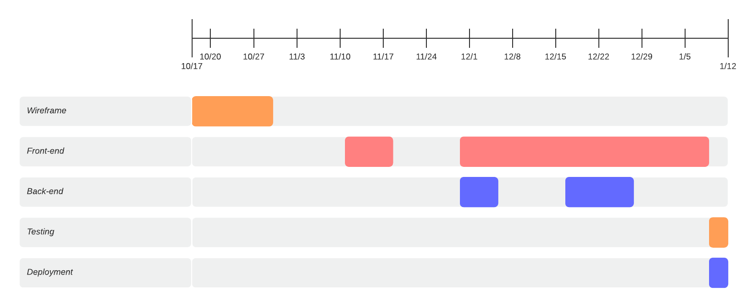
Roadmap – reality

Slide 8
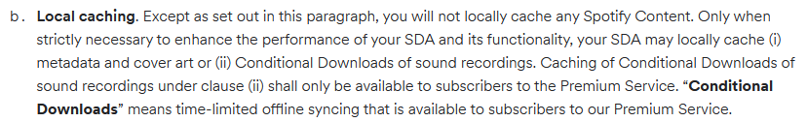
Database…
Yeah, we got rid of it

Slide 9
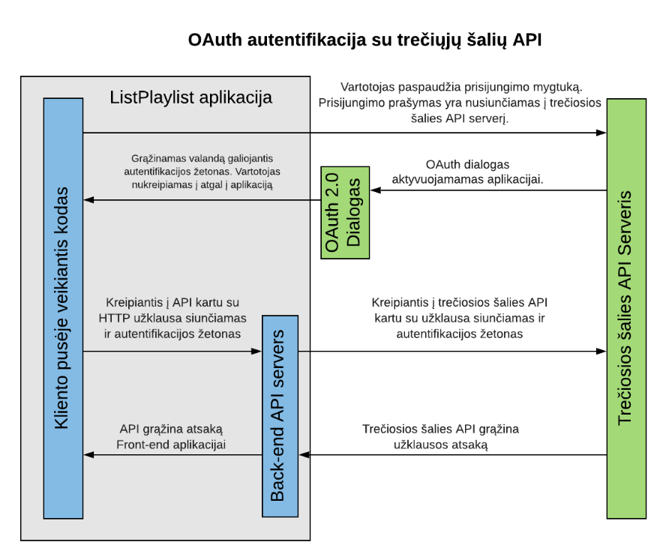
Oauth 2.0

Slide 10
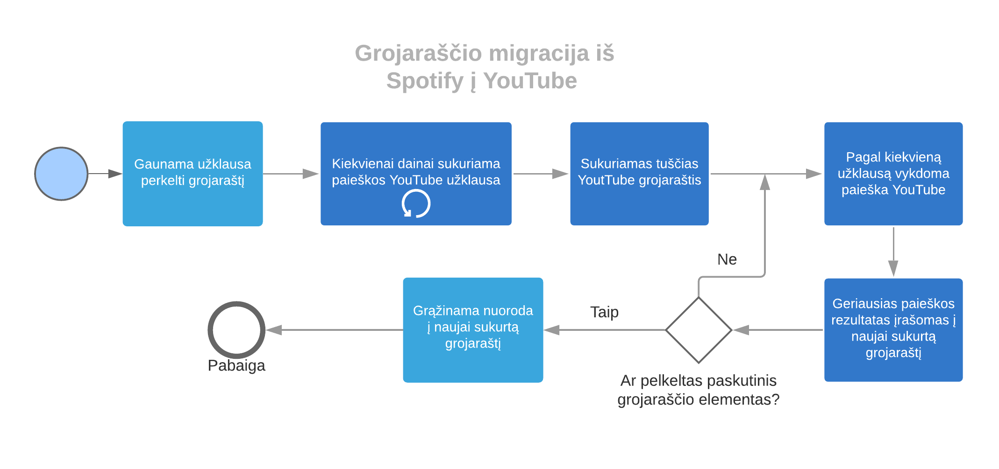
Playlist migration

Slide 11
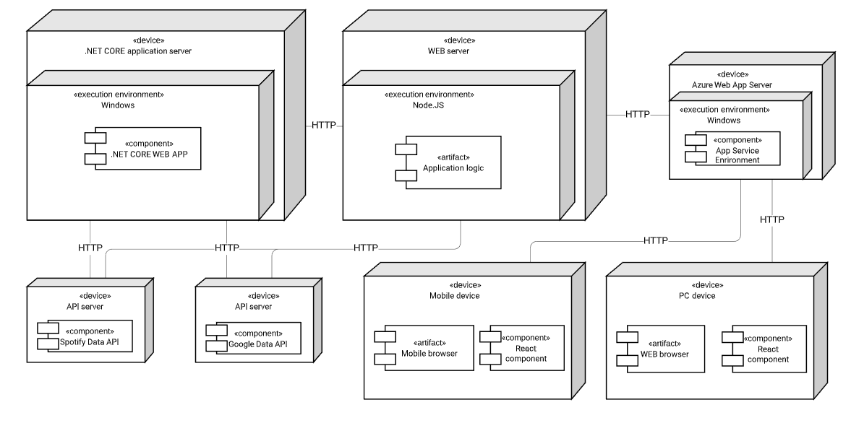
Deployment

Slide 12
Demo

Slide 13
Try it yourselves cutt.ly/lpl Git repo: cutt.ly/lplgit or https://github.com/MKarolis/ListPlaylistV2

