Slide 1
Nutrition agent
IBM HACKATHON PROJECT
Presented By:
Student Name : KARTHIKEYAN M
College Name : S. Veerasamy Chettiar College of Engineering and Technology
Department : B.E - Electronics and Communication Engineering

Slide 2
OUTLINE
Problem Statement
Proposed Solutions
Technology Used
Wow Factor
End Users
Results
Conclusion
Git-Hub Link
Future Scope
IBM Certifications

Slide 3
Problem Statement
In today's health-conscious society, individuals are increasingly seeking personalized nutrition guidance that goes beyond generic diet plans. Existing tools often fail to provide real-time adaptability and do not consider the holistic aspects of a person's lifestyle, including cultural preferences, allergies and evolving health conditions. Additionally, dieticians and nutritionists face significant challenges in scaling personalized consultations due to time and resource constraints.
Generative AI offers a transformative opportunity to address these challenges by creating an intelligent, interactive and adaptive virtual nutrition assistant. This project aims to develop "The Smartest AI Nutrition Assistant" leveraging state-of-the-art generative AI models to deliver a comprehensive and personalized nutrition experience.

Slide 4
Proposed Solution
To address the challenges of personalized nutrition guidance, we propose the development of "The Smartest AI Nutrition Assistant“, aims to revolutionize personalized nutrition by providing an intelligent, adaptive and user-centric solution. By combining advanced AI technologies with deep understanding of individual needs, this platform will empower users to make informed dietary choices, ultimately enhancing their health and well-being. The solution will encompass the following components:
Personalized Meal Planning
User-Friendly Interface
Contextual Explanations and Education
Real-Time Adaptability

Slide 5
Technology used
IBM Cloud Lite Services
Natural Language Processing (NLP)
IBM Granite Model

Slide 6
IBM cloud services used
IBM Cloud Watsonx AI Studio
IBM Cloud Watsonx AI Runtime
IBM Cloud Agent Lab
IBM Granite Foundation Model

Slide 7
Wow factors
The assistant continuously learns from user interactions, health data, and feedback to provide personalized meal plans and recommendations that evolve with the user's lifestyle, preferences, and health conditions.
Personalized meal planning with AI-generated recipes: Create customized meal plans with unique recipes tailored to individual tastes, dietary needs, and health goals.
Real-time nutrient analysis: Provide instant analysis of nutritional content, including macronutrients, micronutrients, and potential allergens.
Smart grocery shopping: Generate grocery lists, suggest healthy alternatives, and offer in-store navigation.
Conversational interface: Engage users with a friendly, conversational AI assistant that provides personalized guidance and support.
Dynamic meal planning adjustments: Continuously update meal plans based on user feedback, progress, and changing dietary needs.

Slide 8
End users
Health-Conscious Individuals
Individuals Managing Health Conditions
Fitness Enthusiasts and Athletes
Busy Professionals and Families
Nutrition Students and Professionals
Health Coaches and Dietitians

Slide 9
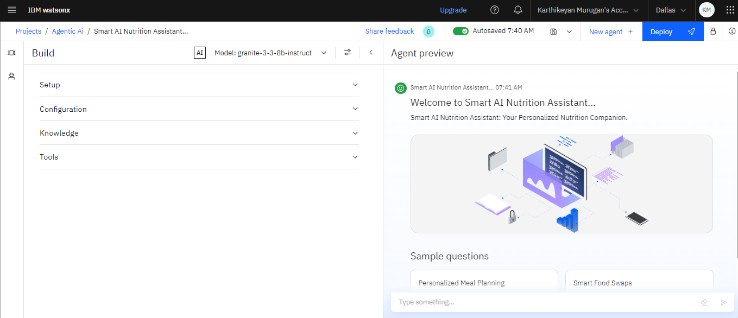
Results

Slide 10
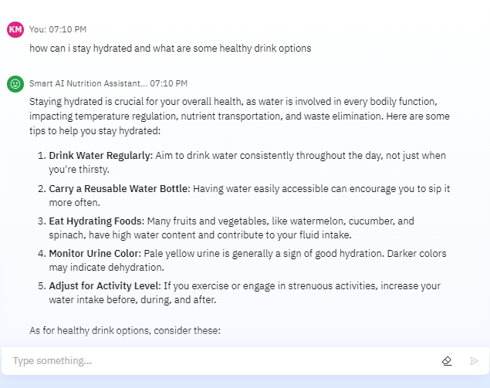
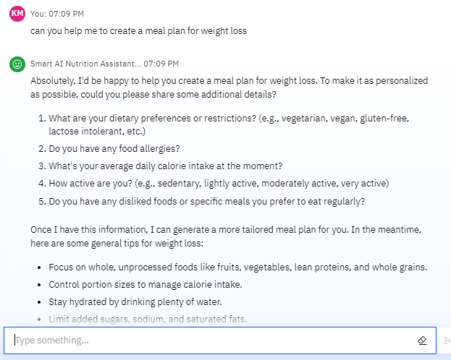
AI AGENT - CHAT INTERFACEs

Slide 11
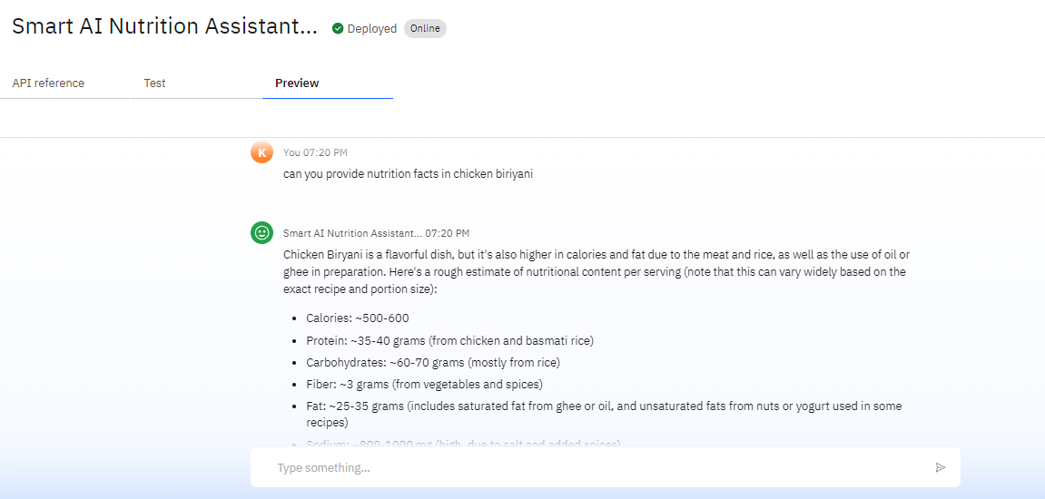
DEPLOYED AI AGENT

Slide 12
Conclusion
The Smartest AI Nutrition Assistant represents a groundbreaking advancement in personalized nutrition guidance, addressing the growing demand for tailored dietary solutions in an increasingly health-conscious society.
As we look to the future, the potential for this project is vast. With ongoing advancements in AI, data integration and user experience design, the Smartest AI Nutrition Assistant can evolve to meet the diverse needs of users worldwide, making personalized nutrition accessible and enjoyable for all.
Ultimately, this project aims to revolutionize the way individuals approach their health, transforming nutrition from a one-size-fits-all solution into a personalized journey that promotes well-being and empowers users to thrive.

Slide 13
Git-Hub Link
GIT-HUB LINK - View Repository

Slide 14
Future scope
Expansion of Personalization Capabilities
Advanced data integration
Cultural and ethical considerations
Enhanced Real-Time Adaptability
Dynamic feedback mechanism
Integration with smart home devices
Community and Social Features
Peer support networks
Collaborative challenges
Market Expansion
Targeting diverse demographics
Global reach
Gamifications and Engagement
Augmented reality experiences
Personalized rewards systems
Research and Development
Continuous improvement through AI research
Partnership with health institutions

Slide 15
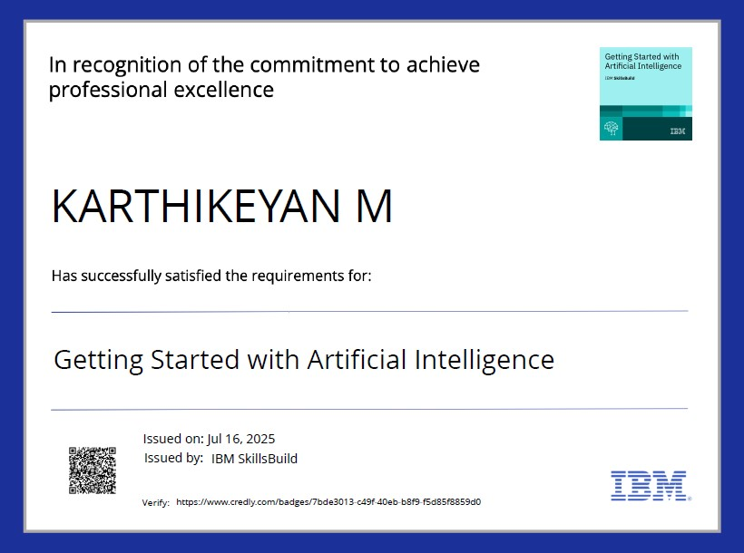
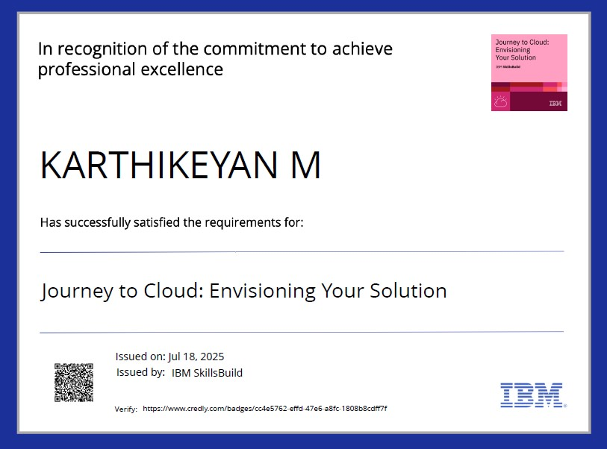
IBM Certifications

Slide 16
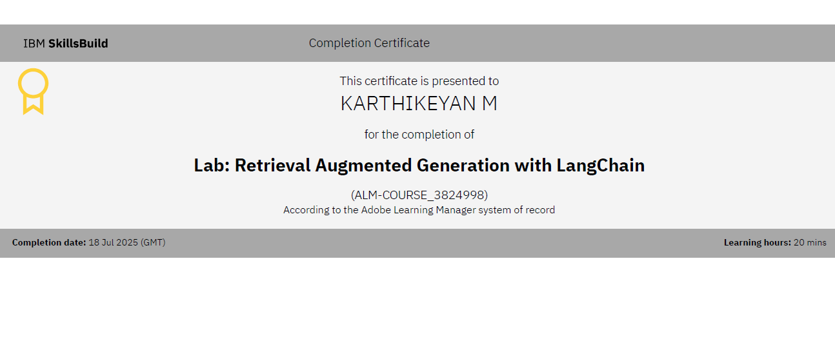
IBM Certifications

Slide 17
THANK YOU

