Slide 1
papaya CMS
Advance Community
a Module Package
by Martin Kelm
Version 31.05.2013
with the bootstrap-theme
http://mkelm.github.io/pcms-advanced-community

Slide 2
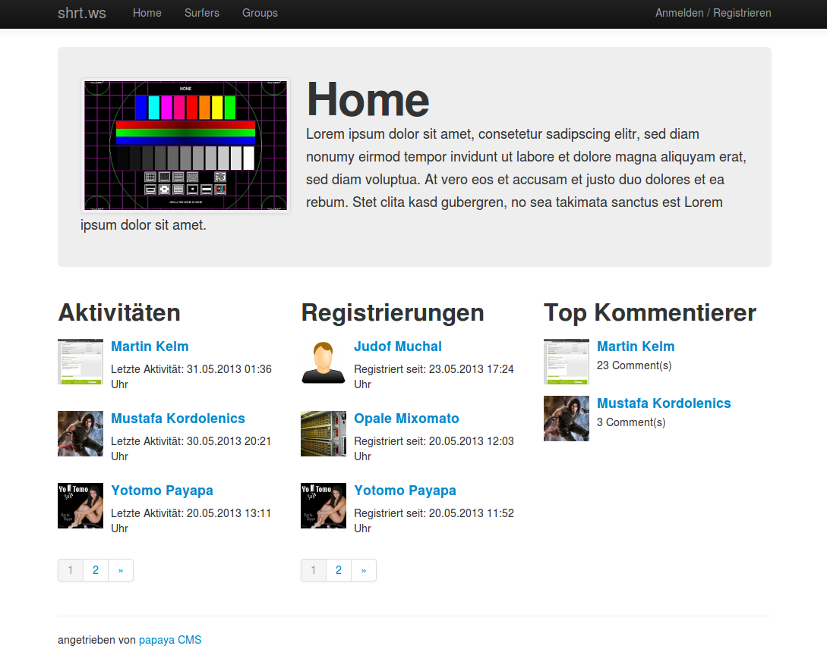
Homepage with surfers boxes

Slide 3
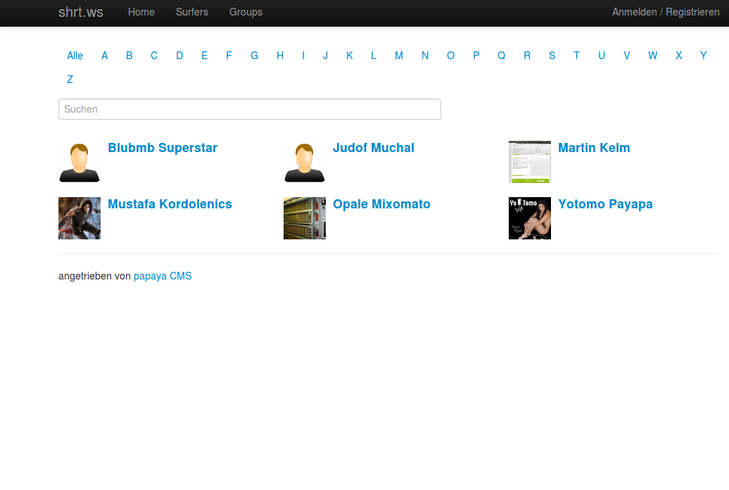
Surfers page with search and filter
and group memberships management in group mode

Slide 4
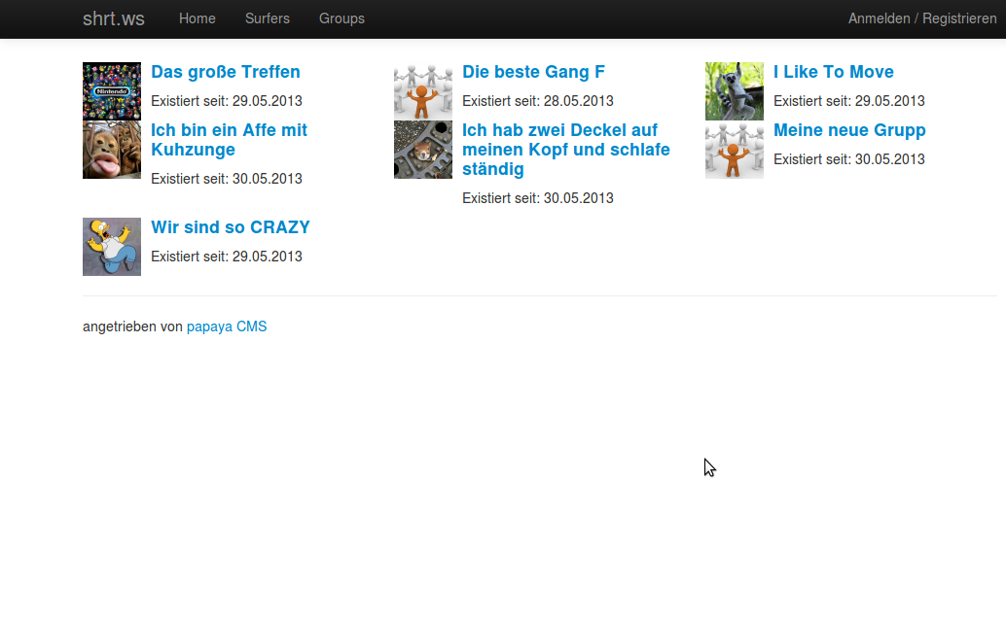
Public groups page

Slide 5
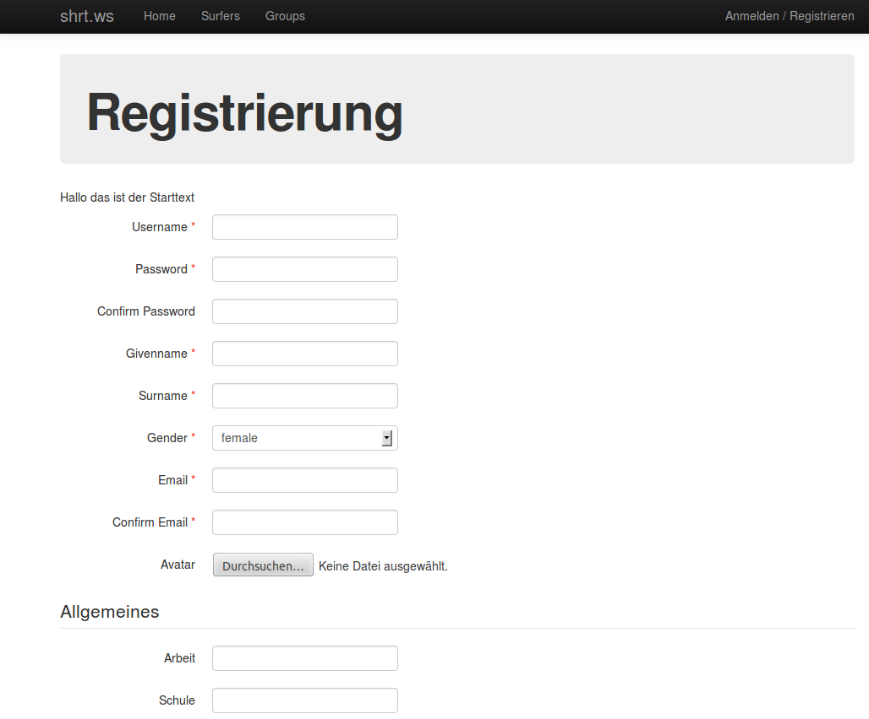
Registration page

Slide 6
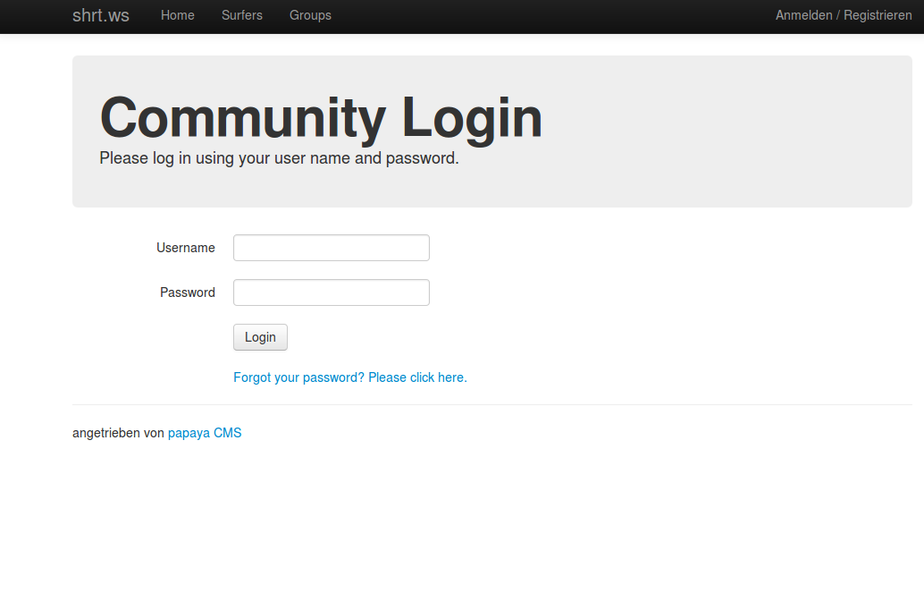
Login page

Slide 7
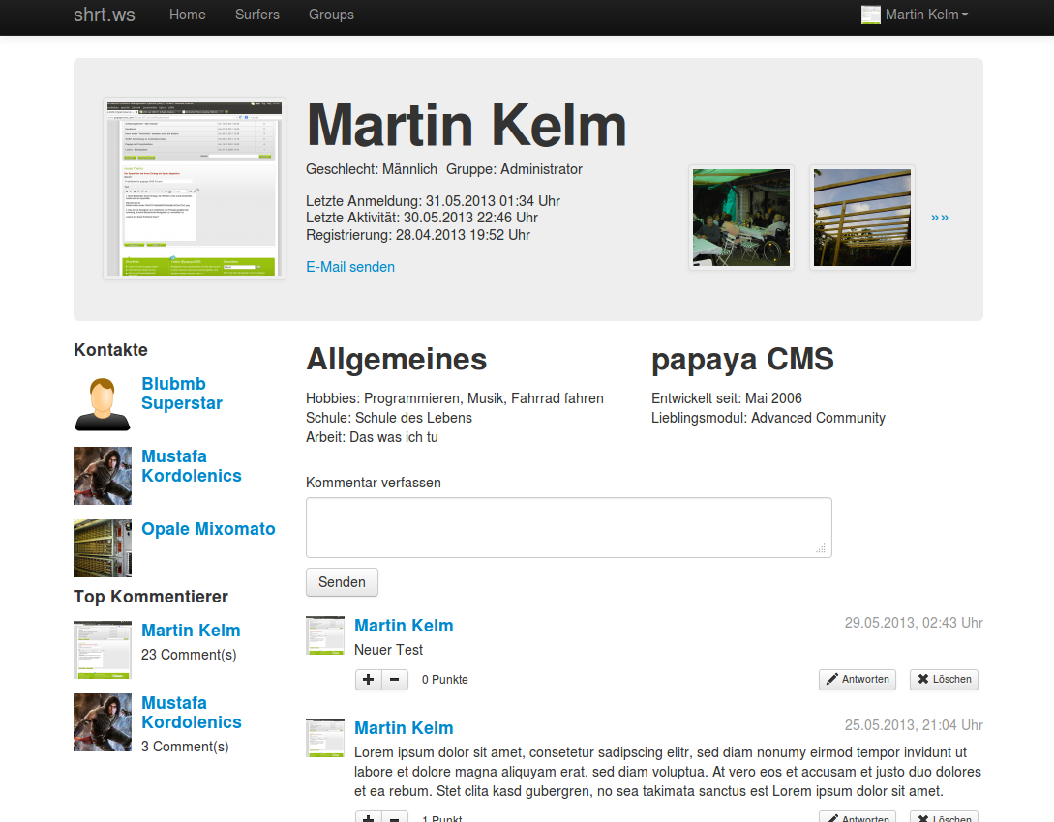
Public profile page

Slide 8
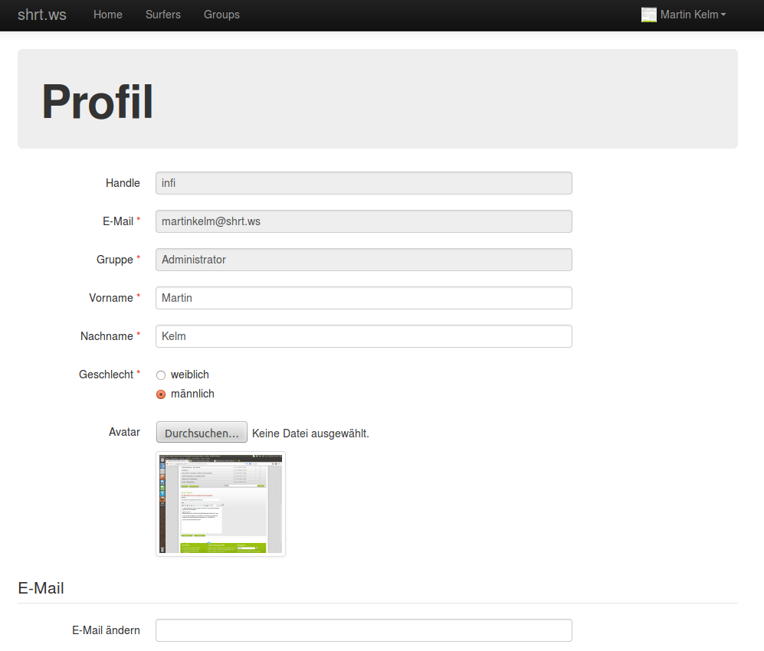
Surfer editor page

Slide 9
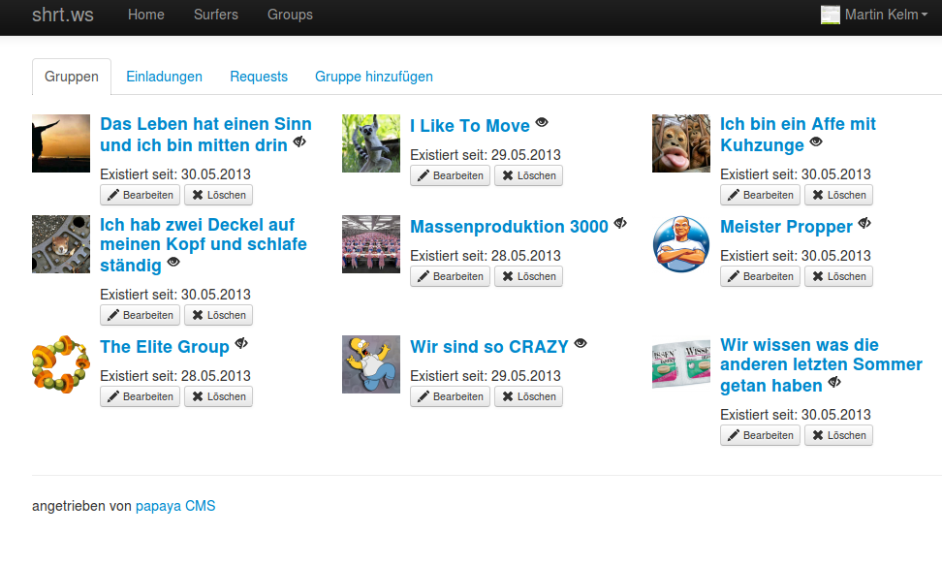
Own groups page with
Invitations / requests management

Slide 10
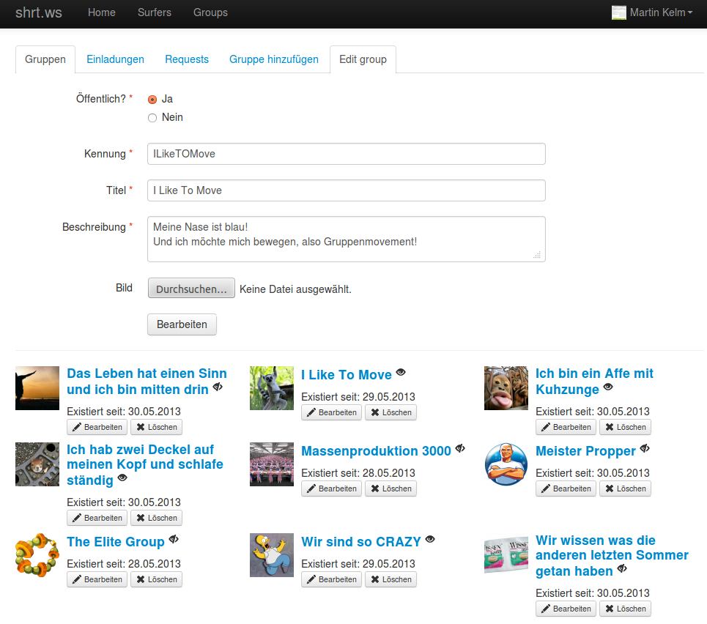
Add / edit own groups

Slide 11
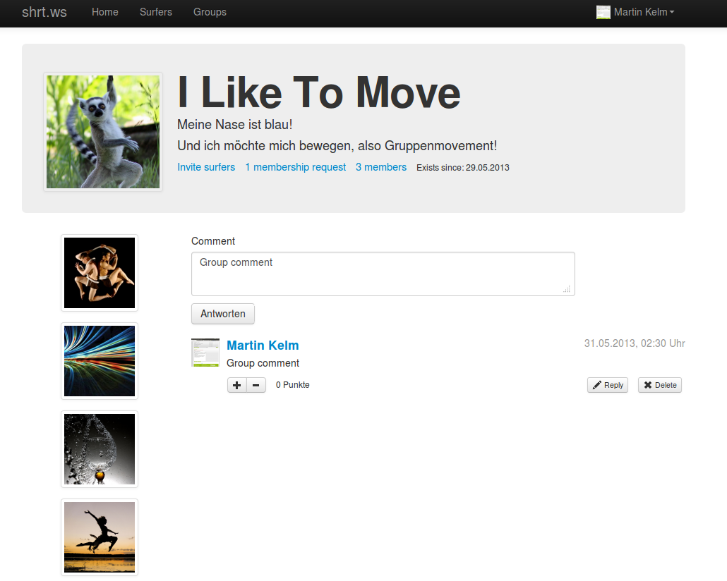
Public or private group page

Slide 12
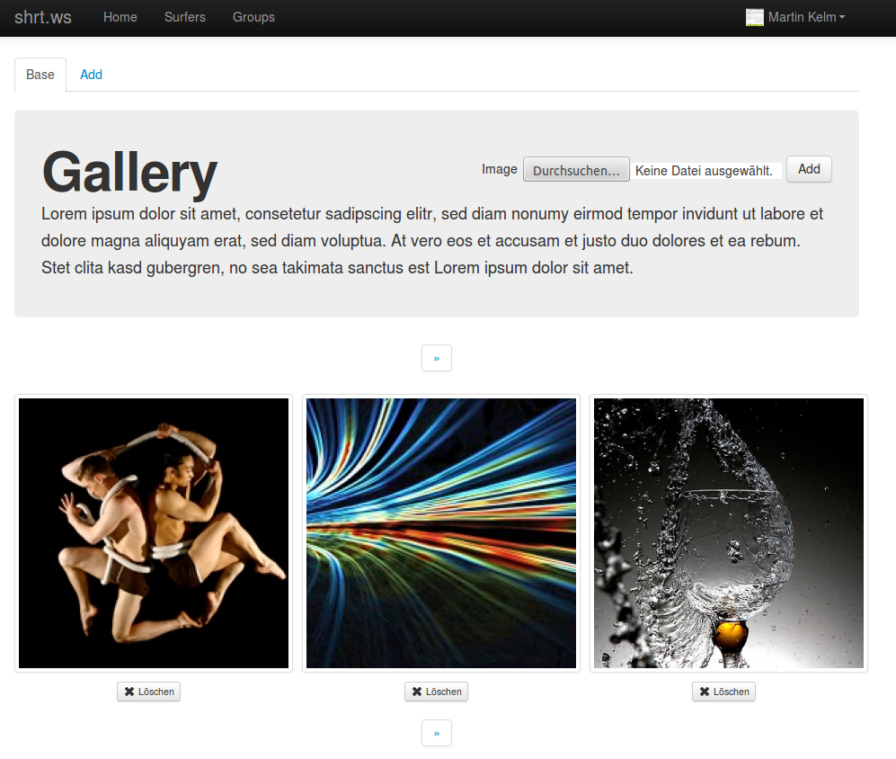
Group or surfer image gallery

Slide 13
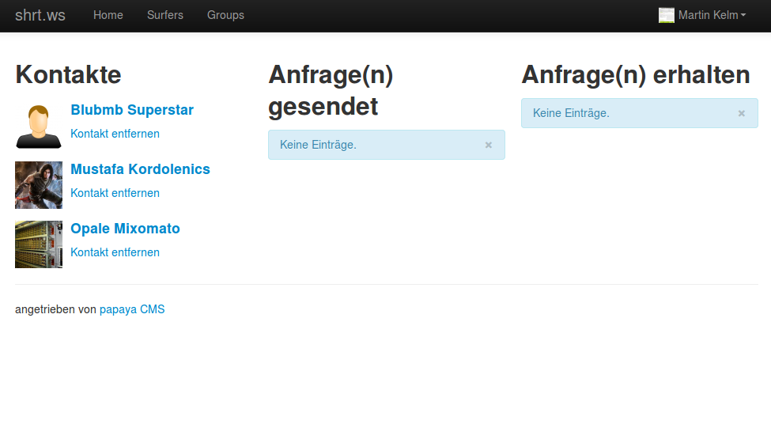
Contacts management

Slide 14
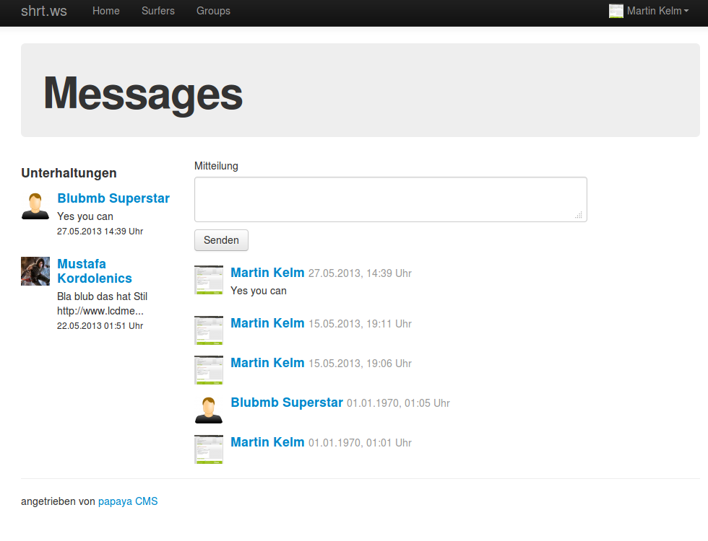
Messages

Slide 15
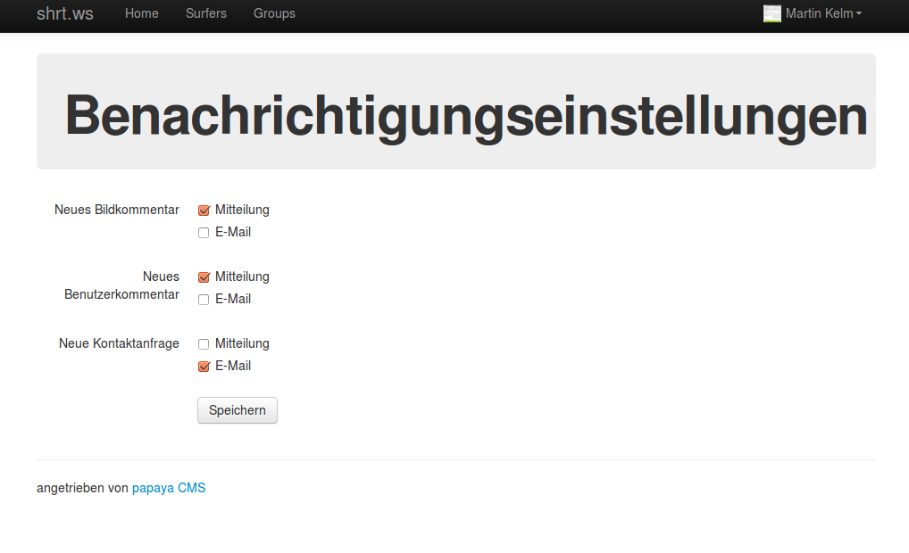
Notification settings

