Slide 1
3D Modeling
Michael & Carlos

Slide 2
Overview
Greenland Ice Sheet
View model in the browser
Public engagement, education

Slide 3
Data Format
.pvd files
Xml based
27,500 data points!

Slide 4
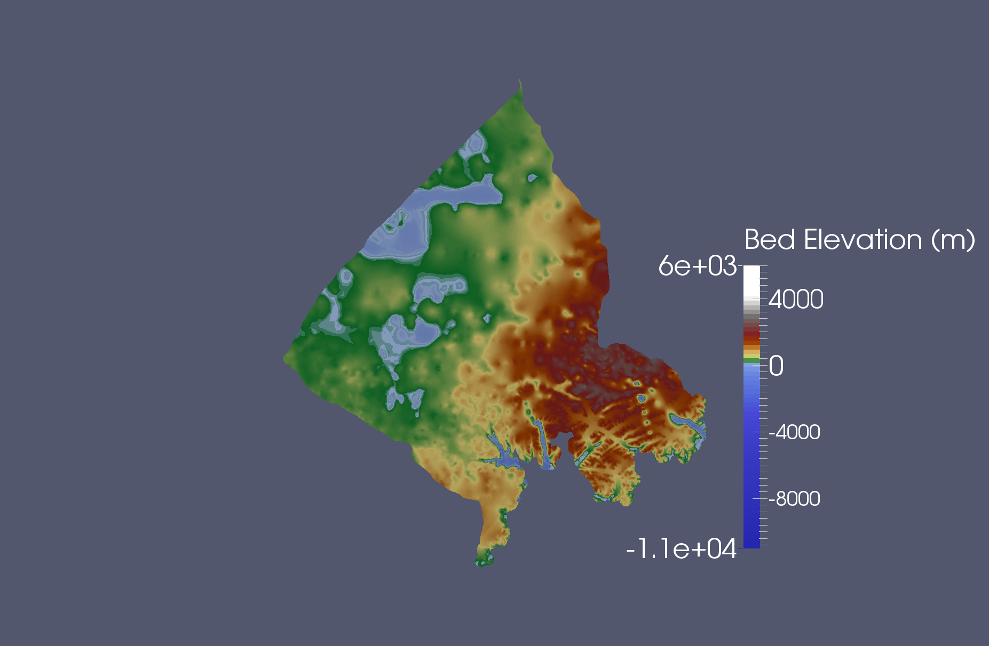
Dataset in ParaView

Slide 5
Requirements
Functional
Non-Functional
3d visualization
click and drag interaction
colorized
Acceptable performance
Pre-process xml data
implement a strategy for optimization
ThreeJs framework, manipulate camera perspective

