Slide 1
3D Modeling
Michael & Carlos

Slide 2
Overview
Model the Greenland Ice Sheet
View 3D model in the browser
Three.js
Public engagement, education

Slide 3
Data Format
Research Model gives vtk files
Visualization toolkit
XML based
Unstructured grid data type (.vtu)
ParaView
27,500 data points, 56,000 cells!

Slide 4
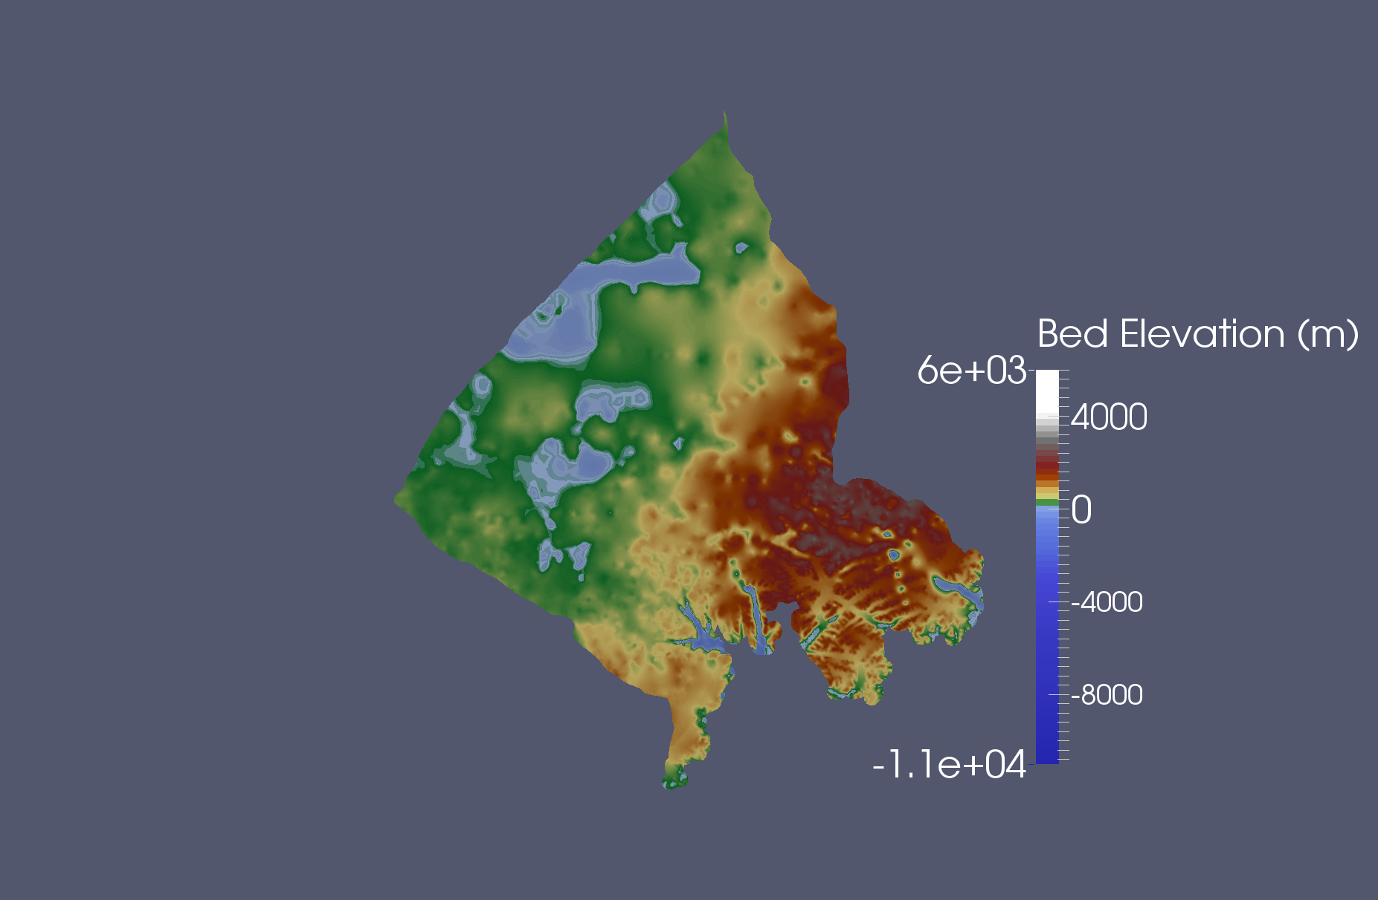
Dataset in ParaView
This will be our target output, as well as test data

Slide 5
Requirements
Functional
Non-Functional
3d visualization
Click and drag interaction
Colorized
Acceptable performance
Pre-process the data
Possibly convert the format
Implement a strategy for optimization
Load using Three.js

Slide 6
Links
http://threejs.org/examples/#webgl_loader_vtk
https://trello.com/b/eh9u8ENn/adv-web-project-timeline

