Slide 1
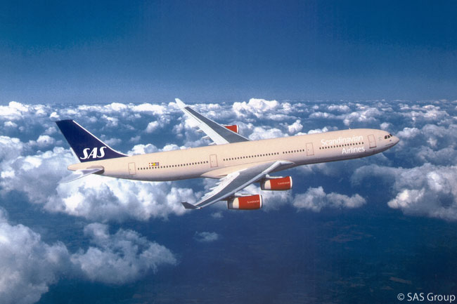
Case story
Comparing the Codon Usage of Human Gut Bacteria obtained from SAS International Flights landing at Copenhagen Airport

Slide 2
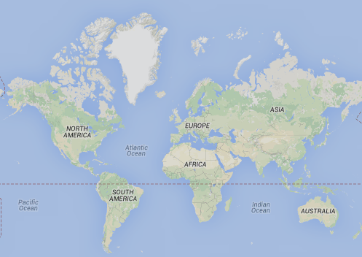
Introduction
Airports have been suggested as potentially optimal control points for limiting the spread of disease outbreaks. Here we investigated combined air toilet waste from 18 international flights arriving to Copenhagen. Total DNA was extracted and sequenced using Illumina technology. The sequence reads were de-novo assembled and all possible microbial genes were extracted. The resulting microbial gene catalogue was compared to the SwissProt database.
Greenland
Toronto
Cph
Washington
Japan
The goal of this case is to calculate the codon usage for all sequences from
a) Alphaproteobacteria and b) Clostridiales and print the codon usage for a) and b) next to each other.
China
Newark
Parkistan
Thailand
Singapore

Slide 3
Input files
The FASTA files containing all microbial genes (nucleotides)
>contig-100_0_1 # 3 # 269 # -1 # ID=1_1;partial=10;start_type=ATG;rbs_motif=TAA;rbs_spacer=14bp;gc_cont=0.378
ATGAGTGAAGAAAATAACTGGAATTATGGAAATGATGAGCCGAATGTAAATCAGGGAAATCCTGTCAGCC
TGGAGAAAAGTACGACTGATGGTACAGCAGGTGTAAATTTAGAGAAGACTGTGACCGGAAATGAAGAGCG
TGTAAATTCAGAAAAGACTATGACAGACAATCCGTATTATACAAATACGTCATATGGAAACGGCAATACA
AATTATAATTACGGACAGTCAAATGACAGTGCAGGTTATAACTATGGACAGTCAAAC
>contig-100_0_2 # 284 # 1297 # -1 # ID=1_2;partial=00;start_type=ATG;rbs_motif=TAA;rbs_spacer=15bp;gc_cont=0.413
ATGAAATTACTGACATTTGCGATCCCGTGTTACAATTCACAGGATTACATGGAAAACTGTATCAAATCCC
TGCTGCCGGGTGGCGATGATGTTGAGATCCTGATCATTGATGATGGGTCAAAAGATAGCACCGGTGACAT
AGCAGATGCCTATGAGAAGAAATATCCGGGAATCATCCGTGCAATCCATCAGGTAAATGGAGGACACGGA
GAGGCTGTCAATGCTGGAATCCGCAATGCGACAGGACTTTATTTTAAAGTGGTAGACAGCGATGACTGGG
...

Slide 4
Input files
the UniProt BLAST result, tab-separated format (geneID bestHit-ID score ....)
contig-100_0_2 EPSJ_BACSU 28.4 222 137 10 1 636 2 211 5.3e-16 86.7
contig-100_0_3 GLF_ECOLI 38.0 392 210 13 1 1152 1 367 8.9e-68 258.8
contig-100_0_43 TAGA_BACSU 30.9 233 147 7 7 687 1 225 1.9e-23 110.9
contig-100_0_14 YNDE_BACSU 22.2 374 256 12 1 1077 1 354 3.1e-18 95.1
contig-100_0_13 SP2R_BACSU 30.0 203 137 2 25 618 2 204 2e-24 114.0
contig-100_1_5 Y112B_HAEIN 38.2 267 156 6 1 792 6 266 3e-41 171.0
contig-100_0_20 Y6286_MYCS2 45.0 429 233 3 4 1284 1 428 7.5e-108 392.1
...

Slide 5
Input files
a UniProt database extract, containing the UniProt-ID, the organism and the NCBI taonomy, tab separated format (UniProt-ID Organism Taxonomy):
EPSJ_BACSU Bacillus subtilis (strain 168) Bacteria; Firmicutes; Bacilli; Bacillales; Bacillaceae; Bacillus
GLF_ECOLI Escherichia coli (strain K12) Bacteria; Proteobacteria; Gammaproteobacteria; Enterobacteriales; Enterobacteriaceae; Escherichia
TAGA_BACSU Bacillus subtilis (strain 168) Bacteria; Firmicutes; Bacilli; Bacillales; Bacillaceae; Bacillus
YNDE_BACSU Bacillus subtilis (strain 168) Bacteria; Firmicutes; Bacilli; Bacillales; Bacillaceae; Bacillus
SP2R_BACSU Bacillus subtilis (strain 168) Bacteria; Firmicutes; Bacilli; Bacillales; Bacillaceae; Bacillus
Y112B_HAEIN Haemophilus influenzae Bacteria; Proteobacteria; Gammaproteobacteria; Pasteurellales;
...

Slide 6
Output
A C
CTT: 1.76 2.14
TAG: 0.04 0.05
ACA: 1.41 1.97
ACG: 1.33 0.92
ATC: 3.43 3.53
AAC: 2.02 1.96
ATA: 1.13 0.95
...

Slide 7
the FASTA files containing all microbial genes (nucleotides)
>contig-100_4_53 # 52968 # 53819 # -1 # ID=5_54;partial=00;start_type=ATG;rbs_motif=GGAGG;rbs_spacer=5-ATGCAGATTATCGACGGAAAAAAGGTATCGGCACAGGTAAAGGAAGAGGTAAAGAGGCAGACGCTTGAGT
TAAAGGAAACTCACAAAATAACCCCCGGTCTTGCGGTAGTAATCGTAGGTGACGATCCGGCGTCAAGAGT
ATATGTAAACAACAAGAAAAAGGCTTGTGAATTTGTAGGCTTTAAGTCTGAGGAGTATGCACTCCCGGC
AGAAACAACA
the UniProt BLAST result, tab-separated format (geneID bestHit-ID score ....)
contig-100_0_2 EPSJ_BACSU 28.4 222 137 10 1 636 2 211 5.3e-16 86.7
contig-100_0_3 GLF_ECOLI 38.0 392 210 13 1 1152 1 367 8.9e-68 258.8
contig-100_4_53 RL21_CLOTH 61.2 103 39 1 1 306 1 103 1.2e-27 123.6
a UniProt database extract
EPSJ_BACSU Bacillus subtilis (strain 168) Bacteria; Firmicutes; Bacilli; Bacillales; Bacillaceae; Bacillus
GLF_ECOLI Escherichia coli (strain K12) Bacteria; Proteobacteria; Gammaproteobacteria; Enterobacteriales;
TAGA_BACSU Bacillus subtilis (strain 168) Bacteria; Firmicutes; Bacilli; Bacillales; Bacillaceae; Bacillus
RL21_CLOTH Clostridium thermocellum Bacteria; Firmicutes; Clostridia; Clostridiales; Clostridiaceae; Clostridium

Slide 8
Step 1: Decide how to attack the problem

