Slide 1
Keylogger and security
CAPSTONE PROJECT
Presented By:
G Mahesh Krishna-DMI College Of Engineering-CSE

Slide 2
OUTLINE
Problem Statement
Proposed System/Solution
System Development Approach
Algorithm & Deployment
Result (Output Image)
Conclusion
Future Scope
References

Slide 3
Problem Statement
In today's digital landscape, ensuring cybersecurity is of paramount importance. With the increasing reliance on computers for personal and professional tasks, the threat of unauthorized access to sensitive information through keystroke logging has become a significant concern. To address this challenge, there is a need to develop a predictive keylogger system capable of preemptively identifying and thwarting potential security breaches.

Slide 4
Proposed Solution
The proposed system aims to address the challenge of enhancing cybersecurity by preemptively identifying and mitigating potential security breaches. This program demonstrates the basic functionality of capturing and logging keystrokes, providing a foundation for further enhancements such as anomaly detection, and user profiling. The solution will consist of the following components:
Data Collection:
- This solution captures keystrokes made by users using the `pynput` library. It records when keys are pressed, held, and released, along with their corresponding timestamps.
Data Logging:
- Keystrokes are logged into both a text file (`key_log.txt`) and a JSON file (`key_log.json`) .
Data Handling and Storage:
- Keystrokes are stored in log files (`key_log.txt` and `key_log.json`) locally on the system.
User Interface and Configuration Options:
- Your program provides a basic user interface using Tkinter, allowing users to start and stop the keylogger.
Deployment:
- The program provides a basic user interface using Tkinter, allowing users to start and stop the keylogger. It saves the captured keystrokes in both a text file (`key_log.txt`) and a JSON file (`key_log.json`) locally on the system.
Anomaly Detection and Analysis:
Integrate anomaly detection algorithms to analyze keystroke patterns and identify suspicious activities indicative of unauthorized access or malicious behavior(not yet implemented)
Evaluation:
Evaluating the effectiveness of the keylogger would involve assessing its ability to accurately capture keystrokes and analyzing its impact on system performance.

Slide 5
System Approach
1. .System Requirements:
- Real-time Keystroke Capture: The keylogger should be capable of capturing keystrokes in real-time, including pressed, held, and released keys.
- Secure Logging: Ensure that captured keystrokes are securely stored locally on the system to prevent unauthorized access or tampering.
- User Interface: Provide a user-friendly interface for starting and stopping the keylogger, giving users control over its operation.
- Cross-platform Compatibility: Ensure compatibility with different operating systems to enable deployment on a wide range of systems.
2. Libraries Used:
- `tkinter`: Utilized for creating the graphical user interface (GUI) to interact with the keylogger, allowing users to start and stop the logging process.
- `pynput`: Employed for capturing and monitoring keystrokes in real-time, providing functionality to detect key press, hold, and release events.
- `json`: Used for handling JSON file operations, facilitating the storage of captured keystrokes in both text and JSON formats.
By meeting these system requirements and utilizing the specified libraries, the keylogger project aims to provide a robust and user-friendly solution for capturing and logging keystrokes on various computer systems.

Slide 6
Algorithm & Deployment
ALGORITHM:
1. Initialization: Initialize variables and setup necessary configurations.
2. Start Keylogger:
- Create a keyboard listener using the `pynput` library.
- Define functions to handle key press and release events (`on_press` and `on_release`).
- Start the keyboard listener to capture keystrokes in real-time.
3. Capture Keystrokes:
- Upon key press event, append the pressed key information to the `keys_used` list.
- If a key is held down, continuously append the held key information until it is released.
- Upon key release event, append the released key information to the `keys_used` list.

Slide 7
Algorithm & Deployment
4. Logging:
- Implement functions (`generate_text_log` and `generate_json_file`) to log captured keystrokes into text and JSON files, respectively.
- Ensure secure and consistent storage of keystrokes locally on the system.
5. User Interface:
- Develop a simple GUI using `tkinter` with buttons to start and stop the keylogger.
- Configure button callbacks to initiate and terminate the keylogging process.

Slide 8
Algorithm & Deployment
DEPLOYMENT:
1. Compatibility Check:
- Ensure that the keylogger program is compatible with the target operating system(s) where it will be deployed.
2. Package Installation:
- Install necessary Python dependencies (`pynput`, `tkinter`, `json`) on the deployment system if not already installed.
3. Code Deployment:
- Transfer the keylogger script to the deployment system.
4. Configuration:
- Configure any necessary settings or parameters within the keylogger script, such as file paths or logging options.

Slide 9
Algorithm & Deployment
5. Execution:
- Run the keylogger program by executing the script.
- Verify that the GUI interface appears and functions correctly.
6. Testing:
- Perform testing to ensure that the keylogger captures keystrokes accurately and logs them securely.
7. Monitoring:
- Monitor the keylogger's operation to ensure it functions as expected and does not impact system performance.
8. Maintenance:
- Regularly update and maintain the keylogger script to address any issues or security vulnerabilities that may arise.
- Consider adding additional features or enhancements based on user feedback and requirements.

Slide 10
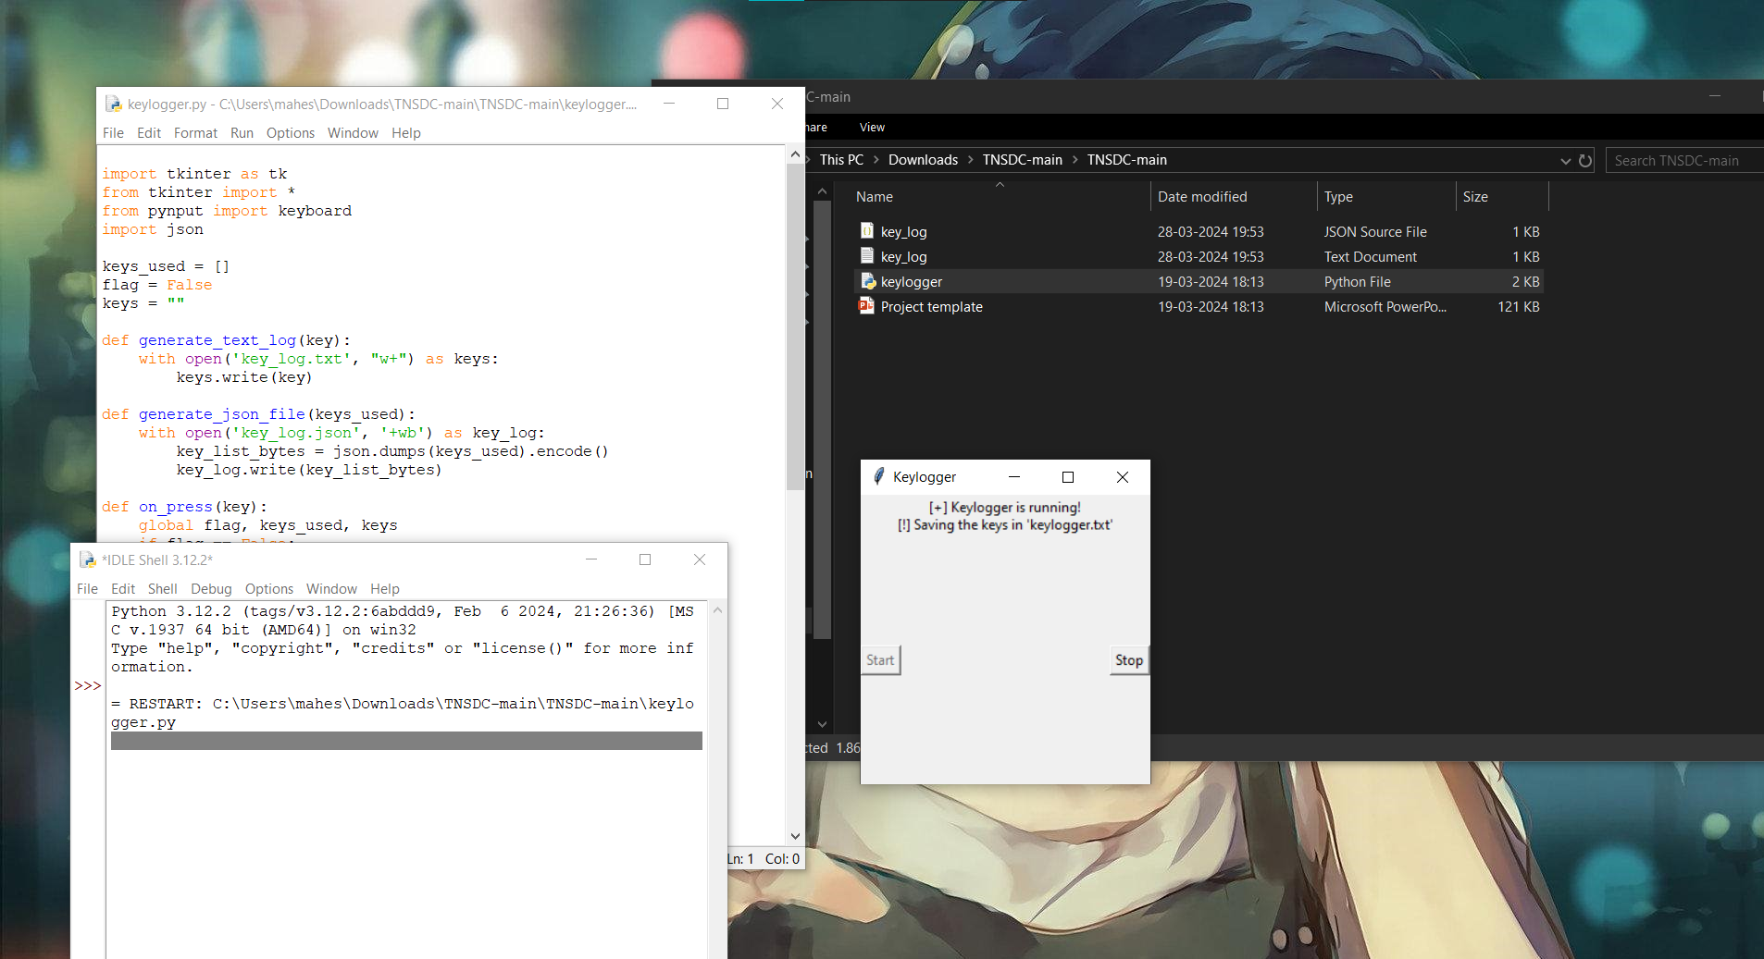
Result
Keylogger is running and key_log.txt is generated:

Slide 11
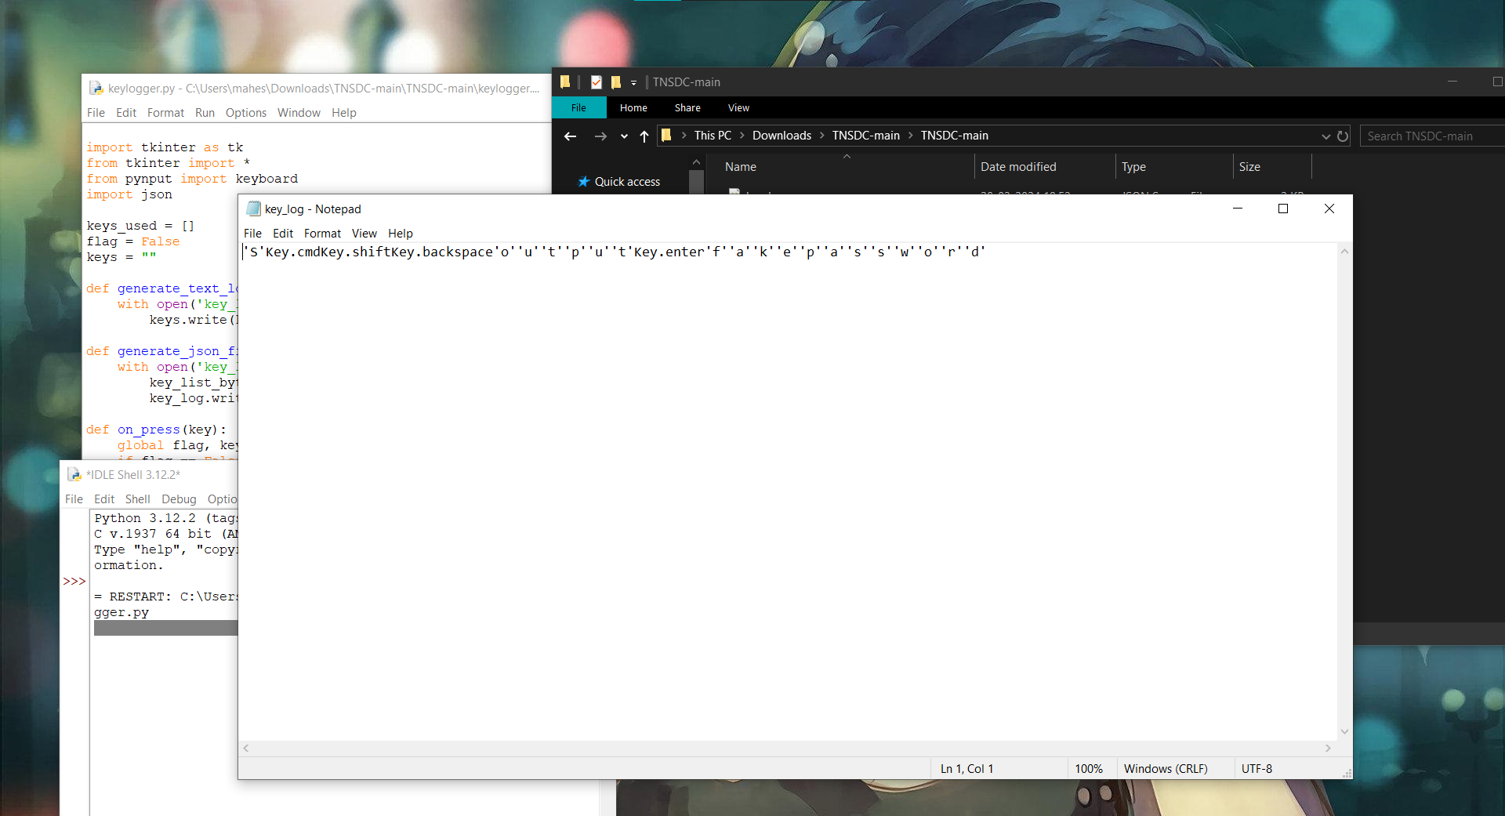
Result
The generated Key_log.txt with the keystrokes recorded:

Slide 12
Security Measures:
To prevent keylogger attacks, several security measures can be taken. Firstly, using reputable antivirus and anti-malware software helps detect and remove keyloggers. Keeping software updated ensures known vulnerabilities are patched promptly. Caution should be exercised when downloading files or clicking on links, especially from unknown sources. Enabling a firewall helps monitor and control network traffic to prevent unauthorized access. Additionally, using virtual keyboards for sensitive inputs and implementing behavior-based detection techniques can thwart keylogger attempts effectively.
Regularly monitoring system activity for unusual behavior and promptly investigating any suspicious activity is essential. Educating users on security best practices, such as avoiding public Wi-Fi networks and using strong, unique passwords, can also help mitigate keylogger risks. Enabling two-factor authentication adds an extra layer of security to accounts, making it harder for attackers to gain unauthorized access. Finally, regularly backing up important data ensures that even in the event of a keylogger infection, data loss can be minimized or mitigated. These preventive measures collectively strengthen defenses against keylogger attacks and safeguard sensitive information from compromise.

Slide 13
Conclusion
In conclusion, the proposed keylogger project presents a robust solution for capturing and logging keystrokes on computer systems. By leveraging the capabilities of libraries such as `pynput`, `tkinter`, and `json`, the keylogger effectively captures real-time keystrokes and securely logs them locally on the system. The user-friendly interface provided by `tkinter` allows users to easily initiate and terminate the keylogging process, enhancing its usability.
While the keylogger project fulfills its primary objective of capturing keystrokes, there are opportunities for further enhancements and refinement. Future iterations of the keylogger could incorporate advanced features such as real-time anomaly detection, user behavior analysis, and secure data transmission to enhance its effectiveness in identifying and mitigating potential security threats.
Overall, the keylogger project serves as a valuable tool for cybersecurity professionals, researchers, and individuals seeking to monitor and analyze user activities on computer systems. It underscores the importance of proactive security measures in safeguarding sensitive information and mitigating risks associated with unauthorized access or malicious activities.

Slide 14
Future scope
To further enhance the keylogger project, several avenues for development and improvement can be explored. Firstly, enhancing the detection algorithms can significantly bolster the keylogger's ability to identify suspicious activities and potential security threats in real-time. By developing more advanced algorithms, the keylogger can better differentiate between normal and abnormal keystroke patterns, thereby improving its effectiveness in threat detection.
Additionally, implementing behavior profiling and analysis techniques can provide valuable insights into user typing behavior over time. Machine learning models can be employed to create profiles for individual users, enabling the keylogger to adapt its detection mechanisms based on observed behavior. This adaptive approach enhances the keylogger's accuracy and reduces false positives, ultimately improving its usability and effectiveness.

Slide 15
Future scope
Furthermore, ensuring secure data transmission mechanisms is paramount for maintaining the confidentiality and integrity of captured keystrokes. By enhancing the keylogger to securely transmit data to a remote server or monitoring system, centralized logging and analysis can be facilitated while mitigating the risk of unauthorized access or tampering.
Integration with security management systems can also enhance the keylogger's capabilities by correlating keystroke data with other security events and logs. This comprehensive approach provides a holistic view of security incidents, enabling proactive threat detection and response strategies to be implemented effectively.
Overall, by pursuing these avenues for development and improvement, the keylogger project can evolve into a more robust and sophisticated tool for enhancing cybersecurity measures and safeguarding sensitive information..

Slide 16
References
Python Documentation:
- Website: https://docs.python.org/3/
- Python's official documentation provides comprehensive information on the Python programming language, including tutorials, guides, and references for various modules and libraries used in the project.
Tkinter Documentation:
- Website: https://docs.python.org/3/library/tkinter.html
- Tkinter is Python's standard GUI (Graphical User Interface) toolkit. The documentation offers detailed explanations, examples, and references for building GUI applications using Tkinter.
Pynput Documentation:
- Website: https://pynput.readthedocs.io/en/latest/
- Pynput is a Python library used for controlling and monitoring input devices such as keyboards and mice. The documentation provides guidance on how to capture keystrokes and handle input events using Pynput.

Slide 17
References
JSON Documentation:
- Website: https://docs.python.org/3/library/json.html
- JSON (JavaScript Object Notation) is a lightweight data-interchange format commonly used for storing and transmitting data. The Python documentation offers guidance on working with JSON data, including parsing, encoding, and decoding operations.
Cybersecurity Resources:
- OWASP Website: https://owasp.org/
-This provide valuable resources, guidelines, and best practices for enhancing cybersecurity and addressing security concerns in software development projects.

Slide 18
THANK YOU

