Slide 1
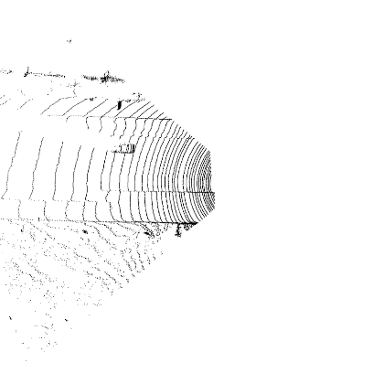
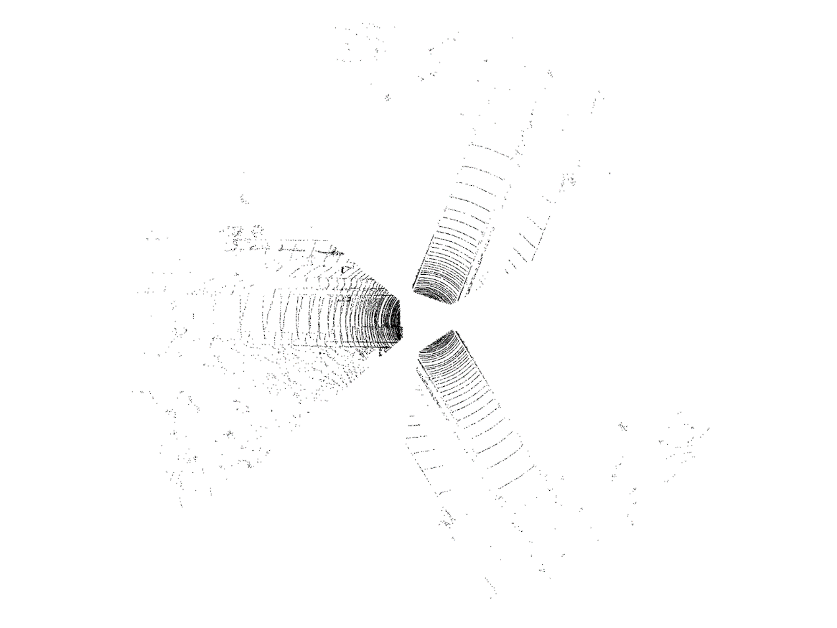
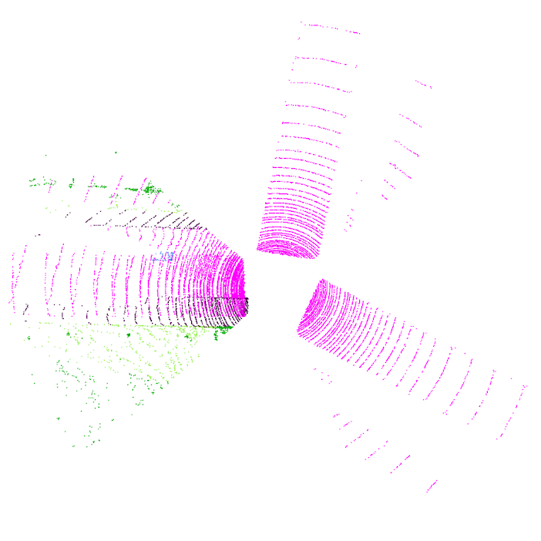

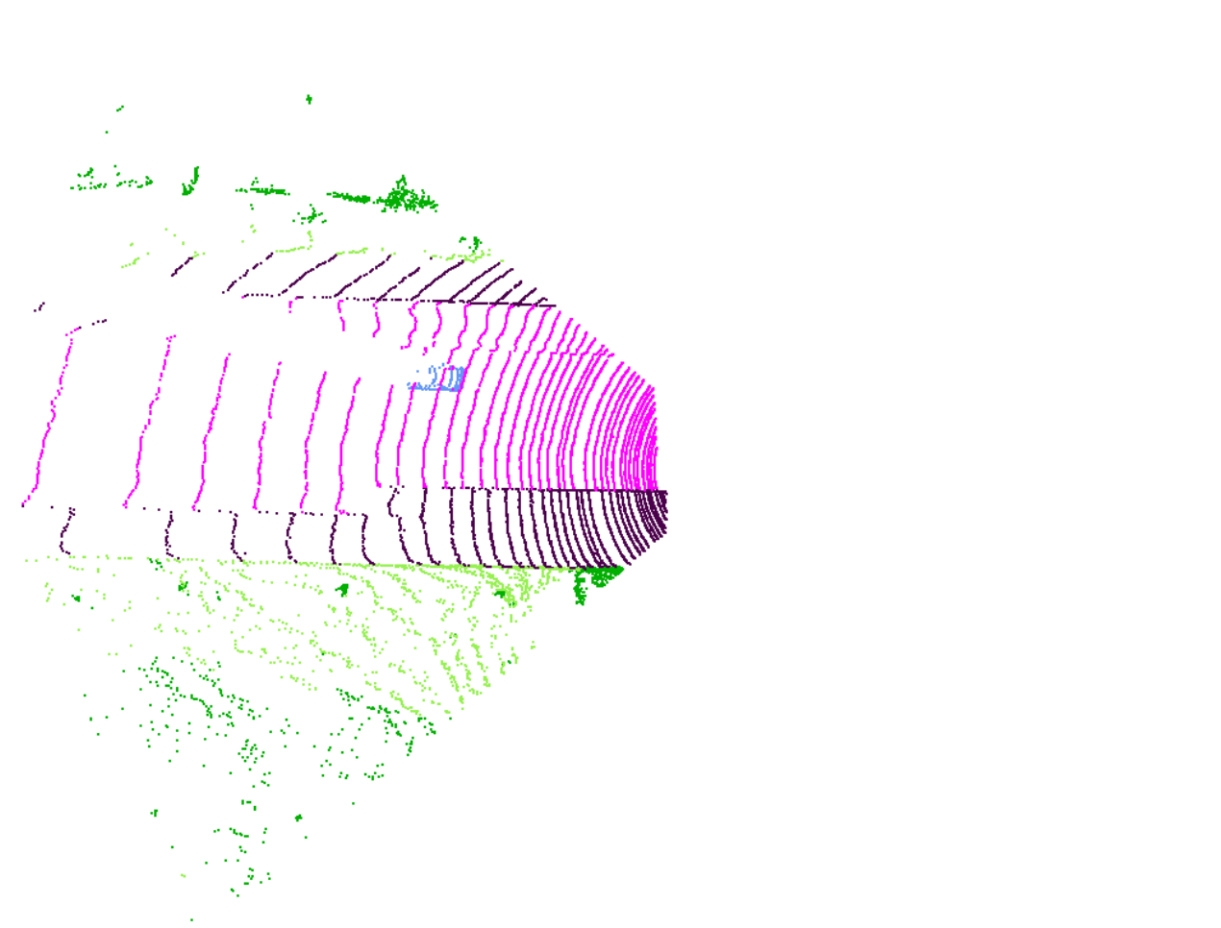
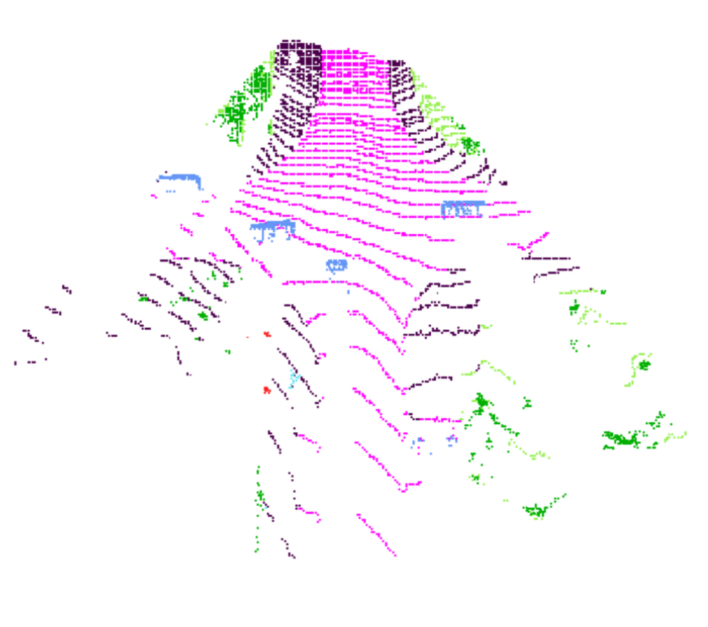

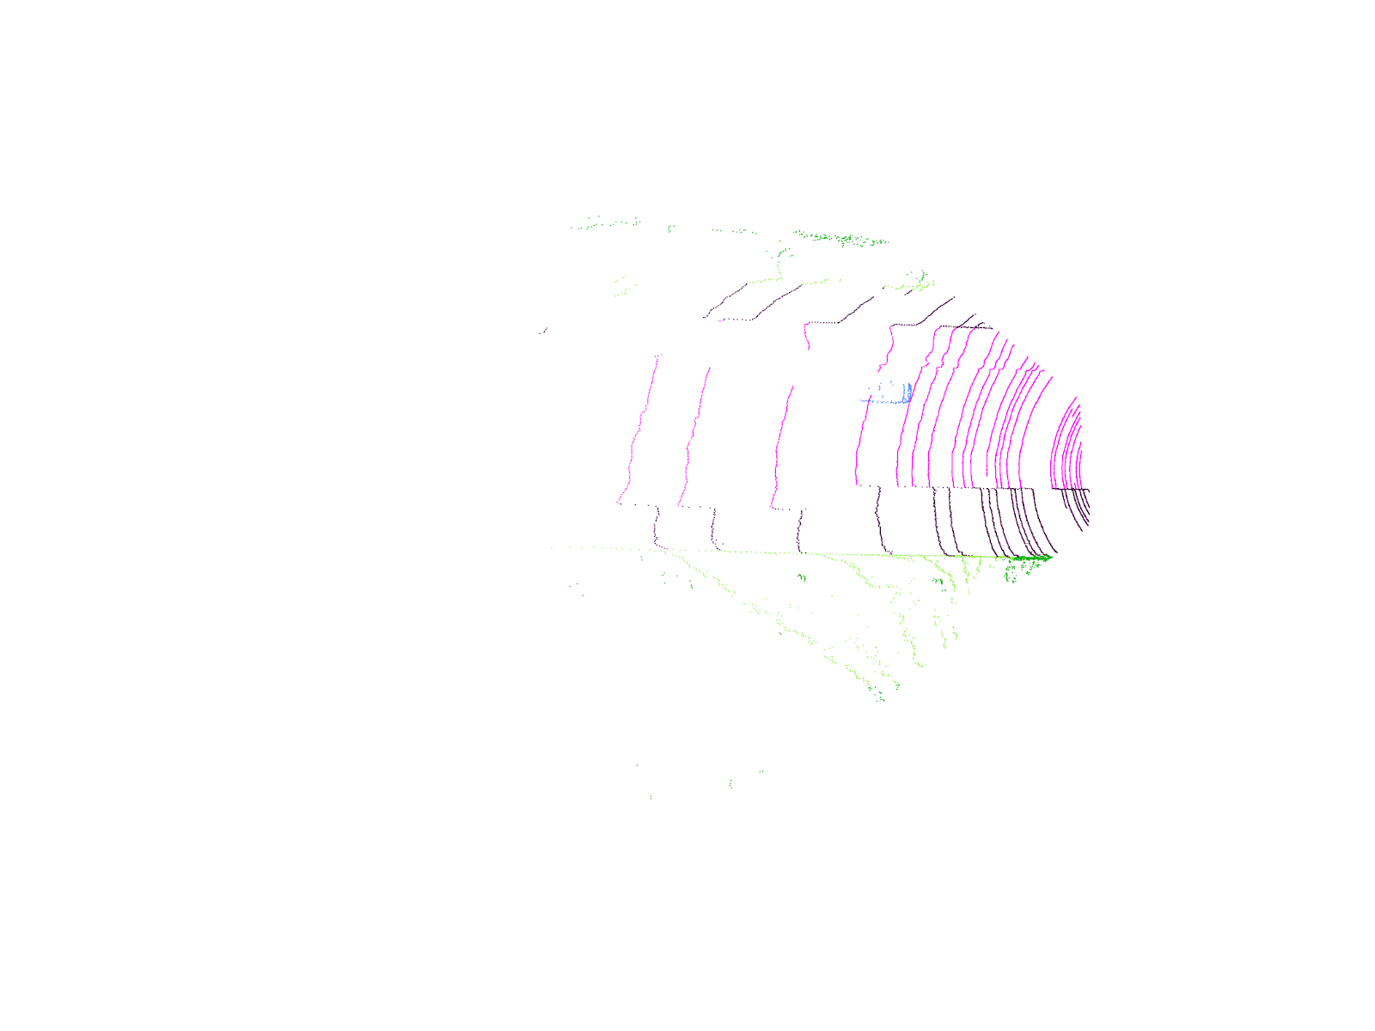






















$$P^{ss}$$
$$V^{ss}$$
$$𝓛_{NPN}$$
Encoder
Decoder
$$F^{s}$$
Classifier
Candidate Labels
Concat.
filter
Complementary Labels
$${\hat{y}}^{s}$$
$$P^{s}$$
$$P^{sa}$$
$$V^{sa}$$
$$𝓛_{FC}$$
Shared
Shared
$$P^{w}$$
$$P^{ws}$$
$$V^{ws}$$
$$F^{ws}$$
$$𝓛_{SIFC}$$
$$𝓛_{sem}$$
Split
$${\hat{y}}^{ws}$$
Concat.
Metric Learner
Encoder
Decoder
$$𝓛_{SCC}$$
$$P^{wa}$$
$$V^{wa}$$
$$F^{wa}$$
$$𝓛_{sem}$$
Classifier
$${\hat{y}}^{wa}$$

