Slide 1
A TMVA framework for VBS analysis
Sergey Uzunyan
LPC Multiboson with Jets team meeting Nov 13, 2019
Raw hit data ( 1 Byte, both for fiber and cal info)
Acronyms : ts - time stamp, mks (0-262144) ;
lfn* – local fiber # (0 – 64) ; pn - plane # ( 0 – 100)
Ef – fiber readout , Ep – plane readout

Slide 2
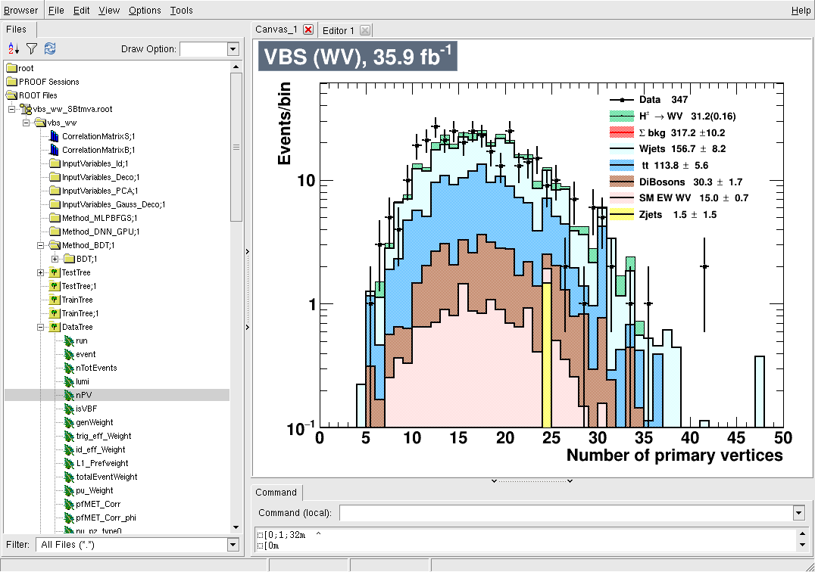
Software
ROOT TMVA
Input :: reduced VBS ntuples (data and MC), 2016
Output :: combined ntuple with TMVA discriminants
Purpose :: fast evaluation of VBS data and MC
Code and documentation: cmslpcgpu1:/home/serguei/nobackup/suvbs/archive/vbstmva.tgz
LPC Multiboson with Jets team meeting -1- S. Uzunyan, NIU -1- Nov 13, 2019
Raw hit data ( 1 Byte, both for fiber and cal info)
Acronyms : ts - time stamp, mks (0-262144) ;
lfn* – local fiber # (0 – 64) ; pn - plane # ( 0 – 100)
Ef – fiber readout , Ep – plane readout

Slide 3
Features
Tools (see also README.cmslpc)
- to examine TMVA plots
tmgui()
- to create set of control plots for TCut=allCuts
cplots(anl, allCuts, "allCuts")
- to find cut on NN discriminants that corresponds to the maximum of significance Example for S= s/sqrt(s+b) , BDT
anl->optCutScan("sgf1",tmvasel+allCuts,"BDT",-1, 1, 0.1,0.0005, 20)
- to create nice looking plots with custom axis labels, title, log scale -
plotvar(anl, "BDT", tmvasel+allCuts, 1.0, 1, 1, -1., 1.3, 0.05, 1, 0, "VBS (WV), 35.9 fb^{-1}", "BDT", "Events/bin");
#############################################################
Development (code tested on cmslpcgpuX nodes)
- to change set of NN variables
edit TMVAVARS in write_vbsDL.sh; ./writeDL.sh
##############################################################
LPC Multiboson with Jets team meeting -2- S. Uzunyan, NIU -2- Nov 13, 2019
Raw hit data ( 1 Byte, both for fiber and cal info)
Acronyms : ts - time stamp, mks (0-262144) ;
lfn* – local fiber # (0 – 64) ; pn - plane # ( 0 – 100)
Ef – fiber readout , Ep – plane readout

Slide 4
Optimization Example.
VBS paper, Table 2 selections
~2x significance increase
BDT>0.07
LPC Multiboson with Jets team meeting -3- S. Uzunyan, NIU -3- Nov 13, 2019
Raw hit data ( 1 Byte, both for fiber and cal info)
Acronyms : ts - time stamp, mks (0-262144) ;
lfn* – local fiber # (0 – 64) ; pn - plane # ( 0 – 100)
Ef – fiber readout , Ep – plane readout

Slide 5
Summary
A working TMVA package for the VBS analysis
A lot of things to play with
Some technical things to improve/add
- limit calculation, systematic, e. t. c.
- NN configurations
LPC Multiboson with Jets team meeting -4- S. Uzunyan, NIU -4- Nov 13, 2019
Raw hit data ( 1 Byte, both for fiber and cal info)
Acronyms : ts - time stamp, mks (0-262144) ;
lfn* – local fiber # (0 – 64) ; pn - plane # ( 0 – 100)
Ef – fiber readout , Ep – plane readout

Slide 6
Backup Slides
Raw hit data ( 1 Byte, both for fiber and cal info)
Acronyms : ts - time stamp, mks (0-262144) ;
lfn* – local fiber # (0 – 64) ; pn - plane # ( 0 – 100)
Ef – fiber readout , Ep – plane readout

Slide 7
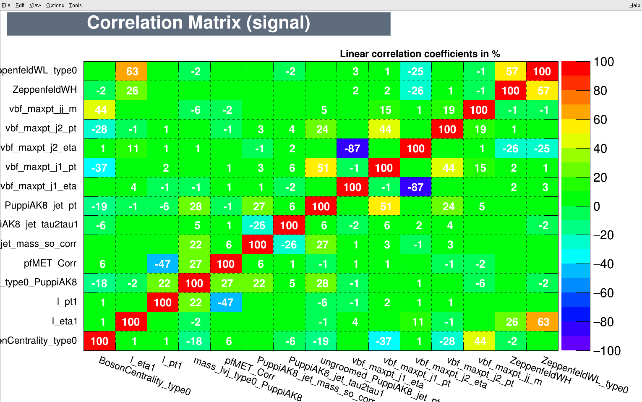
Correlation matrix
LPC Multiboson with Jets team meeting -5- S. Uzunyan, NIU -5- Nov 13, 2019
Raw hit data ( 1 Byte, both for fiber and cal info)
Acronyms : ts - time stamp, mks (0-262144) ;
lfn* – local fiber # (0 – 64) ; pn - plane # ( 0 – 100)
Ef – fiber readout , Ep – plane readout

Slide 8
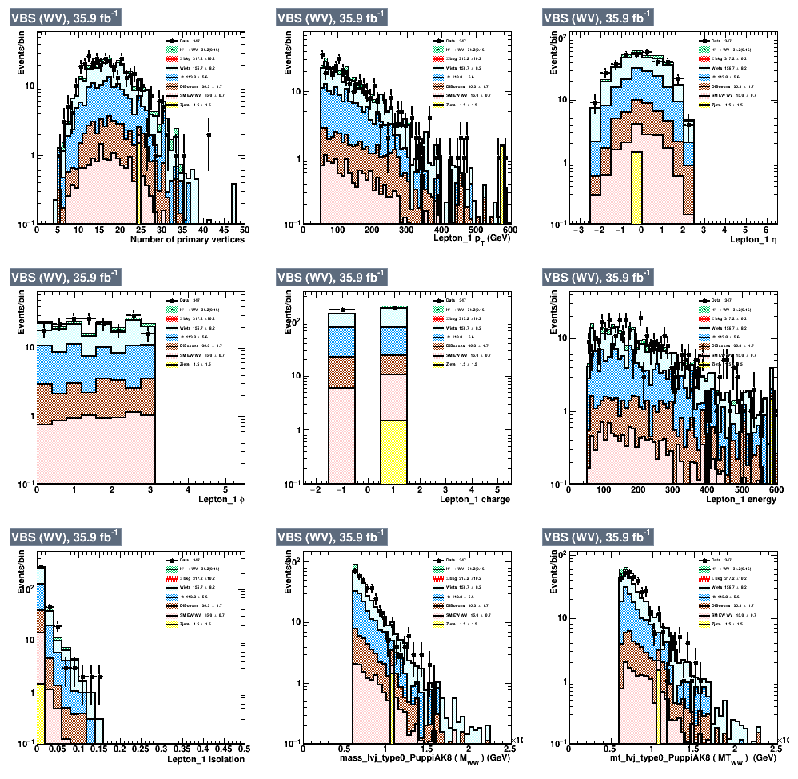
Control plots
LPC Multiboson with Jets team meeting -6- S. Uzunyan, NIU -6- Nov 13, 2019
Raw hit data ( 1 Byte, both for fiber and cal info)
Acronyms : ts - time stamp, mks (0-262144) ;
lfn* – local fiber # (0 – 64) ; pn - plane # ( 0 – 100)
Ef – fiber readout , Ep – plane readout

