Slide 1
A TMVA framework for VBS analysis
Sergey Uzunyan
LPC Multiboson with Jets team meeting Nov 13, 2019
Raw hit data ( 1 Byte, both for fiber and cal info)
Acronyms : ts - time stamp, mks (0-262144) ;
lfn* – local fiber # (0 – 64) ; pn - plane # ( 0 – 100)
Ef – fiber readout , Ep – plane readout

Slide 2
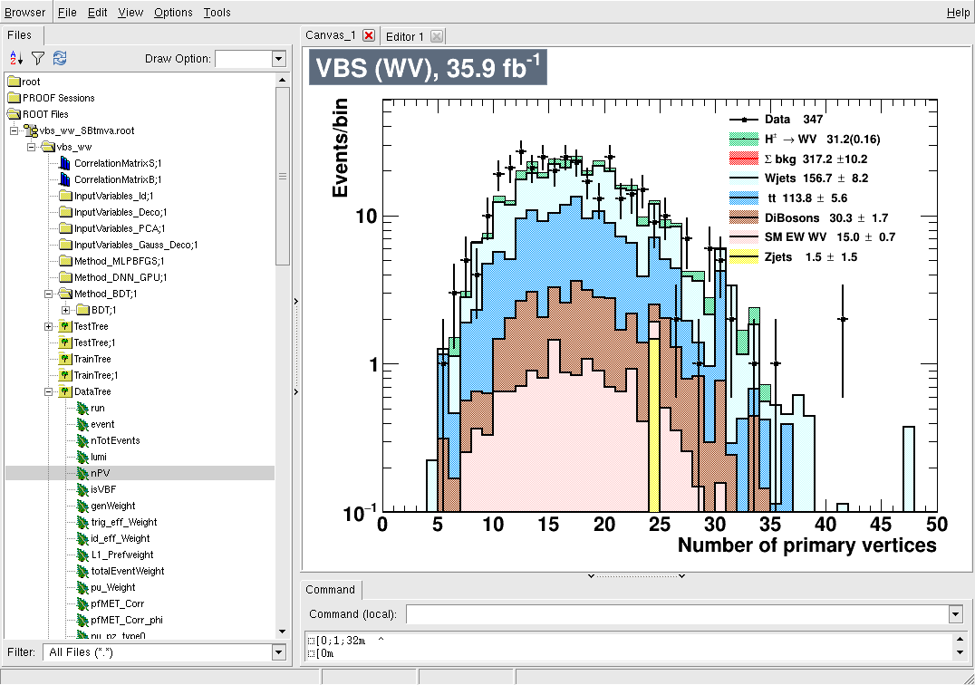
Software
ROOT TMVA
Input :: reduced VBS ntuples (data and MC), 2016
Output :: combined ntuple with TMVA discriminants
Purpose :: fast evaluation of VBS data and MC
Code and documentation: cmslpcgpu1:/home/serguei/nobackup/suvbs/archive/vbstmva.tgz
LPC Multiboson with Jets team meeting -1- S. Uzunyan, NIU -1- Nov 13, 2019
Raw hit data ( 1 Byte, both for fiber and cal info)
Acronyms : ts - time stamp, mks (0-262144) ;
lfn* – local fiber # (0 – 64) ; pn - plane # ( 0 – 100)
Ef – fiber readout , Ep – plane readout

Slide 3
Features
Tools (see also README.cmslpc)
- to examine TMVA plots
tmgui()
- to create set of control plots for TCut=allCuts
cplots(anl, allCuts, "allCuts")
- to find cut on NN discriminants that corresponds to the maximum of significance Example for S= s/sqrt(s+b) , BDT
anl->optCutScan("sgf1",tmvasel+allCuts,"BDT",-1, 1, 0.1,0.0005, 20)
- to create nice looking plots with custom axis labels, title, log scale -
plotvar(anl, "BDT", tmvasel+allCuts, 1.0, 1, 1, -1., 1.3, 0.05, 1, 0, "VBS (WV), 35.9 fb^{-1}", "BDT", "Events/bin");
#############################################################
Development (code tested on cmslpcgpuX nodes)
- to change set of NN variables
edit TMVAVARS in write_vbsDL.sh; ./writeDL.sh
##############################################################
LPC Multiboson with Jets team meeting -2- S. Uzunyan, NIU -2- Nov 13, 2019
Raw hit data ( 1 Byte, both for fiber and cal info)
Acronyms : ts - time stamp, mks (0-262144) ;
lfn* – local fiber # (0 – 64) ; pn - plane # ( 0 – 100)
Ef – fiber readout , Ep – plane readout

Slide 4
Optimization Example.
VBS paper, Table 2 selections
~2x significance increase
BDT>0.07
LPC Multiboson with Jets team meeting -3- S. Uzunyan, NIU -3- Nov 13, 2019
Raw hit data ( 1 Byte, both for fiber and cal info)
Acronyms : ts - time stamp, mks (0-262144) ;
lfn* – local fiber # (0 – 64) ; pn - plane # ( 0 – 100)
Ef – fiber readout , Ep – plane readout

Slide 5
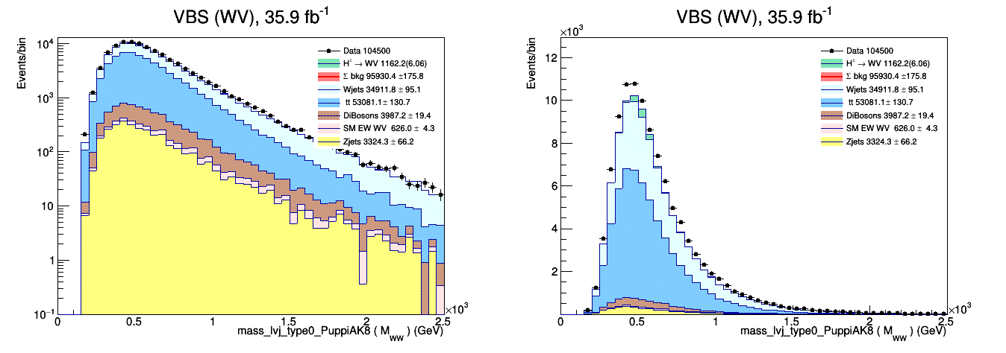
Interesting plots
|----------------------------------------------------------------------------------------|
| rOneLpt | 104500 | 95926.3+/-175.9 | 1162.18+/-15.31 ( 6.06) | 3.73 | 3.75 |
|----------------------------------------------------------------------------------------|
TCut rOneLpt ("rOneLpt", "(l_pt2<0 && l_pt1>50 && (((type==0)&&(abs(l_eta1)<2.4)) || ((type==1)&&((abs(l_eta1)<2.5)&&!(abs(l_eta1)>1.4442 && abs(l_eta1)<1.566)))))" );
LPC Multiboson with Jets team meeting -4- S. Uzunyan, NIU -4- Nov 13, 2019
Raw hit data ( 1 Byte, both for fiber and cal info)
Acronyms : ts - time stamp, mks (0-262144) ;
lfn* – local fiber # (0 – 64) ; pn - plane # ( 0 – 100)
Ef – fiber readout , Ep – plane readout

Slide 6
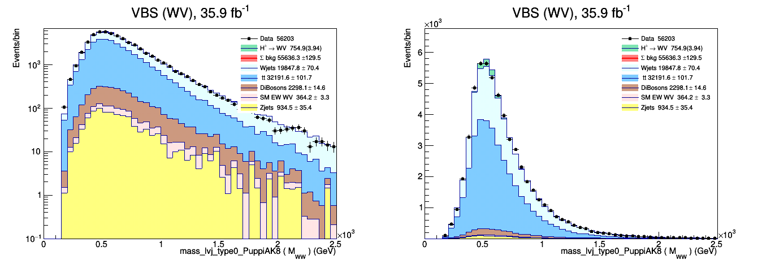
Interesting plots
|----------------------------------------------------------------------------------------|
| rOneLpt | 56203 | 55712.2+/-129.7 | 754.92+/-12.53 ( 3.94) | 3.18 | 3.20 |
|----------------------------------------------------------------------------------------|
TCut rOneLpt+ rpfMETpuppi_m50e80
Note: nice DATA/MC agreement
LPC Multiboson with Jets team meeting -4- S. Uzunyan, NIU -4- Nov 13, 2019
Raw hit data ( 1 Byte, both for fiber and cal info)
Acronyms : ts - time stamp, mks (0-262144) ;
lfn* – local fiber # (0 – 64) ; pn - plane # ( 0 – 100)
Ef – fiber readout , Ep – plane readout

Slide 7
Interesting plots
TCut rOneLpt+ rpfMETpuppi_m50e80
|----------------------------------------------------------------------------------------|
| rOneLpt | 56203 | 55712.2+/-129.7 | 754.92+/-12.53 ( 3.94) | 3.18 | 3.20 |
|----------------------------------------------------------------------------------------|
TCut rOneLpt+ rpfMETpuppi_m50e80+rptjjVBF30
|----------------------------------------------------------------------------------------|
| rOneLpt | 56203 | 55712.2+/-129.7 | 754.92+/-12.53 ( 3.94) | 3.18 | 3.20 |
|----------------------------------------------------------------------------------------|
Note: nice DATA/MC agreement and no effect of pt30 cut
LPC Multiboson with Jets team meeting -4- S. Uzunyan, NIU -4- Nov 13, 2019
Raw hit data ( 1 Byte, both for fiber and cal info)
Acronyms : ts - time stamp, mks (0-262144) ;
lfn* – local fiber # (0 – 64) ; pn - plane # ( 0 – 100)
Ef – fiber readout , Ep – plane readout

Slide 8
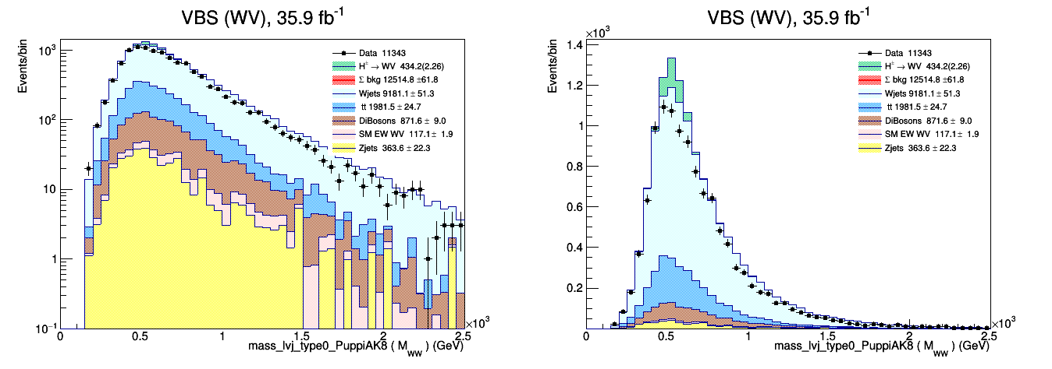
Interesting plots
TCut rOneLpt+ rpfMETpuppi_m50e80+rptjjVBF30+(nBTagJet_loose==0)
|----------------------------------------------------------------------------------------|
| rOneLpt | 11343 | 12540.3+/-62.0 | 434.16+/-9.66 ( 2.26) | 3.81 | 3.88 |
|----------------------------------------------------------------------------------------|
Note: Excess of MC in central mass bins
LPC Multiboson with Jets team meeting -4- S. Uzunyan, NIU -4- Nov 13, 2019
Raw hit data ( 1 Byte, both for fiber and cal info)
Acronyms : ts - time stamp, mks (0-262144) ;
lfn* – local fiber # (0 – 64) ; pn - plane # ( 0 – 100)
Ef – fiber readout , Ep – plane readout

Slide 9
Interesting plots
TCut rOneLpt+ rpfMETpuppi_m50e80+rptjjVBF30+(nBTagJet_loose==0)
|----------------------------------------------------------------------------------------|
| rOneLpt | 11343 | 12540.3+/-62.0 | 434.16+/-9.66 ( 2.26) | 3.81 | 3.88 |
|----------------------------------------------------------------------------------------|
TCut rOneLpt+ rpfMETpuppi_m50e80+rptjjVBF30+
(nBTagJet_loose==0)+(ungroomed_PuppiAK8_jet_pt>200)
|----------------------------------------------------------------------------------------|
| rOneLpt | 11343 | 12540.3+/-62.0 | 434.16+/-9.66 ( 2.26) | 3.81 | 3.88 |
|----------------------------------------------------------------------------------------|
Note: Excess of MC in central mass bins; MC drops;
LPC Multiboson with Jets team meeting -4- S. Uzunyan, NIU -4- Nov 13, 2019
Raw hit data ( 1 Byte, both for fiber and cal info)
Acronyms : ts - time stamp, mks (0-262144) ;
lfn* – local fiber # (0 – 64) ; pn - plane # ( 0 – 100)
Ef – fiber readout , Ep – plane readout

Slide 10
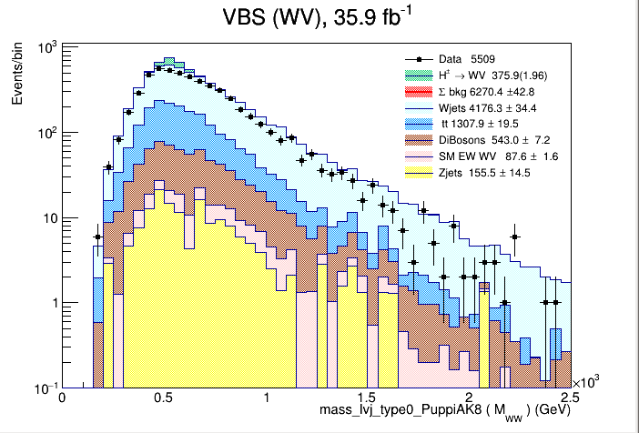
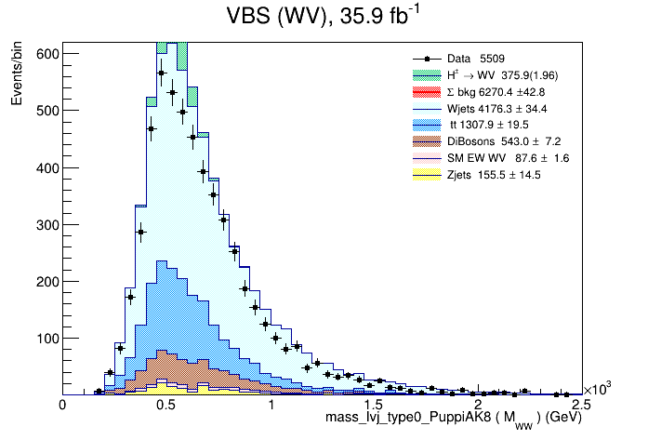
Interesting plots
TCut … + ((PuppiAK8_jet_mass_so_corr>65) && (PuppiAK8_jet_mass_so_corr<105))
|----------------------------------------------------------------------------------------|
| rOneLpt | 5509 | 6270.4+/-42.8 | 375.95+/-9.02 ( 1.96) | 4.61 | 4.75 |
|----------------------------------------------------------------------------------------|
r
Note: Excess of MC in central mass bins; MC drops;
LPC Multiboson with Jets team meeting -4- S. Uzunyan, NIU -4- Nov 13, 2019
Raw hit data ( 1 Byte, both for fiber and cal info)
Acronyms : ts - time stamp, mks (0-262144) ;
lfn* – local fiber # (0 – 64) ; pn - plane # ( 0 – 100)
Ef – fiber readout , Ep – plane readout

Slide 11
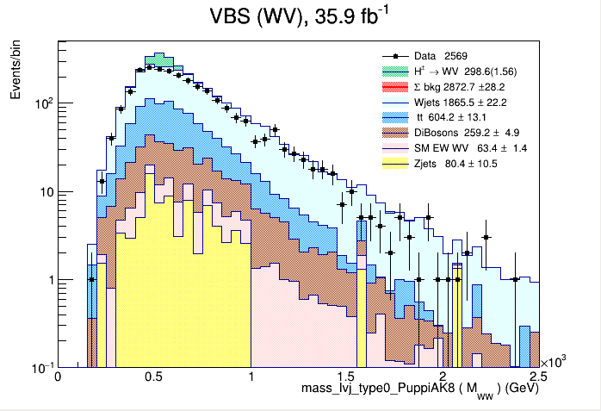
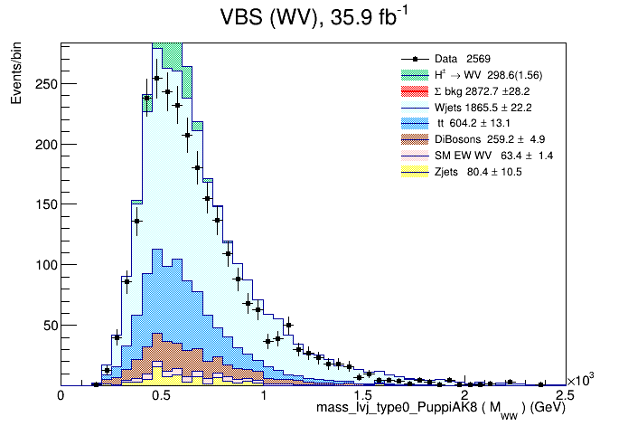
Interesting plots
TCut … + (vbf_maxpt_jj_m>800)
|----------------------------------------------------------------------------------------|
| rOneLpt | 2569 | 2872.7+/-28.2 | 298.61+/-8.06 ( 1.56) | 5.30 | 5.57 |
|----------------------------------------------------------------------------------------|
Note: Excess of MC in central mass bins; MC drops;
LPC Multiboson with Jets team meeting -4- S. Uzunyan, NIU -4- Nov 13, 2019
Raw hit data ( 1 Byte, both for fiber and cal info)
Acronyms : ts - time stamp, mks (0-262144) ;
lfn* – local fiber # (0 – 64) ; pn - plane # ( 0 – 100)
Ef – fiber readout , Ep – plane readout

Slide 12
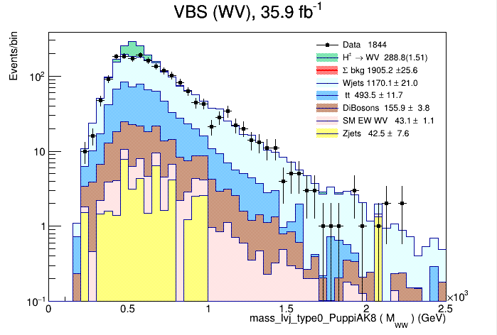
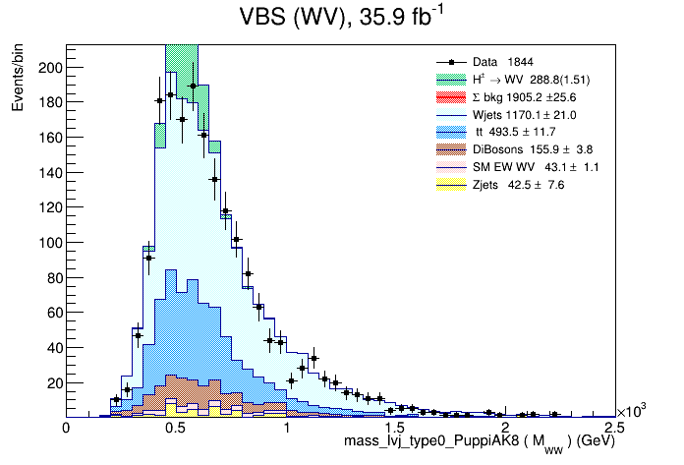
Interesting plots
TCut … + (abs(vbf_maxpt_j2_eta-vbf_maxpt_j1_eta)>4.0)
|----------------------------------------------------------------------------------------|
| rOneLpt | 1844 | 1905.2+/-25.6 | 288.83+/-7.95 ( 1.51) | 6.17 | 6.62 |
|----------------------------------------------------------------------------------------|
Note: Excess of MC in central mass bins; MC drops;
LPC Multiboson with Jets team meeting -4- S. Uzunyan, NIU -4- Nov 13, 2019
Raw hit data ( 1 Byte, both for fiber and cal info)
Acronyms : ts - time stamp, mks (0-262144) ;
lfn* – local fiber # (0 – 64) ; pn - plane # ( 0 – 100)
Ef – fiber readout , Ep – plane readout

Slide 13
CutFlow
|----------------------------------------------------------------------------------------|
| rOneLpt | 104500 | 95926.3+/-175.9 | 1162.18+/-15.31 ( 6.06) | 3.73 | 3.75 |
|----------------------------------------------------------------------------------------|
|----------------------------------------------------------------------------------------|
| met_m50e80 | 56203 | 55712.2+/-129.7 | 754.92+/-12.53 ( 3.94) | 3.18 | 3.20 |
|----------------------------------------------------------------------------------------|
|----------------------------------------------------------------------------------------|
| j1j2pt30 | 56203 | 55712.2+/-129.7 | 754.92+/-12.53 ( 3.94) | 3.18 | 3.20 |
|----------------------------------------------------------------------------------------|
|----------------------------------------------------------------------------------------|
| nBtagJetL | 11343 | 12540.3+/-62.0 | 434.16+/-9.66 ( 2.26) | 3.81 | 3.88 |
|----------------------------------------------------------------------------------------|
|----------------------------------------------------------------------------------------|
| fatjetpt200| 11343 | 12540.3+/-62.0 | 434.16+/-9.66 ( 2.26) | 3.81 | 3.88 |
|----------------------------------------------------------------------------------------|
|----------------------------------------------------------------------------------------|
| fatjeteta2p4 | 11343 | 12540.3+/-62.0 | 434.16+/-9.66 ( 2.26) | 3.81 | 3.88 |
|----------------------------------------------------------------------------------------|
|----------------------------------------------------------------------------------------|
| mjw65-105 | 5509 | 6270.4+/-42.8 | 375.95+/-9.02 ( 1.96) | 4.61 | 4.75 |
|----------------------------------------------------------------------------------------|
|----------------------------------------------------------------------------------------|
| MjjVBF800 | 2569 | 2872.7+/-28.2 | 298.61+/-8.06 ( 1.56) | 5.30 | 5.57 |
|----------------------------------------------------------------------------------------|
|----------------------------------------------------------------------------------------|
| detajjVBF4 | 1844 | 1905.2+/-25.6 | 288.83+/-7.95 ( 1.51) | 6.17 | 6.62 |
|----------------------------------------------------------------------------------------|
LPC Multiboson with Jets team meeting -4- S. Uzunyan, NIU -4- Nov 13, 2019
Raw hit data ( 1 Byte, both for fiber and cal info)
Acronyms : ts - time stamp, mks (0-262144) ;
lfn* – local fiber # (0 – 64) ; pn - plane # ( 0 – 100)
Ef – fiber readout , Ep – plane readout

Slide 14
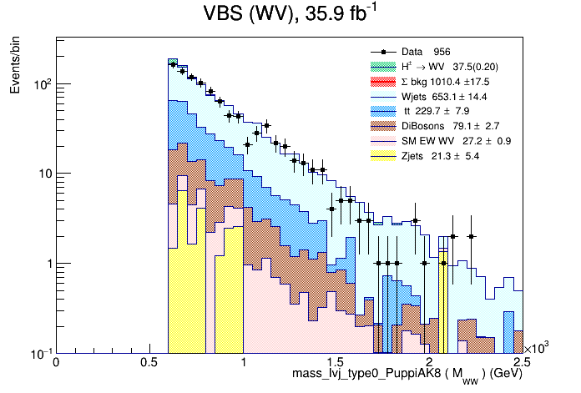
Forgotten cut (in Raman's description)
TCut … + (mass_lvj_type0_PuppiAK8>600)
Likelihood function is evaluated over [0,4000]
|----------------------------------------------------------------------------------------|
| rOneLpt | 956 | 1010.4+/-17.5 | 37.50+/-2.81 ( 0.20) | 1.16 | 1.18 |
|----------------------------------------------------------------------------------------|
Note: Excess of MC in central mass bins; MC drops;
LPC Multiboson with Jets team meeting -4- S. Uzunyan, NIU -4- Nov 13, 2019
Raw hit data ( 1 Byte, both for fiber and cal info)
Acronyms : ts - time stamp, mks (0-262144) ;
lfn* – local fiber # (0 – 64) ; pn - plane # ( 0 – 100)
Ef – fiber readout , Ep – plane readout

Slide 15
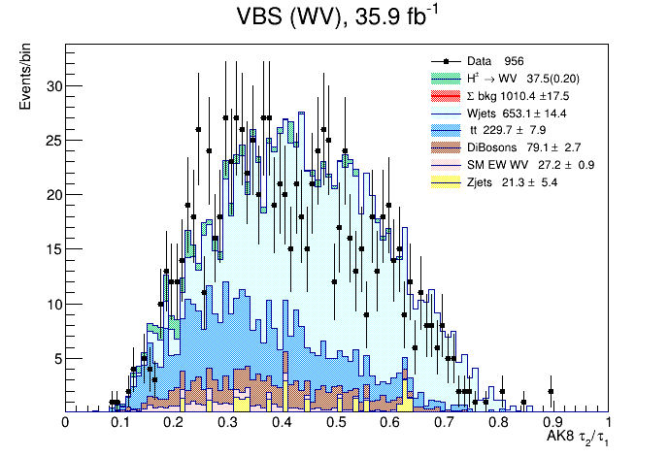
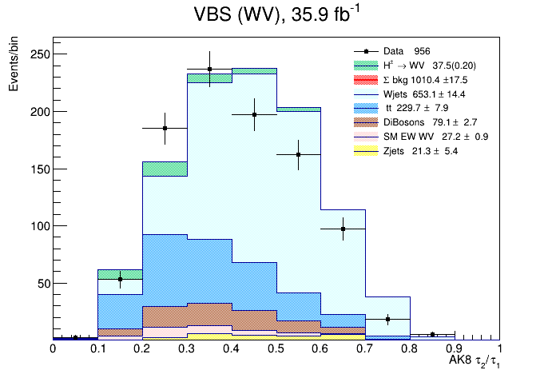
Tau21 description
TCut … + (mass_lvj_type0_PuppiAK8>600)
Likelihood function is evaluated over [0,4000]
|----------------------------------------------------------------------------------------|
| rOneLpt | 956 | 1010.4+/-17.5 | 37.50+/-2.81 ( 0.20) | 1.16 | 1.18 |
|----------------------------------------------------------------------------------------|
Note: Excess of MC in central mass bins; MC drops;
LPC Multiboson with Jets team meeting -4- S. Uzunyan, NIU -4- Nov 13, 2019
Raw hit data ( 1 Byte, both for fiber and cal info)
Acronyms : ts - time stamp, mks (0-262144) ;
lfn* – local fiber # (0 – 64) ; pn - plane # ( 0 – 100)
Ef – fiber readout , Ep – plane readout

Slide 16
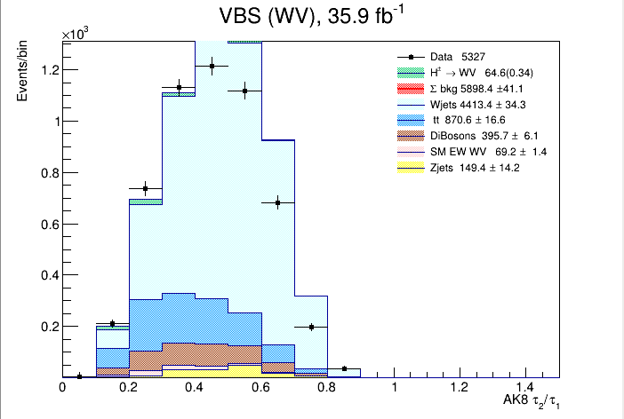


Tau21 description
TCut … + (mass_lvj_type0_PuppiAK8>600)
+ no Mass>600 cut
|----------------------------------------------------------------------------------------|
| rOneLpt | 5327 | 5898.4+/-41.1 | 64.59+/-3.67 ( 0.34) | 0.84 | 0.84 |
|----------------------------------------------------------------------------------------|
|----------------------------------------------------------------------------------------|
| rOneLpt | 10273 | 10972.7+/-60.4 | 433.12+/-9.65 ( 2.26) | 4.06 | 4.13 |
|----------------------------------------------------------------------------------------|
Note: Excess of MC in central mass bins; MC drops;
LPC Multiboson with Jets team meeting -4- S. Uzunyan, NIU -4- Nov 13, 2019
Raw hit data ( 1 Byte, both for fiber and cal info)
Acronyms : ts - time stamp, mks (0-262144) ;
lfn* – local fiber # (0 – 64) ; pn - plane # ( 0 – 100)
Ef – fiber readout , Ep – plane readout

Slide 17
Summary
A working TMVA package for the VBS analysis
A lot of things to play with
Some technical things to improve/add
- limit calculation, systematic, e. t. c.
- NN configurations
LPC Multiboson with Jets team meeting -4- S. Uzunyan, NIU -4- Nov 13, 2019
Raw hit data ( 1 Byte, both for fiber and cal info)
Acronyms : ts - time stamp, mks (0-262144) ;
lfn* – local fiber # (0 – 64) ; pn - plane # ( 0 – 100)
Ef – fiber readout , Ep – plane readout

Slide 18
Backup Slides
Raw hit data ( 1 Byte, both for fiber and cal info)
Acronyms : ts - time stamp, mks (0-262144) ;
lfn* – local fiber # (0 – 64) ; pn - plane # ( 0 – 100)
Ef – fiber readout , Ep – plane readout

Slide 19
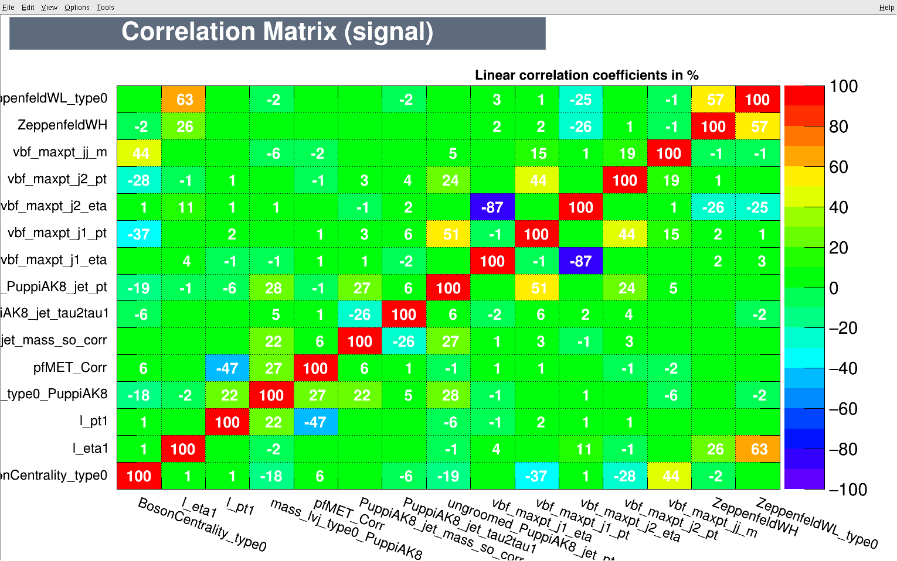
Correlation matrix
LPC Multiboson with Jets team meeting -5- S. Uzunyan, NIU -5- Nov 13, 2019
Raw hit data ( 1 Byte, both for fiber and cal info)
Acronyms : ts - time stamp, mks (0-262144) ;
lfn* – local fiber # (0 – 64) ; pn - plane # ( 0 – 100)
Ef – fiber readout , Ep – plane readout

Slide 20
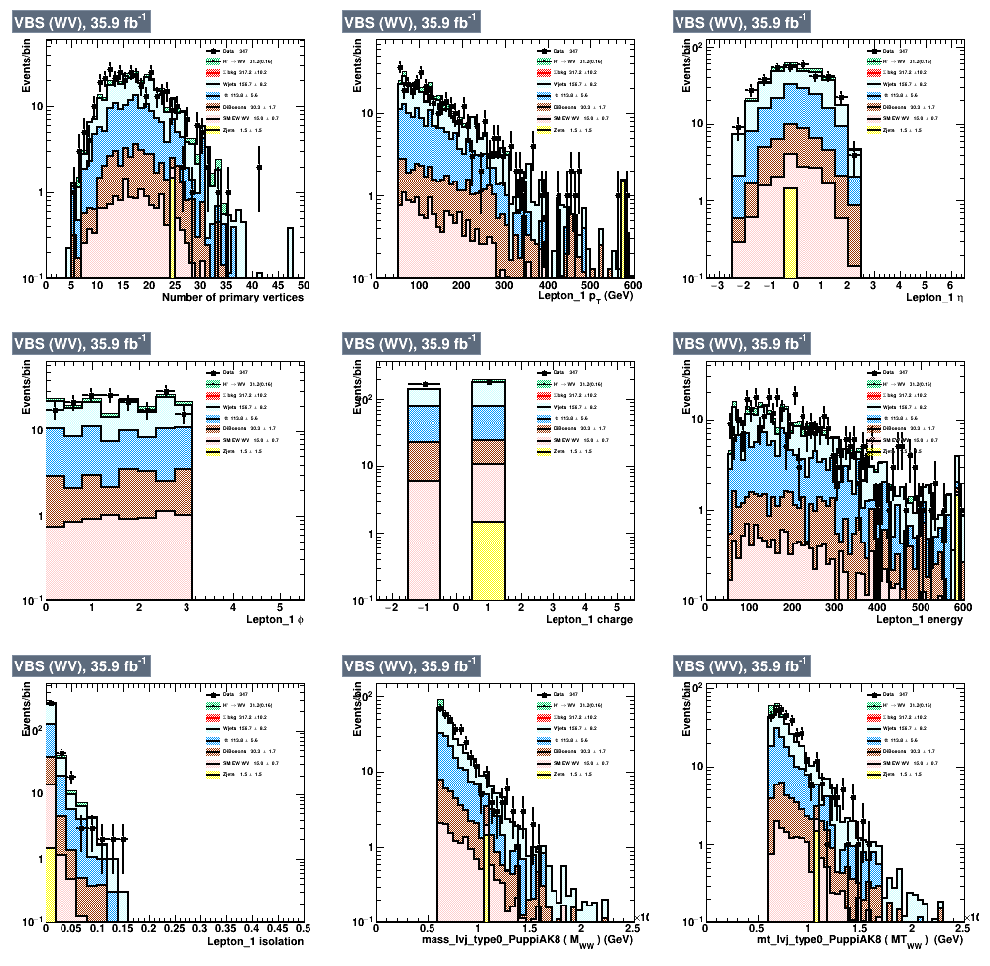
Control plots
LPC Multiboson with Jets team meeting -6- S. Uzunyan, NIU -6- Nov 13, 2019
Raw hit data ( 1 Byte, both for fiber and cal info)
Acronyms : ts - time stamp, mks (0-262144) ;
lfn* – local fiber # (0 – 64) ; pn - plane # ( 0 – 100)
Ef – fiber readout , Ep – plane readout

