Slide 1
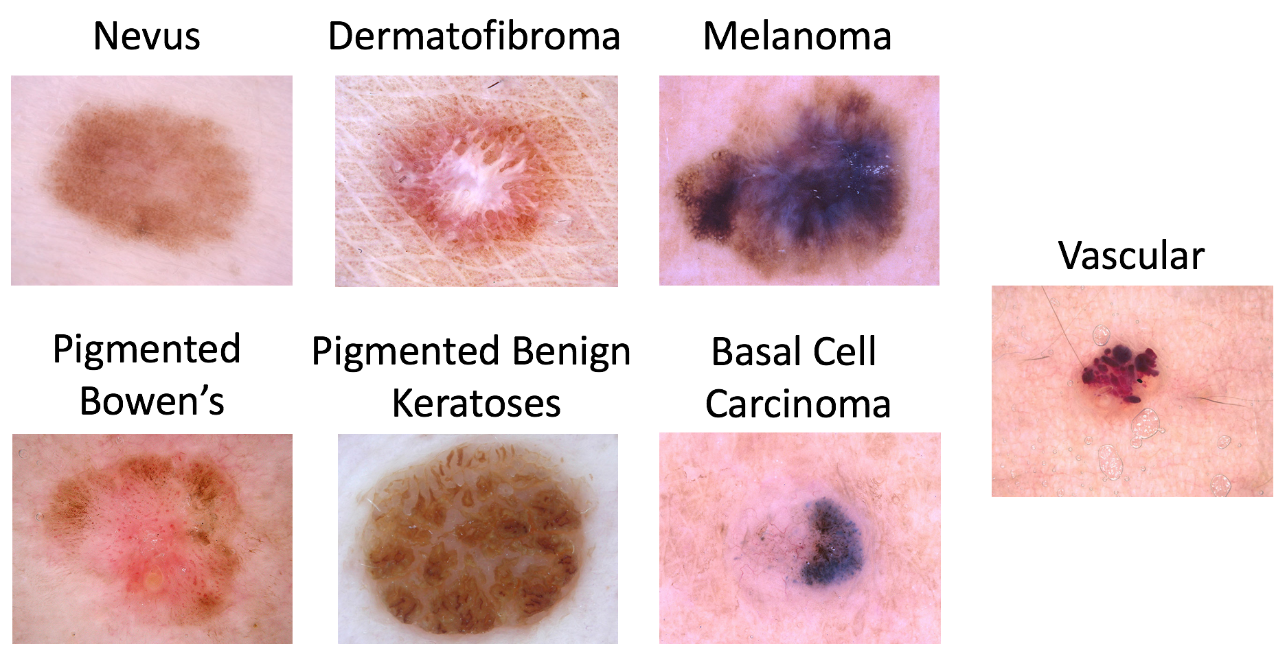
Project Seminar Overview
Goal: Develop a Computer Aided Diagnosis System for Skin Lesions
Use data-driven approach: Dataset with 10.000 images, categorized by experts into seven classes of lesions
Binary and multi-class classification
https://challenge2018.isic-archive.com/task3/

Slide 2
Project Seminar Overview (2)
Submit your results to our web-based evaluation system
Get feedback in form of multiple metrics
You will be able to compare your results with state-of-the-art research at the end of the course
Apply the developed system to images of your skin

Slide 3
Project Seminar Time Plan
Until 19.11.: Form groups of 4-6 students via Stud.IP
Phase 1 (19.11-31.12): Use manually extracted features for a classifier of your choice
Phase 2 (17.12-24.01.): Use a deep learning based approach
Present and discuss your results
in a presentation (25.01.)
in a written report (deadline in march)

