Slide 1
Lunch meeting
April 27th
Keisuke Murota

Slide 2
My recent work
Try to reduce negative sign on frustration-free quantum spin model by locally changes the basis and reweighting. (in progress)
Writing documents for Research Fellowships (DC1)
Published a book about basic statistical machine learning as a co-author
Developing New prediction model for limit order book (I haven’t touched it for a while)

Slide 3
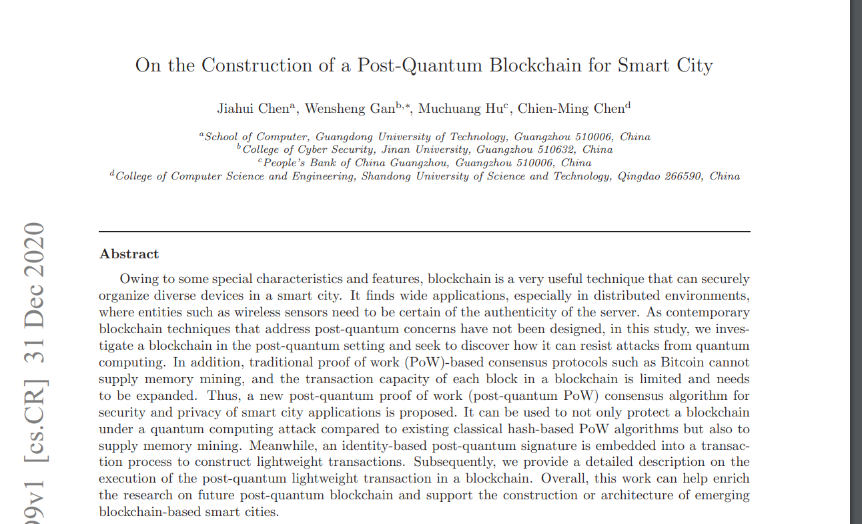
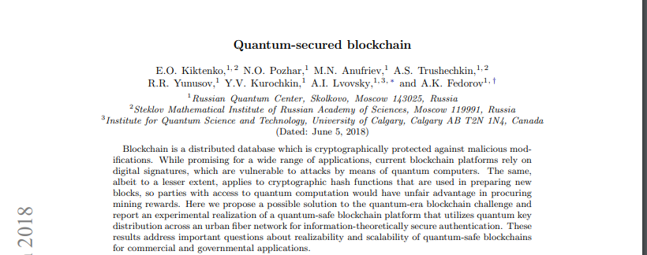

Slide 4
Theory of Blockchain

Slide 5
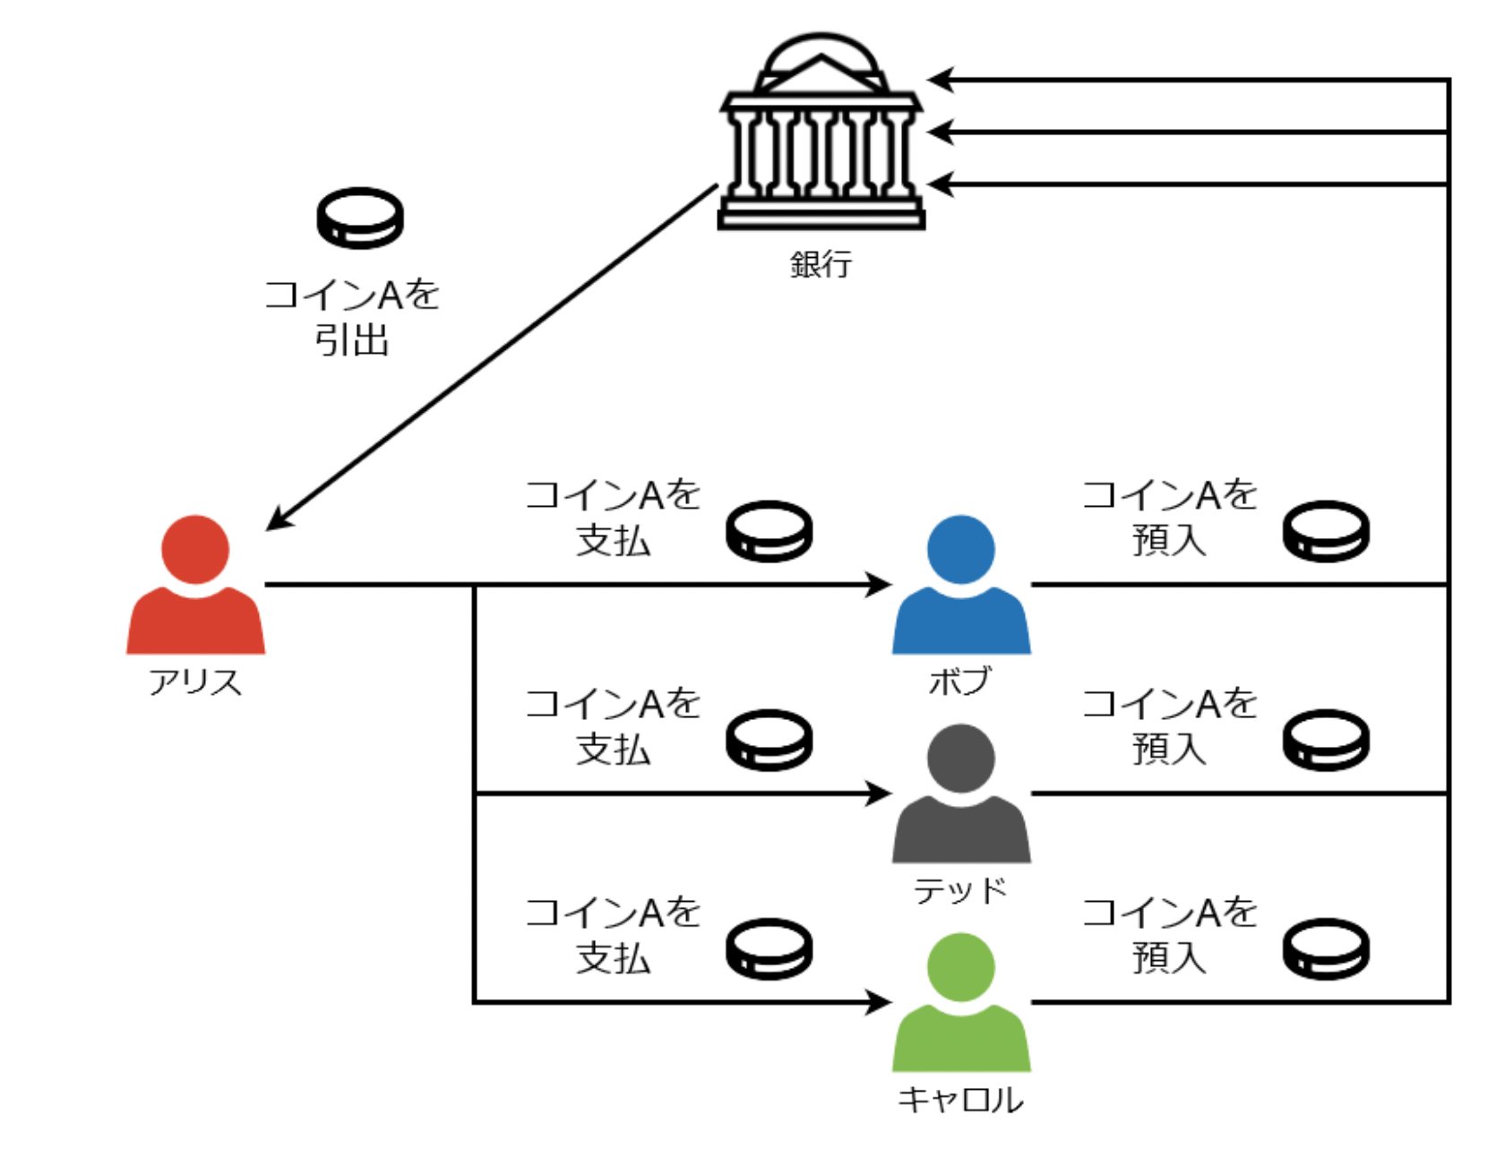
Problems of electronic cash
Tampering
Change balance
Token Forgery
Create valid-looking coin
multiple spending
Spend one electronic cash for multiple time (because electronic coin consists of digital information).
Proof for payment
Need to guarantee that you made a transfer.
multiple spending

Slide 6
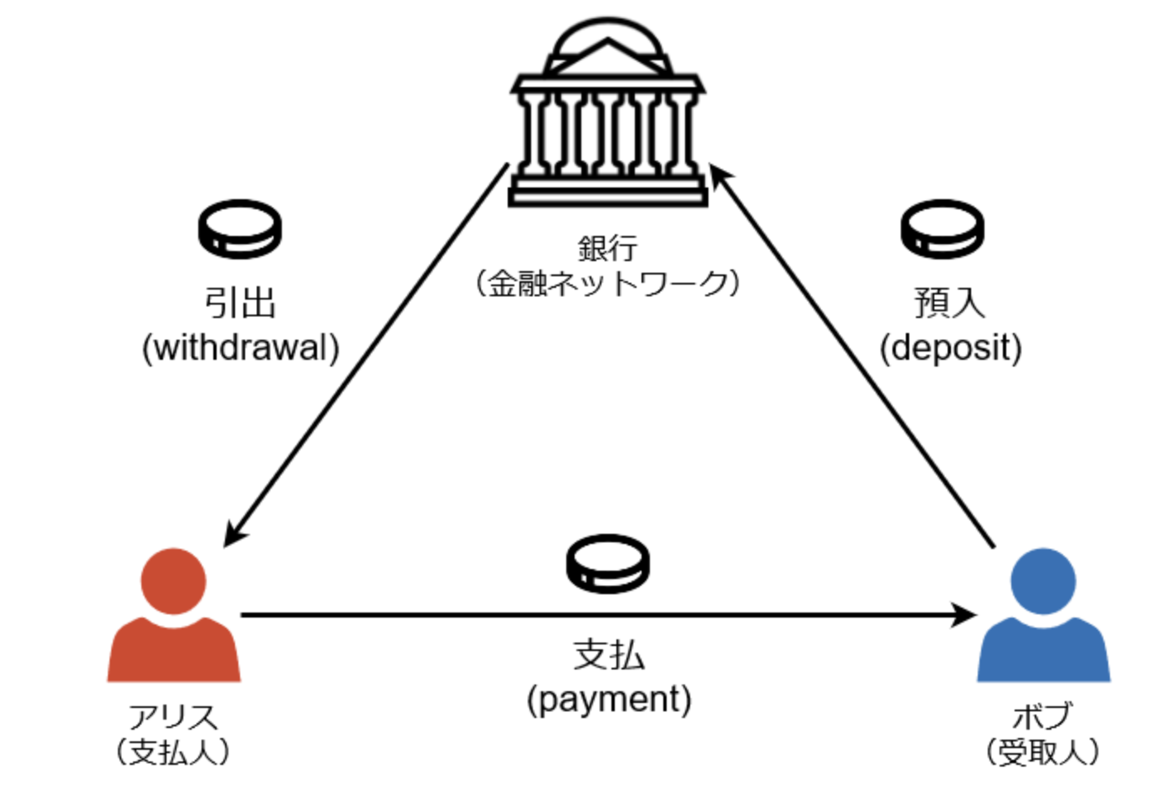
Electronic payment before blockchain
Assume the existence of Trusted Third Party(TTP)
Three process when using electric cash
Withdrawal
Payment
Deposit
If bank(TTP) manage all transaction, then there is no room for multiple spending
If the servers used in bank are secure enough, then no tempering
How to prove that the token is issued by the TTP?
Require one more step for preventing token forgery
bank
(TTP)
Alice
(payer)
Bob
(payee)

Slide 7
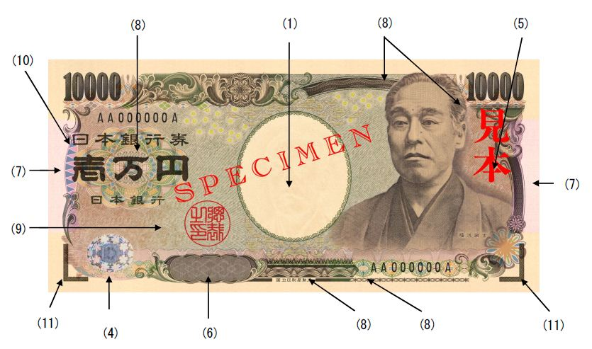
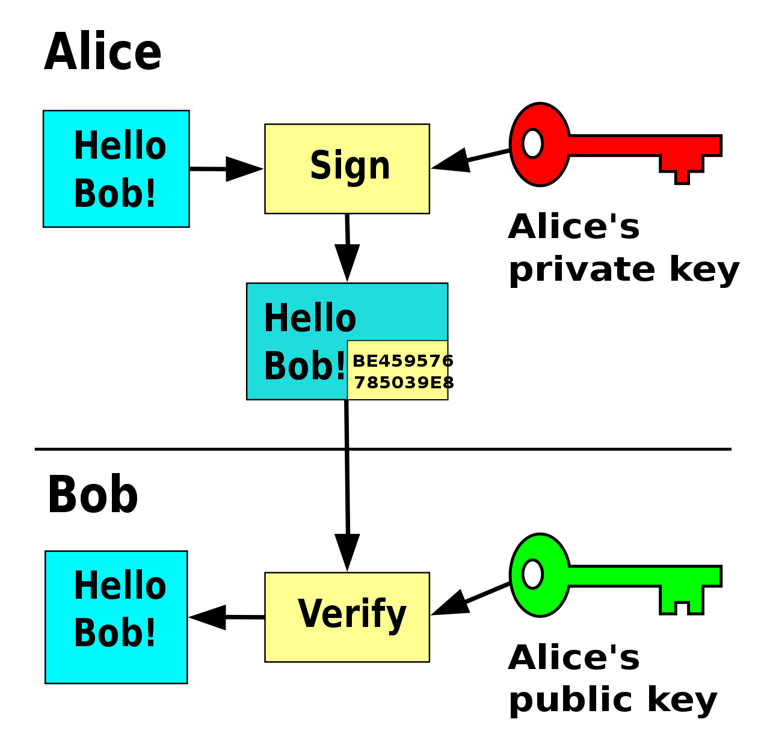
Electronic payment before blockchain
Japanese 10,000 yen bill is issued by National Printing Bureau, and justified by anti-fraud features.
Simple answer for forgrey-proof system in electronic coin
use digital signature.
EX)
Bank can attatch digital signature to electronic cash so that client (payee) verify if the coin is valid.
Digital signature

Slide 8
Some problems of rellying on TTPs
New Trusted Third Parties are Costly and Risky
Existing Trusted Third Parties are Valuable
Almost all people blindly trusting Companies like Visa, Dun and Bradstreet, Underwriter's Laboratories.
Personal Property Has Not and Should Not Depend On TTPs
Satoshi thought we should store our personal properties by ourselves.
Cost of transaction
e.g. fee for international transaction. cost when importing credit card payment
Risk of server down. (zero-downtime is required)
We hope the server or application is never down or in an unstable state.

Slide 9
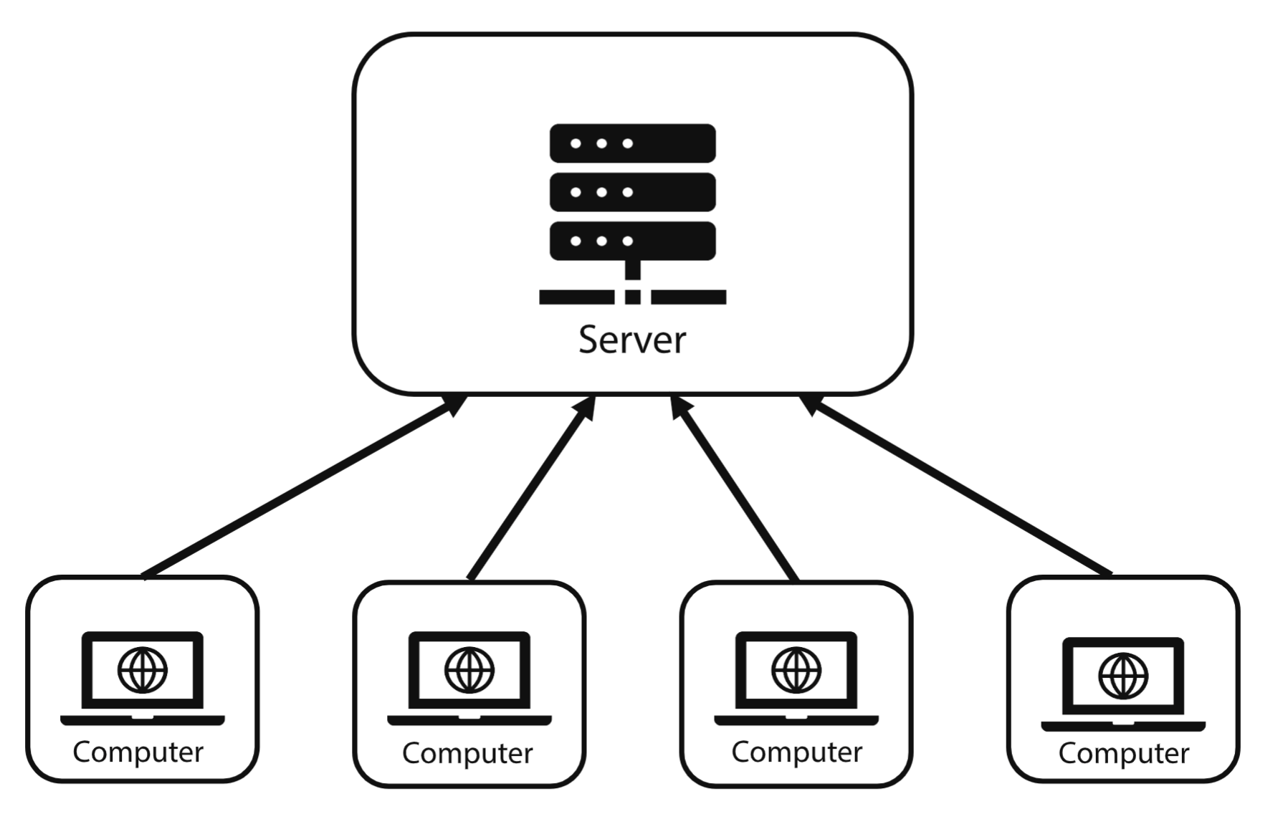
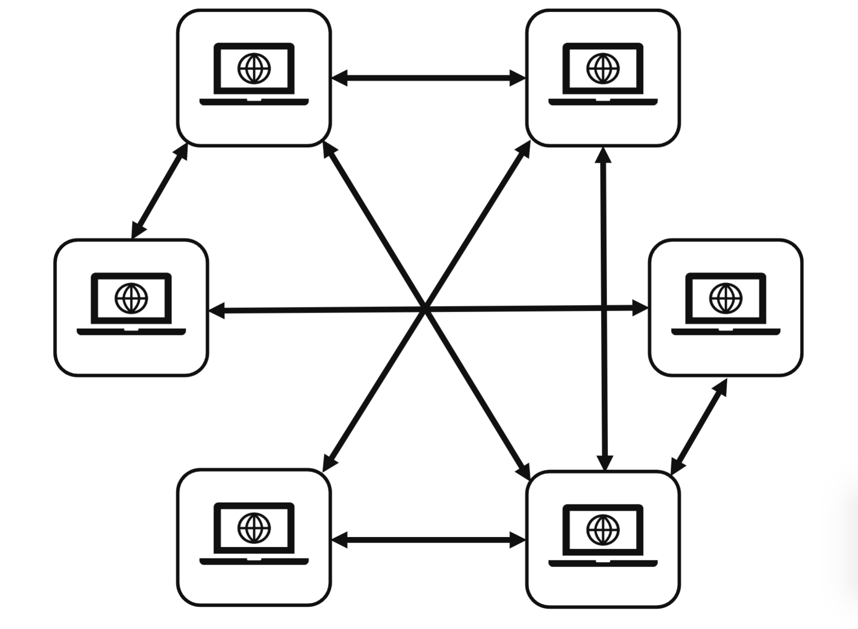
How to develop decentralized transaction system
A central idea : Peer to Peer
We don’t trust anybody but the system.
All stakeholder will be audited by the others.

Slide 10
Distribute ledger across Peers
New node downloads the entire ledger history.
Satoshi publish a model with blockchain data structure for fully decentralized, permissionless and secure ledger.
Regardless of models, distribution is the best assurance against risks of data loss, and tampering.

Slide 11
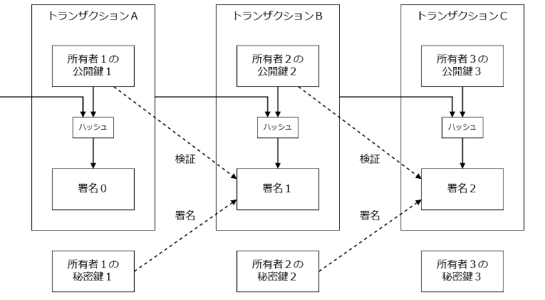
Definition of the coin
Satoshi define an electronic coin as a chain of transaction (digital signature).
Each transaction is managed by TXID
Let’s try to send 0.0005 BTC from Alice to Bob

Slide 12
Transaction
Each user has unique public & private key pairs.
Users ID are public key.
In the naïve bitcoin model, a bitcoin is sent from Alice’s public key to Bob’s public key.
When making transaction we need to create json file that contains
Input TXID’s
Output amount
Output address (Bob’s pubkey)
Digital signature of Alice.
After writing the json, Alice gonna broadcast them to whole p2p network.
Nodes receiving the TXs need to check if the input TXID’s and Digital signature are valid (in many sense)

Slide 13
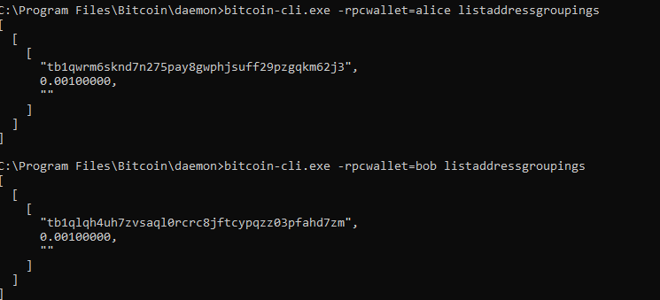
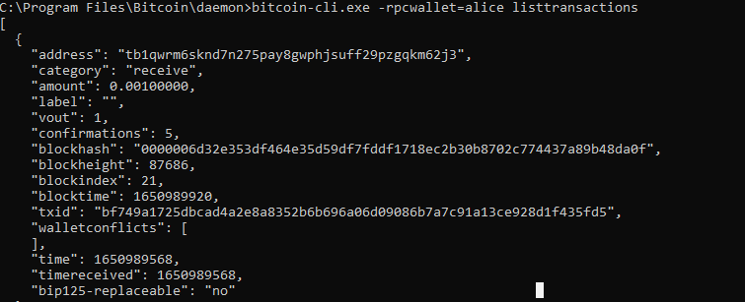

Slide 14
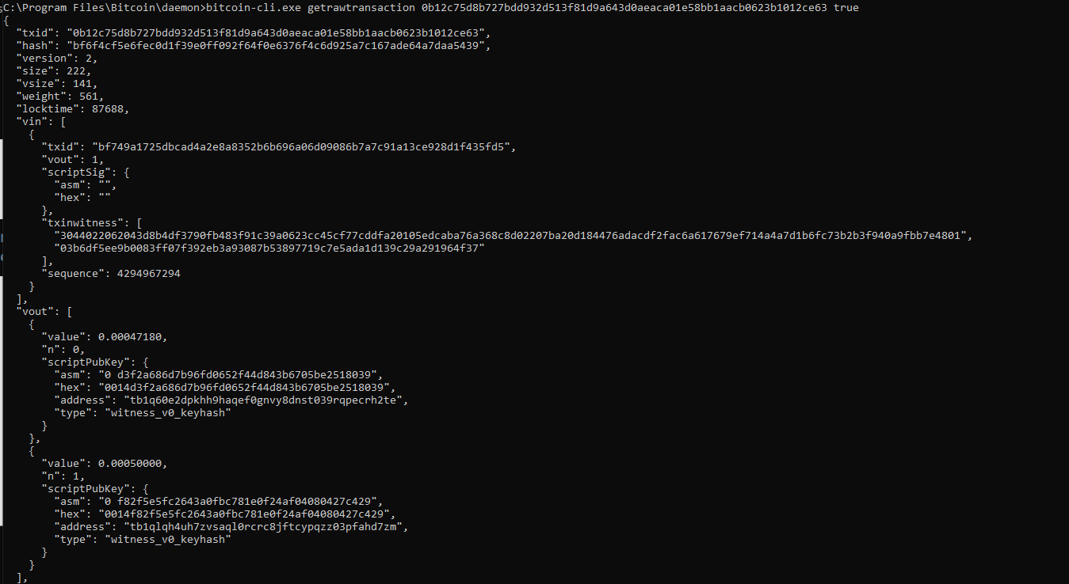


Slide 15
UTXO model
This model is called UTXO(unspent transaction outputs) model.
Peers don’t store an explicit balance for each address instead, hold all transaction history.
Ethereum use Account model.

Slide 16
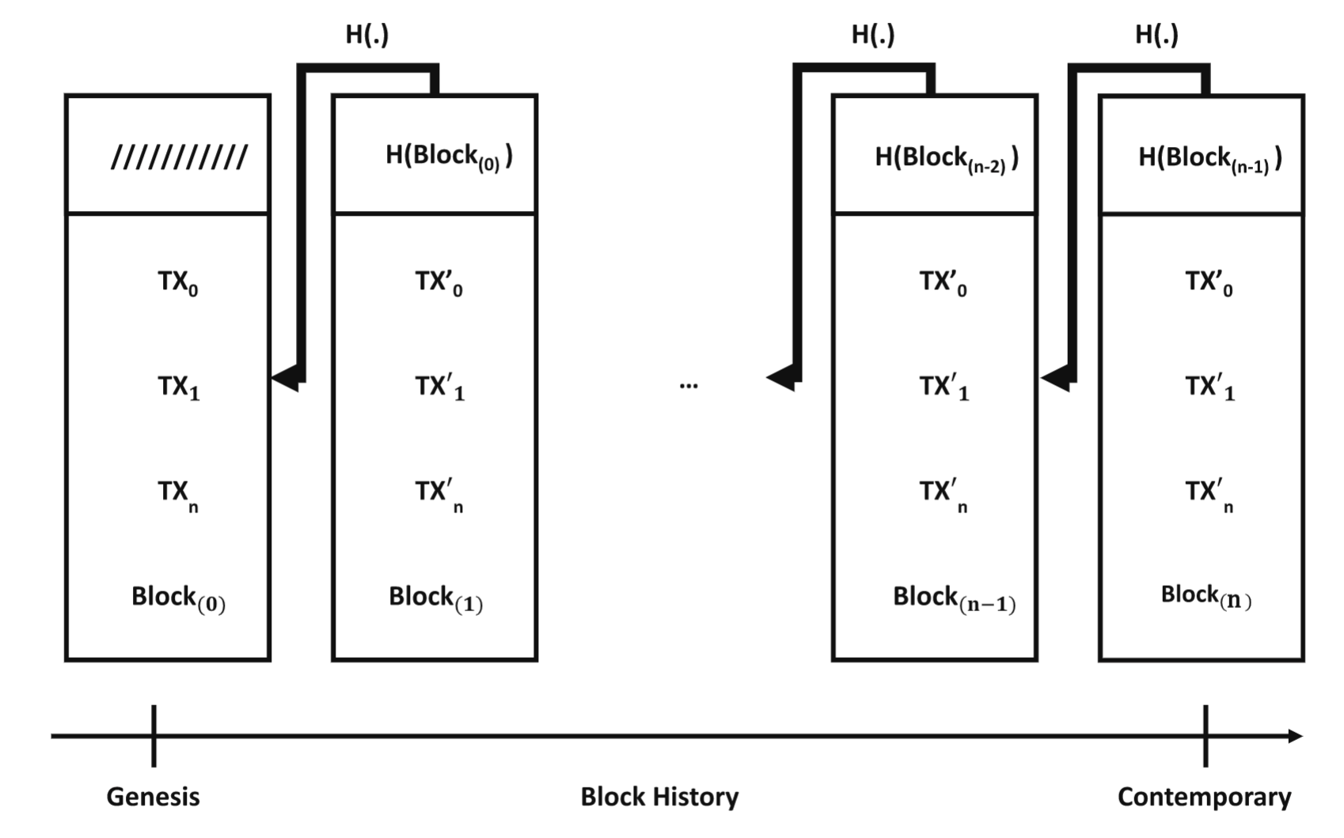
Blockchain data structure
A cryptographic chain of data blocks.
Each node has own chain of block or “blockchain”.
Each nodes receiving broadcasted transaction need to verify them and attach them to their own block.
Each block includes
bunch of transactions
hashes of parent blocks
some additional information. e.g. Nonce

Slide 17
Blockchain data structure
If almost all nodes share the only one chain of block, then attackings such as change a balance, modify or cancel a transaction are impossible
The transactions(TX) contained in sufficiently shared blockchain are considered as confirmed transaction, and we can use them for the new transaction inputs.

Slide 18
Multiple spending
Attackerrs try to create another chain on purpose in order to modify or cancel a transaction.
No Multiple spending for TTP model.
There is no guarantee that we can prevent the appearance of new chain yet, there is multiple spend in decentralized setup.

Slide 19
Network consensus
Although Distributed ledger is robust for any other problems, it is fragile to multiple spending
So, it needs consensus algorithm that is also resilient to the other problems.
Many such algorithm can be considered
Majority votes
Proof of work
Proof of stake

Slide 20
Majority votes and Sybil attack
Each nodes vote for the proper chain.
This algorithm break down if attacker can increase number of pseudonymous identities at will.
In fact, because blockchain is permissionless, they can append many nodes as much as they want and influence on the outcome of an agreement.

Slide 21
Proof of work
How network-wide agreement may be reached even if one can artificially multiply the nodes and there is no reason to trust other participants.
Bitcoin setup a protocol where voting requires computational costs together with the system encouraging clients to attend voting (initiative)
Difficulty of work will be adjusted from time to time

Slide 22
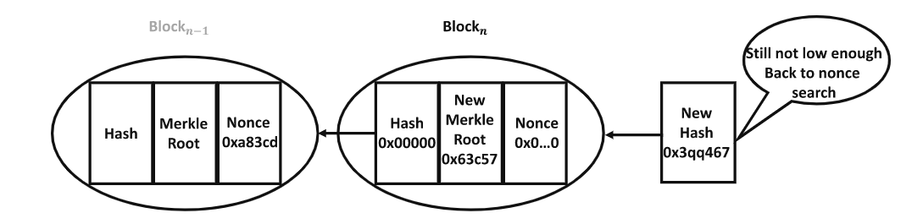
Proof of Work2
The bitcoin force miners to search for a valid nonce whose value is adjusted by miners until the hash of the block is less than or equal to the current target difficulty of the block.
A Miner who find the valid nonce broadcasts it to the network

Slide 23
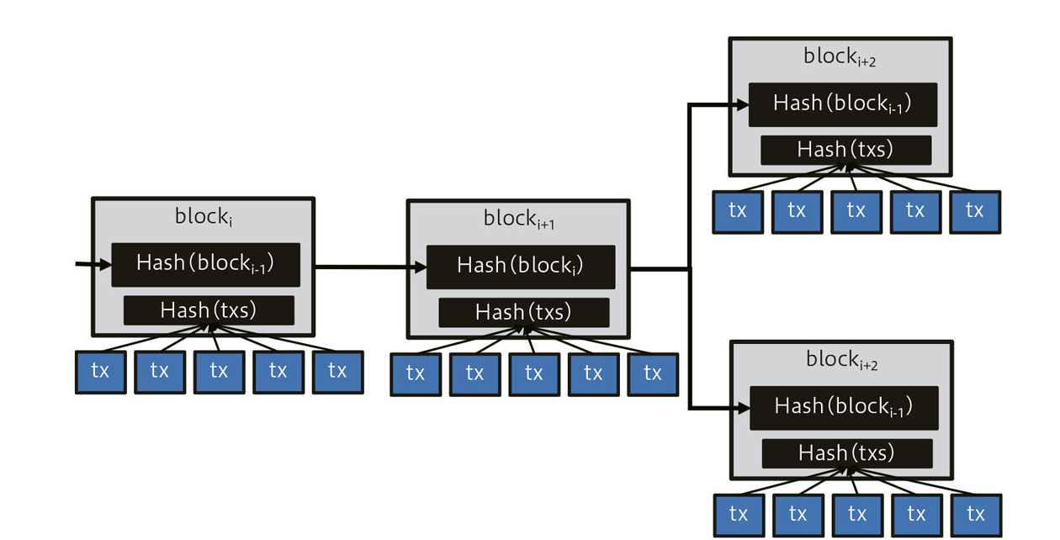
Forks and consensus chain
A fork happens when two or more valid blocks refer to the same parent.
A selection rule is required.
the branch with the longest cumulative proof-of-work difficulty is the one that is chosen as the consensus chain

Slide 24
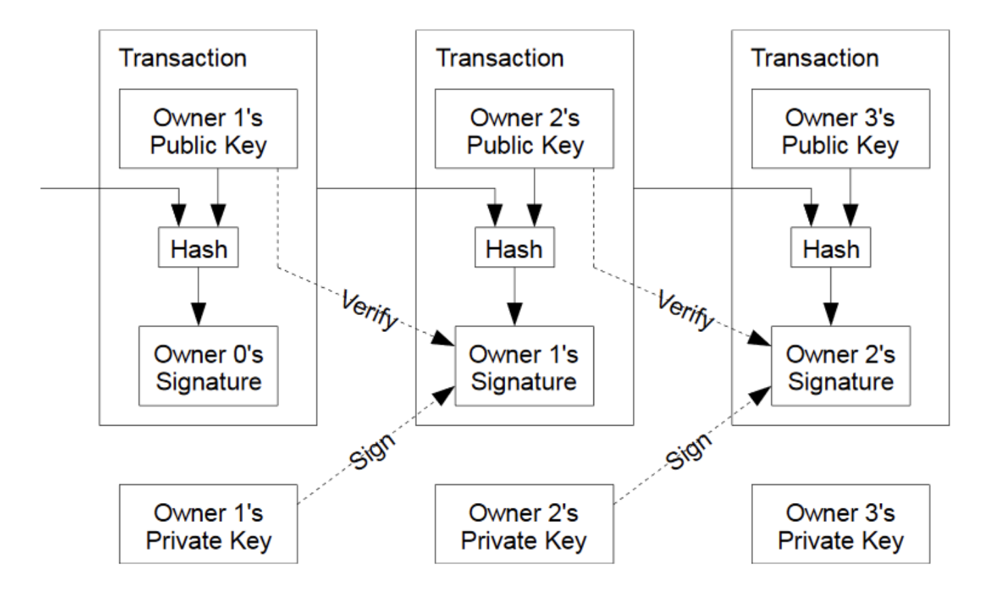
Define coin (base idea)
In the paper, electronic coin is defined as a chain of digital signatures.
Share this chain over all nodes(peers)

