Slide 1

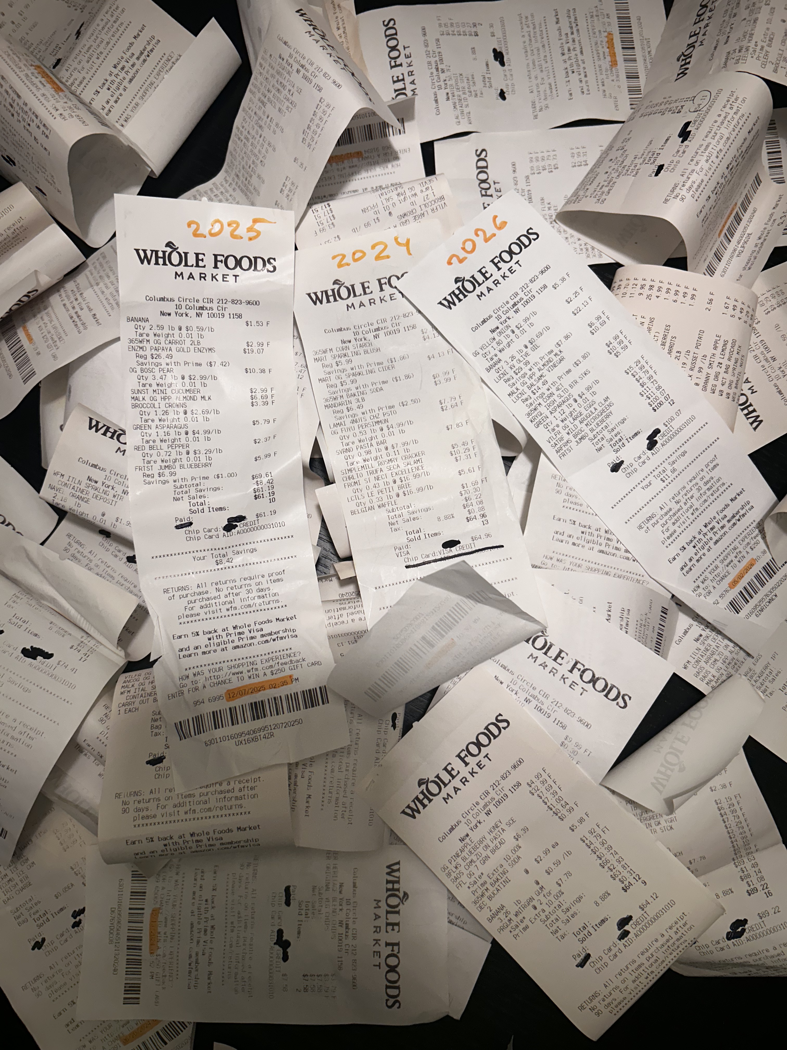
Data 607 Final Project: Tracking Grocery Spending from a Consumer Perspective Over a Three-Year Period"
Madina Kudanova

Slide 2

Research Questions
Primary: How have prices of consistently purchased grocery items changed between 2024 and 2026, and how do these changes compare to the official U.S. food inflation rate reported by the Bureau of Labor Statistics?
Secondary: Do Amazon Prime membership discounts at Whole Foods offset rising prices over the same period?

Slide 3
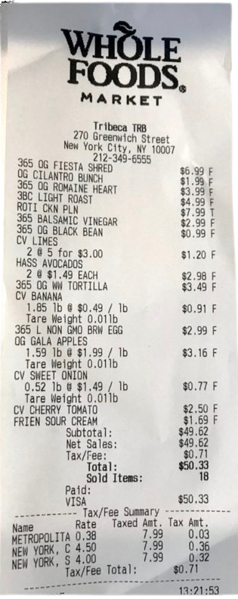
Motivation
I've collected Whole Foods receipts over three years and wanted to analyze my own spending patterns. This project transforms that personal archive into a structured dataset to answer a question that affects everyday life: How much have grocery prices actually changed, and does the official inflation
rate reflect what real consumers experience?

Slide 4
Focus of Analysis
Main analysis:
Price trends per item (2024-2026)
Observed basket price change rate vs BLS CPI
Sub-analysis:
Whether Prime discounts offset rising prices

Slide 5
Analysis Workflow
Following the OSEMN framework:
Obtain: Collected receipt photos + downloaded BLS CPI data
Scrub: Standardized formats, handled OCR errors via synonym mapping
Explore: Built monthly price trend visualizations per item
Model: Calculated year-over-year change rates, ran linear regression
Interpret: Compared observed rates to official metrics

Slide 6
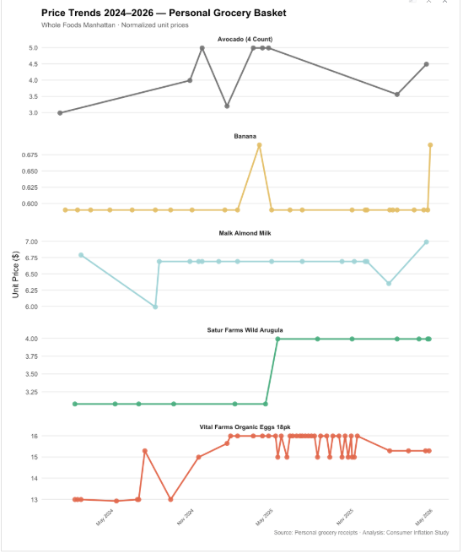
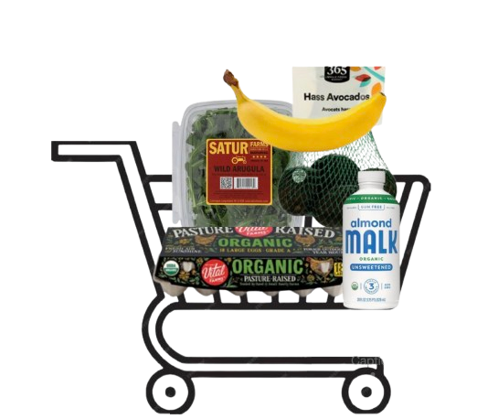
Findings
Annual Price Trends 2024-2026

Slide 7
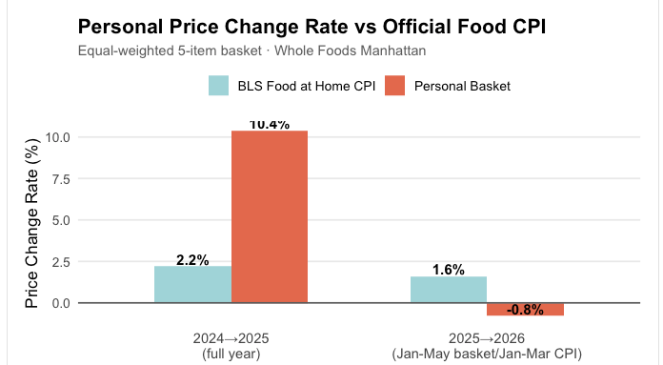
Findings
Personal Observations vs Official Inflation Rate
2024→2025: Personal +10.4% vs BLS +2.2% → 8.2 pp gap
2025→2026 (partial): Personal -0.8% vs BLS +1.6%

Slide 8
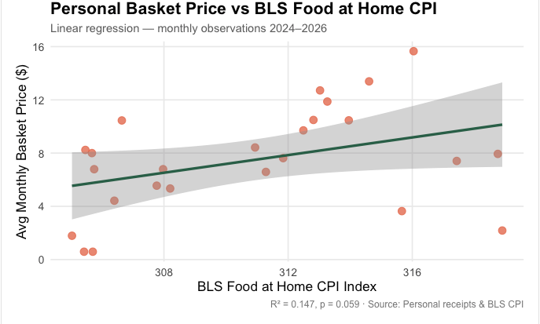


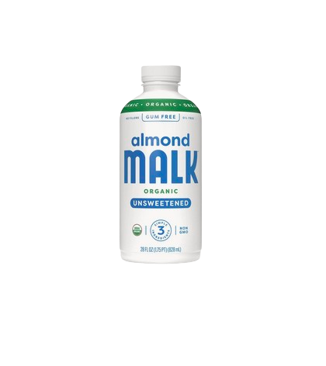
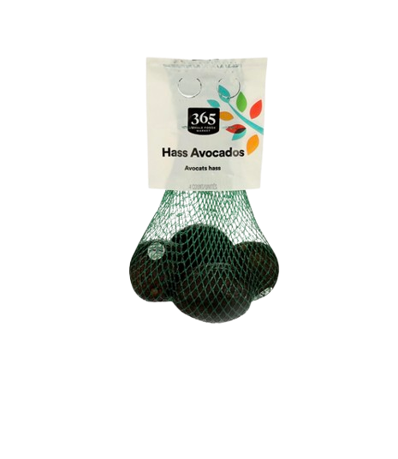
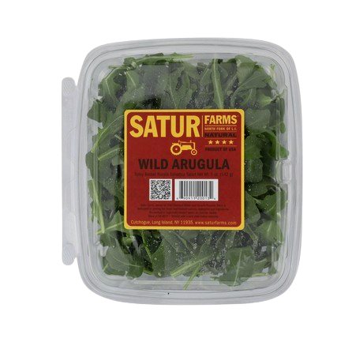
Findings
Linear Regression Analysis
R² = 0.147 (CPI explains only 14.7% of variance)
p = 0.059 (statistically marginal)

Slide 9
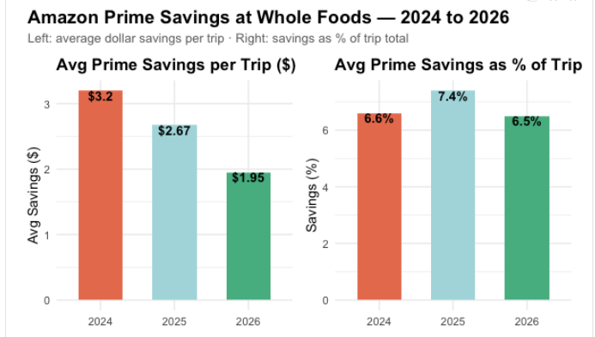
Sub-analysis Findings

Slide 10
Data Sources
Primary Data Source: Personal Whole Foods receipts (collected by you over 3 years, OCR digitized)
Secondary Data Source: U.S. Bureau of Labor Statistics CPI Food at Home (CUUR0000SAF11) https://data.bls.gov/timeseries/CUUR0000SAF11

Slide 11
Challenges and limitations
Challenges:
OCR extraction from receipt photos produced inconsistent item names
Solution: Manual synonym lookup table + fuzzy string matching (stringdist)
Limitations:
Single household, one premium store → not generalizable
5-item basket vs. hundreds in BLS CPI
2026 data partial (Jan-May only)
Equal-weighted basket doesn't reflect actual
spending patterns

Slide 12
Conclusion Main takeaway
Official food inflation does not always reflect individual consumer experience:
Personal basket rose 10.4% vs official 2.2% (2024→2025) — 8.2 pp gap
Regression confirms CPI weakly predicts personal prices (R² = 0.147)
Prime savings did not offset rising prices

Slide 13



