Slide 1
ML & UDP-based SpeedTests
27th April 2025
COL 867: PROJECT PRESENTATION
Presented By:
Manish Kumar | Pratham Agrawal
(2023MCS2497) (2023MCS2486)
1

Slide 2
TABLE OF CONTENTS
3
Problem Statement
5
Model Proposed By the Paper
8
Implementation Highlights
10
Results
14
Observations

Slide 3


Problem Statement
What speedtests are though?
How can Bandwidth
be estimated?
Some Assumptions that failed for UDP based methods for speed tests:
Cross Traffic rate remains constant.
There is one "tight link" (limiting the bandwidth)
3

Slide 4
Approaching the Problem!
Collect real world data
Measure input gap (g_{in}) and output gap (g_{out})
Build a feature vector using (g_{out}/g_{in})
Collect this data at different probe rates.
Train a Neural Network
No strong assumptions about network
Need to be simple (complex networks are often slow)
4

Slide 5
Model Proposed By the Paper
The model proposes two models
Simple NN Model
A shallow NN model consisting of,
Input layer, Hidden layer & an Output layer
Iterative Model
A deeper but slower model that refines
Available(A) & Total Capacity(C) at every iteration.
5

Slide 6
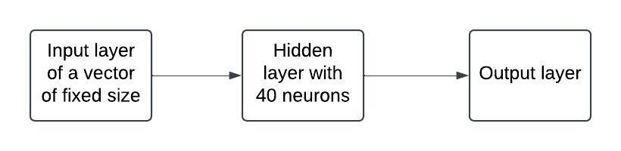
Simple NN Model
6

Slide 7
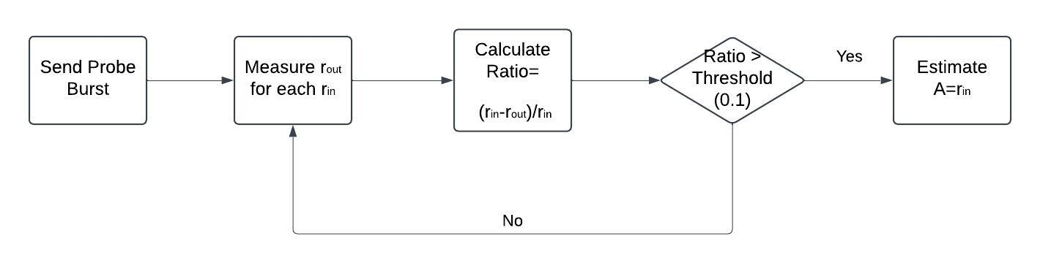
Iterative Model
7

Slide 8



Implementation: Data Collection
Cross Traffic
We simulated a simple network topology.
Initially, a TCP connection was setup, to ensure the Client & server are connected. Simultaneously, cross traffic was generated btw other 2 additional pairs of hosts on the same link.
Afterwards, packet trains were sent at regular intervals (C S) and rates at which pkts. were sent/received (r_{in} & r_{out} ) were measured.
Packet Trains
client
server
8

Slide 9
Implementation: Neural Networks & Iterative Method
We implement a similar NN based method,
{ Input vector size : 21 }
We use a loss function of MSE for training and MAE for testing.
For the Iterative Method:
Set a threshold of 0.1 &,
During congestion (ratio > threshold):
estimate A as 0.9 * A, {A otherwise}
9

Slide 10
Results
 |  | Simple NN | Iterative
Testing | MSE | 119.68 | 281.26
 | MAE | 7.84 | 11.90
Interpolation | MSE | 477.87 | 179.85
 | MAE | 15.07 | 13.37
Extrapolation | MSE | 355.86 | 262.71
 | MAE | 16.28 | 14.12
10
* all units are in Mbps² for MSE & Mbps for MAE

Slide 11
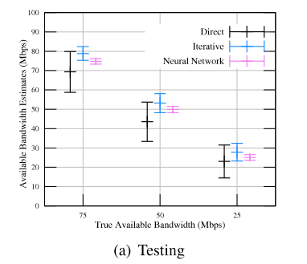
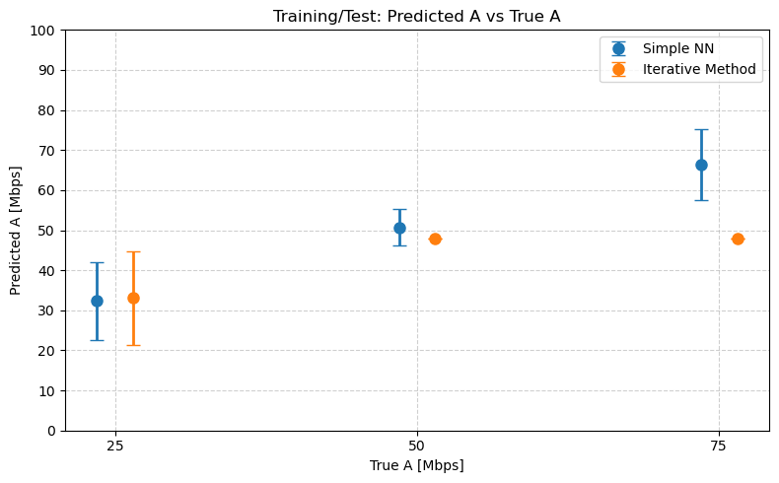
Results: Testing
11

Slide 12
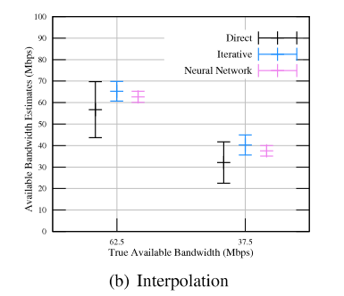
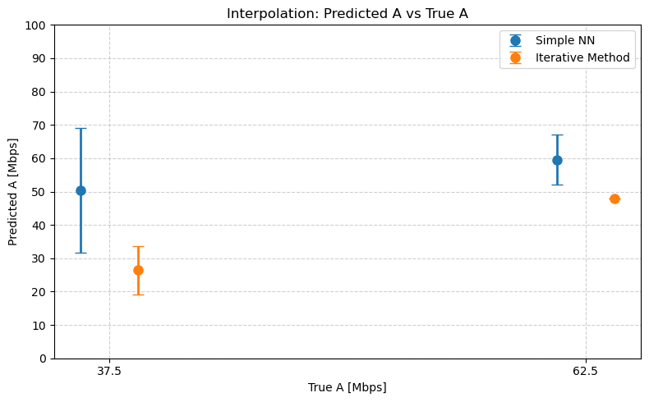
Results: Interpolation
12

Slide 13
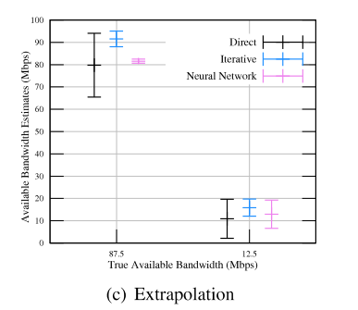
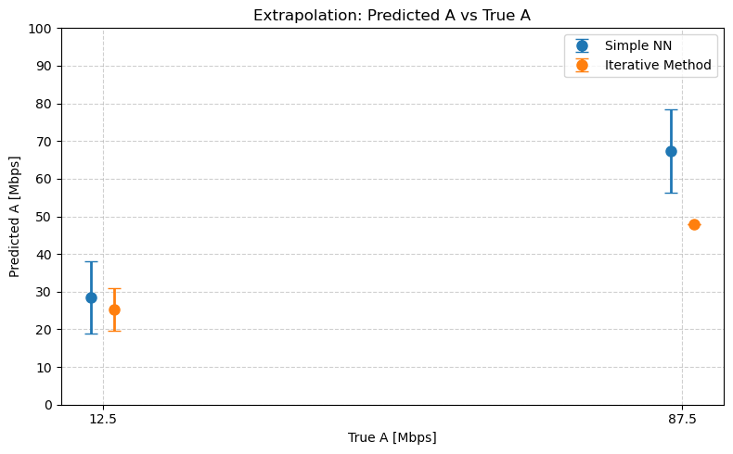
Results: Extrapolation
13

Slide 14
Observations and Future Work
Simple NN performed better than iterative probing on seen data.
Iterative probing often produced a single output for many bandwidths (check if it persists on complex topologies)
Try to get the model to match the paper’s outputs.
14

Slide 15


THANK YOU!
mcs232497@iitd.ac.in
mcs232486@iitd.ac.in https://github.com/pprrathamagarwal/UDP_ML_col867_2402

