Slide 1



Sales and Revenue Performance
View in Power BI
Last data refresh:
3/4/2025 7:30:23 PM UTC
Downloaded at:
3/4/2025 7:33:42 PM UTC

Slide 2
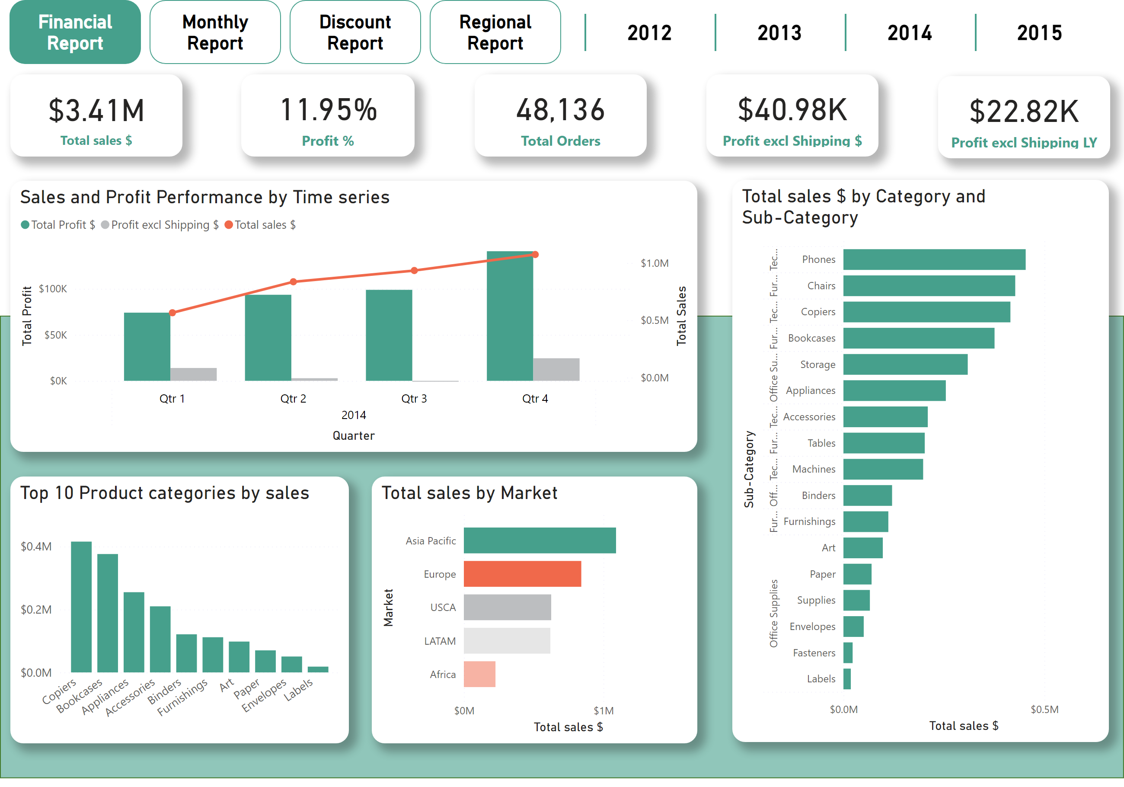
Financial Report
Notes:
Sales and Profit Performance by Time series
No alt text provided
Top 10 Product categories by sales
No alt text provided
Total sales by Market
No alt text provided
barChart
No alt text provided
card
No alt text provided
card
No alt text provided
card
No alt text provided
slicer
No alt text provided
card
No alt text provided
card
No alt text provided
shape
No alt text provided
pageNavigator
No alt text provided

Slide 3
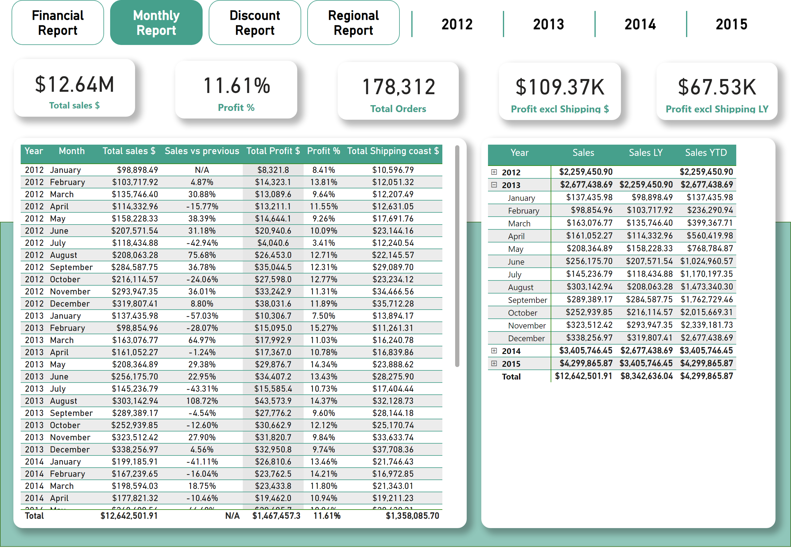
Monthly Report
Notes:
tableEx
No alt text provided
pivotTable
No alt text provided
shape
No alt text provided
card
No alt text provided
card
No alt text provided
card
No alt text provided
card
No alt text provided
card
No alt text provided
slicer
No alt text provided
pageNavigator
No alt text provided

Slide 4
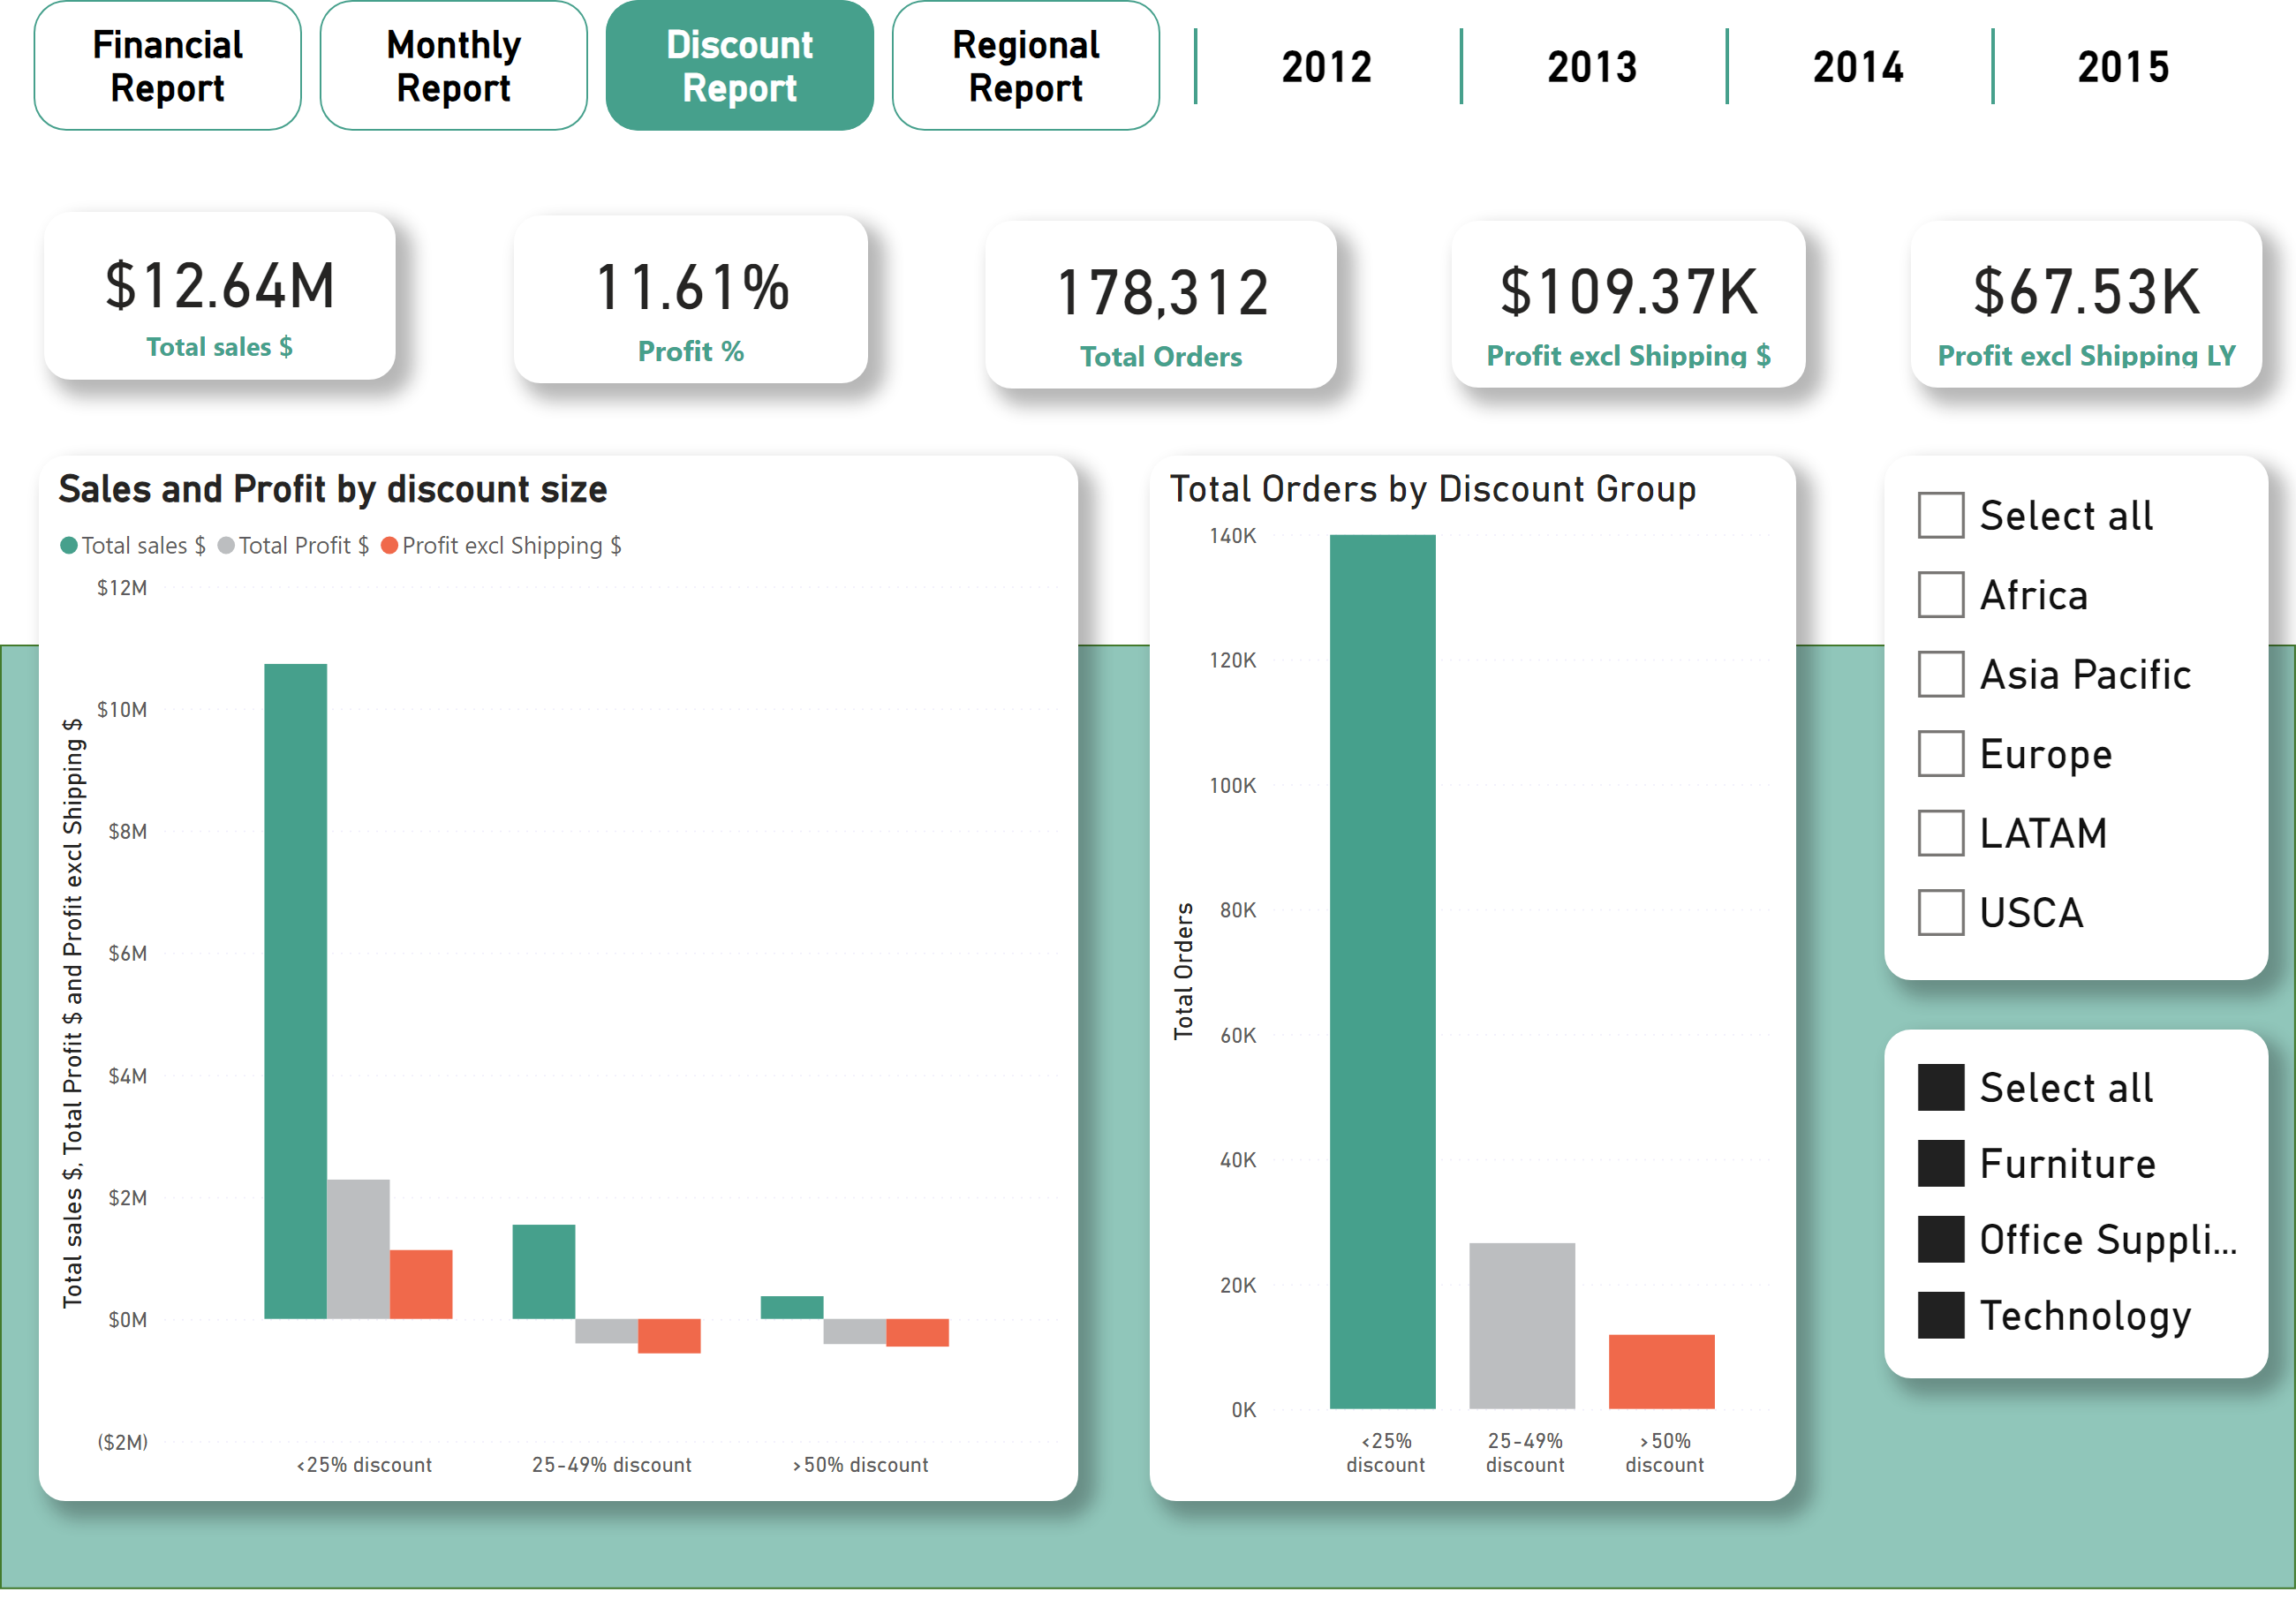
Discount Report
Notes:
Sales and Profit by discount size
No alt text provided
clusteredColumnChart
No alt text provided
slicer
No alt text provided
shape
No alt text provided
card
No alt text provided
card
No alt text provided
card
No alt text provided
card
No alt text provided
card
No alt text provided
slicer
No alt text provided
slicer
No alt text provided
pageNavigator
No alt text provided

Slide 5
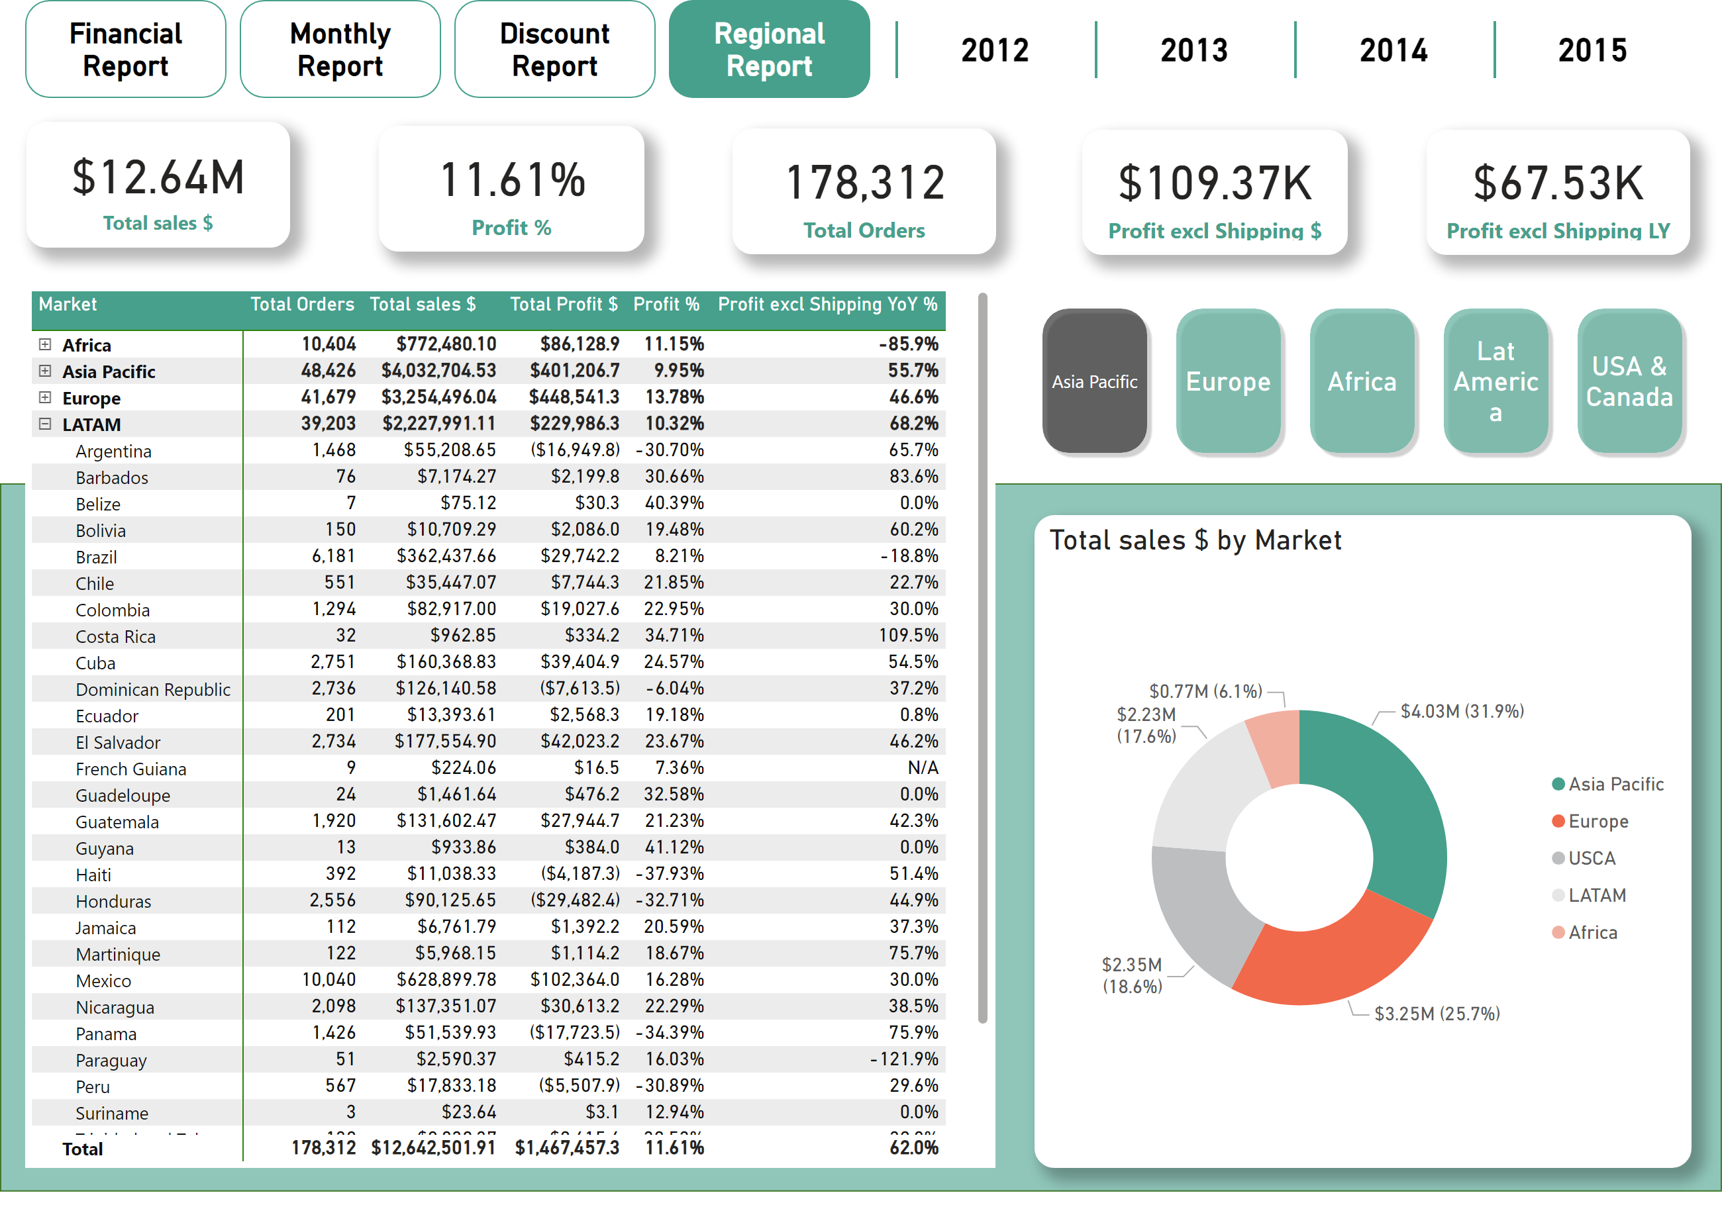
Regional Report
Notes:
shape
No alt text provided
card
No alt text provided
card
No alt text provided
card
No alt text provided
card
No alt text provided
card
No alt text provided
pivotTable
No alt text provided
donutChart
No alt text provided
slicer
No alt text provided
pageNavigator
No alt text provided
bookmarkNavigator
No alt text provided

Slide 6
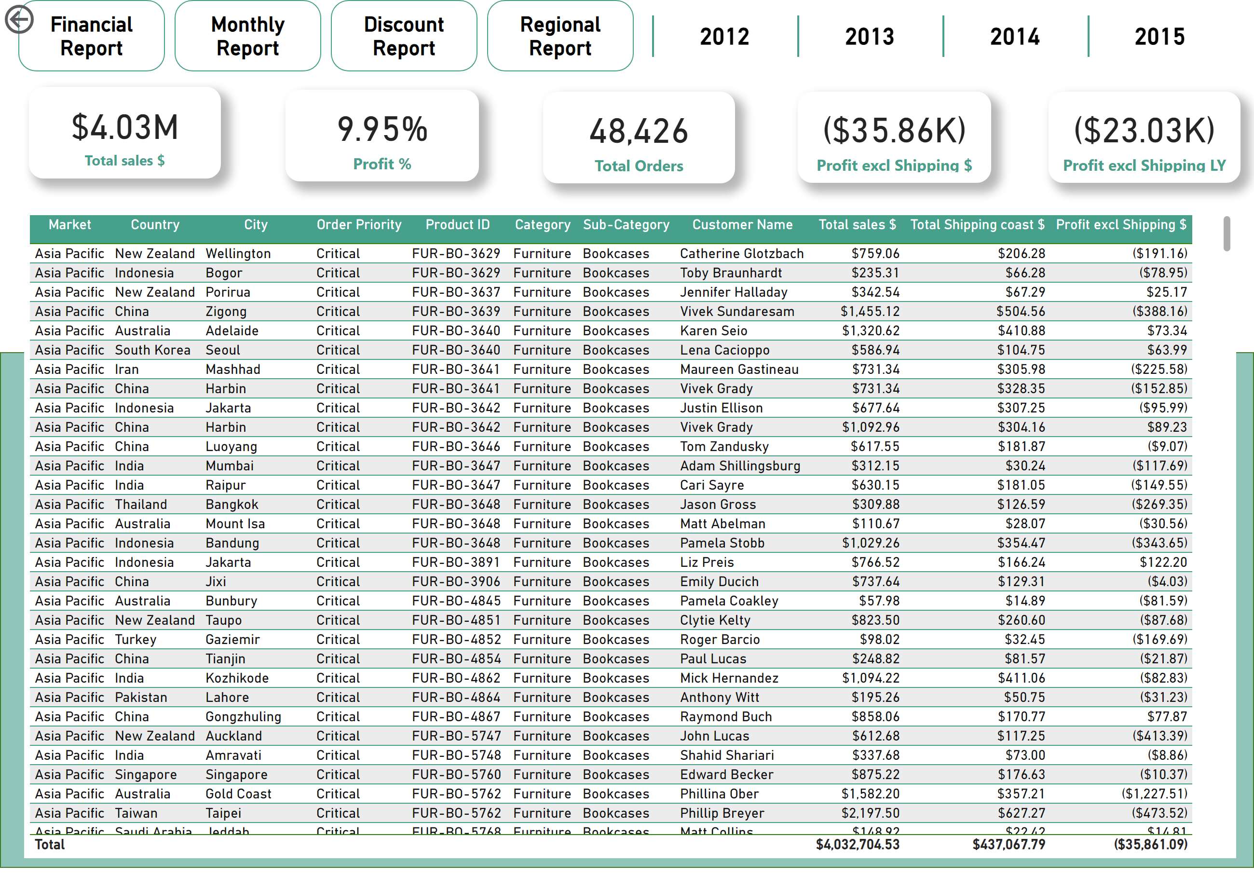
Product Report
Notes:
slicer
No alt text provided
card
No alt text provided
card
No alt text provided
card
No alt text provided
card
No alt text provided
card
No alt text provided
pageNavigator
No alt text provided
shape
No alt text provided
tableEx
No alt text provided
actionButton
No alt text provided

