Slide 1
Discussion #2 12.12.2021
Explain Data
Confusion Matrix
Data collection #4

Slide 2
Data
Total Measurements | 24500
Empty Seat/Human | Measurement | Already have | Require more
Empty Seat | 20,000 | 8740
Human-1 | 2000 | 160
Human-2 | 2000 | 160
Human-3 | 2000 | 160
Human-4 | 2000 | 160
Human-5 | 2000 | 2160
Human-6 | 2000 | 2160
Human-7 | 2000 | 2000
Human-8 | 2000 | 3600
Human-9 | 2000 | 3600
Human-10 | 2000 | 1600

Slide 3
Confusion Matrix
Do we need CNN model before creating Confusion Matrix
How do we create Confusion Matrix?

Slide 4
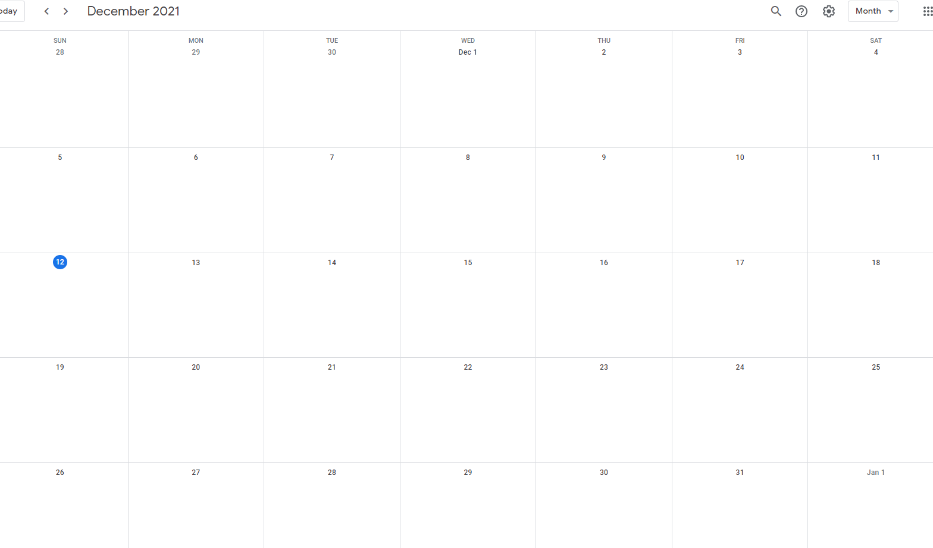
Schedule
Measurement #4 15:00
Not in Frankfurt
Not in Frankfurt
Not in Frankfurt

