Slide 1
HOUSE PRICE PREDICTION
-Linear regression & SVR
Prepared by: Chirag sahu
1802913054 (IT-A) Team 3

Slide 2
Introduction
House price prediction helps to determine the selling price of a house and can help the person to arrange the right statements to purchase a house. There are many factors that influence the price of a house which include physical conditions, concept and location etc.

Slide 3
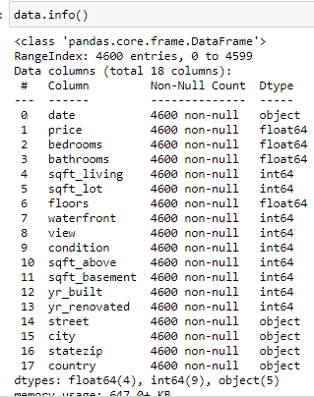
objective
■ Create an analytical framework to understand –
Key factors impacting house price
■ Develop a modeling framework –
To estimate the price of a house
That is up for sale

Slide 4
Dataset
■ Variables: – 14 variables present in the dataset
■ Variable named “Price” – Dependent variable – Represent final price at which the house was sold
■ Remaining 13 variables – Represent different attributes of the house like sq_ft, number of bedrooms,waterfront etc.

Slide 5
Data Processing
■ Normalizing Response Variable
■ Training Vs Validation split – Train data – 80% & Validation Data – 20%
■ Data cleansing – Variable treatments
■ Missing value treatment: – Continuous variables – Character variables
■ Variable creations: – Character variables were converted to indicators – Based on train data, further grouping of character variables were done

Slide 6
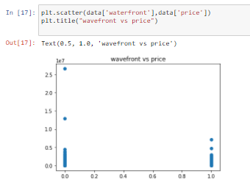
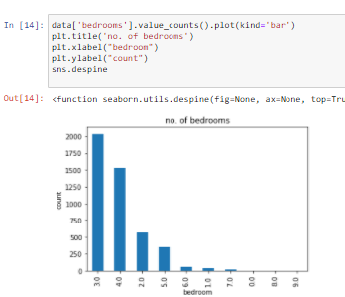
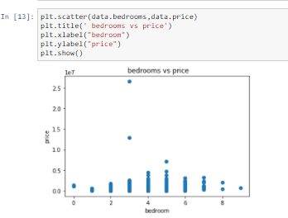
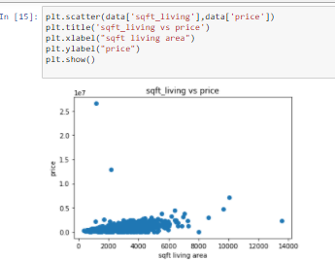
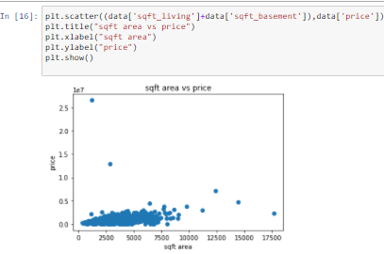
Data Visualization

Slide 7
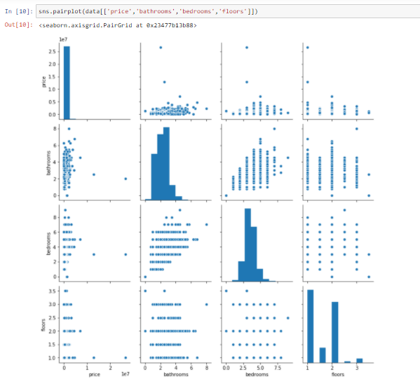
Exploratory Data Analysis
It is also quite useful
to have a quick
overview of how the data is
distributed and whether
it contains or not outliers.

Slide 8
Linear Regression
Linear regression is a linear model, e.g. a model that assumes a linear relationship between the input variables (x) and the single output variable (y). More specifically, that y can be calculated from a linear combination of the input variables (x)
When there is a single input variable (x), the method is referred to as simple linear regression. When there are multiple input variables, literature from statistics often refers to the method as multiple linear regression.

Slide 9
Support Vector Regression (SVR)
Support Vector Regression (SVR) uses the same principle as SVM, but for regression problems.
Support Vector Regression as the counterpart of SVM for regression problems, SVR acknowledges the presence of non-linearity in the data and provides a proficient prediction model.

Slide 10
Algorithm Comparison
Linear Regression
 R-squared: 0.5091231
 Root Mean Squared Error: 269489.25355
Support Vector Regression
 R-squared: 0.4594522
 Root Mean Squared Error: 270428.67900

Slide 11
C0NCLUSION
Throughout this project, i made a machine learning regression project based on the sale price
and learned several insights about linear regression and support vector regression model, in
the end we can easily predict the price of the house.

Slide 12
Thank you

