Slide 1


Slide 2

Big (O) Notation

Slide 3

Big (O)? What is all this?
How do we measure the efficiency of an algorithm? Do we simply look at execution time and measure it in seconds?? Or computational space?
When trying to characterize an algorithm’s efficiency, it is important to quantify the number of operations or steps that the algorithm will require.
Order of Growth Big(O) defines how the program would behave as the order of size of input is increased.
Let’s unpack all this.

Slide 4
The algorithm of Summation
If we wanted to understand the number of steps required to add 100 numbers in Python.
Lets’ count the number of assignments.
The number of assignment statements is 1 (j=0) plus the value of n (the number of times we perform j=j+i). We can denote this by a function, call it T, where T(n)=1+n.
def addition(n):
j = 0
for i in range(n+1):
j = j + i
return j

Slide 5
Big (O), Order of Magnitude
We can then say that the sum of the first 100 integers is a bigger instance of the summation problem than the sum of the first 10 since there are more steps.
It turns out that the exact number of operations is not as important as determining the most dominant part of the T(n) function. In other words, as the problem gets larger, some portion of the T(n) function tends to overpower the rest. What is this portion for the addition algorithm??
The order of magnitude function describes the part of T(n) that increases the fastest as the value of n increases. Order of magnitude is often called Big-O notation (for “order”).

Slide 6
Big (O), Order of Magnitude
def func(n):
a=5
b=6
c=10
for i in range(n):
for j in range(n):
x = i * i
y = j * j
z = i * j
for k in range(n):
w = a*k + 45
v = b*b
d = 3
3 constant terms
3 assignments performed n² times.
2 assignments performed n times and 1 constant term

Slide 7
Common Magnitudes
g(n) | Name
1 | Constant
O(N) | Linear
O(Log N) | Logarithmic
O(N Log N) | Log-Linear
O(N²) | Quadratic
O(N³) | Cubic

Slide 8
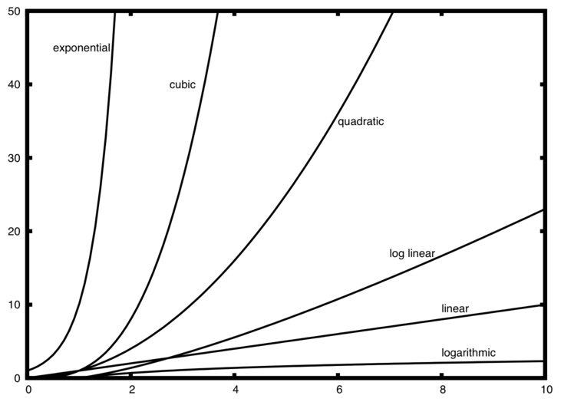
Common Magnitudes

Slide 9
Challenge: Compute the complexity
def power_of_2(a):
x = 0
while a > 1:
a = a/2
x = x+1
return x

Slide 10


