Slide 1
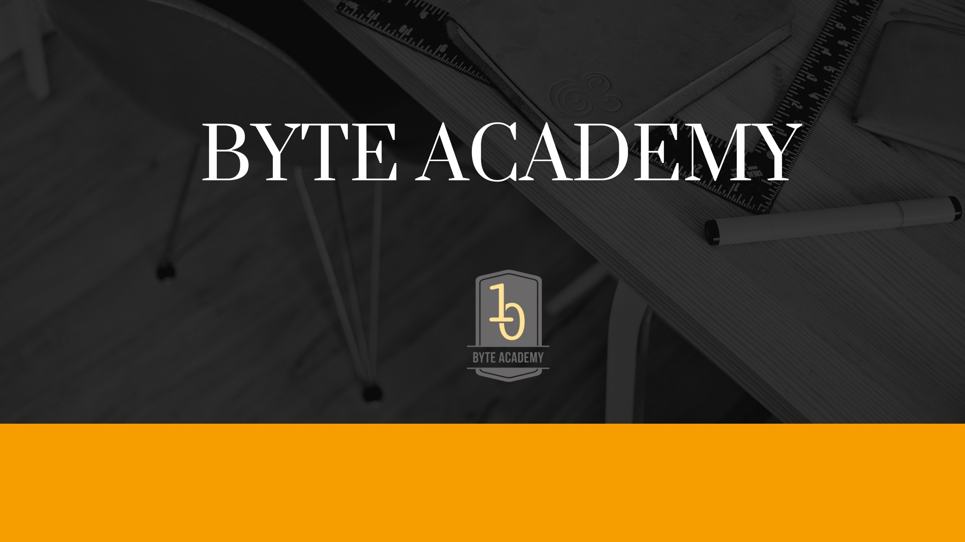

Slide 2
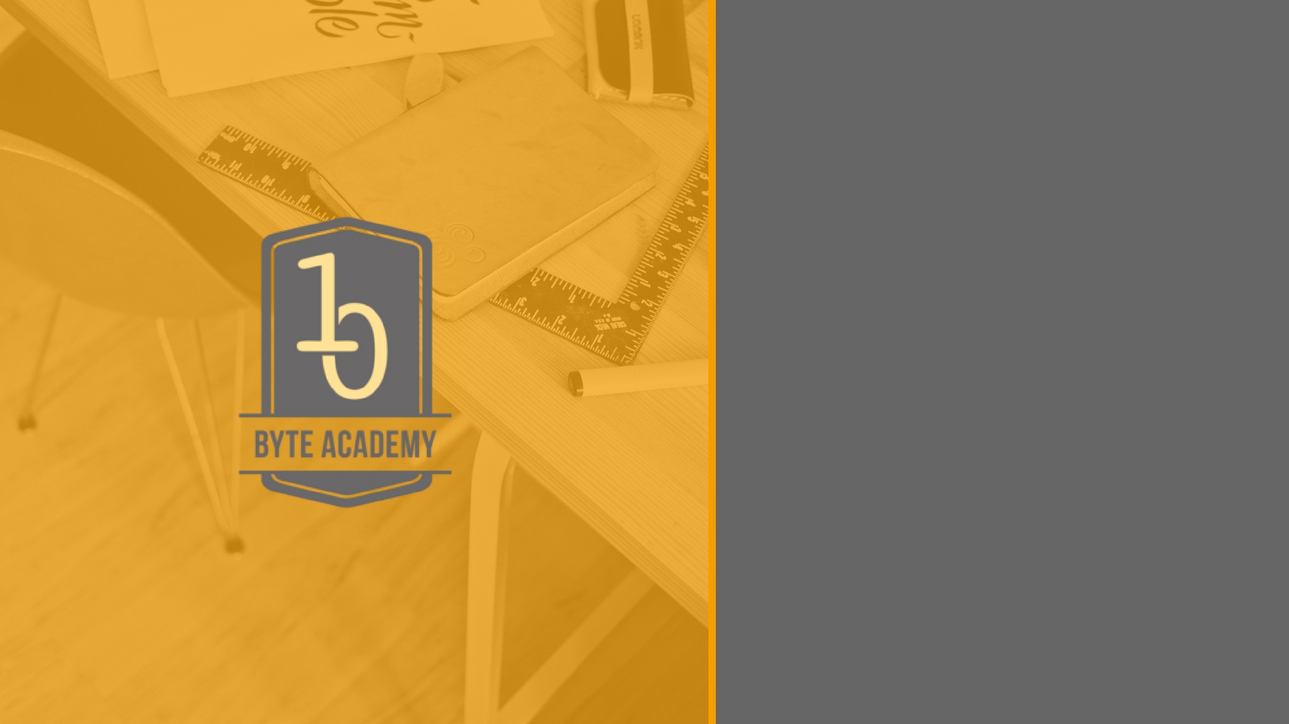
Object Oriented Programming

Slide 3

Programmer Defined Types
So far we have become familiar with Python built-in types - integers, floating points, lists etc.
What if we want to create our own type, whether it be a collection type or number representation, to organize our code and data?
In order to do this we need to engage in the Object Oriented paradigm of programming.
In OOPs, programs manipulate collections of objects. Objects have internal state and support methods that query or modify this internal state in some way.

Slide 4
Concrete Example
Say we want to create a new object or class, a user database that manages a system requiring user to log in.
Here the database is the object. When the database is empty, that state of the object is empty. What do we need to do in order to change the state?
We need to have methods (functions and operations) that can modify the state. Eg. update, delete.
As programmers, we have to specify how this updation and deletion will take place.

Slide 5
OOP’s in Python
In Python, we implement new programmer defined types with classes.
A class has methods which define what an object can or cannot do.
Lets learn how to build a new class by implementing a new data type: Fractions.

Slide 6
OOP’s in Python
In Python, we implement new programmer defined types with classes.
A class has methods which define what an object can or cannot do.
Lets learn how to build a new class by implementing a new data type: Fractions.

Slide 7
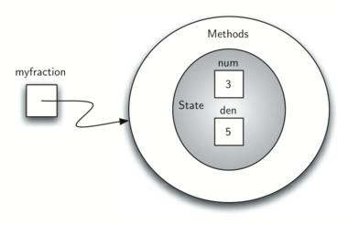
Our class so far

Slide 8
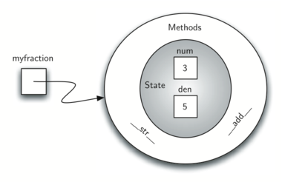
Our class so far

Slide 9
Inheritance
Inheritance is the ability for one class to be related to another class in much the same way that people can be related to one another. Children inherit characteristics from their parents. Similarly, Python child classes can inherit characteristic data and behavior from a parent class. These classes are often referred to as subclasses and superclasses.
By organizing classes in this hierarchical fashion, object-oriented programming languages allow previously written code to be extended to meet the needs of a new situation.

Slide 10
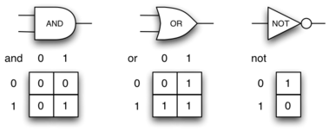
Example: Logic Gates

Slide 11
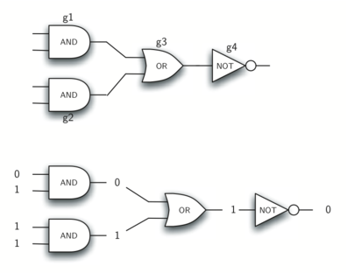
Example: Logic Gates

Slide 12
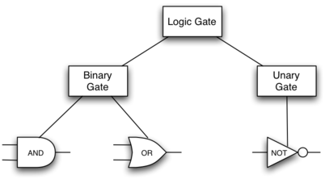
Desired Inheritance Structure

Slide 13


