Slide 1

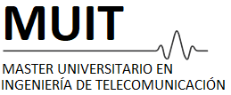
Predictive and Descriptive Learning
Chapter 1
Eduardo López Gonzalo
eduardo.lopez@upm.es
Luis Hernández Gómez
luisalfonso.hernandez@upm.es
Alejandro Almodóvar Espeso alejandro.almdodovar@upm.es

Slide 2
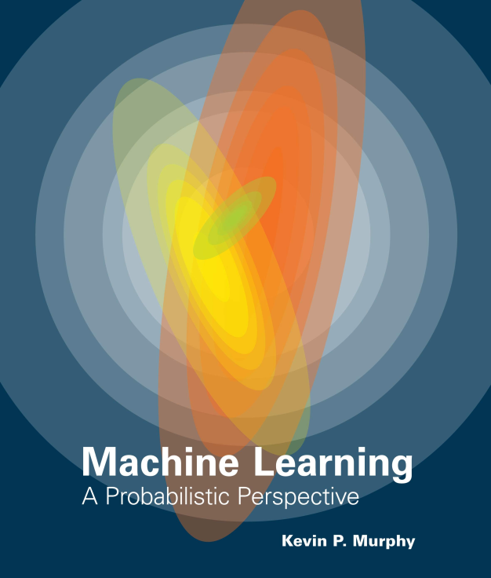
Introduction to Machine Learning
What and Why?
Types of machine learning
Murphy, Kevin P. Machine learning: a probabilistic perspective. MIT press, 2012.

Slide 3
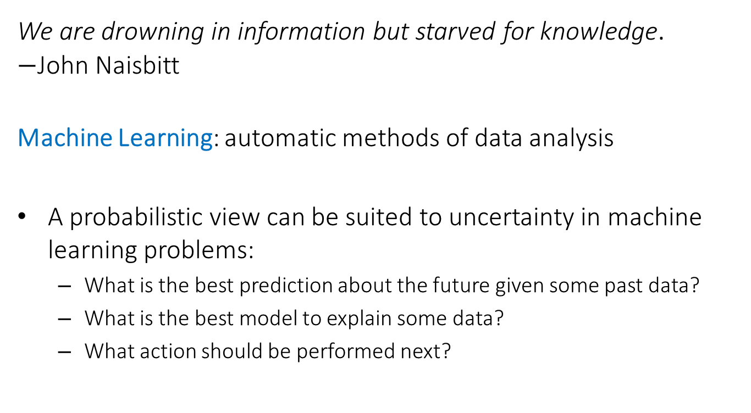
Introduction to Machine Learning
What and Why?
We are drowning in information but starved for knowledge. $−$John Naisbitt
Machine Learning: automatic methods of data analysis
A probabilistic view can be suited to uncertainty in machine learning problems:
  What is the best prediction about the future given some past data?
  What is the best model to explain some data?
  What action should be performed next?

Slide 4
Introduction to Machine Learning
What and Why?
Thus we will study the most used and widely applicable machine techniques from a probabilistic view.
This is fundamental ingredient in the training of a modern data scientist providing a solid base for its use on a wide range of applications in science and industry.
The course will start presenting simple machine learning techniques in order to grasp the more sophisticated ones.
Through examples and use cases we will see how important is to accurately assess the performance of a method.
You will also acquire solid criteria on what could be best model for a given data and task.

Slide 5
Introduction to Machine Learning
What and Why?
Types of machine learning
Murphy, Kevin P. Machine learning: a probabilistic perspective. MIT press, 2012.

Slide 6
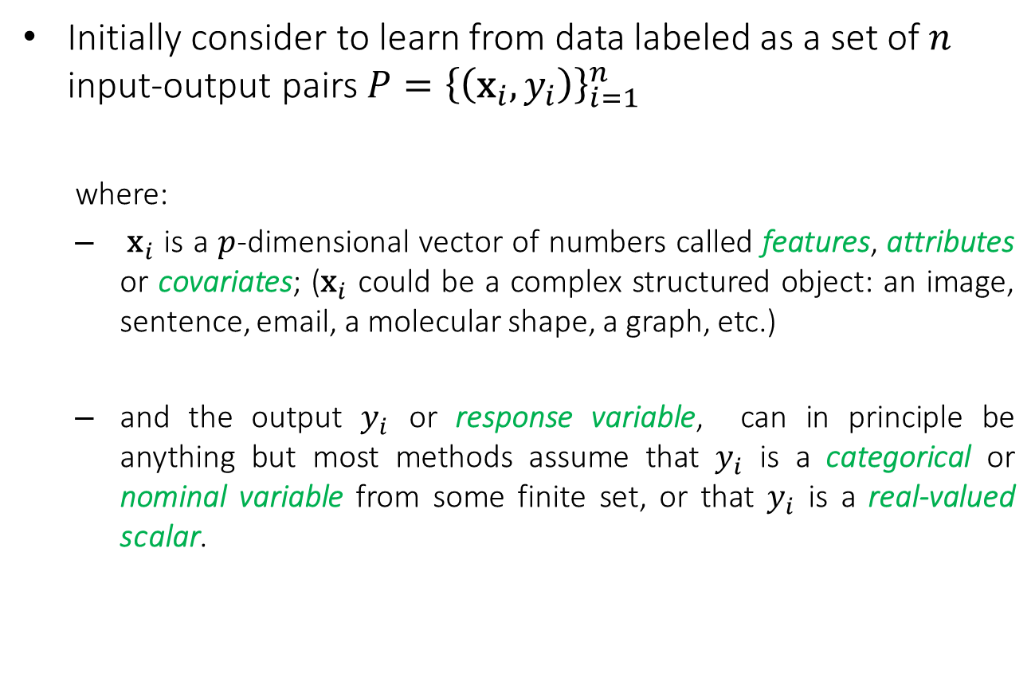
Introduction to Machine Learning
Types of machine learning
Initially consider to learn from data labeled as a set of $n$ input-output pairs $P={\left\{\left({\text{x}}_{i},y_{i}\right)\right\}}_{i=1}^{n}$
  where:
  ${\text{x}}_{i}$ is a $p$-dimensional vector of numbers called features, attributes or covariates; (${\text{x}}_{i}$ could be a complex structured object: an image, sentence, email, a molecular shape, a graph, etc.)
  and the output $y_{i}$ or response variable, can in principle be anything but most methods assume that $y_{i}$ is a categorical or nominal variable from some finite set, or that $y_{i}$ is a real-valued scalar.

Slide 7
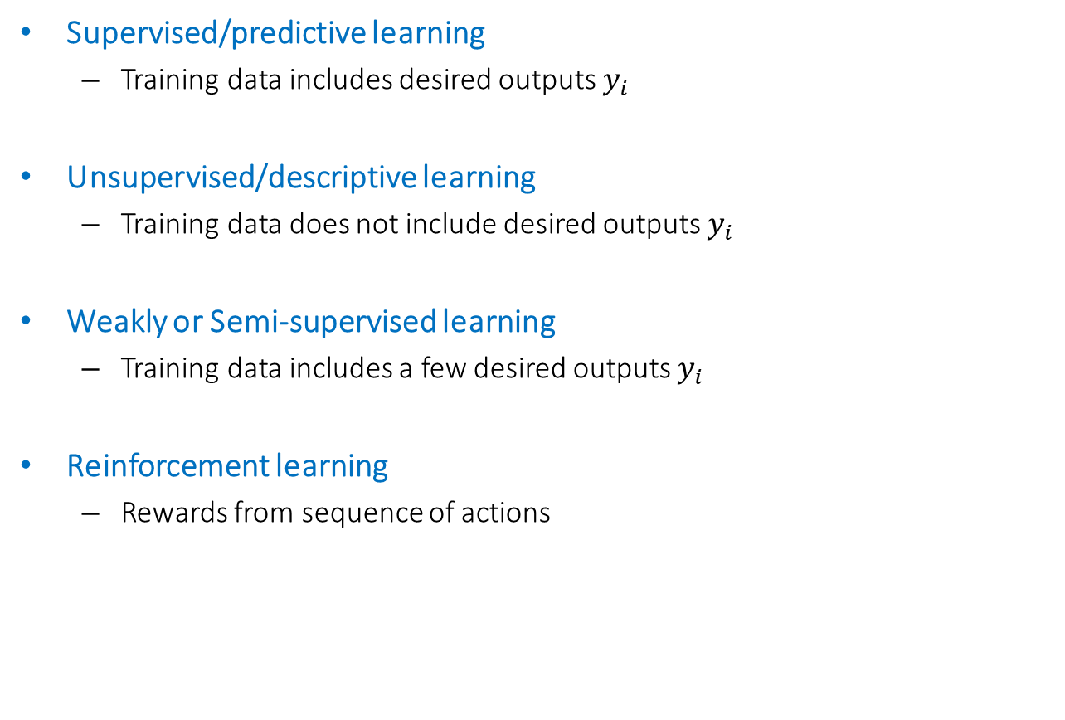
Introduction to Machine Learning
Types of machine learning
Supervised/predictive learning
  Training data includes desired outputs $y_{i}$
Unsupervised/descriptive learning
  Training data does not include desired outputs $y_{i}$
Weakly or Semi-supervised learning
  Training data includes a few desired outputs $y_{i}$
Reinforcement learning
  Rewards from sequence of actions
In this course we will only study supervised/predictive learning and unsupervised/descriptive learning; reinforcement learning is covered in a subsequent course in the second semester.

Slide 8
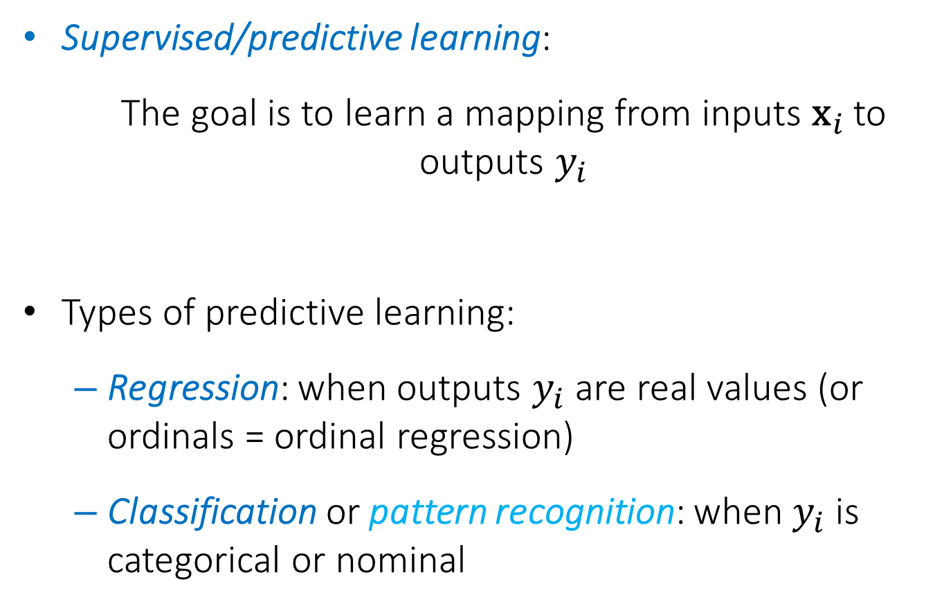
Introduction to Machine Learning
Types supervised/predictive learning
Supervised/predictive learning:
  The goal is to learn a mapping from inputs ${\text{x}}_{i}$ to outputs $y_{i}$
Types of predictive learning:
  Regression: when outputs $y_{i}$ are real values (or ordinals = ordinal regression)
  Classification or pattern recognition: when $y_{i}$ is categorical or nominal

Slide 9
Introduction to Machine Learning
Supervised/predictive learning
Objectives of Supervised/predictive learning
On the basis of the training data we would like to:
Accurately predict unseen test cases.
Understand which inputs affect the outcome.
Assess the quality of our predictions and inferences.

Slide 10
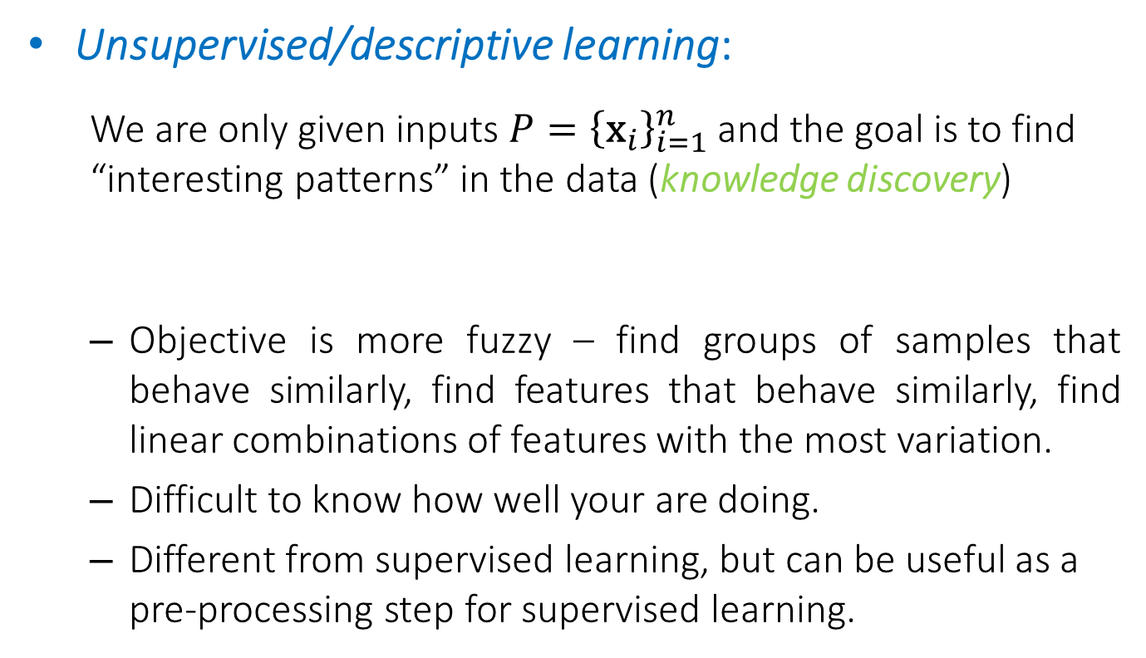
Introduction to Machine Learning
Unsupervised/descriptive learning
Unsupervised/descriptive learning:
  We are only given inputs $P={\left\{{\text{x}}_{i}\right\}}_{i=1}^{n}$and the goal is to find “interesting patterns” in the data (knowledge discovery)
  Objective is more fuzzy – find groups of samples that behave similarly, find features that behave similarly, find linear combinations of features with the most variation.
  Difficult to know how well your are doing.
  Different from supervised learning, but can be useful as a pre-processing step for supervised learning.

Slide 11
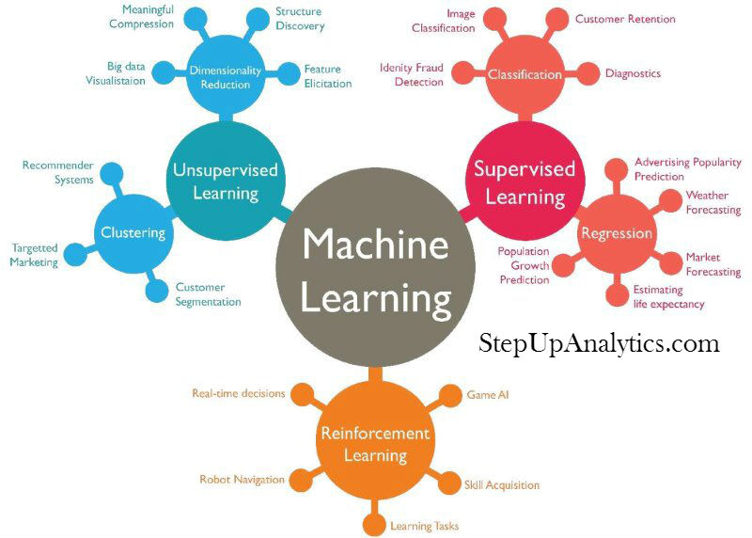

Slide 12

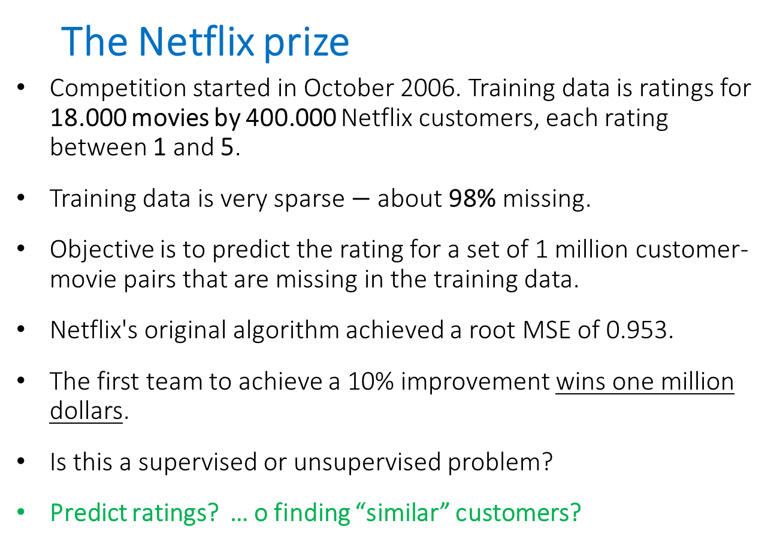
Introduction to Machine Learning
  The Netflix prize
Competition started in October 2006. Training data is ratings for 18.000 movies by 400.000 Netflix customers, each rating between 1 and 5.
Training data is very sparse $−$ about 98% missing.
Objective is to predict the rating for a set of 1 million customer-movie pairs that are missing in the training data.
Netflix's original algorithm achieved a root MSE of 0.953.
The first team to achieve a 10% improvement wins one million dollars.
Is this a supervised or unsupervised problem?
Predict ratings? … o finding “similar” customers?
A $1 million competition

Slide 13
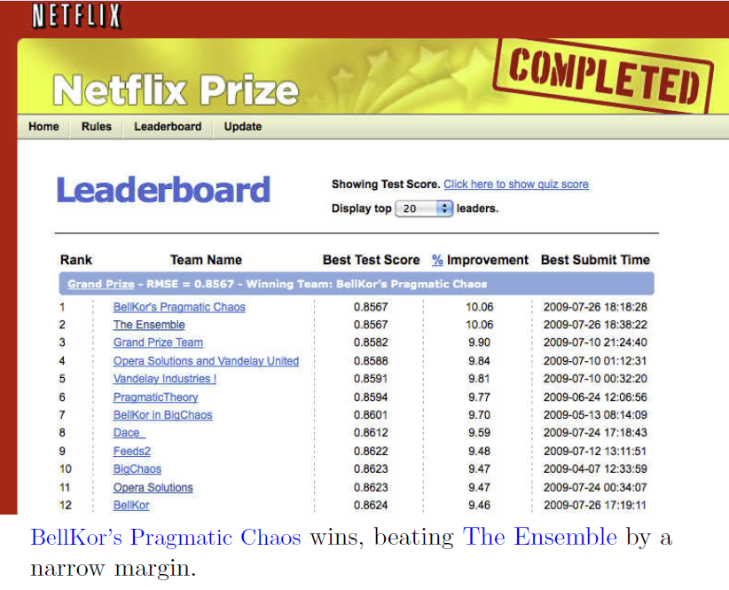
Introduction to Machine Learning

Slide 14
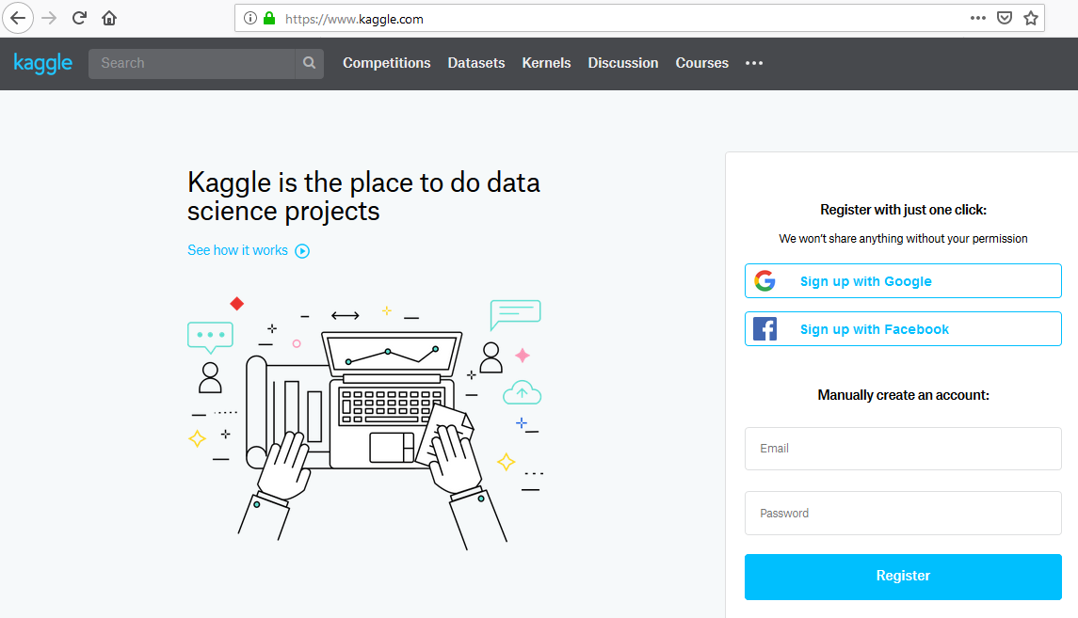

Slide 15
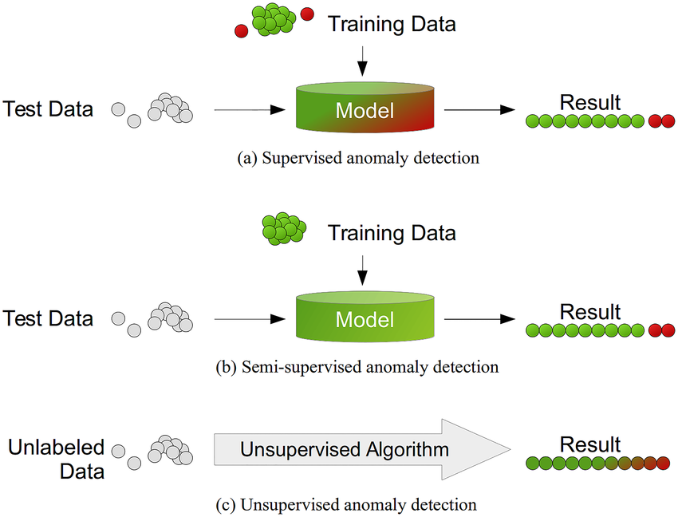
Supervised or unsupervised?
Fraud detection?
Anomaly detection?
  ONEClass models!
Telefónica (Network Optimization)
  Can we detect AVE Passengers?
  Labels?

Slide 16
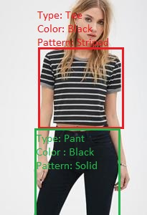
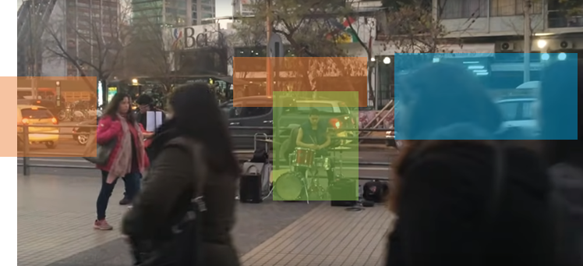
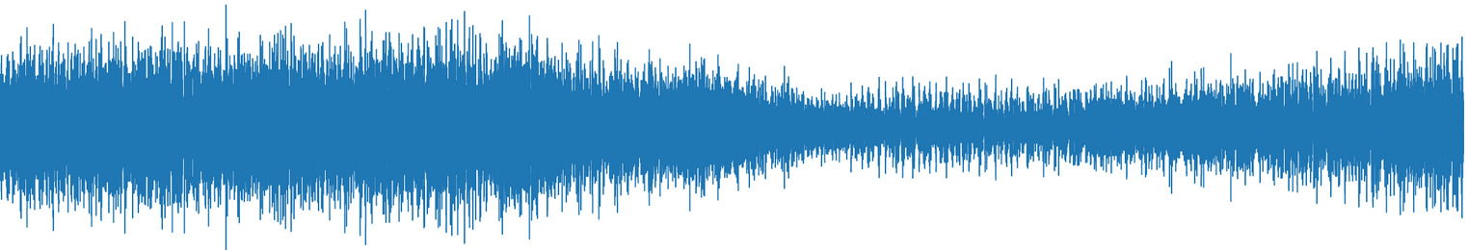
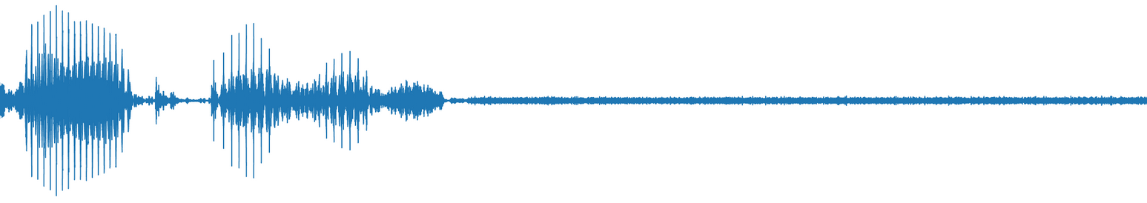

Also different Supervised problems:
Multi-class & Multi-Label Classification
Think about the labels in these applications:
Object detection?
              Sound classification?
Cars
People talking
Music

Slide 17

Consider that sometimes you can decide more efficient or effective to change:
A classification problem into a regression one.

Slide 18
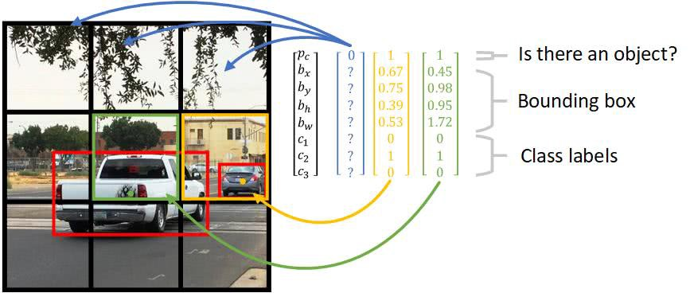
In first versions of image segmentation YOLO algorithm object detection was addressed as a single regression problem:
predicting bounding boxes (location and size)
and class probabilities simultaneously from an image in one pass.

Slide 19
Consider that sometimes you can decide more efficient or effective to change:
A classification problem into a regression one.
A regression problem into a classification one.

Slide 20
Convert you regression problem into a classification problem.
For example, instead of predicting the exact Sleep Apnea Index of a patient (regression), you can classify as “healthy" or "severe" (classification).

Slide 21
Also know about different classification tasks:
Binary classification
Multiclass classification
Multiclass Multilabel classification

Slide 22
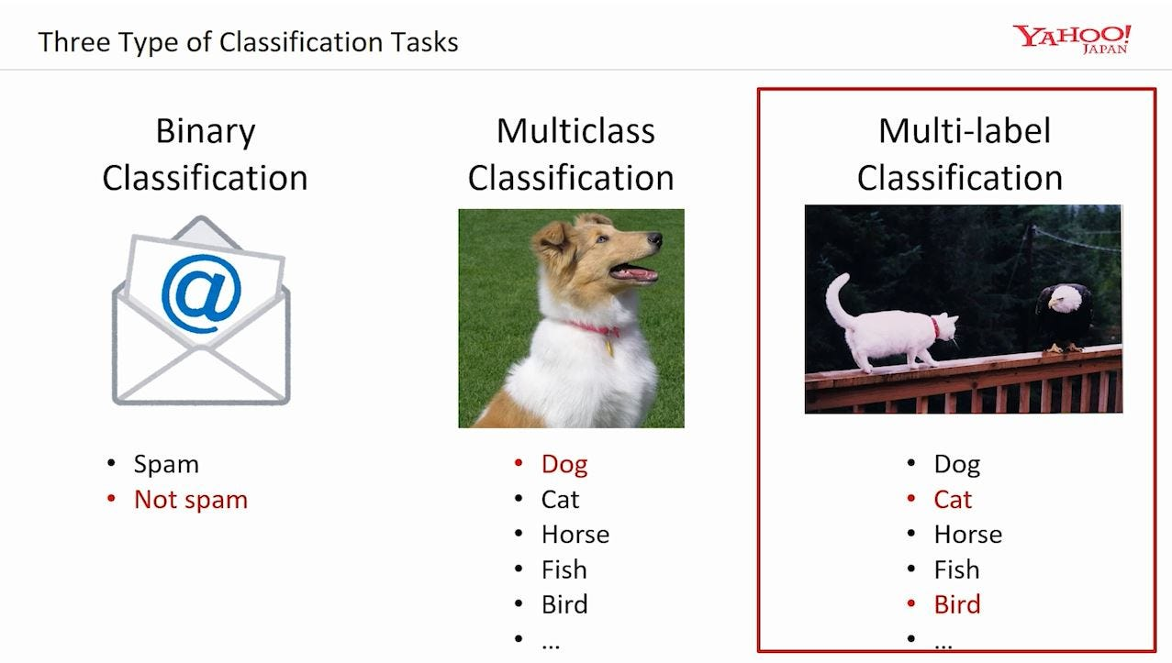
https://medium.com/@saugata.paul1010/a-detailed-case-study-on-multi-label-classification-with-machine-learning-algorithms-and-72031742c9aa

Slide 23
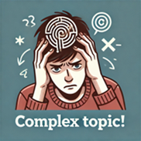
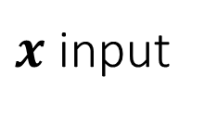
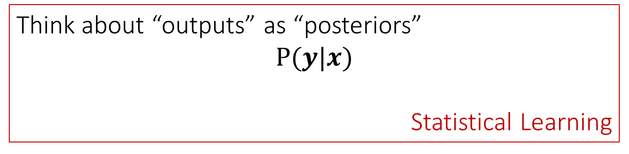
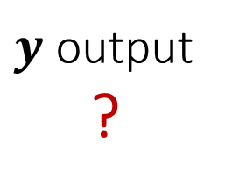
What would be the outputs of a classification algorithm for these different tasks?
Machine Learning
Deep Learning
AI
Classification Algorithm
$y$ output
?
$x$ input
Think about “outputs” as “posteriors”
$$P(y|x)$$
Statistical Learning

Slide 24
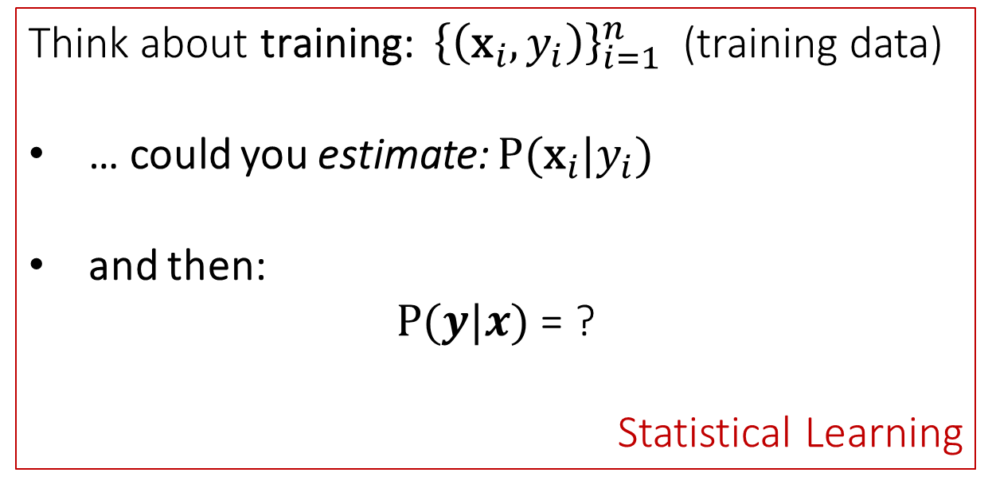

Now considering “outputs” as “posteriors”
$$P(y|x)$$
Think about training: ${\left\{\left({\text{x}}_{i},y_{i}\right)\right\}}_{i=1}^{n}$ (training data)
… could you estimate: $P({\text{x}}_{i}|y_{i})$
and then:
$P(y|x)$ = ?
Statistical Learning

Slide 25
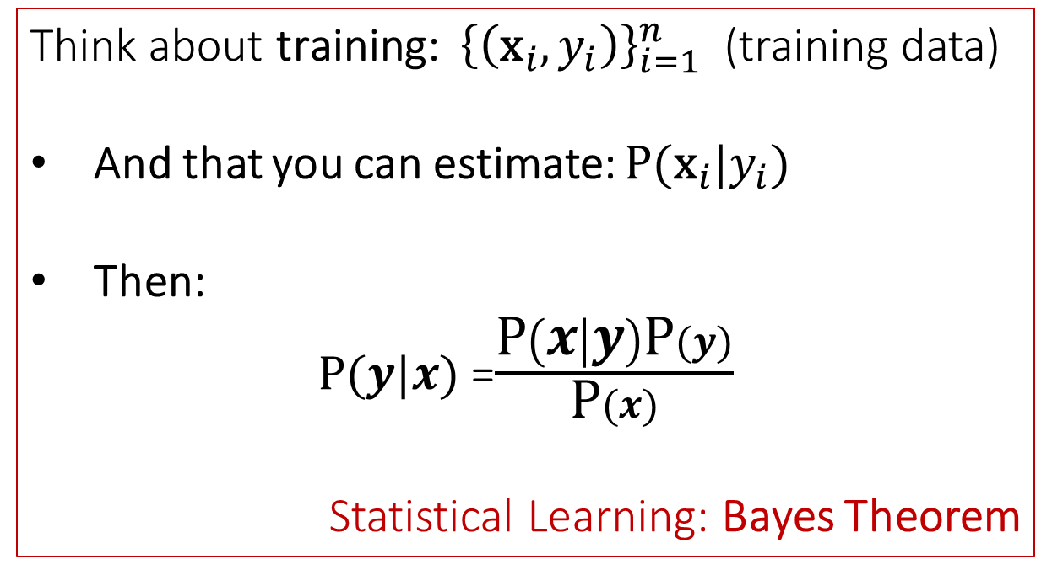
Now considering “outputs” as “posteriors”
$$P(y|x)$$
Think about training: ${\left\{\left({\text{x}}_{i},y_{i}\right)\right\}}_{i=1}^{n}$ (training data)
And that you can estimate: $P({\text{x}}_{i}|y_{i})$
Then:
$P(y|x)$ =$\frac{\text{P}\left(x | y\right)\text{P}(y)}{\text{P}(x)}$
Statistical Learning: Bayes Theorem

Slide 26
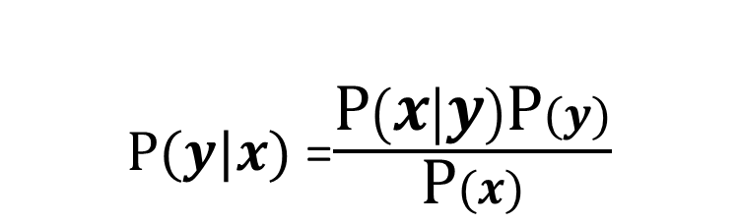
$P(y|x)$ =$\frac{\text{P}\left(x | y\right)\text{P}(y)}{\text{P}(x)}$
Bayes Theorem
Main takeaways:
To succeed in classification, we should approach probabilities, thus the name:
      statistical learning

Slide 27
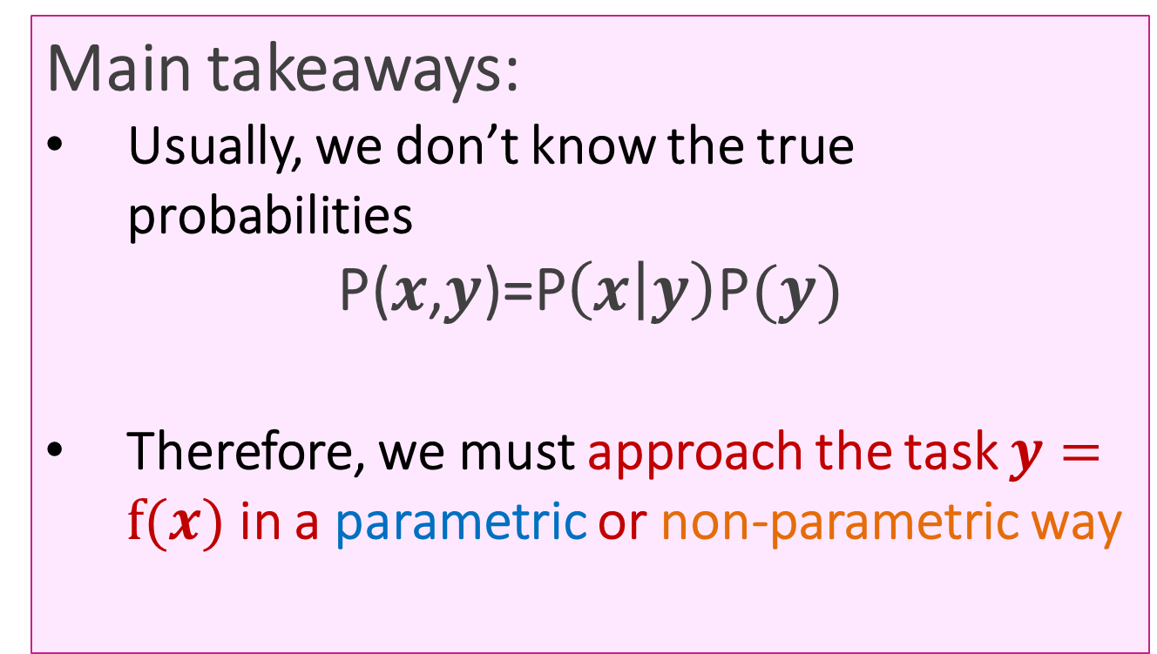
Main takeaways:
Usually, we don’t know the true probabilities
$$\text{P(}x\text{,}y\text{)=P}\left(x | y\right)\text{P}(y)$$
Therefore, we must approach the task $y=f(x)$ in a parametric or non-parametric way

Slide 28
Main takeaways:
A similar same discussion can be done for a regression problems.
These discussions are studied in Chapter 2

Slide 29
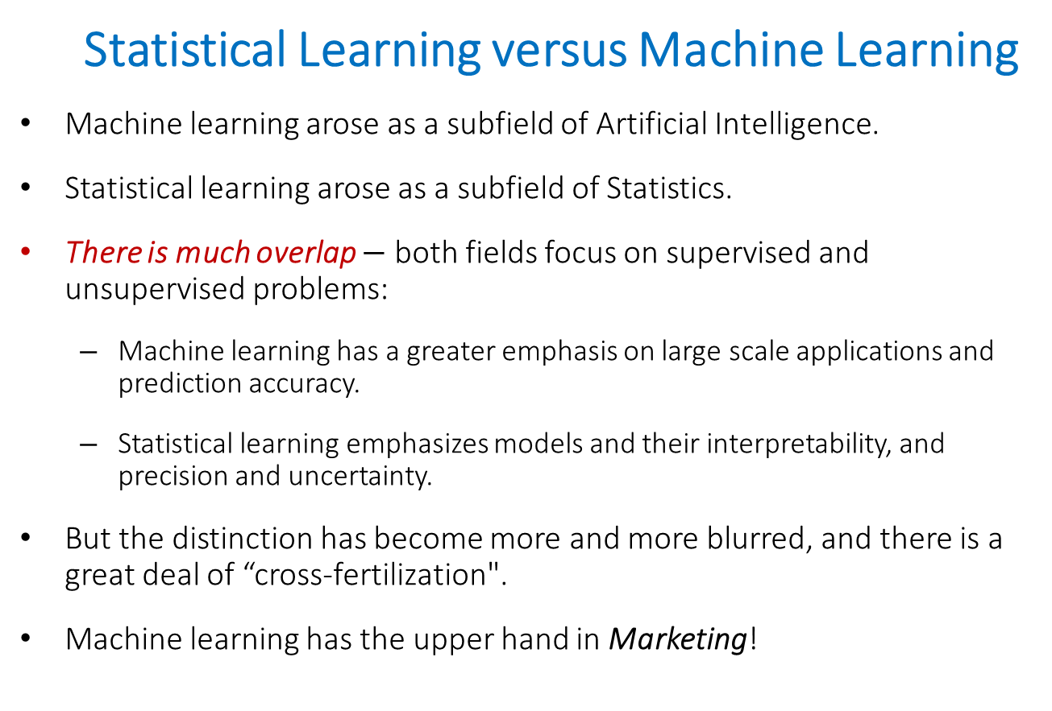
Introduction to Machine Learning
  Statistical Learning versus Machine Learning
Machine learning arose as a subfield of Artificial Intelligence.
Statistical learning arose as a subfield of Statistics.
There is much overlap $−$ both fields focus on supervised and unsupervised problems:
  Machine learning has a greater emphasis on large scale applications and prediction accuracy.
  Statistical learning emphasizes models and their interpretability, and precision and uncertainty.
But the distinction has become more and more blurred, and there is a great deal of “cross-fertilization".
Machine learning has the upper hand in Marketing!

Slide 30
Find your own descriptions or relationships for the following terms:
    Statistical Learning
    Machine Learning
    Deep Learning
    Artificial Intelligence

Slide 31

But before Chapter 2
Let’s think a little more far away…

Slide 32
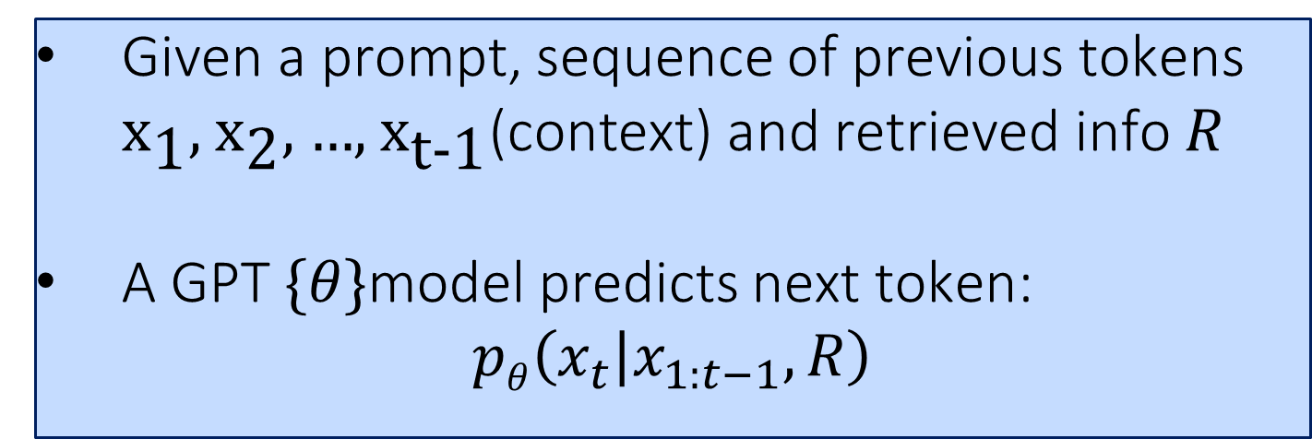
GPT models, are trained to predict the next word (token) given the context (prompt, previous words, retrieved information RAG –Retrieval Augmented Generation- , etc.)
Given a prompt, sequence of previous tokens ${\text{x}}_{\text{1}}\text{, }{\text{x}}_{\text{2}}\text{, …, }{\text{x}}_{\text{t−1}}\text{(context) and} \text{retrieved info}$ $R$
A GPT $\{θ\}$model predicts next token:
$$pθ\left(x_{t} | x_{1:t−1},R\right)$$

Slide 33
GPT models, are trained to predict the next word (token) given the context
Is it a classification task?
Is GPT a classification model?

Slide 34
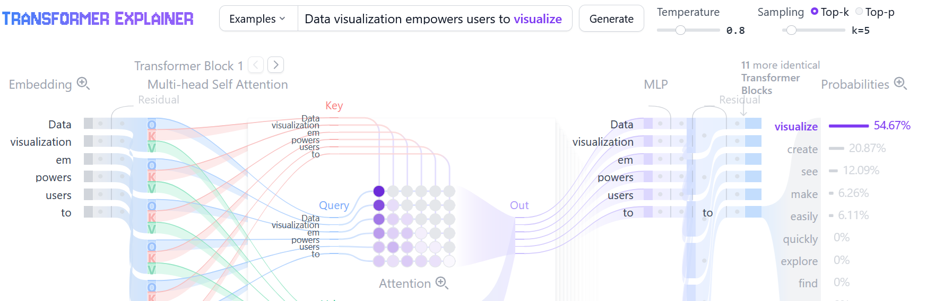
When we study transformers, we will use this nice tool:
https://poloclub.github.io/transformer-explainer/
By now just look at the output of this GPT-2 implementation:

Slide 35

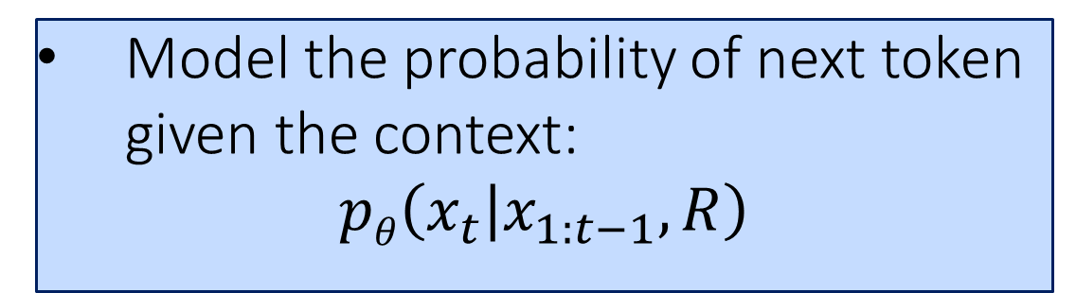
Therefore, GPT models, are trained to:
Model the probability of next token given the context:
$$pθ\left(x_{t} | x_{1:t−1},R\right)$$
and SAMPLE from this probability !
Be sure you that you know the generation of sample from a given statistical distribution.

Slide 36
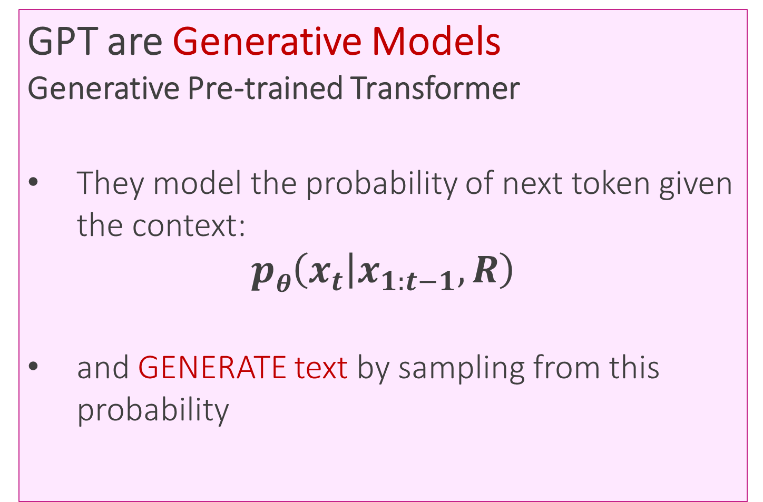
GPT are Generative Models
Generative Pre-trained Transformer
They model the probability of next token given the context:
$$pθ\left(x_{t} | x_{1:t−1},R\right)$$
and GENERATE text by sampling from this probability

Slide 37
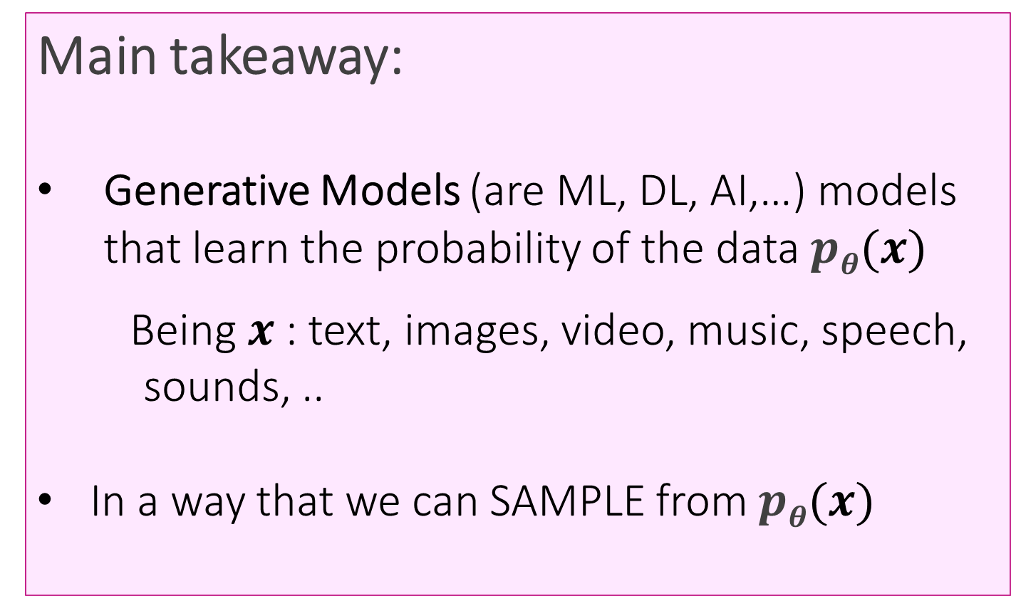
Main takeaway:
Generative Models (are ML, DL, AI,…) models that learn the probability of the data $pθ(x)$
      Being $x$: text, images, video, music, speech, sounds, ..
In a way that we can SAMPLE from $pθ(x)$

Slide 38
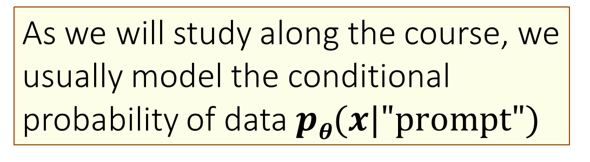
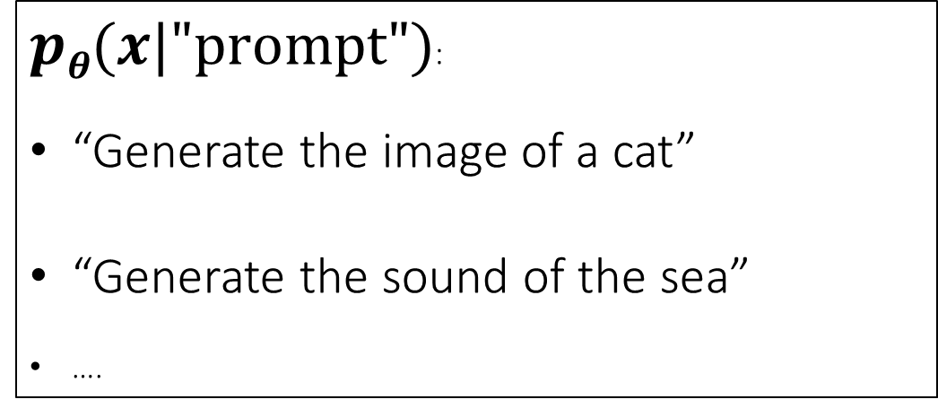
As we will study along the course, we usually model the conditional probability of data $pθ(x|"prompt")$
$pθ(x|"prompt")$:
“Generate the image of a cat”
“Generate the sound of the sea”
….

Slide 39
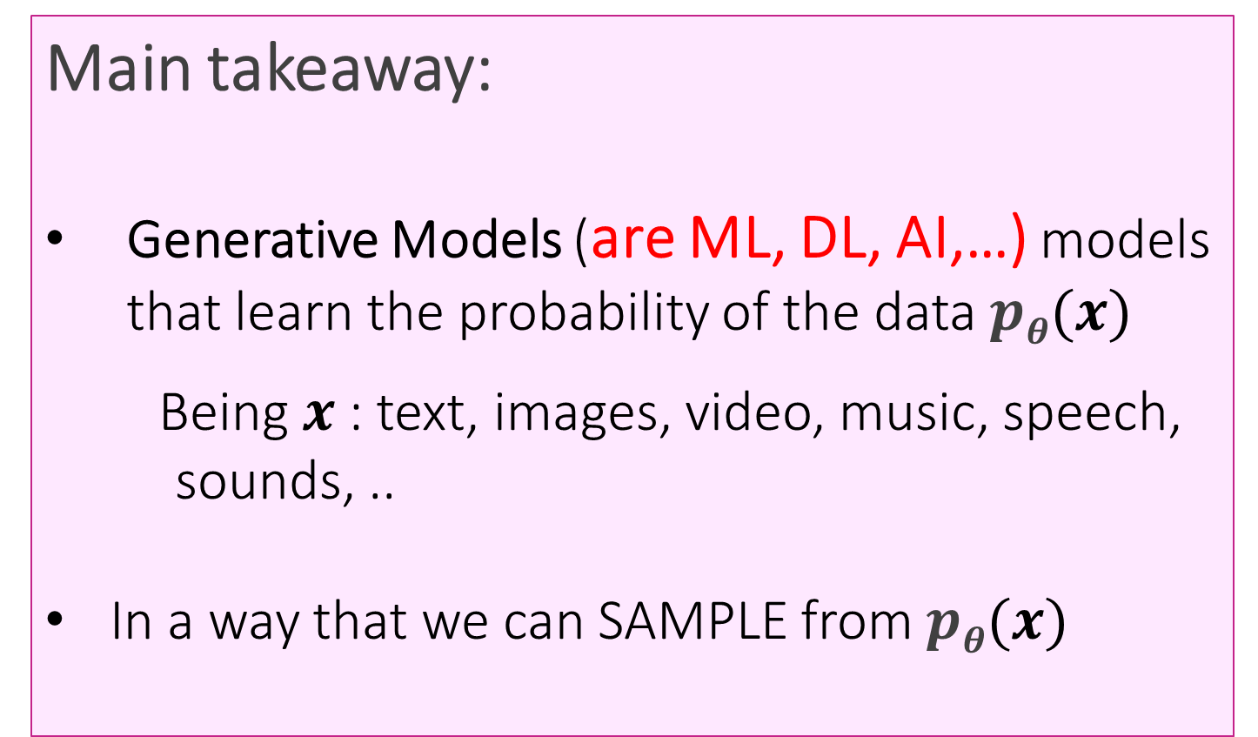
Main takeaway:
Generative Models (are ML, DL, AI,…) models that learn the probability of the data $pθ(x)$
      Being $x$: text, images, video, music, speech, sounds, ..
In a way that we can SAMPLE from $pθ(x)$

Slide 40
We will see this in
Chapter 4
Classification

Slide 41
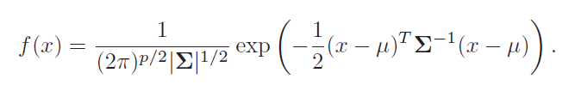
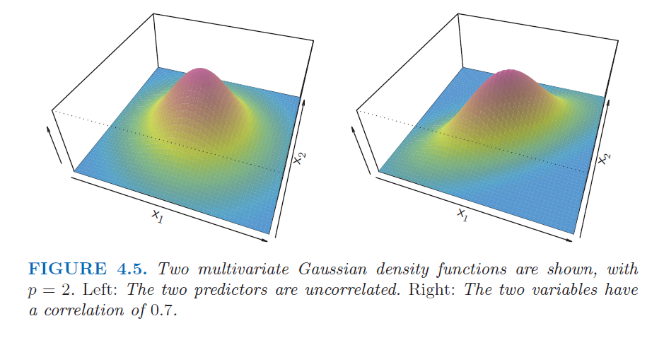
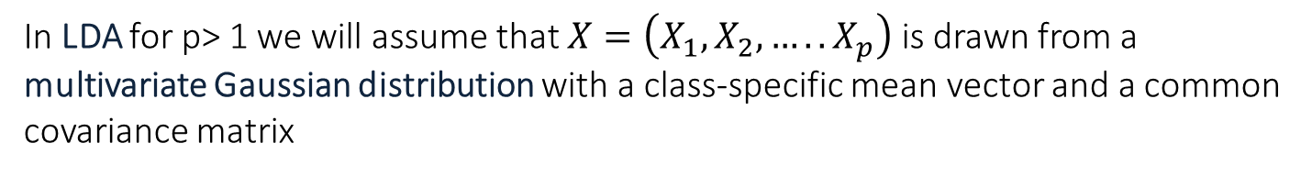
Linear Discriminant Analysis for p>1
In LDA for p> 1 we will assume that $X=\left(X_{1},X_{2},…..X_{p}\right)$ is drawn from a multivariate Gaussian distribution with a class-specific mean vector and a common covariance matrix
$μ$ is the mean vector and $Σ$ is the $p \text{x} p$covariance matrix of $X \text{that is}, Σ=\text{Cov}(X)$

Slide 42
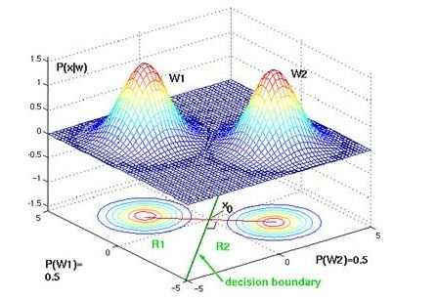

Slide 43
Generative vs. Discriminative Models
Generative
Discriminative
Learn a model of the joint probability p(X, y)
Use Bayes’ Rule to calculate p(y|X)
Build a model of each class; given example, return the model most likely to have generated that example
Examples: Naïve Bayes, Gaussian Discriminant Analysis, HMM, Probabilistic CFG
Model posterior probability p(y|X) directly
Class is a function of document vector
Find the exact function that minimizes classification errors on the training data
Examples: Logistic regression, Neural Networks (NNs), Support Vector Machines (SVMs), Decision Trees
Notes:
Example from Ng notes:
Discriminative: “Consider a classification problem in which we want to learn to distinguish between elephants (y = 1) and dogs (y = 0), based on some features of an animal. Given a training set, an algorithm like logistic regression or the perceptron algorithm (basically) tries to find a straight line—that is, a decision boundary—that separates the elephants and dogs. Then, to classify a new animal as either an elephant or a dog, it checks on which side of the decision boundary it falls, and makes its prediction accordingly. “
Generative: “Here’s a different approach. First, looking at elephants, we can build a model of what elephants look like. Then, looking at dogs, we can build a separate model of what dogs look like. Finally, to classify a new animal, we can match the new animal against the elephant model, and match it against the dog model, to see whether the new animal looks more like the elephants or more like the dogs we had seen in the training set.” http://cs229.stanford.edu/notes/cs229-notes2.pdf

Slide 44
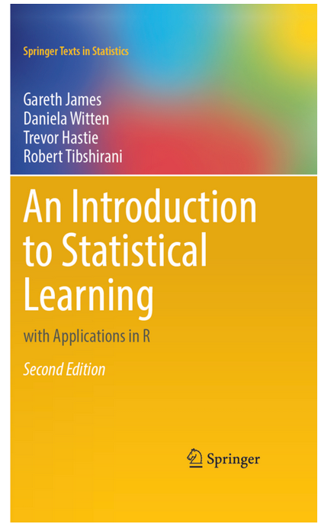
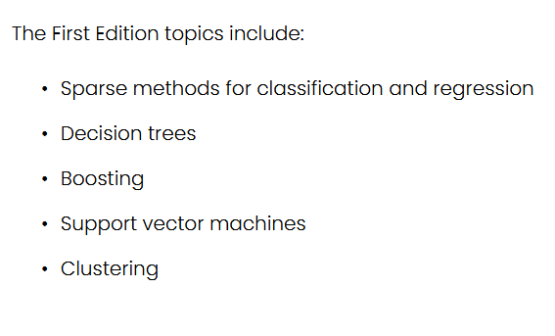
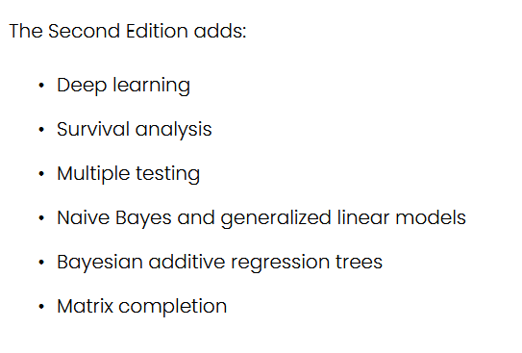
Textbook for ML part
Can be downloaded from: https://www.statlearning.com/

Slide 45
We don’t have time for everything, we will not study some interesting areas such as Survival Analysis
In many medical studies, the primary endpoint is time until an event occurs (e.g. death, remission)
Data are typically subject to censoring when a study ends before the event occurs
Survival Function - A function describing the proportion of individuals surviving to or beyond a given time. Notation:
  T ≡ survival time of a randomly selected individual
  t ≡ a specific point in time.
  S(t) = P(T > t) ≡ Survival Function
  λ(t) ≡ instantaneous failure rate at time t aka hazard function

Slide 46
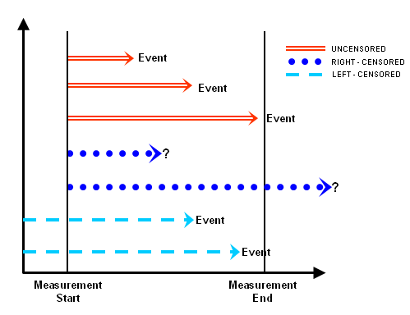
Survival Analysis
Patient drop out of the study
Patient alive at the end of a clinical trial
https://infocenter.informationbuilders.com/wf80/index.jsp?topic=%2Fpubdocs%2FRStat16%2Fsource%2Ftopic45.htm

Slide 47
We don’t have time for everything, we will not study some interesting areas such as Survival Analysis
… but if you have previous ML skills + time + interest…
go for it!

Slide 48
Predictive and Descriptive Learning
Main ML models you should learn
  The predictive or supervised techniques include:
    Linear regression, logistic regression, generalized linear models,…
    K-nearest neighbor classifier,
    classification and regression trees,
    ensemble methods (Bagging, Random Forests and Boosting),
    and kernel methods and Support Vector Machines.
  The descriptive or unsupervised techniques include:
  Principal components analysis (PCA)
  and Clustering methods (k-means and hierarchical clustering)

Slide 49
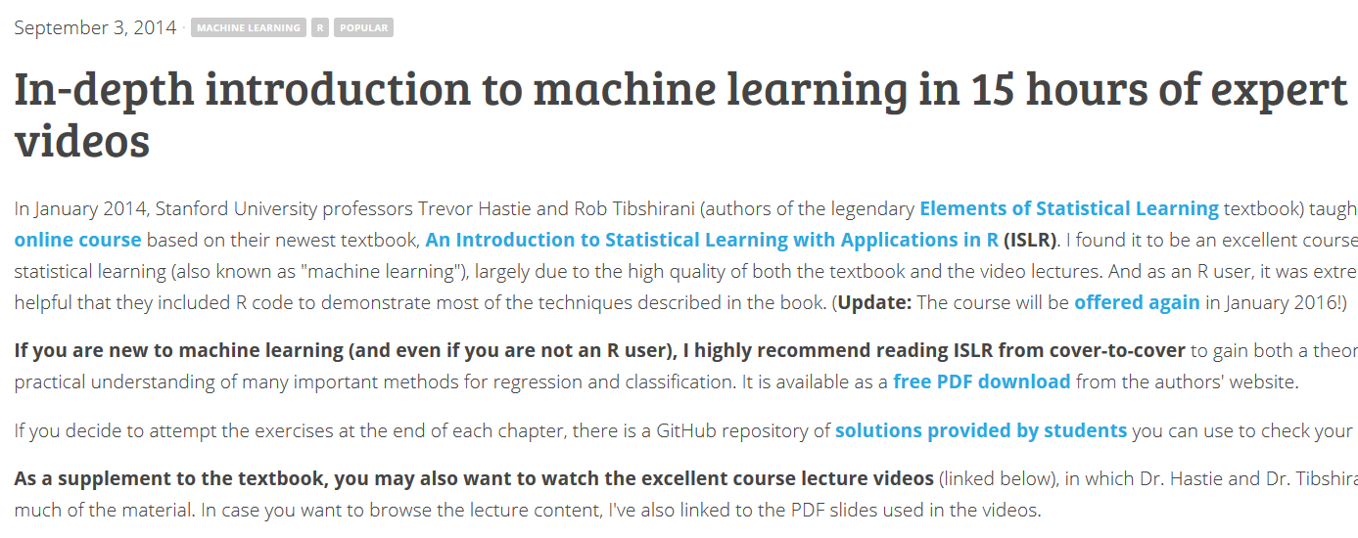
On-line course
Some slides and figures in our Moodle material are from the on-line course:
In-depth introduction to machine learning in 15 hours of expert videos
But you can access the original material and follow author’s videos at:
https://www.statlearning.com/online-course
http://www.r-bloggers.com/in-depth-introduction-to-machine-learning-in-15-hours-of-expert-videos/
http://www.dataschool.io/15-hours-of-expert-machine-learning-videos/

Slide 50
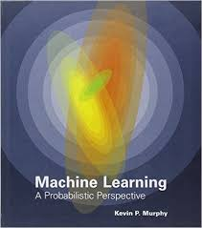
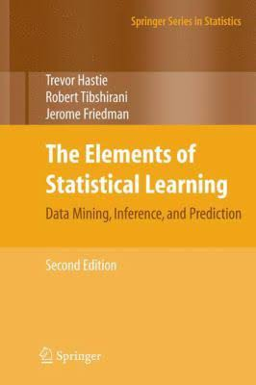
Bibliography
Murphy, Kevin P. Machine learning: a probabilistic perspective. MIT press, 2012.
Hastie, Trevor, Tibshirani, Robert and Friedman, Jerome. The Elements of Statistical Learning Data Mining, Inference, and Prediction, Second Edition. Springer Series in Statistics, 2009.
Konstantinos Koutroumbas, Sergios Theodoridis. Pattern Recognition, 4th Edition. Academic Press, 2008.
Rajaraman, Anand, and Jeffrey D. Ullman. Mining of massive datasets. Vol. 77. Cambridge: Cambridge University Press, 2012.
Bekkerman, Ron, Mikhail Bilenko, and John Langford, eds. Scaling up machine learning: Parallel and distributed approaches. Cambridge University Press, 2011.

Slide 52
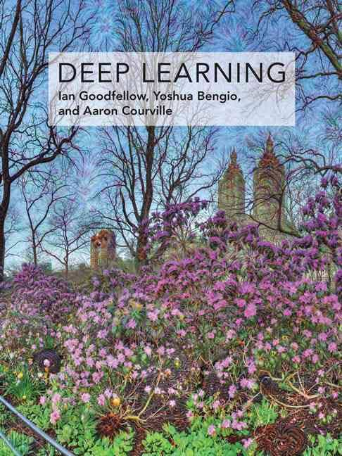
Deep Learning
Learn the whole
Machine Learning context
On line:
www.deeplearningbook.org
Deep Learning courses
Prof. Hung-yi Lee National Taiwan University (NTU) Taipei

Slide 53
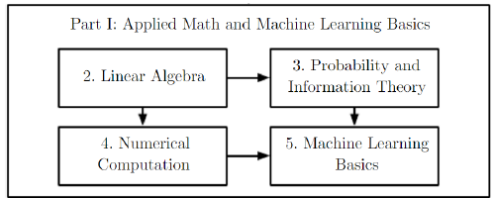
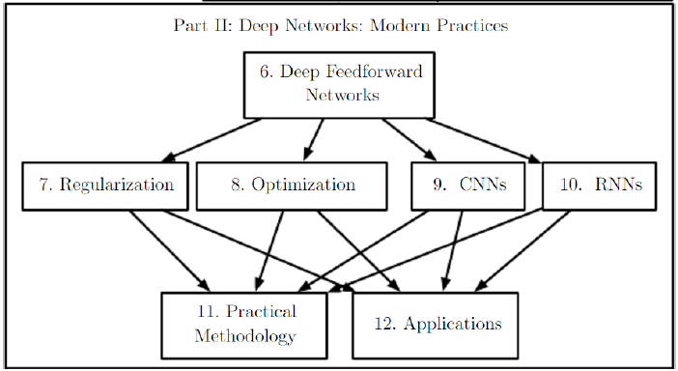

Slide 54
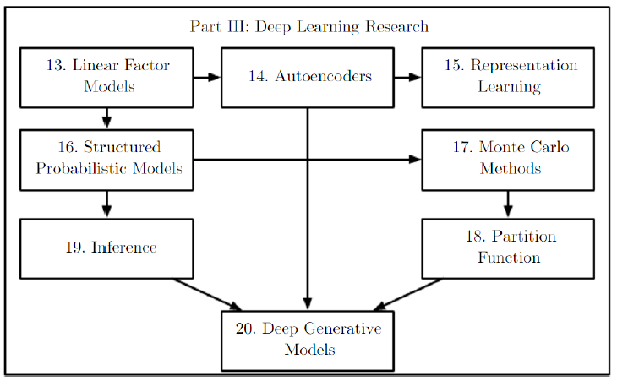

Slide 55

https://www.bishopbook.com/

Slide 56


Slide 57


Slide 58
Now let’s you propose a first assignment!

Slide 59
The impressive advances in AI (Deep Learning flexibility/creativity) have (and is) driving new ways of “learning”, and thus “new terms”.

Slide 60

Evolution of Speech Processing over the Years
Source: https://arxiv.org/pdf/2305.00359.pdf

Slide 61
The impressive advances in AI (Deep Learning flexibility/creativity) have (and is) driving new ways of “learning”, and thus “new terms”.
Your first course assignment will be to do your own research on some of “these new terms”.
Therefore, your activities will be:
Research (look/read for sources)
You can ask LLMs (like ChatGPT)
Write your ideas in your Deep Learning Report (PRDL may be also MLLB)
Present/discuss in class (you may prepare pptx)
Of course, you can work with your classmates.

Slide 62
Key points:
This will be your FIRST version of your Deep Learning Report (PRDL, optionally MLLB)
In your Report as in any technical/scientific document, it is very important to properly cite your references (Bibliography Section)
Know about citation styles….

Slide 63

https://pitt.libguides.com/citationhelp

Slide 64
How to cite info from LLMs (as ChatGPT)?
Be critical with yourself (use only reviewed/contrasted information)

Slide 65

How to cite info from LLMs (as ChatGPT)?
2. Decide the format, for example:
https://guides.libraries.psu.edu/c.php?g=1338692&p=9866353

Slide 66


How to cite info from LLMs (as ChatGPT)?
2. Decide the format, for example:
Make your own research on this topic!
https://libguides.umn.edu/c.php?g=1314591&p=9664746

Slide 67
These new learning techniques are usually behind NLP (Natural Language Processing) and Multimodal Image, Video, Audio, Speech, Music,…

Slide 68




https://www.cortical.io/blog/chatgpt-and-large-language-models-the-holy-grail-of-enterprise-ai/
https://learnopencv.com/ai-art-generation-tools/
https://imagebind.metademolab.com/
https://codi-gen.github.io/

Slide 69




These learning techniques are mainly used when developing Deep Learning models
https://arxiv.org/abs/2204.06125v1

Slide 70
FIRST ASSIGNMENT – Learning Techniques in Machine Learning
Groups of 3 or 4 people
Research on already explained types (classical categorization):
  supervised,
  unsupervised
  and reinforcement learning.
Extend the research by exploring one additional modern learning paradigm:
  Transfer learning,
  Contrastive learning,
  Meta-learning,
  Self-supervised learning,
  Semi-supervised learning,
  Zero-shot/few-shot learning,
  Multi-task learning,
  Active learning,
  Online learning,
  Ensemble learning,
  …

Slide 71

FIRST ASSIGNMENT – Learning Techniques in Machine Learning
  Tasks for each group
  → Overview of classical learning type:
    main idea or intuition,
    typical algorithms/models,
    application examples
    → Advanced paradigm:
      definition, concept explanation
      how does it differ from the classical paradigms? does it overlap with any of the classical paradigms?
      representative models or approaches
      provide some applications in different domains if possible
Coding possibility!!!
If comfortable with programming → implement a simple demo
(e.g., with sklearn package and Keras/Tensoflow/Pytorch frameworks)
If not → explore existing demos (e.g., HuggingFace, Google Colab notebooks)
https://huggingface.co/

Slide 72
FIRST ASSIGNMENT – Learning Techniques in Machine Learning
  Deliverables
  Written report (PRDL)
  Practical experiments (MLLB)
  5-10 minutes in-class presentation per group
IMPORTANT NOTES
You can (should) update your PRDL and MLLB Reports until the end of the course
At any time, you can send us updated versions to receive our feedback
You may find PRDL & MLLP Report templates at Moodle, BUT you may use any format (Latex) you prefer

Slide 73
FIRST ASSIGNMENT – Learning Techniques in Machine Learning
  Deadlines
  Send group members by email to luisalfonso.Hernandez@upm.es by Friday, 18. We will assign your advanced learning topic!!
  Upload PRDL and MLLB reports by September 27
  Presentations will start on September 29

