Slide 1








THE ML FMEA IN ACTION: LESSONS FROM APPLICATIONS OF MACHINE LEARNING SAFETY
Paul Schmitt, Reynolds & Moore
Krzysztof Pennar, Torc Robotics
Akshay Chalana, Saphira.AI
Majed Mohammed, APTIV
Bodo Seifert, TÜV Rheinland
Jerry Lopez, Torc Robotics
Neil Wadhvana, Torc Robotics
Michael Wagner, Edge Case
Chaitanya Shinde, Torc Robotics
Justin Poh, Torc Robotics
Simon Diemert, Critical Systems Labs
Fahim Mannan, Torc Robotics
David Ward, HORIBA MIRA
Link to the paper

Slide 2
Torc Robotics Legal Disclaimer
This presentation reflects the research and methodology of the ML FMEA Collaborative and its members collectively. Nothing in this presentation represents the internal practices, standards, or systems of any Torc Robotics co-author or Torc Robotics. This methodology is provided for informational and research purposes only and is not intended to establish a standard of care or constitute a representation regarding the safety, compliance, or fitness of any system. Results from specific application examples reflect the projects described and should not be generalized beyond those contexts.
Torc Robotics
Notes:
Problem: Machine learning is increasingly embedded in safety-critical systems, but traditional safety analysis methods do not adequately address ML-specific risks such as data bias, reward misalignment, and distribution shift.
Approach: We applied and refined the open-source Machine Learning Failure Mode and Effects Analysis (ML FMEA) method across real-world autonomous vehicle and humanoid robot projects.
Impact: ML FMEA provides a structured, auditable bridge between machine learning development and safety engineering, supporting traceable, standards-aligned risk management for learning-enabled systems.

Slide 3
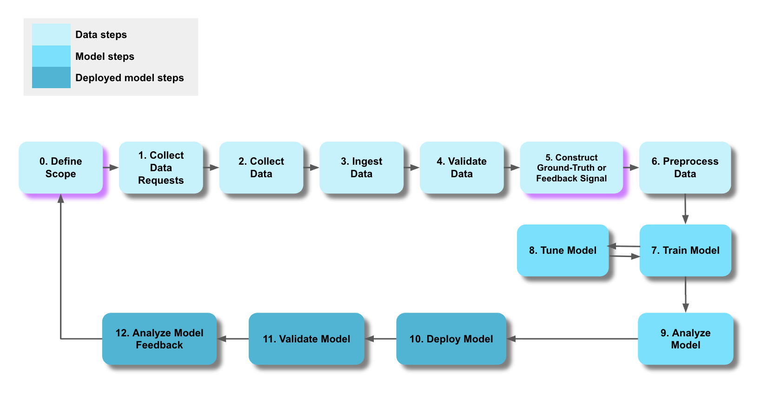
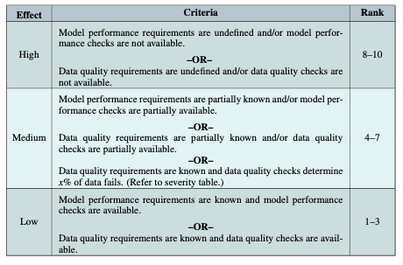
Executive Summary
Problem
Machine learning is increasingly embedded in safety-critical systems
Approach
We applied and refined ML FMEA
Autonomous Vehicle
Humanoid Robot
Impact
A structured, auditable method
Standards-aligned risk management
Notes:
Problem: Machine learning is increasingly embedded in safety-critical systems, but traditional safety analysis methods do not adequately address ML-specific risks such as data bias, reward misalignment, and distribution shift.
Approach: We applied and refined the open-source Machine Learning Failure Mode and Effects Analysis (ML FMEA) method across real-world autonomous vehicle and humanoid robot projects.
Impact: ML FMEA provides a structured, auditable bridge between machine learning development and safety engineering, supporting traceable, standards-aligned risk management for learning-enabled systems.

Slide 4
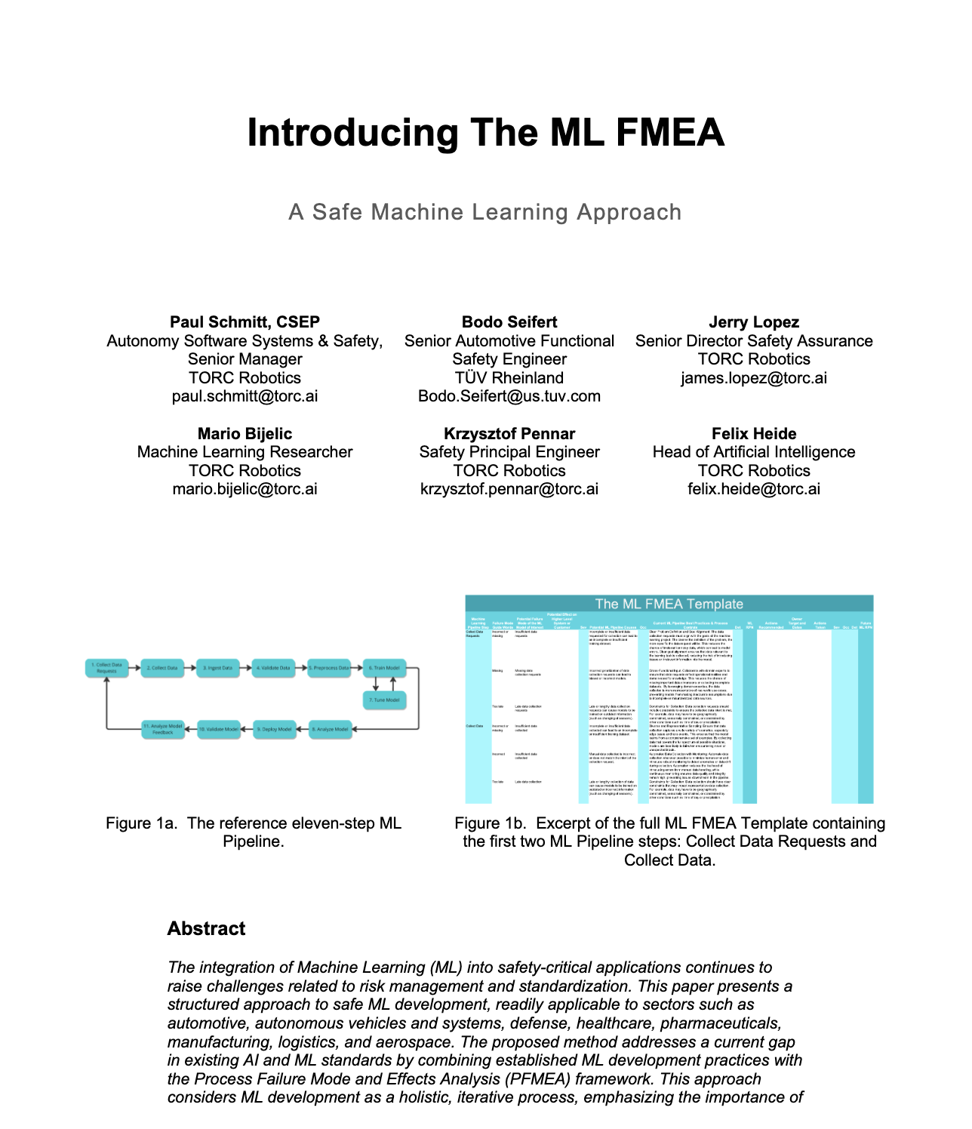
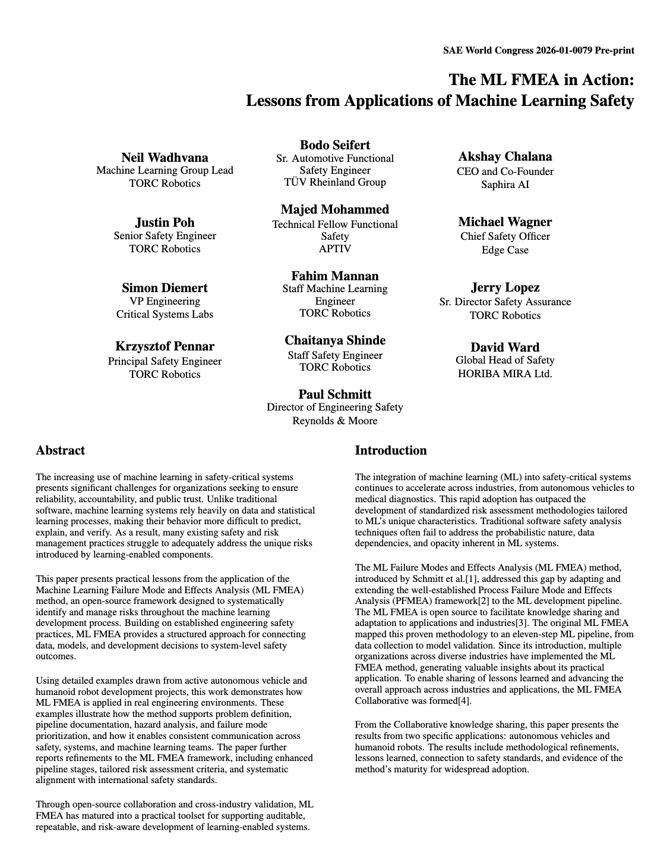
Executive Summary
+
Theory
Application
Notes:
Problem: Machine learning is increasingly embedded in safety-critical systems, but traditional safety analysis methods do not adequately address ML-specific risks such as data bias, reward misalignment, and distribution shift.
Approach: We applied and refined the open-source Machine Learning Failure Mode and Effects Analysis (ML FMEA) method across real-world autonomous vehicle and humanoid robot projects.
Impact: ML FMEA provides a structured, auditable bridge between machine learning development and safety engineering, supporting traceable, standards-aligned risk management for learning-enabled systems.

Slide 5
Agenda
Motivation
ML FMEA Overview
Four Key Contributions
Application Examples
Autonomous Vehicle
Humanoid
Q&A
Link to the paper

Slide 6
MOTIVATION
Link to the paper

Slide 7

Motivation
The Problem
ML is now in safety-critical systems
ML is non-deterministic and opaque
Challenges traditional safety analyses
Notes:
Explainability and transparency is an active area of research
Explainable AI Explainable AI Explain able AI

Slide 8
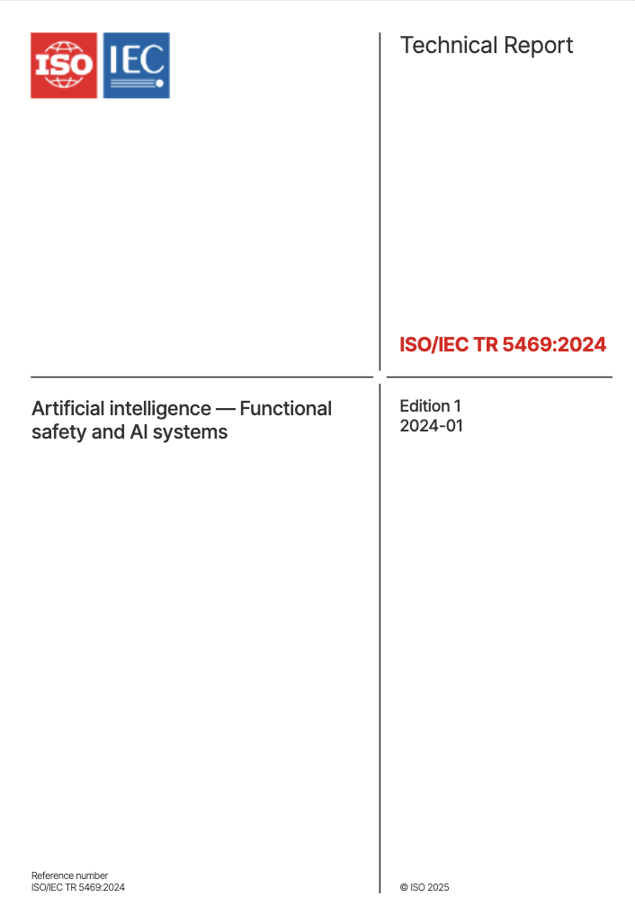
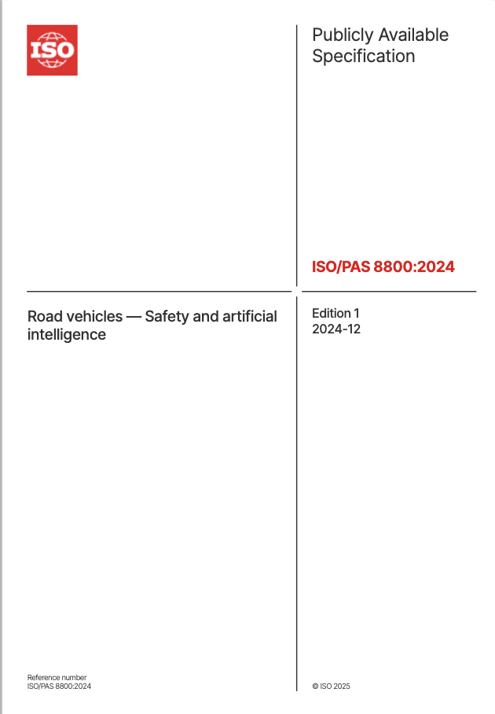
State of the Art
Several current and upcoming standards:
ISO/PAS 8800
UL 4600
ISO 21448​
Highlight the need to systematically ensure safety of ML
But they do not yet provide:
Step by step failure analysis
Pipeline-level failure mode structure
ML specific risk scoring
Notes:
While the above standards mention the need to systematically ensure safety of ML, they fail to prescribe specific techniques and methodologies to ensure that all engineering and V&V activities involving the ML pipeline are performed in a satisfactorily rigorous manner in order to argue with sufficient evidence that the ML algorithm is absent unreasonable risk.​

Slide 9

State of the Art
Opportunity Gap:
Step by step failure analysis
Pipeline-level failure mode structure
ML specific risk scoring
Gap
Notes:
While the above standards mention the need to systematically ensure safety of ML, they fail to prescribe specific techniques and methodologies to ensure that all engineering and V&V activities involving the ML pipeline are performed in a satisfactorily rigorous manner in order to argue with sufficient evidence that the ML algorithm is absent unreasonable risk.​

Slide 10
State of the Art
Opportunity Gap: Specific techniques and methodologies
Holistic: Addresses all ML engineering and V&V activities
Indicates the needed level of rigor
Supports a safety argument
Provides sufficient evidence
Supports the argument that ML algorithm is absent unreasonable risk
Gap
Notes:
While the above standards mention the need to systematically ensure safety of ML, they fail to prescribe specific techniques and methodologies to ensure that all engineering and V&V activities involving the ML pipeline are performed in a satisfactorily rigorous manner in order to argue with sufficient evidence that the ML algorithm is absent unreasonable risk.​

Slide 11
FUNDAMENTALS
Link to the paper

Slide 12
Fundamentals
ML Pipeline
View the ML Pipeline as a process​
The model is an output of the process

Slide 13
Fundamentals
ML Pipeline
View the ML Pipeline as a process​
The model is an output of the process

Slide 14
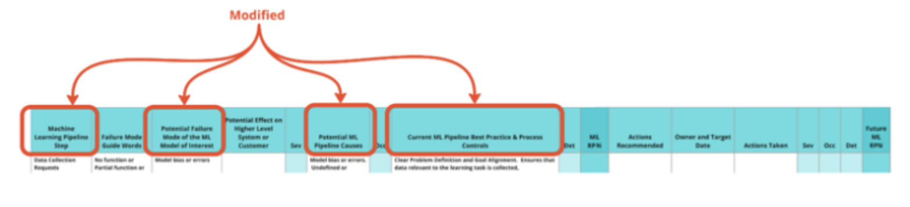
Fundamentals
PFMEA Template tailored for ML

Slide 15
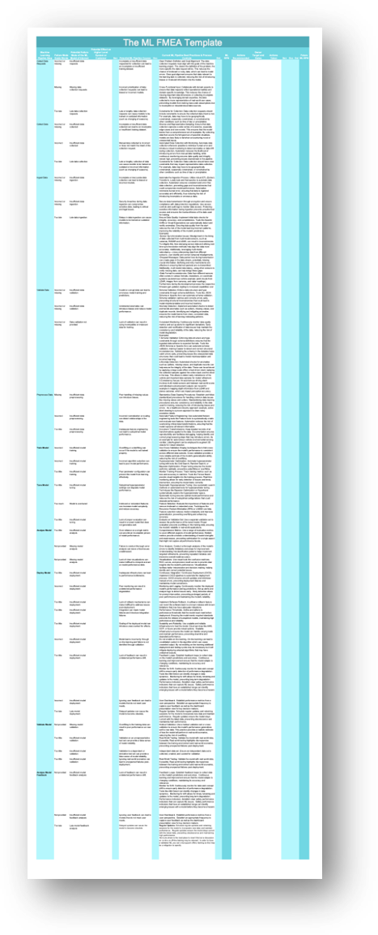
Fundamentals
ML FMEA Template
Pre-populated
Open source

Slide 16
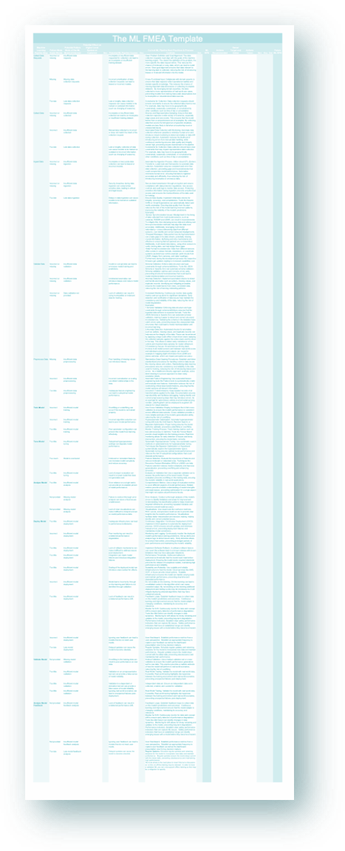
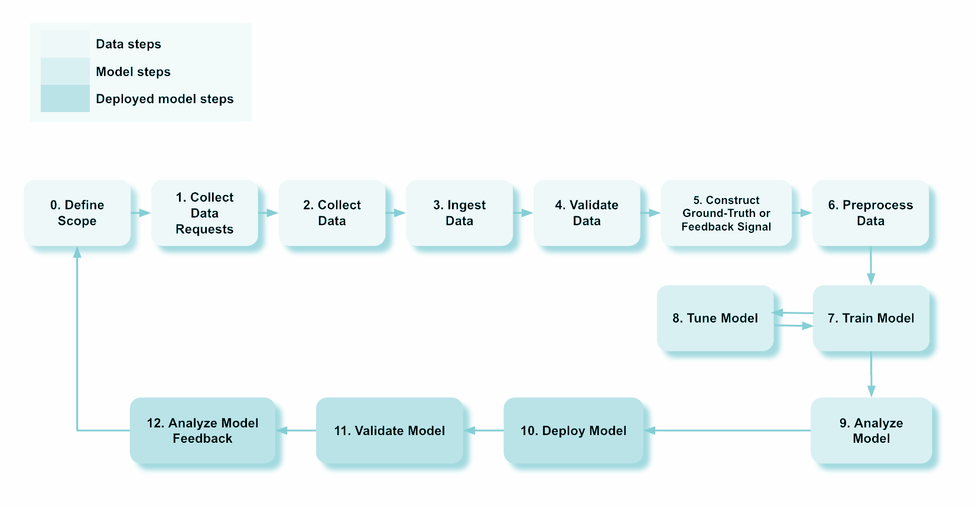
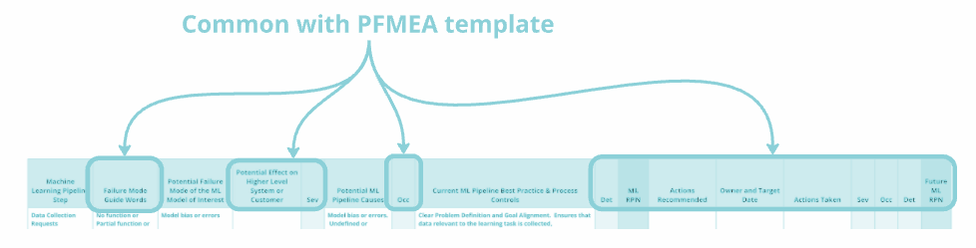
Fundamentals
ML Pipeline
Populated
ML FMEA
Template
ML FMEA
Template

Slide 17
CONTRIBUTIONS
Link to the paper

Slide 18
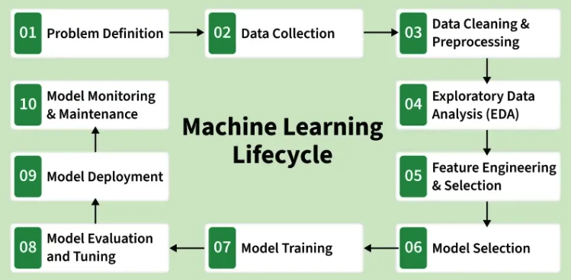
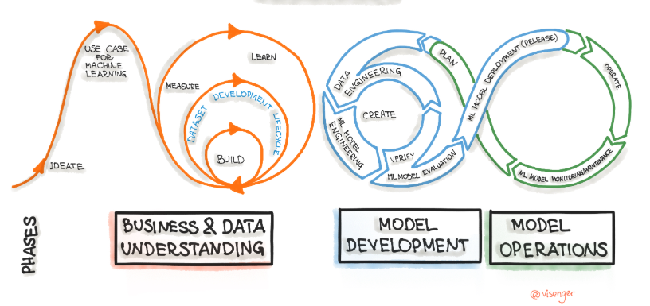
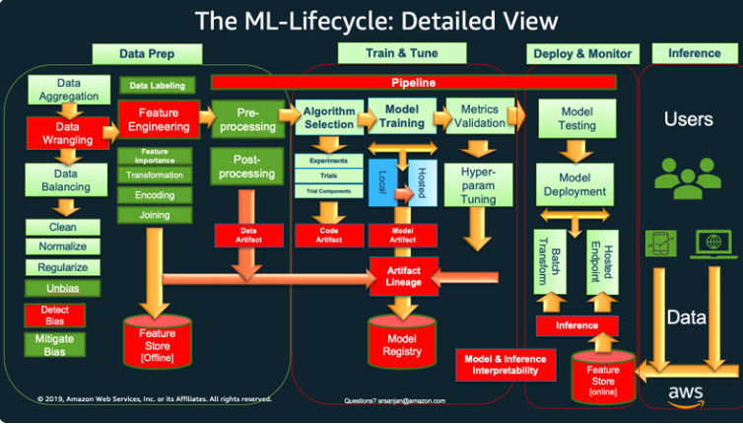
Vocabulary
Similar Definitions
ML Pipeline: A systematic process that connects the stages of the lifecycle (data processing, training, deployment) into a single reproducible sequence. Much of the pipeline is often automated.
ML Lifecycle: A structured workflow that defines how machine learning (ML) models are developed, deployed and maintained. It consists of a series of steps that ensure the model is accurate, reliable and scalable.
MLOps: The management and governance of ML models pipeline/lifecycle within an organization.
GforG
INNOQ
AWS

Slide 19
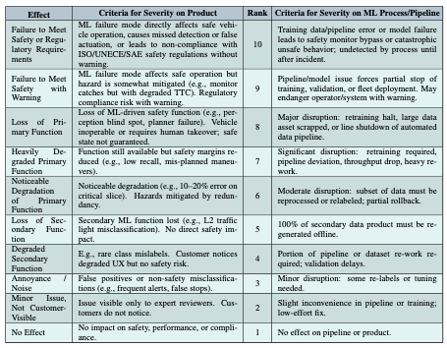
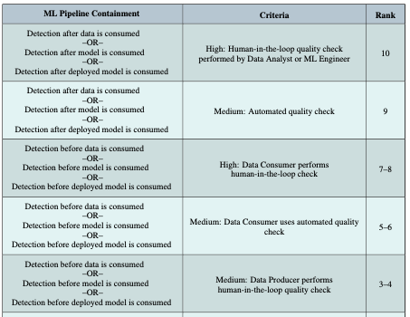
Four Contributions
Contributions:
ML FMEA Pipeline Additions
Step Zero
Step Five: Construct Ground Truth
Tailored Risk Assessment Criteria
Demonstration of Standards Alignment
Cross-Industry Perspectives

Slide 20
FIRST
CONTRIBUTION
Link to the paper

Slide 21
First Contribution
Step “Zero”
Problem Observed: Teams jumped to data collection without:
Clear problem definition
Defined system boundary
Hazard analysis
Step “Zero” Adds:
ML model problem definition
System-level hazard definition

Slide 22
First Contribution
Step Five
Addresses the gap for supervised learning.
Failure modes for data annotations, ground-truth, or reinforcement learning rewards.
Supervised Learning
Reinforcement Learning

Slide 23
First Contribution
Step Five
Addresses ML pipeline failures caused by:
Annotation bias
Label noise
Unintended optimization
Rewards misaligned with safety critical scenarios

Slide 24
SECOND
CONTRIBUTION
Link to the paper

Slide 25
Second Contribution
Risk Assessment Criteria
Severity, Occurrence, Detection tables
Example: Cause probability ≠ Failure probability

Slide 26
Second Contribution
Risk Assessment Criteria
Severity Table:
Changed product vocabulary to ML vocabulary
Provided ML examples
Occurrence Table:
Shifted from probability to quality management
Defined model performance requirements and checks
Detection Table:
Inspired by manufacturing quality
Detection timing: before or after
Human vs. automation check

Slide 27
THIRD
CONTRIBUTION
Link to the paper

Slide 28
Third Contribution
Safety Standards Alignment
ML FMEA maps to:
ISO/PAS 8800 (process-level analysis)
ISO 21448 (functional insufficiency)
UL 4600 (data quality + V&V arguments)
MIL-STD-882E (PHA/FHA inputs)
Key insight:
ML FMEA artifacts become safety case evidence

Slide 29
FOURTH
CONTRIBUTION
Link to the paper

Slide 30




Fourth Contribution
Cross Industry Application
Applied ML FMEA in:
Automotive and Mobility
Aerospace/defense
Humanoid
Medical
Lesson:
The ML FMEA approach generalizes well across diverse applications

Slide 31
APPLICATION EXAMPLES
Link to the paper

Slide 32
AUTONOMOUS VEHICLE
Link to the paper

Slide 33
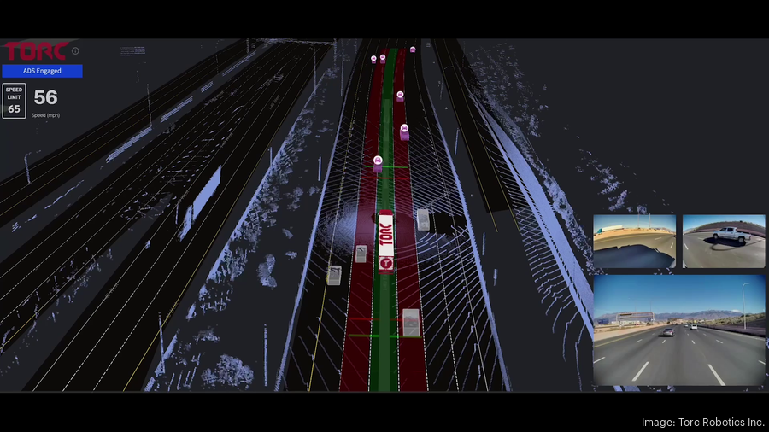
Autonomous Vehicle Example
Model of Interest
Road and Lane Model
Within Perception subsystem

Slide 34
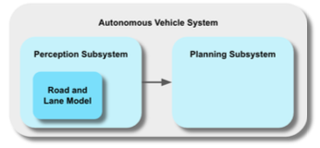
Autonomous Vehicle Example
Model of Interest
Road and Lane Model
Within Perception subsystem
Functions
Detect subject vehicle lane boundaries
Detect adjacent lane boundaries
System hazards
Lane departure
Collision
Simplified architecture diagram

Slide 35
Autonomous Vehicle Example
Step Zero Impact
Without Step Zero:
Unclear responsibility between Localization, Perception, Planning
With Step Zero:
Clear traceability:
Model -> Lane Detection -> Lateral localization -> Lane keeping

Slide 36
Autonomous Vehicle Example
Step Five Failures
Annotation bias -> Skewed lane position
Dataset mismatch -> poor edge-case generalization
Misaligned loss function -> under/overcritical lane weighting
Key Insight
Model trained correctly but optimization objective did not equal system safety objective

Slide 37
Autonomous Vehicle Example
AV Takeaway
Benefits of ML FMEA:
Traceable link from annotation → system hazard
Explicit identification of functional insufficiencies (SOTIF relevance)
Structured mitigation prioritization
Notes:
Supports

Slide 38
HUMANOID ROBOT
Link to the paper

Slide 39
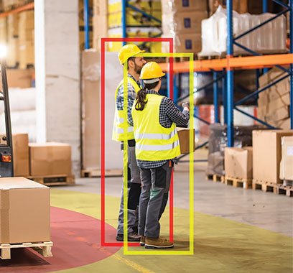
Humanoid Robot Example
Models of Interest
Perception: Human Detection Model
Control: Actuation Control Policy Model
Warehouse Use Case
Humanoid Robot

Slide 40
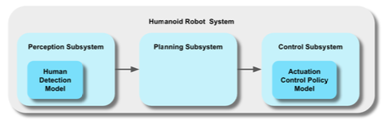
Humanoid Robot Example
Models of Interest
Perception: Human Detection Model
Control: Actuation Control Policy Model
Functions
Detect human
Localize human
System hazards
Unintended human contact
Simplified architecture diagram

Slide 41
Humanoid Robot Example
Step Zero Impact
Without Step Zero:
Unclear responsibility between perception, control, and safety system
Ambiguity in what “human detection” must guarantee
Hazards evaluated inconsistently across teams
With Step Zero:
Clear traceability:
Model -> Human Detection -> Proximity Estimation -> Safe Motion
Explicit definition of safety function: Maintain safe human-robot separation
Direct linkage to system hazard: Unintended human contact

Slide 42
Humanoid Robot Example
Step Five Failures
Annotation ambiguity -> missed human detections
Occluded, seated, or partially visible humans inconsistently labeled
Dataset bias -> poor generalization in real environments
Limited variation in posture, PPE, shelving occlusions
Misaligned reward function -> unsafe motion behavior
Efficiency of stability prioritized over human separation
Sim-to-real gap -> unstable control policies
Policy behaves safely in simulation but unsafe on hardware
Key Insight
Correct perception does not guarantee safe interaction
Safety depends on the coupling between perception and control policy
A model can perform well in isolation but still lead to unsafe system-level habior

Slide 43
Humanoid Robot Example
Humanoid Robot Takeaway
Benefits of ML FMEA:
Traceable link from perception + control → human safety hazard
Identification of interaction-level failure modes
Explicit evaluation of reward and policy safety alignment
Structured mitigation (e.g. motion bounds, confidence thresholds)
Notes:
Supports

Slide 44
BIG PICTURE
Link to the paper

Slide 45
What We Learned
Most ML risk originates upstream in the pipeline
Severity requires system-level hazard context
Annotation and reward design are safety-critical
Shared vocabulary dramatically improves cross-team communication

Slide 46
Conclusion
ML FMEA has evolved from concept → applied method.
Step Zero and Step 5 close critical gaps.
It now provides:
Structured ML risk analysis
Standards-aligned artifacts
Cross-industry applicability
The method is available for practitioners to evaluate and implement

Slide 47
OPEN SOURCE
Link to the paper

Slide 48
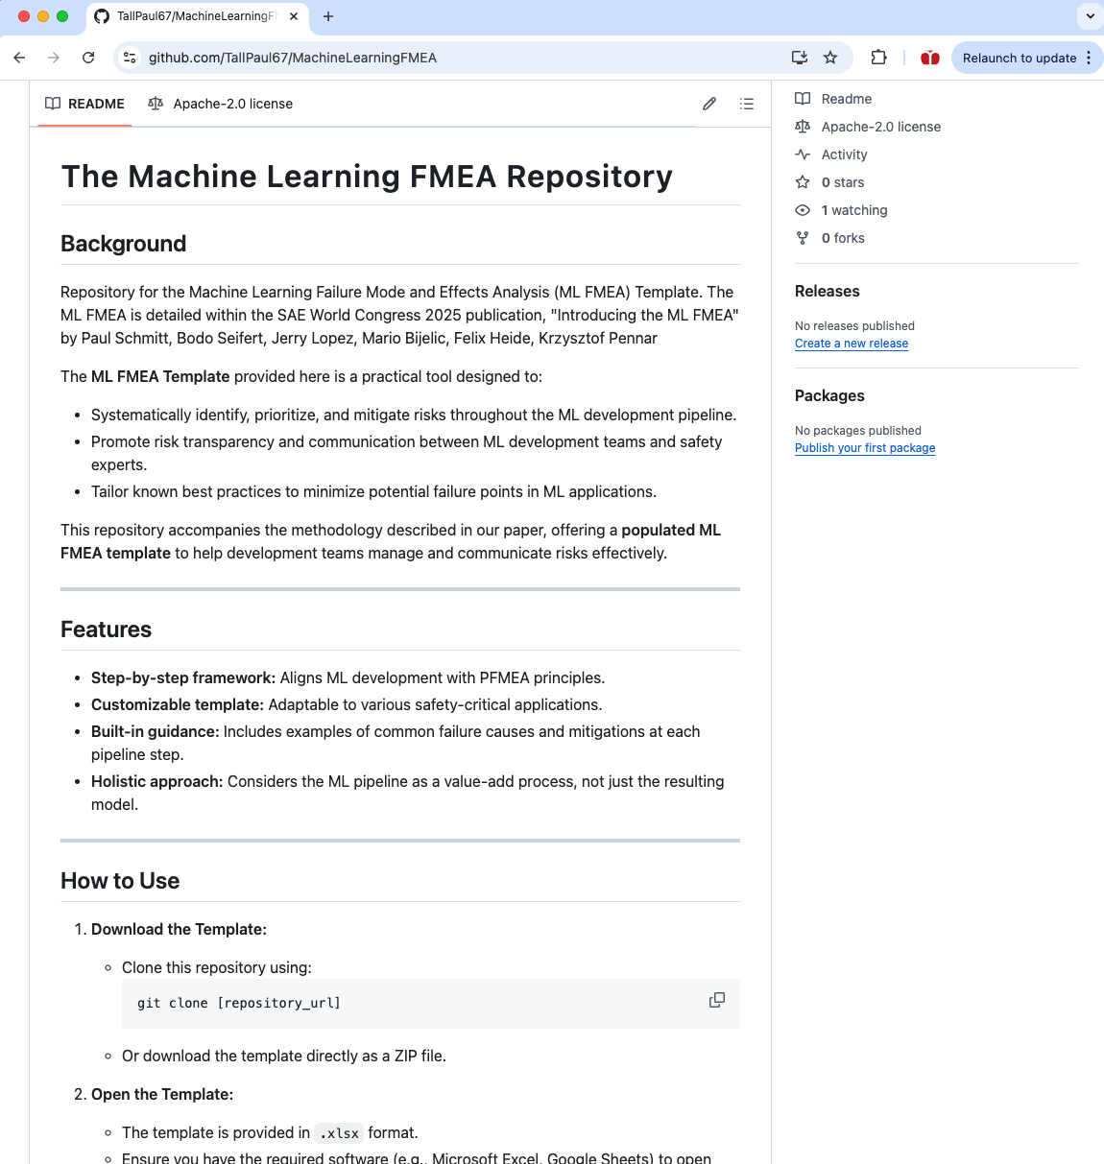

The ML FMEA Template: Open Source
Available on github.com
Inviting the community to use and improve the template. Across industries!
Start here:

Slide 49
DISCUSSION
BENEFITS & LIMITATIONS
Link to the paper

Slide 50
FUTURE WORK
Link to the paper

Slide 51
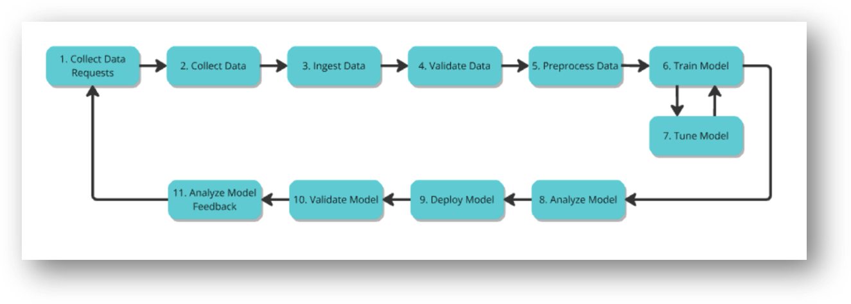
Future Work: The ML FMEA
Conceptual -> Applied
Open Source Community improvements!

Slide 52
SUMMARY
Link to the paper

Slide 53
Summary
The ML FMEA Method
Analyzes safety risk at each stage of the ML pipeline.
Based upon proven failure mode analysis and ML methods

Slide 54
CO-AUTHOR
APPRECIATION
Link to the paper

Slide 55













Co-authors: The ML FMEA in Action
Paul Schmitt
Director of Engineering
Reynolds & Moore
Neil Wadhvana
Machine Learning Group Lead
Torc Robotics
Akshay Chalana
CEO and Co-Founder
Saphira AI
Fahim Mannan
Staff Machine Learning Engineer, Torc Robotics
Michael Wagner
Chief Safety Officer
Edge Case
Jerry Lopez
Sr. Director of Safety Assurance, Torc Robotics
Bodo Seifert
Sr. Safety Lead
TÜV Rheinland Group
Majed Mohammed
Technical Fellow Functional Safety, Aptiv
David Ward
Global Head of Safety
HORIBA MIRA
Krzysztof Pennar
Principal Safety Engineer
Torc Robotics
Chaitanya Shinde
Staff Safety Engineer
Torc Robotics
Justin Poh
Sr. Safety Engineer
Torc Robotics
Simon Diemert
VP Engineering
Critical Systems Labs

Slide 56
Question and Answers
Paul Schmitt
Director of Engineering
Reynolds & Moore
Neil Wadhvana
Machine Learning Group Lead
Torc Robotics
Akshay Chalana
CEO and Co-Founder
Saphira AI
Fahim Mannan
Staff Machine Learning Engineer, Torc Robotics
Michael Wagner
Chief Safety Officer
Edge Case
Jerry Lopez
Sr. Director of Safety Assurance, Torc Robotics
Link to the paper
Bodo Seifert
Sr. Safety Lead
TÜV Rheinland Group
Majed Mohammed
Technical Fellow Functional Safety, Aptiv
David Ward
Global Head of Safety
HORIBA MIRA
Krzysztof Pennar
Principal Safety Engineer
Torc Robotics
Chaitanya Shinde
Staff Safety Engineer
Torc Robotics
Justin Poh
Sr. Safety Engineer
Torc Robotics
Simon Diemert
VP Engineering
Critical Systems Labs

Slide 57
THE ML FMEA IN ACTION: LESSONS FROM APPLICATIONS OF MACHINE LEARNING SAFETY
Paul Schmitt, Reynolds & Moore
Krzysztof Pennar, Torc Robotics
Akshay Chalana, Saphira.AI
Majed Mohammed, APTIV
Bodo Seifert, TÜV Rheinland
Jerry Lopez, Torc Robotics
Neil Wadhvana, Torc Robotics
Michael Wagner, Edge Case
Chaitanya Shinde, Torc Robotics
Justin Poh, Torc Robotics
Simon Diemert, Critical Systems Labs
Fahim Mannan, Torc Robotics
David Ward, HORIBA MIRA
Link to the paper

Slide 58

Co-authors: The ML FMEA in Action
Paul Schmitt
Director of Engineering
Reynolds & Moore
Neil Wadhvana
Machine Learning Group Lead
Torc Robotics
Akshay Chalana
CEO and Co-Founder
Saphira AI
Fahim Mannan
Staff Machine Learning Engineer, Torc Robotics
Michael Wagner
Chief Safety Officer
Edge Case
Jerry Lopez
Sr. Director of Safety Assurance, Torc Robotics
Bodo Seifert
Sr. Safety Lead
TÜV Rheinland Group
Majed Mohammed
Technical Fellow Functional Safety, Aptiv
David Ward
Global Head of Safety
HORIBA MIRA
Krzysztof Pennar
Principal Safety Engineer
Torc Robotics
Chaitanya Shinde
Staff Safety Engineer
Torc Robotics
Justin Poh
Sr. Safety Engineer
Torc Robotics
Simon Diemert
VP Engineering
Critical Systems Labs

Slide 59
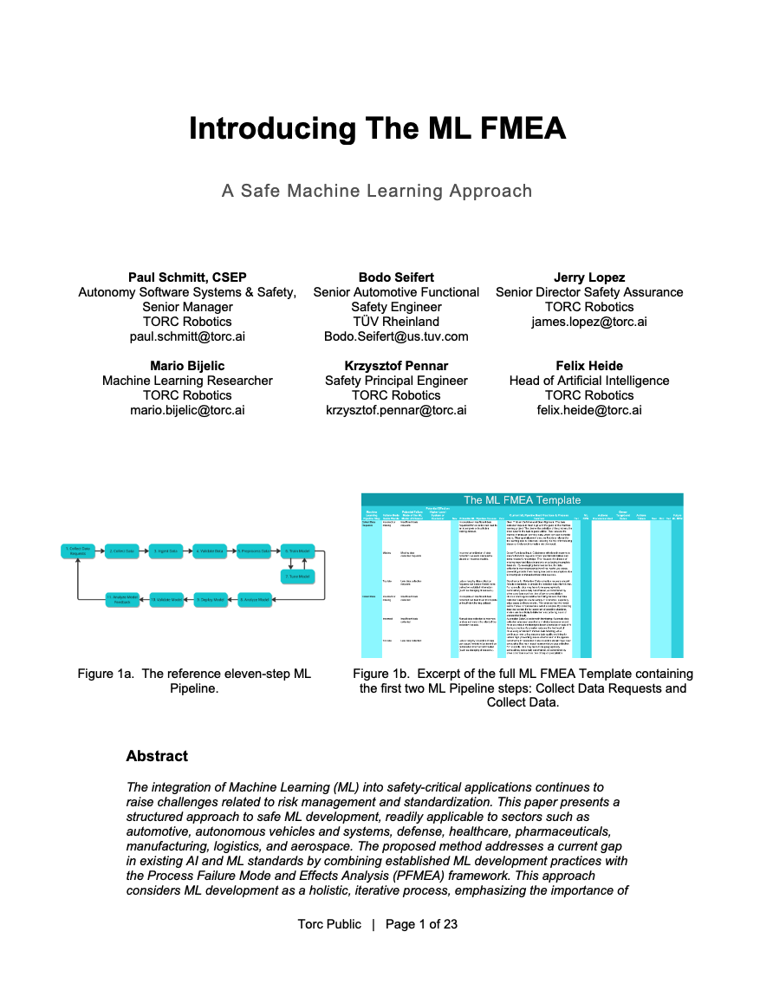

What is the ML FMEA?
Three elements:
Process-oriented ML pipeline
Pre-populated template
Open source
Key Concept:
Apply PFMEA logic to the ML pipeline
Not to the model output, but how the model is built
Link to the paper
Notes:
While the above standards mention the need to systematically ensure safety of ML, they fail to prescribe specific techniques and methodologies to ensure that all engineering and V&V activities involving the ML pipeline are performed in a satisfactorily rigorous manner in order to argue with sufficient evidence that the ML algorithm is absent unreasonable risk.​

Slide 60
First Contribution
Step Five
We discovered a number of failure modes related to annotating training data.
Ground Truth
Supervised Learning
Feedback Signal
–
Rewards
Policies
Reinforcement Learning

Slide 61
First Contribution
Step Five
We discovered a number of failure modes related to annotating training data.
Ground Truth
Supervised Learning
Reinforcement Learning
Feedback Signal

