Slide 1
Adv ML for Gen-AI
Generative Adversarial Network
https://ml-graph.github.io/spring-2026/
Yu Wang, Ph.D.
Assistant Professor
Department of Computer Science
University of Oregon
Personal: https://yuwang0103.github.io/
Lab: https://kindlab-fly.github.io/

Slide 2
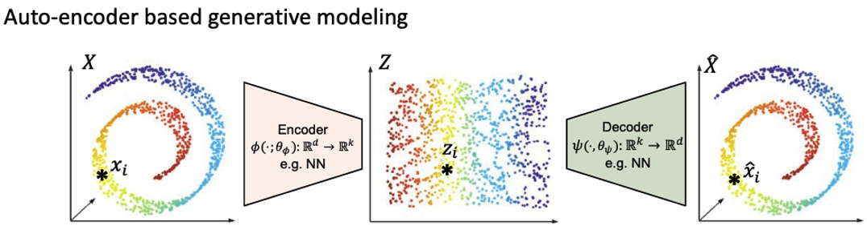
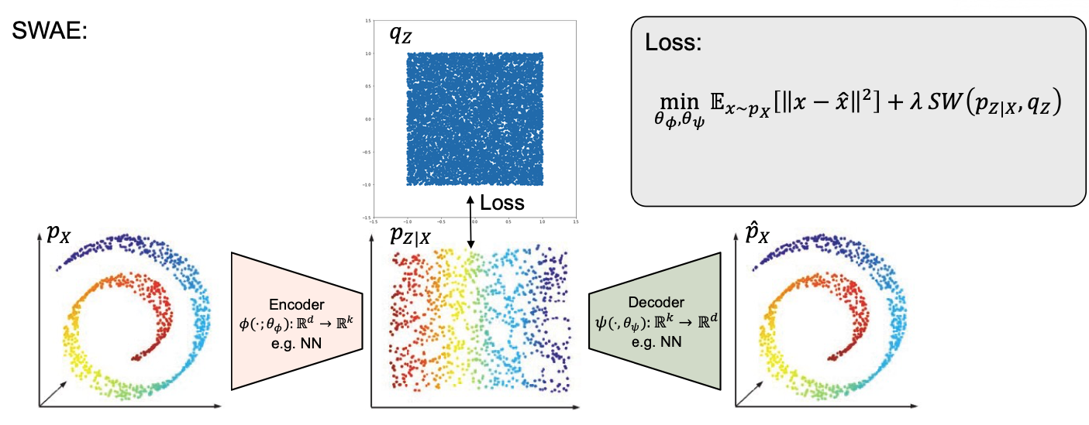
Recap
Variational Auto-encoder

Slide 3
2D

Slide 4
3D

Slide 5
Self-Introduction

Slide 6
Self-Introduction

Slide 7
Self-Introduction

Slide 8

QA

