Slide 1
Adv ML for Gen-AI
Diffusion
https://ml-graph.github.io/spring-2026/
Yu Wang, Ph.D.
Assistant Professor
Department of Computer Science
University of Oregon
Personal: https://yuwang0103.github.io/
Lab: https://kindlab-fly.github.io/

Slide 2
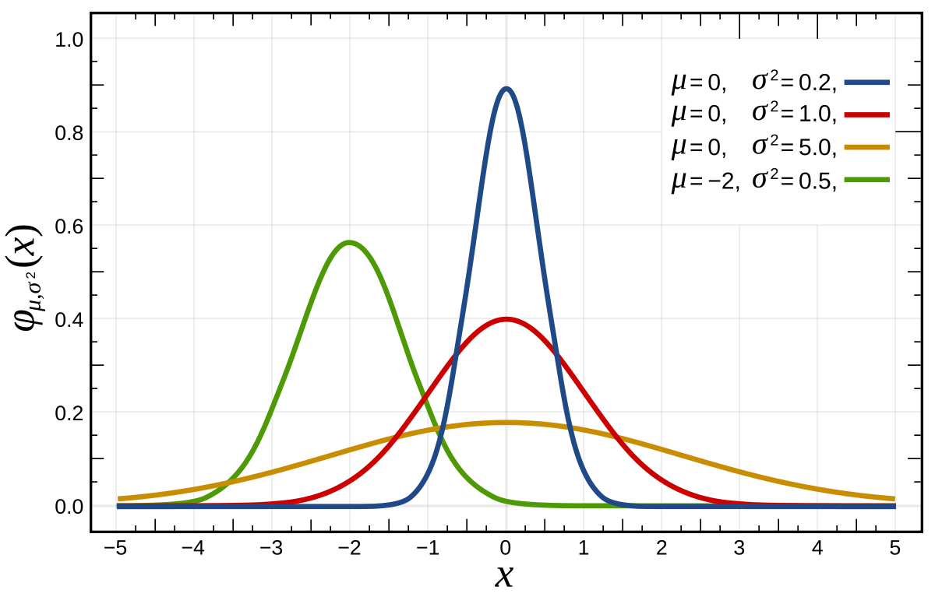
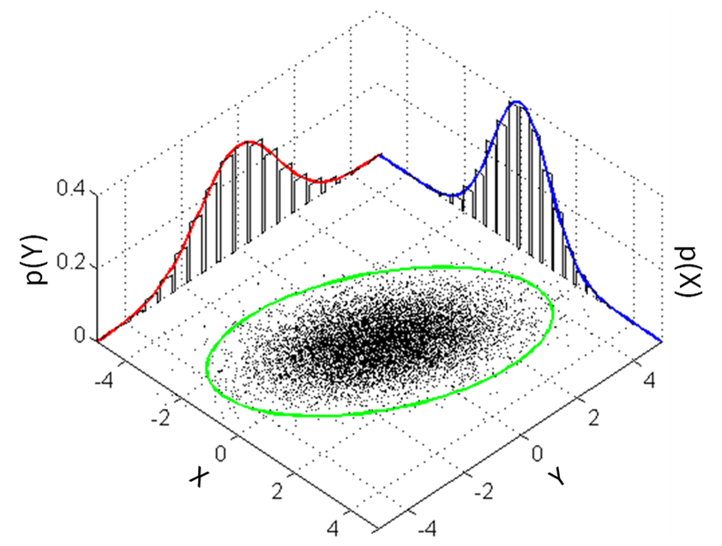
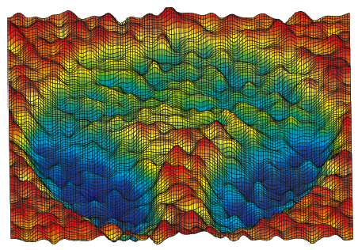

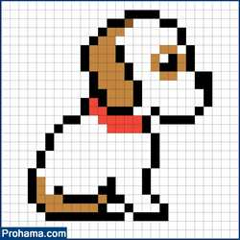



Summary
1D Gaussian Distribution
2D Gaussian Distribution
$$ℝ$$
$$ℝ^{2}$$
$$ℝ^{256×256}$$

Slide 3



Summary
Probability distribution of the objective based on the observed data
Machine Learning Methods
Gaussian Kernel Density Estimation
Gaussian Mixture Models
$${\left\{x_{i}\right\}}_{i=1}^{N}$$
$$P(x)$$
$$x$$
Good Model
Good Data
Using existing function to estimate what you do not know that can best fit your observation
Deep Learning Methods
Auto-Encoder (AE)
Variational AE (VAE)
Generative Adversarial Network (GAN)
Diffusion Model
……
Using learnable function to estimate what you do not know that can best fit your observation

Slide 4
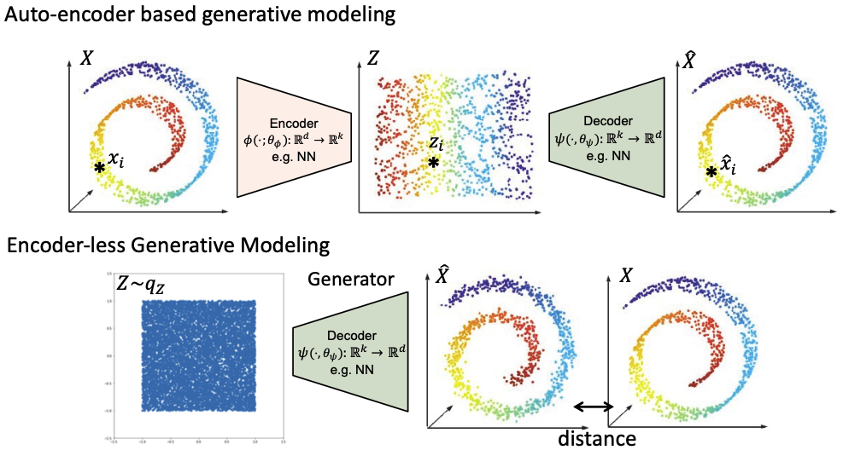
Summary

Slide 5
Summary – GAN/AE(VAE) shares the same decoder architecture

Slide 6
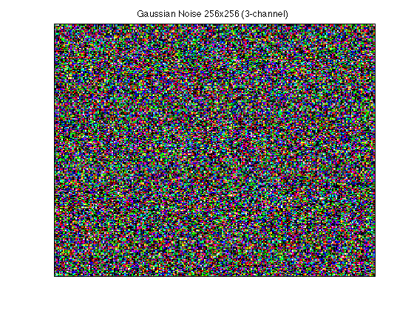
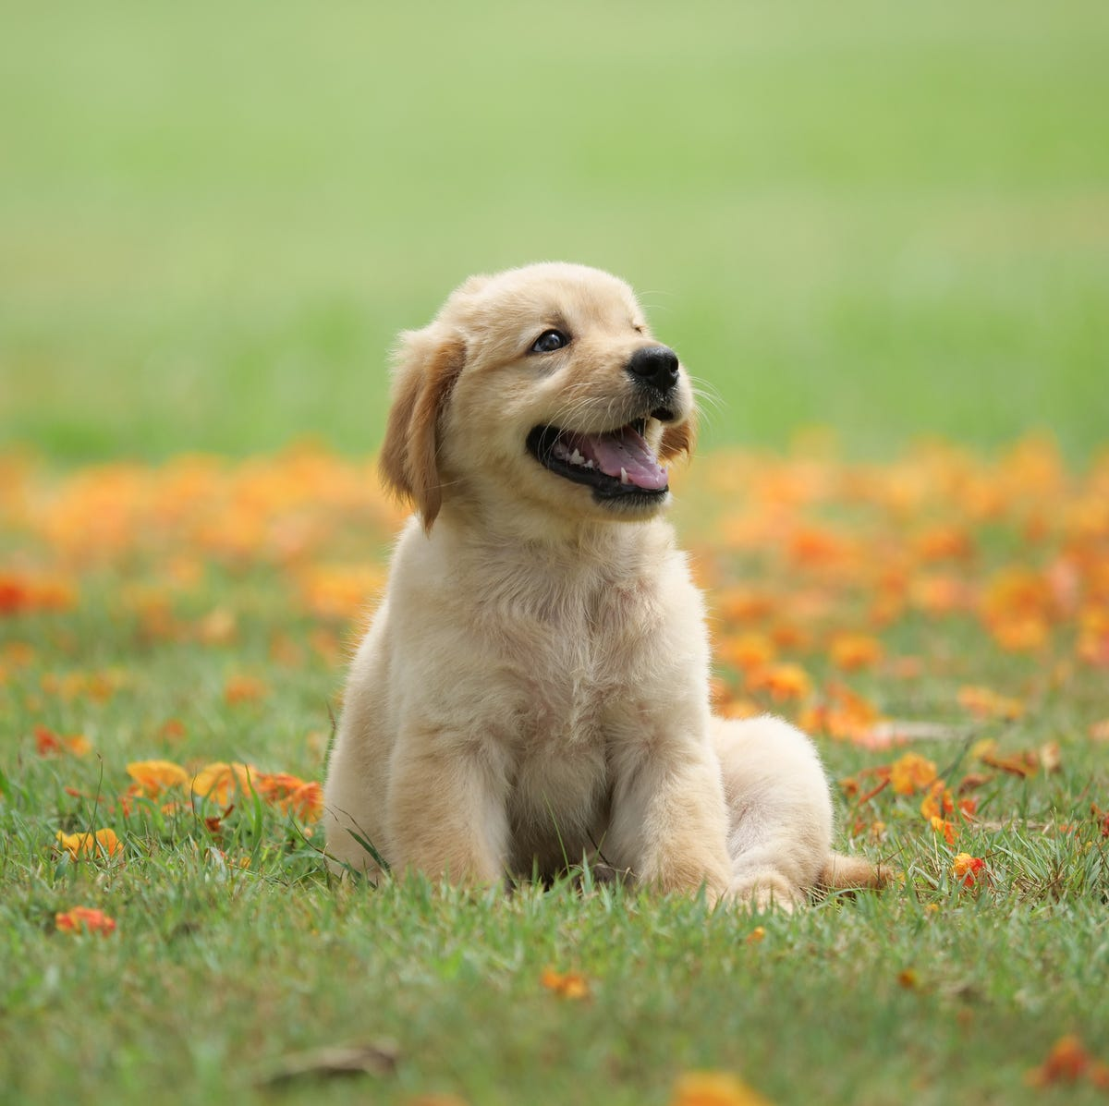
One-step Decoder-based Generation is too Difficult
One-shot Generation
Too difficulty
Standard Gaussian
Target Distribution

Slide 7
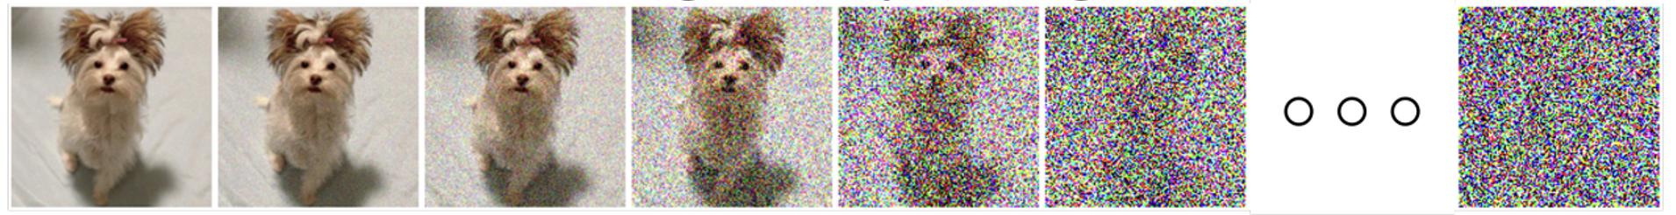
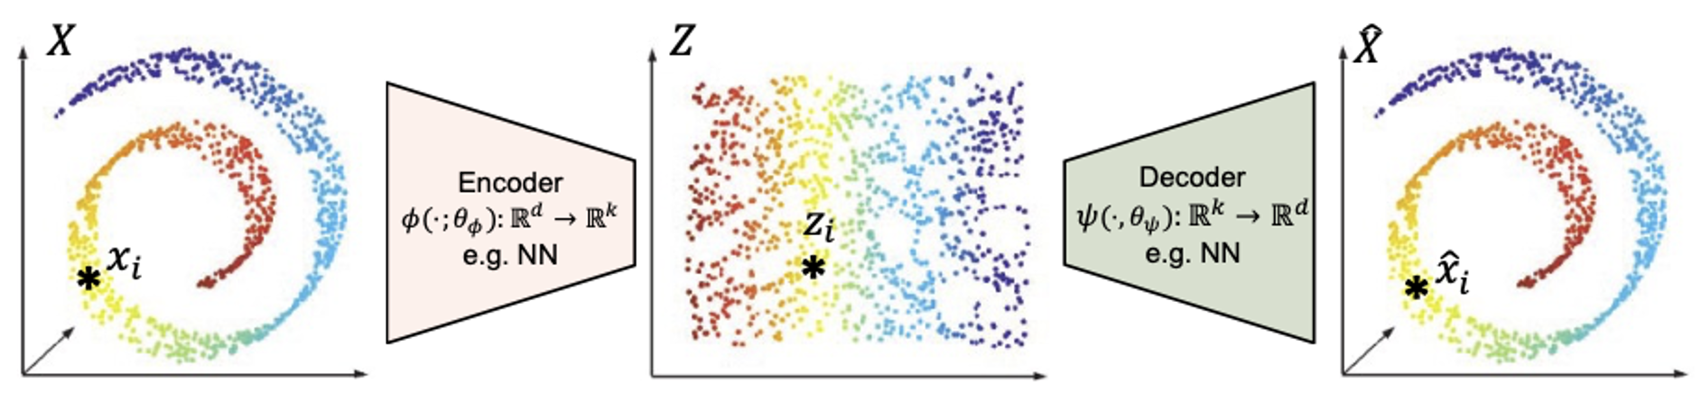









Motivation of Diffusion
Generation by denoising step by step
Noise
Data
$$x_{T}$$
$$x_{6}$$
$$x_{5}$$
$$x_{4}$$
$$x_{3}$$
$$x_{2}$$
$$x_{1}$$
Predicted
Ground-truth
Generation by one step
$$ℱ(x)$$
$${\left\|\hat{x} −x\right\|}_{2}^{2}$$

Slide 8
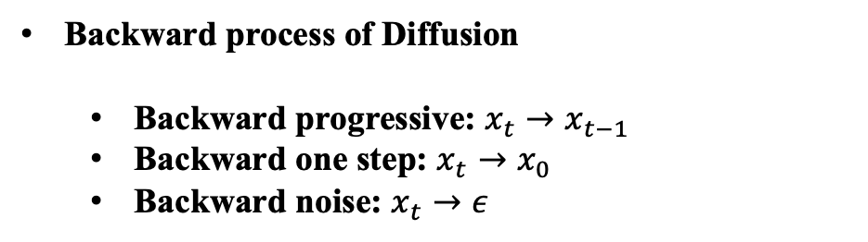
Summary
Motivation and Introduction of Diffusion
Forward process of Diffusion
Backward process of Diffusion
Backward progressive: $x_{t}→x_{t−1}$
Backward one step: $x_{t}→x_{0}$
Backward noise: $x_{t}→ε$

Slide 9

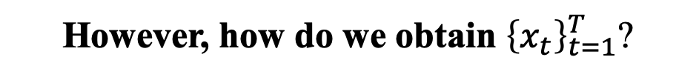
Motivation of Diffusion
Generation by denoising step by step
Noise
Data
$$x_{T}$$
$$x_{6}$$
$$x_{5}$$
$$x_{4}$$
$$x_{3}$$
$$x_{2}$$
$$x_{1}$$
Predicted
Ground-truth
$${\left\|\hat{x}−x_{t−1}\right\|}_{2}^{2}={\left\|ℱ(x_{t},t)−x_{t−1}\right\|}_{2}^{2}$$
However, how do we obtain ${\left\{x_{t}\right\}}_{t=1}^{T}$?

Slide 10
Motivation of Diffusion
Generation by denoising step by step
Noise
Data
Destructing data by adding noise
Noise
Data
However, how do we obtain ${\left\{x_{t}\right\}}_{t=1}^{T}$? – Forward Process

Slide 11
Motivation of Diffusion
Generation by denoising step by step
Noise
Data
Destructing data by adding noise
Noise
Data
Forward Process (Data - Noise): Gradually add noise to generate intermediate data
Backward Process (Noise - Data): Learn to denoise the intermediate data and recover back

Slide 12
Summary
Motivation and Introduction of Diffusion
Forward process of Diffusion
Backward process of Diffusion
Backward progressive: $x_{t}→x_{t−1}$
Backward one step: $x_{t}→x_{0}$
Backward noise: $x_{t}→ε$

Slide 13
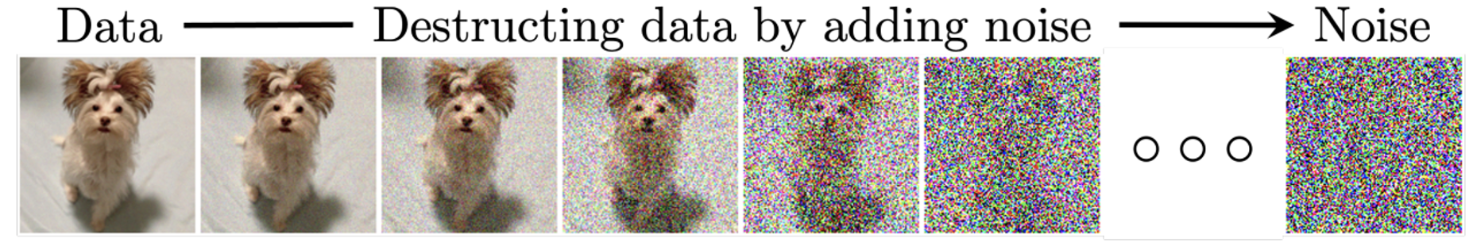
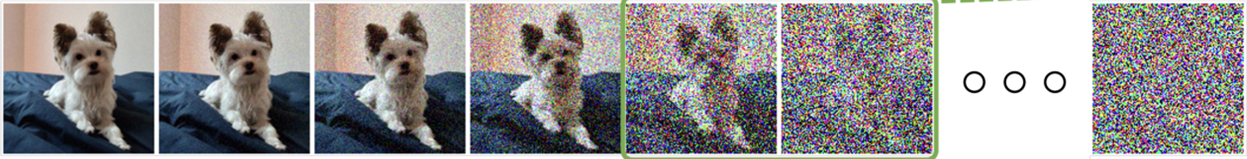






















Forward Process
$$x_{0}$$
$$x_{1}$$
$$x_{2}$$
$$x_{3}$$
$$x_{4}$$
$$x_{5}$$
$$x_{T}$$
$$q(x_{1}|x_{0})$$
$$q(x_{2}|x_{1})$$
$$q(x_{0})$$
$$q(x_{1})$$
$$q(x_{2})$$
$$q(x_{3})$$
$$q(x_{4})$$
$$q(x_{5})$$
$$q(x_{T})$$
$$q(x_{t})$$
Data distribution at time step $t$
$$q(x_{0})$$
Start
$$q(x_{t}|x_{t−1})$$
Transitional distribution at time step $t$
$$𝒩(0,I)$$

Slide 14







Forward Process
$$x_{0}$$
$$x_{1}$$
$$x_{2}$$
$$x_{3}$$
$$x_{4}$$
$$x_{5}$$
$$x_{T}$$
$$q(x_{1}|x_{0})$$
$$q(x_{2}|x_{1})$$
$$q(x_{0})$$
$$q(x_{1})$$
$$q(x_{2})$$
$$q(x_{3})$$
$$q(x_{4})$$
$$q(x_{5})$$
$$q(x_{T})$$
$$β_{t}∈[0,1]$$
$$q(x_{0})$$
$$x_{0}∼𝒩(0,I)$$
Re-parametric trick (VAE)
$$q(x_{t}|x_{t−1})$$
$$x_{t}∼𝒩(\sqrt{1−β_{t}}x_{t−1},β_{t}I)$$
$x_{t}=$ $\sqrt{α_{t}}x_{t−1}+\sqrt{(1−α_{t})}ε,ε∈𝒩(0,I)$
$$x_{t}∼𝒩(\sqrt{α_{t}}x_{t−1},{(1−α}_{t})I)$$
$x_{t}=$ $\sqrt{α_{t}}x_{t−1}+\sqrt{(1−α_{t})}ε,ε∈𝒩(0,I)$

Slide 15





Forward Process
$$x_{0}$$
$$x_{1}$$
$$x_{2}$$
$$x_{3}$$
$$x_{4}$$
$$x_{5}$$
$$x_{T}$$
$$q(x_{1}|x_{0})$$
$$q(x_{2}|x_{1})$$
$$q(x_{0})$$
$$q(x_{1})$$
$$q(x_{2})$$
$$q(x_{3})$$
$$q(x_{4})$$
$$q(x_{5})$$
$$q(x_{T})$$
$x_{1}=$ $\sqrt{α_{1}}x_{0}+\sqrt{(1−α_{1})}ε_{1}$
$$ε_{1}∼𝒩(0,I)$$
$$ε_{2}∼𝒩(0,I)$$
$x_{2}=$ $\sqrt{α_{2}}x_{1}+\sqrt{(1−α_{2})}ε_{2}$
$$Aε_{1}+Bε_{2}∼𝒩(0,\left(A^{2}+B^{2}\right)I)$$
$x_{2}=$ $\sqrt{α_{2}}\left(\sqrt{α_{1}}x_{0}+\sqrt{(1−α_{1})}ε_{1}\right)+\sqrt{(1−α_{2})}ε_{2}=\sqrt{α_{2}α_{1}}x_{0}+\sqrt{α_{2}}\sqrt{1−α_{1}}ε_{1}+\sqrt{(1−α_{2})}ε_{2}$

Slide 16




Forward Process
$$x_{0}$$
$$x_{1}$$
$$x_{2}$$
$$x_{3}$$
$$x_{4}$$
$$x_{5}$$
$$x_{T}$$
$$q(x_{1}|x_{0})$$
$$q(x_{2}|x_{1})$$
$$q(x_{0})$$
$$q(x_{1})$$
$$q(x_{2})$$
$$q(x_{3})$$
$$q(x_{4})$$
$$q(x_{5})$$
$$q(x_{T})$$
$x_{2}=$ $\sqrt{α_{2}}\left(\sqrt{α_{1}}x_{0}+\sqrt{(1−α_{1})}ε_{1}\right)+\sqrt{(1−α_{2})}ε_{2}=\sqrt{α_{2}α_{1}}x_{0}+\sqrt{α_{2}}\sqrt{1−α_{1}}ε_{1}+\sqrt{(1−α_{2})}ε_{2}$
$$ε_{1}∼𝒩(0,I)$$
$$ε_{2}∼𝒩(0,I)$$
$$\sqrt{α_{2}}\sqrt{1−α_{1}}ε_{1}+\sqrt{(1−α_{2})}ε_{2}∼𝒩(0, \left(1−α_{1}α_{2}\right)I)$$
$$Aε_{1}+Bε_{2}∼𝒩(0,\left(A^{2}+B^{2}\right)I)$$
$$x_{2}∼𝒩(\sqrt{α_{2}α_{1}}x_{0}, \left(1−α_{1}α_{2}\right)I)$$

Slide 17


Forward Process
$$x_{0}$$
$$x_{1}$$
$$x_{2}$$
$$x_{3}$$
$$x_{4}$$
$$x_{5}$$
$$x_{T}$$
$$q(x_{1}|x_{0})$$
$$q(x_{2}|x_{1})$$
$$q(x_{0})$$
$$q(x_{1})$$
$$q(x_{2})$$
$$q(x_{3})$$
$$q(x_{4})$$
$$q(x_{5})$$
$$q(x_{T})$$
$x_{2}=$ $\sqrt{α_{2}}\left(\sqrt{α_{1}}x_{0}+\sqrt{(1−α_{1})}ε_{1}\right)+\sqrt{(1−α_{2})}ε_{2}=\sqrt{α_{2}α_{1}}x_{0}+\sqrt{α_{2}}\sqrt{1−α_{1}}ε_{1}+\sqrt{(1−α_{2})}ε_{2}$
$$ε_{1}∼𝒩(0,I)$$
$$ε_{2}∼𝒩(0,I)$$
$$\sqrt{α_{2}}\sqrt{1−α_{1}}ε_{1}+\sqrt{(1−α_{2})}ε_{2}∼𝒩(0, \left(1−α_{1}α_{2}\right)I)$$
$$Aε_{1}+Bε_{2}∼𝒩(0,\left(A^{2}+B^{2}\right)I)$$
$$x_{2}∼𝒩(\sqrt{α_{2}α_{1}}x_{0}, \left(1−α_{1}α_{2}\right)I)$$
$$x_{3}∼𝒩(\sqrt{α_{3}α_{2}α_{1}}x_{0}, \left(1−α_{1}α_{2}α_{3}\right)I)$$

Slide 18



Forward Process
$$x_{0}$$
$$x_{1}$$
$$x_{2}$$
$$x_{3}$$
$$x_{4}$$
$$x_{5}$$
$$x_{T}$$
$$q(x_{1}|x_{0})$$
$$q(x_{2}|x_{1})$$
$$q(x_{0})$$
$$q(x_{1})$$
$$q(x_{2})$$
$$q(x_{3})$$
$$q(x_{4})$$
$$q(x_{5})$$
$$q(x_{T})$$
$$q(x_{0})$$
$$x_{0}∼𝒩(0,I)$$
$$x_{t}∼𝒩(\sqrt{{\overline{α}}_{t}}x_{0},(1−{\overline{α}}_{t})I)$$
$${\overline{α}}_{t}=∏_{s=1}^{T}α_{s}=∏_{s=1}^{T}{(1−β}_{s})$$
$$q(x_{t}|x_{t−1})$$
$$x_{t}∼𝒩(\sqrt{α_{t}}x_{t−1},{(1−α}_{t})I)$$

Slide 19
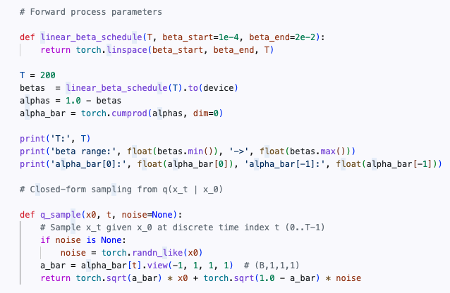
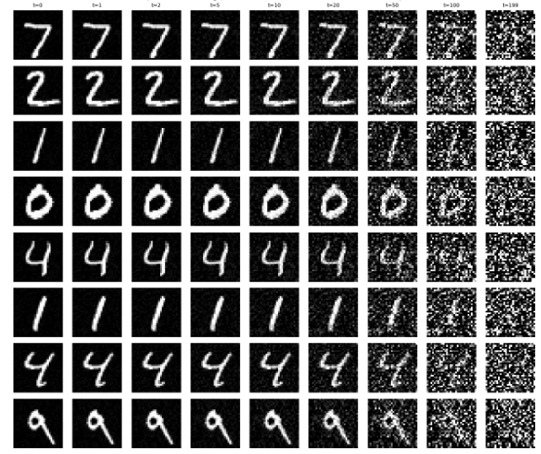












Forward Process
$$q(x_{0})$$
$$x_{0}∼𝒩(0,I)$$
$$x_{t}∼𝒩(\sqrt{{\overline{α}}_{t}}x_{0},(1−{\overline{α}}_{t})I)$$
$${\overline{α}}_{t}=∏_{s=1}^{T}α_{s}=∏_{s=1}^{T}{(1−β}_{s})$$
$$q(x_{t}|x_{t−1})$$
$$x_{t}∼𝒩(\sqrt{α_{t}}x_{t−1},{(1−α}_{t})I)$$
$$β_{s}∈[0,1]$$
$$x_{0}$$
$$x_{1}$$
$$x_{2}$$
$$x_{3}$$
……
……
$$x_{T}$$

Slide 20
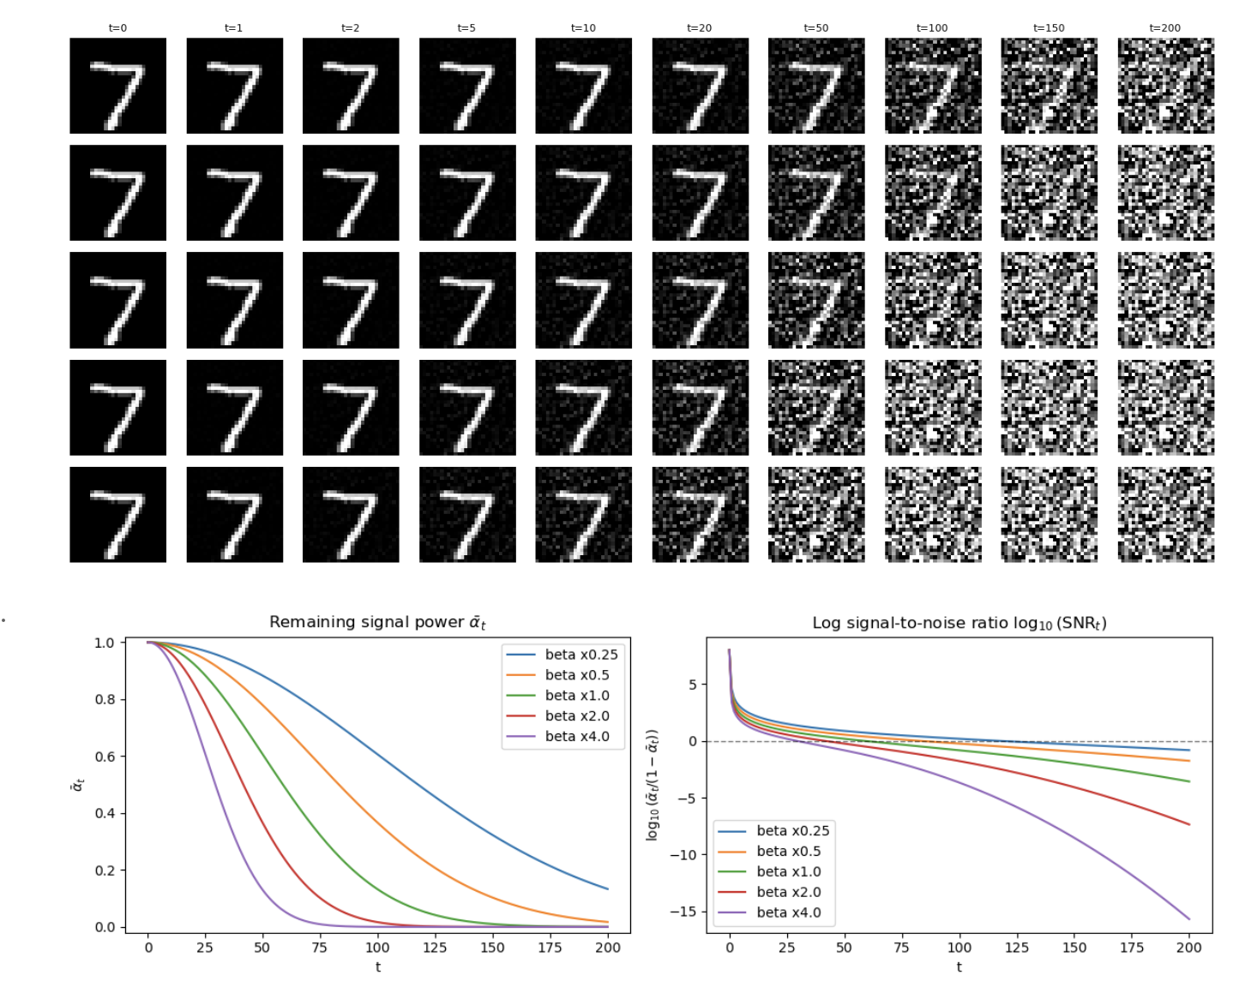
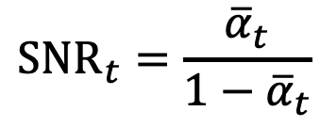
Forward Process
$$q(x_{0})$$
$$x_{0}∼𝒩(0,I)$$
$$x_{t}∼𝒩(\sqrt{{\overline{α}}_{t}}x_{0},(1−{\overline{α}}_{t})I)$$
$${\overline{α}}_{t}=∏_{s=1}^{T}α_{s}=∏_{s=1}^{T}{(1−β}_{s})$$
$$q(x_{t}|x_{t−1})$$
$$x_{t}∼𝒩(\sqrt{α_{t}}x_{t−1},{(1−α}_{t})I)$$
$$β_{s}∈[0,1]$$
$${SNR}_{t}=\frac{{\overline{α}}_{t}}{1−{\overline{α}}_{t}}$$
Signal Noise Ratio

Slide 21
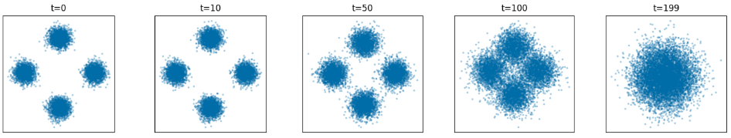
Forward Process
$$q(x_{0})$$
$$x_{0}∼𝒩(0,I)$$
$$x_{t}∼𝒩(\sqrt{{\overline{α}}_{t}}x_{0},(1−{\overline{α}}_{t})I)$$
$${\overline{α}}_{t}=∏_{s=1}^{T}α_{s}=∏_{s=1}^{T}{(1−β}_{s})$$
$$q(x_{t}|x_{t−1})$$
$$x_{t}∼𝒩(\sqrt{α_{t}}x_{t−1},{(1−α}_{t})I)$$
$$β_{s}∈[0,1]$$

Slide 22
Forward Process
$$q(x_{0})$$
$$x_{0}∼𝒩(0,I)$$
$$x_{t}∼𝒩(\sqrt{{\overline{α}}_{t}}x_{0},(1−{\overline{α}}_{t})I)$$
$${\overline{α}}_{t}=∏_{s=1}^{T}α_{s}=∏_{s=1}^{T}{(1−β}_{s})$$
$$q(x_{t}|x_{t−1})$$
$$x_{t}∼𝒩(\sqrt{α_{t}}x_{t−1},{(1−α}_{t})I)$$
$$β_{s}∈[0,1]$$
Dog Image

Slide 23

Forward/Backward Process of Diffusion
Generation by denoising step by step
Noise
Data
Destructing data by adding noise
Noise
Data
Forward Process (Data - Noise): Gradually add noise to generate intermediate data
Backward Process (Noise - Data): Learn to denoise the intermediate data and recover back

Slide 24




We now can use forward process to obtain data pairs
Generation by denoising step by step
Noise
Data
$$x_{T}$$
$$x_{6}$$
$$x_{5}$$
$$x_{4}$$
$$x_{3}$$
$$x_{2}$$
$$x_{1}$$
Predicted
Ground-truth
$$x_{t−1}$$
$$x_{t}$$
$${\left\|\hat{x}−x_{t−1}\right\|}_{2}^{2}={\left\|ℱ(x_{t},t)−x_{t−1}\right\|}_{2}^{2}$$
$$𝔼_{x_{0}∼p_{data}\left(x\right),t∼U\left(1,T\right),x_{t−1}∼q\left(x_{t−1} | x_{0}\right),x_{t}∼q(x_{t}|x_{t−1})}{\left\|ℱ(x_{t},t)−x_{t−1}\right\|}_{2}^{2}$$

Slide 25
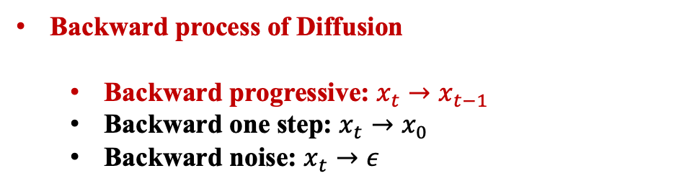
Summary
Motivation and Introduction of Diffusion
Forward process of Diffusion
Backward process of Diffusion
Backward progressive: $x_{t}→x_{t−1}$
Backward one step: $x_{t}→x_{0}$
Backward noise: $x_{t}→ε$

Slide 26
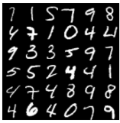



Backward Optimization
Generation by denoising step by step
Noise
Data
$$x_{T}$$
$$x_{6}$$
$$x_{5}$$
$$x_{4}$$
$$x_{3}$$
$$x_{2}$$
$$x_{1}$$
Predicted
Ground-truth
$$p_{data}\left(x\right)$$
$${\left\|\hat{x}−x_{t−1}\right\|}_{2}^{2}={\left\|ℱ(x_{t},t)−x_{t−1}\right\|}_{2}^{2}$$
Sample
$$𝔼_{x_{0}∼p_{data}\left(x\right),t∼U\left(1,T\right),x_{t−1}∼q\left(x_{t−1} | x_{0}\right),x_{t}∼q(x_{t}|x_{t−1})}{\left\|ℱ(x_{t},t)−x_{t−1}\right\|}_{2}^{2}$$
$$x_{0}$$

Slide 27
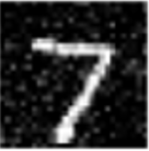


Backward Optimization
Generation by denoising step by step
Noise
Data
$$x_{T}$$
$$x_{6}$$
$$x_{5}$$
$$x_{4}$$
$$x_{3}$$
$$x_{2}$$
$$x_{1}$$
Predicted
Ground-truth
$$x_{0}$$
$${\left\|\hat{x}−x_{t−1}\right\|}_{2}^{2}={\left\|ℱ(x_{t},t)−x_{t−1}\right\|}_{2}^{2}$$
$$𝔼_{x_{0}∼p_{data}\left(x\right),t∼U\left(1,T\right),x_{t−1}∼q\left(x_{t−1} | x_{0}\right),x_{t}∼q(x_{t}|x_{t−1})}{\left\|ℱ(x_{t},t)−x_{t−1}\right\|}_{2}^{2}$$
$$x_{t−1}$$

Slide 28
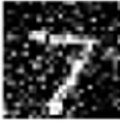


Backward Optimization
Generation by denoising step by step
Noise
Data
$$x_{T}$$
$$x_{6}$$
$$x_{5}$$
$$x_{4}$$
$$x_{3}$$
$$x_{2}$$
$$x_{1}$$
Predicted
Ground-truth
$$x_{t−1}$$
$${\left\|\hat{x}−x_{t−1}\right\|}_{2}^{2}={\left\|ℱ(x_{t},t)−x_{t−1}\right\|}_{2}^{2}$$
$$𝔼_{x_{0}∼p_{data}\left(x\right),t∼U\left(1,T\right),x_{t−1}∼q\left(x_{t−1} | x_{0}\right),x_{t}∼q(x_{t}|x_{t−1})}{\left\|ℱ(x_{t},t)−x_{t−1}\right\|}_{2}^{2}$$
$$x_{t}$$

Slide 29
Backward Optimization
Generation by denoising step by step
Noise
Data
$$x_{T}$$
$$x_{6}$$
$$x_{5}$$
$$x_{4}$$
$$x_{3}$$
$$x_{2}$$
$$x_{1}$$
Predicted
Ground-truth
$$x_{t−1}$$
$$x_{t}$$
$${\left\|\hat{x}−x_{t−1}\right\|}_{2}^{2}={\left\|ℱ(x_{t},t)−x_{t−1}\right\|}_{2}^{2}$$
$${θ^{∗}=argmin 𝔼}_{x_{0}∼p_{data}\left(x\right),t∼U\left(1,T\right),x_{t−1}∼q\left(x_{t−1} | x_{0}\right),x_{t}∼q(x_{t}|x_{t−1})}{\left\|ℱ_{θ}(x_{t},t)−x_{t−1}\right\|}_{2}^{2}$$

Slide 30





Generation
Generation by denoising step by step
Noise
Data
$$x_{T}$$
$$x_{6}$$
$$x_{5}$$
$$x_{4}$$
$$x_{3}$$
$$x_{2}$$
$$x_{1}$$
$$ℱ_{θ}(x_{6},6)$$
$$ℱ_{θ}(x_{5},5)$$
$$ℱ_{θ}(x_{4},4)$$
$$ℱ_{θ}(x_{3},3)$$
$$ℱ_{θ}(x_{2},2)$$
Recursively generate back the original image

Slide 31
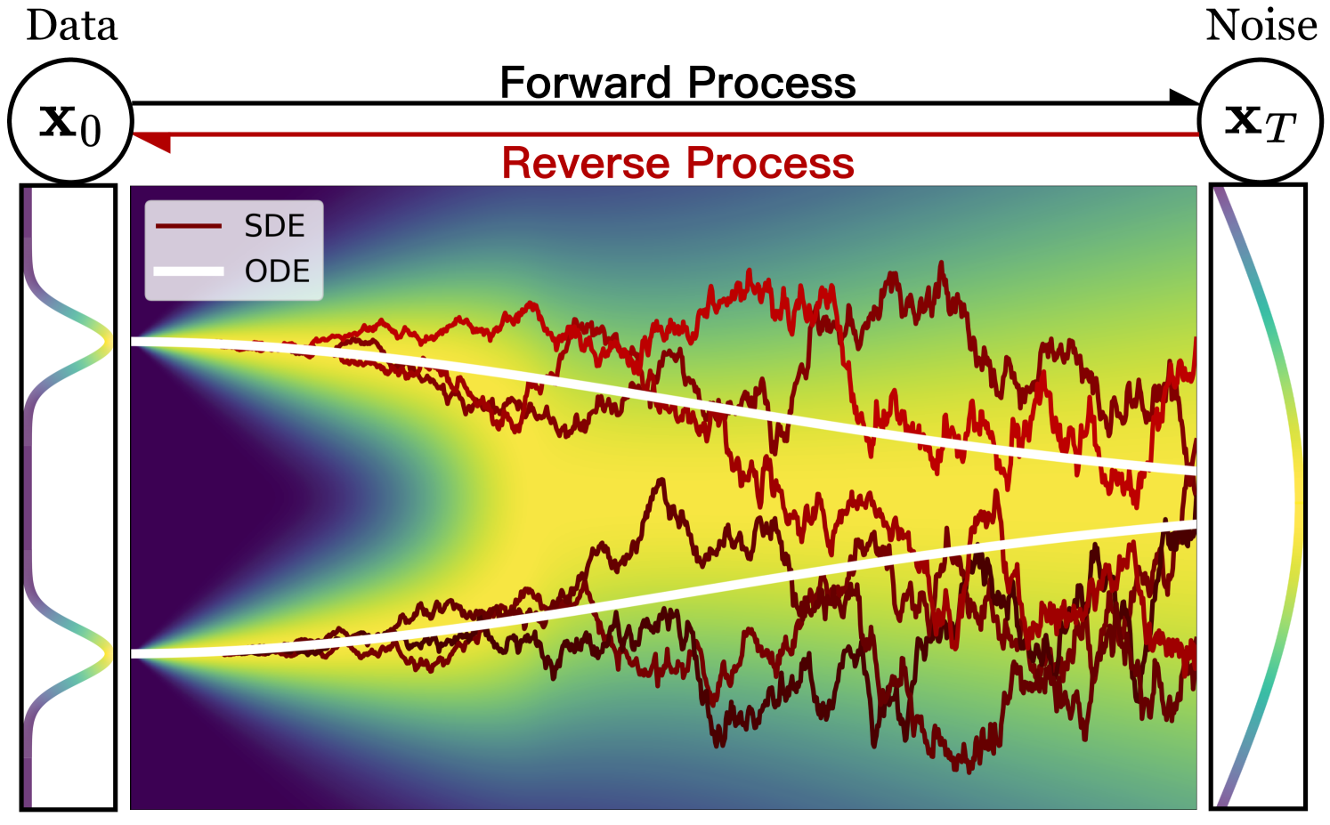





Generation

Slide 32
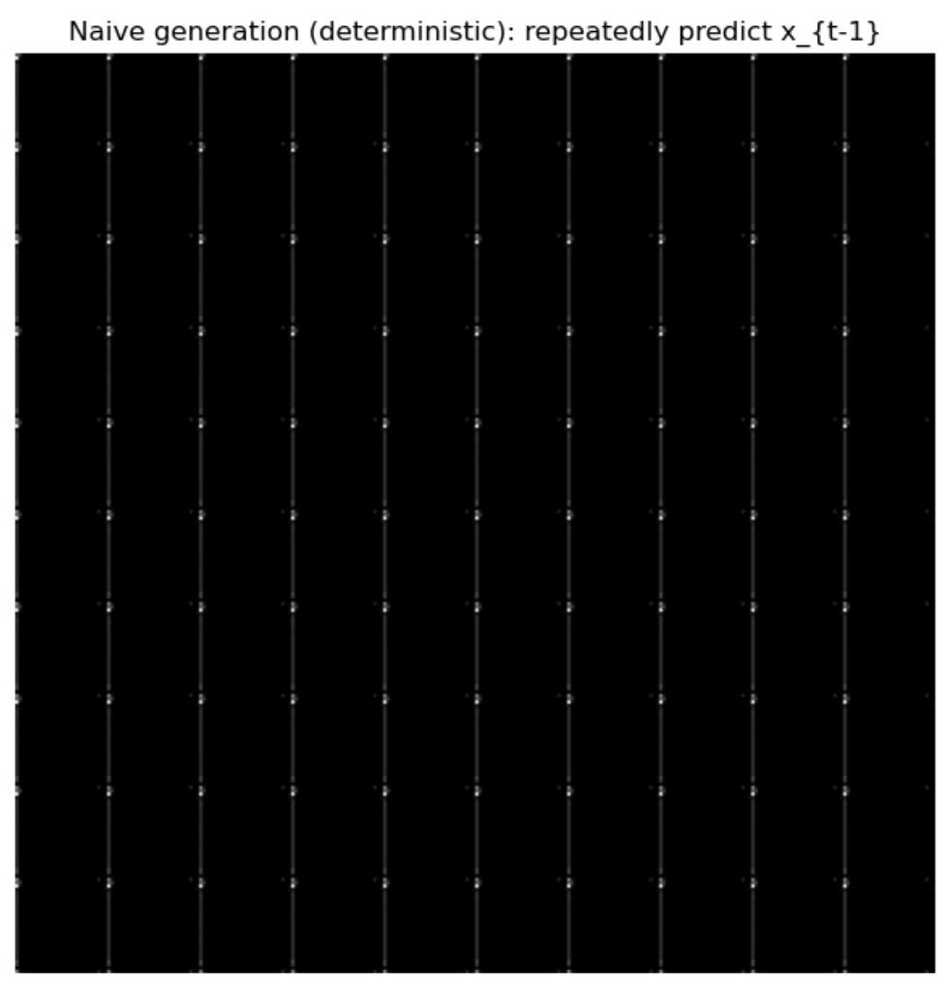
Generation - Problem
Generation by denoising step by step
Noise
Data
$$x_{T}$$
$$x_{6}$$
$$x_{5}$$
$$x_{4}$$
$$x_{3}$$
$$x_{2}$$
$$x_{1}$$
$$ℱ_{θ}(x_{6},6)$$
$$ℱ_{θ}(x_{5},5)$$
$$ℱ_{θ}(x_{4},4)$$
$$ℱ_{θ}(x_{3},3)$$
$$ℱ_{θ}(x_{2},2)$$
$${θ^{∗}=argmin 𝔼}_{x_{0}∼p_{data}\left(x\right),t∼U\left(1,T\right),x_{t−1}∼q\left(x_{t−1} | x_{0}\right),x_{t}∼q(x_{t}|x_{t−1})}{\left\|ℱ_{θ}(x_{t},t)−x_{t−1}\right\|}_{2}^{2}$$

Slide 33












Generation - Problem
Generation by denoising step by step
Noise
Data
$$x_{T}$$
$$x_{6}$$
$$x_{5}$$
$$x_{4}$$
$$x_{3}$$
$$x_{2}$$
$$x_{1}$$
$$ℱ_{θ}(x_{6},6)$$
$$ℱ_{θ}(x_{5},5)$$
$$ℱ_{θ}(x_{4},4)$$
$$ℱ_{θ}(x_{3},3)$$
$$ℱ_{θ}(x_{2},2)$$
$${θ^{∗}=argmin 𝔼}_{x_{0}∼p_{data}\left(x\right),t∼U\left(1,T\right),x_{t−1}∼q\left(x_{t−1} | x_{0}\right),x_{t}∼q(x_{t}|x_{t−1})}{\left\|𝓕_{θ}(x_{t},t)−x_{t−1}\right\|}_{2}^{2}$$
$$x_{0}$$
$$x_{1}$$
$$x_{2}$$
$$x_{3}$$
……
……
$$x_{T}$$
Many
Map
$$x_{t−1}^{1}$$
Very different
Very similar
$$𝓕_{θ}\left(x_{t},t\right)=𝔼[x_{t−1}|x_{t},t]$$
Map
$$x_{t}$$
$$x_{t−1}^{2}$$
One

Slide 34







Generation - Problem
$${θ^{∗}=argmin 𝔼}_{x_{0}∼p_{data}\left(x\right),t∼U\left(1,T\right),x_{t−1}∼q\left(x_{t−1} | x_{0}\right),x_{t}∼q(x_{t}|x_{t−1})}{\left\|𝓕_{θ}(x_{t},t)−x_{t−1}\right\|}_{2}^{2}$$
$$x_{0}$$
$$x_{1}$$
$$x_{2}$$
$$x_{3}$$
……
……
$$x_{T}$$
Many
Map
$$x_{t−1}^{1}$$
Very different
Very similar
$$𝓕_{θ}\left(x_{t},t\right)=𝔼[x_{t−1}|x_{t},t]$$
Map
$$x_{t}$$
$$x_{t−1}^{2}$$
One

Slide 35
Generation - Problem
$${θ^{∗}=argmin 𝔼}_{x_{0}∼p_{data}\left(x\right),t∼U\left(1,T\right),x_{t−1}∼q\left(x_{t−1} | x_{0}\right),x_{t}∼q(x_{t}|x_{t−1})}{\left\|𝓕_{θ}(x_{t},t)−x_{t−1}\right\|}_{2}^{2}$$
$$x_{0}$$
$$x_{1}$$
$$x_{2}$$
$$x_{3}$$
……
……
$$x_{T}$$
Many
Map
$$x_{t−1}^{1}$$
Very different
Very similar
$$𝓕_{θ}\left(x_{t},t\right)=𝔼[x_{t−1}|x_{t},t]$$
Map
$$x_{t}$$
$$x_{t−1}^{2}$$
One

Slide 36
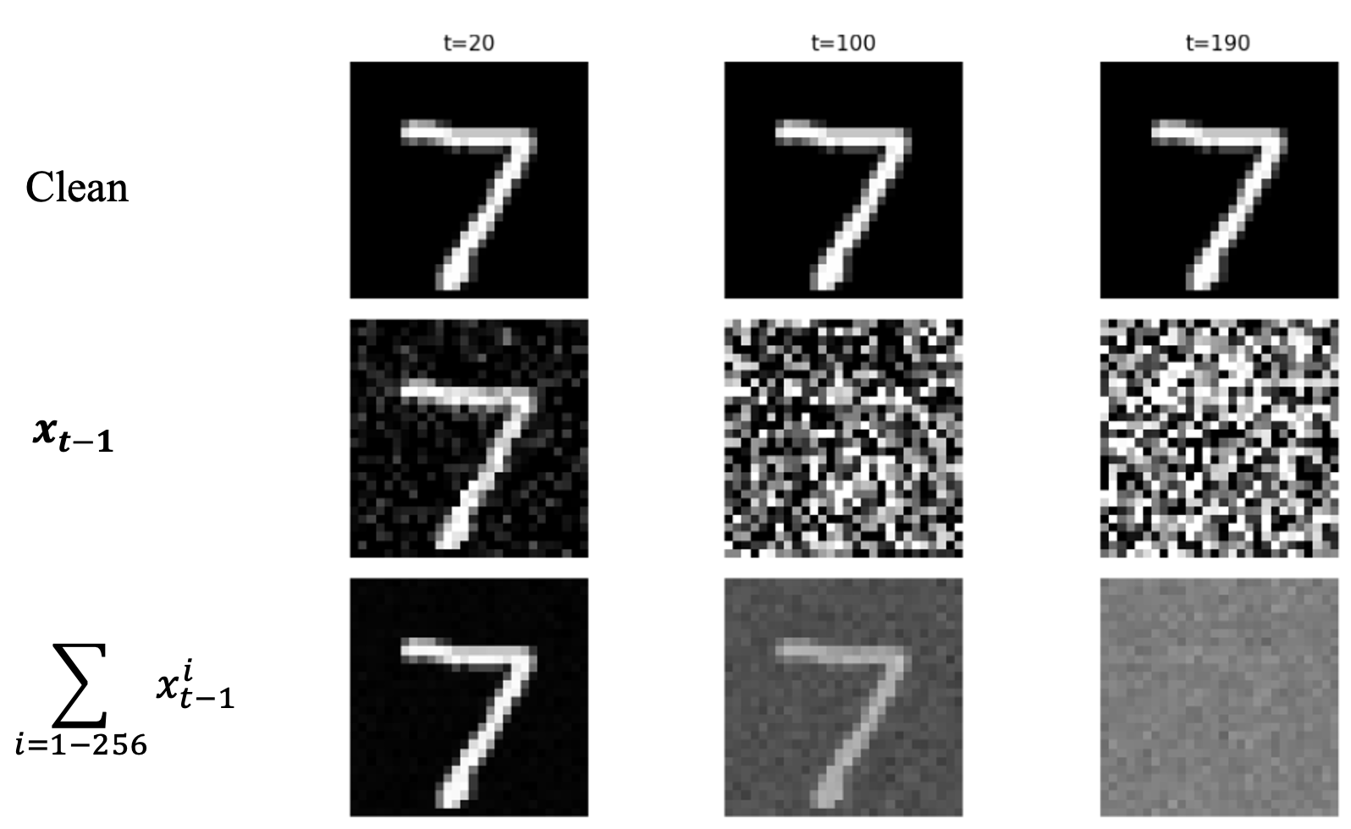
Generation - Problem

Slide 37






Generation - Problem
$${θ^{∗}=argmin 𝔼}_{x_{0}∼p_{data}\left(x\right),t∼U\left(1,T\right),x_{t−1}∼q\left(x_{t−1} | x_{0}\right),x_{t}∼q(x_{t}|x_{t−1})}{\left\|𝓕_{θ}(x_{t},t)−x_{t−1}\right\|}_{2}^{2}$$
$$x_{0}$$
$$x_{1}$$
$$x_{2}$$
$$x_{3}$$
……
……
$$x_{T}$$
Many
Map
$$x_{t−1}^{1}$$
Very different
Very similar
$$𝓕_{θ}\left(x_{t},t\right)=𝔼[x_{t−1}|x_{t},t]$$
Map
$$x_{t}$$
$$x_{t−1}^{2}$$
One
Train a neural network to predict the nearly grey image

Slide 38
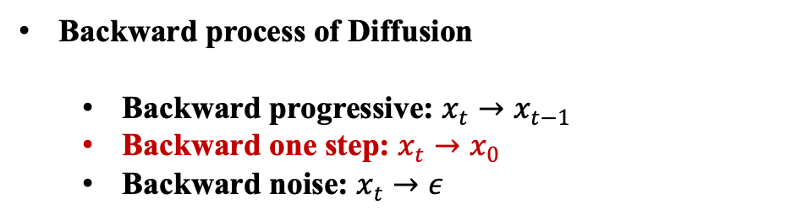
Summary
Motivation and Introduction of Diffusion
Forward process of Diffusion
Backward process of Diffusion
Backward progressive: $x_{t}→x_{t−1}$
Backward one step: $x_{t}→x_{0}$
Backward noise: $x_{t}→ε$

Slide 39



Backward Optimization 2
Generation by denoising step by step
Noise
Data
$$x_{T}$$
$$x_{6}$$
$$x_{5}$$
$$x_{4}$$
$$x_{3}$$
$$x_{2}$$
$$x_{1}$$
Predicted
Ground-truth
$$x_{0}$$
$$x_{t}$$
$${\left\|\hat{x}−x_{t−1}\right\|}_{2}^{2}={\left\|ℱ(x_{t},t)−x_{t−1}\right\|}_{2}^{2}$$
No randomness
$${\left\|\hat{x}−x_{0}\right\|}_{2}^{2}={\left\|ℱ(x_{t},t)−x_{0}\right\|}_{2}^{2}$$
$$θ^{∗}=argmin𝔼_{x_{0}∼p_{data}\left(x\right),t∼U\left(1,T\right),x_{t}∼q\left(x_{t} | x_{0}\right)}{\left\|ℱ_{θ}(x_{t},t)−x_{0}\right\|}_{2}^{2}$$
Given this noisy image and noise level, recover the clean digit.

Slide 40
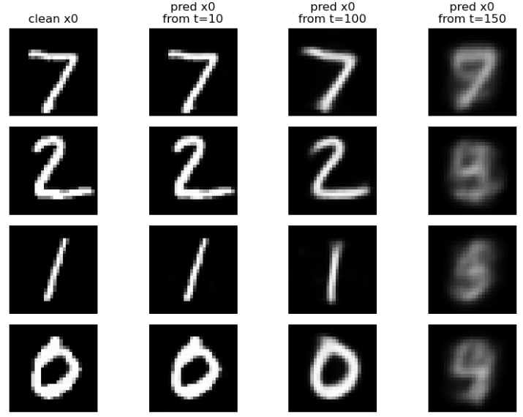


Backward Optimization 2
$$θ^{∗}=argmin𝔼_{x_{0}∼p_{data}\left(x\right),t∼U\left(1,T\right),x_{t}∼q\left(x_{t} | x_{0}\right)}{\left\|ℱ_{θ}(x_{t},t)−x_{0}\right\|}_{2}^{2}$$
$$x_{T}∼𝒩(0,I)$$
$$ℱ_{θ^{∗}}\left(x_{T},t\right)={\overline{x}}_{0}$$
Predict from later time step gives more noisy images

Slide 41
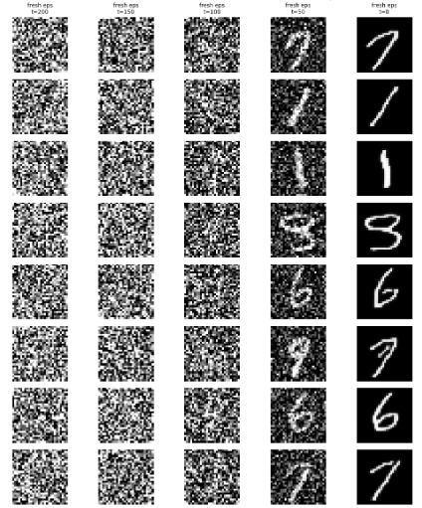

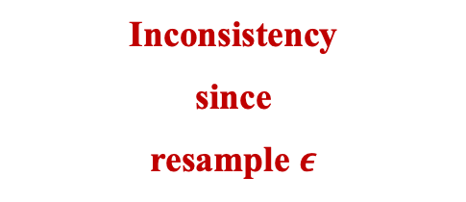







Backward Optimization 2
$$θ^{∗}=argmin𝔼_{x_{0}∼p_{data}\left(x\right),t∼U\left(1,T\right),x_{t}∼q\left(x_{t} | x_{0}\right)}{\left\|ℱ_{θ}(x_{t},t)−x_{0}\right\|}_{2}^{2}$$
$$x_{T}∼𝒩(0,I)$$
$$ℱ_{θ^{∗}}\left(x_{T},t\right)={\overline{x}}_{0}$$
$$ℱ_{θ^{∗}}$$
$$ℱ_{θ^{∗}}$$
$$x_{T}→{\overline{x}}_{0}→x_{T−1}→{\overline{x}}_{0}→x_{T−2}…$$
$$q(x_{T−1}|{\overline{x}}_{0})$$
$$q(x_{T−1}|{\overline{x}}_{0})$$
$$x_{t}∼𝒩(\sqrt{{\overline{α}}_{t}}x_{0},(1−{\overline{α}}_{t})I)$$
Inconsistency
since
resample $ε$

Slide 42
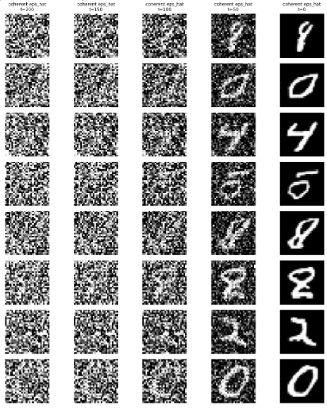


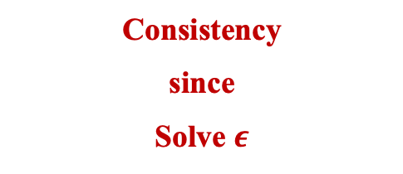


Backward Optimization 2
$$θ^{∗}=argmin𝔼_{x_{0}∼p_{data}\left(x\right),t∼U\left(1,T\right),x_{t}∼q\left(x_{t} | x_{0}\right)}{\left\|ℱ_{θ}(x_{t},t)−x_{0}\right\|}_{2}^{2}$$
$$x_{T}∼𝒩(0,I)$$
$$ℱ_{θ^{∗}}\left(x_{T},t\right)={\overline{x}}_{0}$$
$$x_{T}→{\overline{x}}_{0}→ε→x_{T−1}→$$
$$x_{t}∼𝒩(\sqrt{{\overline{α}}_{t}}x_{0},(1−{\overline{α}}_{t})I)$$
Consistency
since
Solve $ε$

Slide 43


Backward Optimization 2
$$x_{T}→{\overline{x}}_{0}→x_{T−1}→{\overline{x}}_{0}→x_{T−2}…$$
$$x_{T}→{\overline{x}}_{0}→ε→x_{T−1}→$$
Inconsistency
Consistency

Slide 44


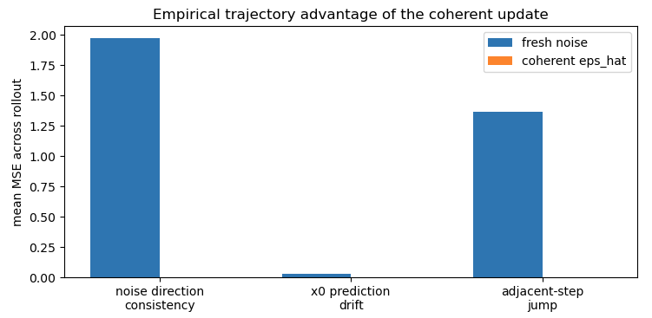

Backward Optimization 2
$$x_{T}→{\overline{x}}_{0}→x_{T−1}→{\overline{x}}_{0}→x_{T−2}…$$
$$x_{T}→{\overline{x}}_{0}→ε→x_{T−1}→$$
Both are good

Slide 45


Backward Optimization 2 - Problem
$$θ^{∗}=argmin𝔼_{x_{0}∼p_{data}\left(x\right),t∼U\left(1,T\right),x_{t}∼q\left(x_{t} | x_{0}\right)}{\left\|ℱ_{θ}(x_{t},t)−x_{0}\right\|}_{2}^{2}$$
$t$ small, easy
$t$ large, easy

Slide 46
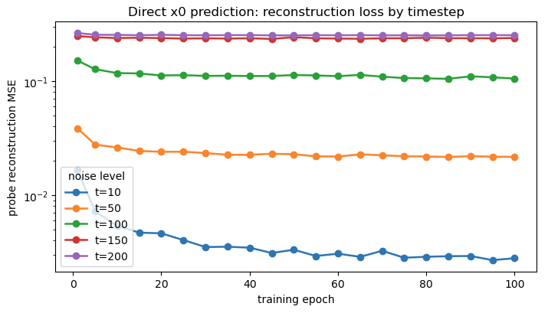
Backward Optimization 2 - Problem
$$θ^{∗}=argmin𝔼_{x_{0}∼p_{data}\left(x\right),t∼U\left(1,T\right),x_{t}∼q\left(x_{t} | x_{0}\right)}{\left\|ℱ_{θ}(x_{t},t)−x_{0}\right\|}_{2}^{2}$$
$t$ small, easy
$t$ large, easy

Slide 47
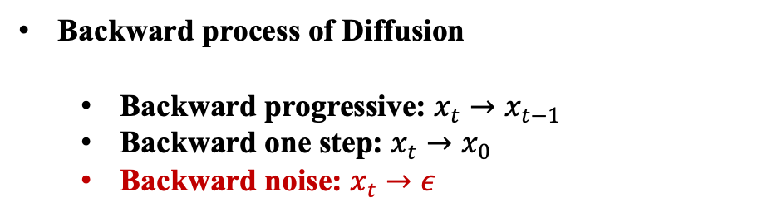
Summary
Motivation and Introduction of Diffusion
Forward process of Diffusion
Backward process of Diffusion
Backward progressive: $x_{t}→x_{t−1}$
Backward one step: $x_{t}→x_{0}$
Backward noise: $x_{t}→ε$

Slide 48



Backward Optimization 3
$$θ^{∗}=argmin𝔼_{x_{0}∼p_{data}\left(x\right),t∼U\left(1,T\right),x_{t}∼q\left(x_{t} | x_{0}\right)}{\left\|ℱ_{θ}(x_{t},t)−x_{0}\right\|}_{2}^{2}$$
$$ℱ_{θ^{∗}}\left(x_{T},t\right)={\overline{x}}_{0}$$
Can we instead directly predict noise?
$$θ^{∗}=argmin𝔼_{x_{0}∼p_{data}\left(x\right),t∼U\left(1,T\right),ε∼𝒩(0,I)}{\left\|ε_{θ}(x_{t},t)−ε\right\|}_{2}^{2}$$

Slide 49
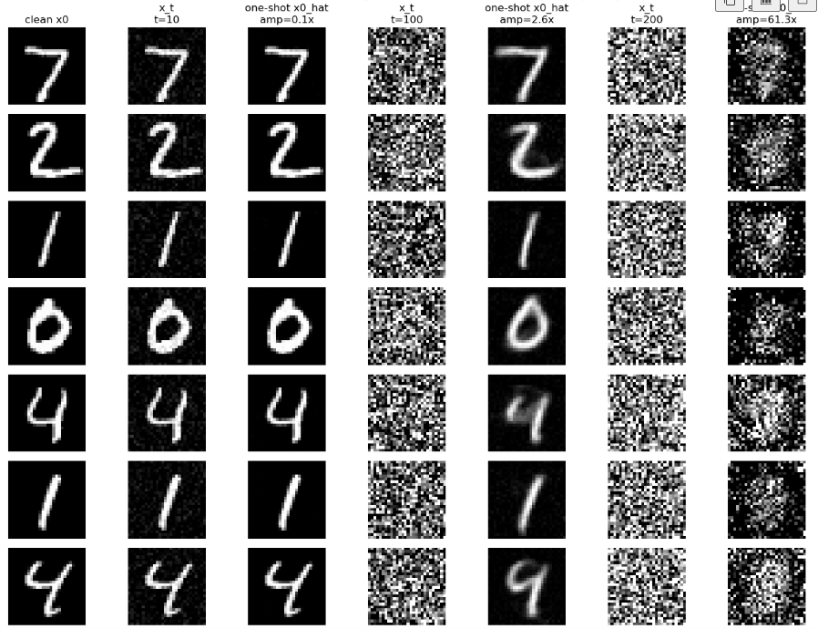


Backward Optimization 3
$$θ^{∗}=argmin𝔼_{x_{0}∼p_{data}\left(x\right),t∼U\left(1,T\right),ε∼𝒩(0,I)}{\left\|ε_{θ}(x_{t},t)−ε\right\|}_{2}^{2}$$
$$x_{T}∼𝒩(0,I)$$
$$\hat{ε}=ε_{θ^{∗}}(x_{t},t)$$

Slide 50
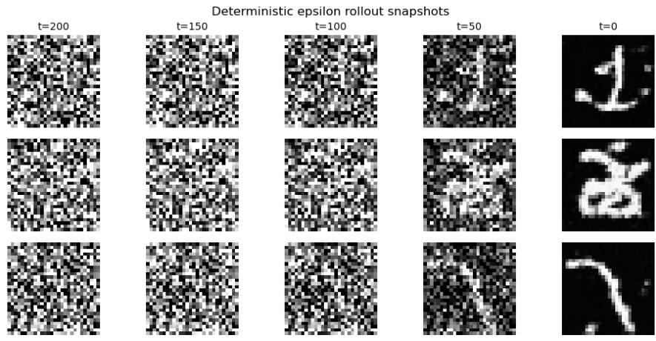
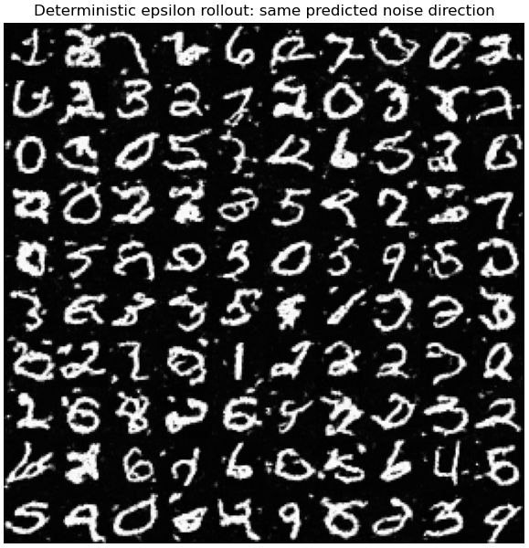


Backward Optimization 3
$$θ^{∗}=argmin𝔼_{x_{0}∼p_{data}\left(x\right),t∼U\left(1,T\right),ε∼𝒩(0,I)}{\left\|ε_{θ}(x_{t},t)−ε\right\|}_{2}^{2}$$
$$x_{T}∼𝒩(0,I)$$
$$\hat{ε}=ε_{θ^{∗}}(x_{t},t)$$

Slide 51





Backward Optimization 3
$$θ^{∗}=argmin𝔼_{x_{0}∼p_{data}\left(x\right),t∼U\left(1,T\right),ε∼𝒩(0,I)}{\left\|ε_{θ}(x_{t},t)−ε\right\|}_{2}^{2}$$
$$x_{T}∼𝒩(0,I)$$
$$\hat{ε}=ε_{θ^{∗}}(x_{t},t)$$

Slide 52






Summary of three backward optimization - 1
Many
$$𝔼_{x_{0}∼p_{data}\left(x\right),t∼U\left(1,T\right),x_{t−1}∼q\left(x_{t−1} | x_{0}\right),x_{t}∼q(x_{t}|x_{t−1})}{\left\|ℱ(x_{t},t)−x_{t−1}\right\|}_{2}^{2}$$
Map
$$x_{t−1}^{1}$$
Map
$$x_{t}$$
$$x_{t−1}^{2}$$
One
Forward Process
Backward Process
$$x_{t}→x_{t−1}$$

Slide 53


Summary of three backward optimization - 2
$$θ^{∗}=argmin𝔼_{x_{0}∼p_{data}\left(x\right),t∼U\left(1,T\right),x_{t}∼q\left(x_{t} | x_{0}\right)}{\left\|ℱ_{θ}(x_{t},t)−x_{0}\right\|}_{2}^{2}$$
$$x_{T}∼𝒩(0,I)$$
$$ℱ_{θ^{∗}}\left(x_{T},t\right)={\overline{x}}_{0}$$
One-shot Generation

Slide 54








Summary of three backward optimization - 2
$$θ^{∗}=argmin𝔼_{x_{0}∼p_{data}\left(x\right),t∼U\left(1,T\right),x_{t}∼q\left(x_{t} | x_{0}\right)}{\left\|ℱ_{θ}(x_{t},t)−x_{0}\right\|}_{2}^{2}$$
$$x_{T}∼𝒩(0,I)$$
$$ℱ_{θ^{∗}}\left(x_{T},t\right)={\overline{x}}_{0}$$
Inconsistency
$$x_{T}→{\overline{x}}_{0}→ε→x_{T−1}→$$
Consistency
$$ℱ_{θ^{∗}}$$
$$ℱ_{θ^{∗}}$$
$$x_{T}→{\overline{x}}_{0}→x_{T−1}→{\overline{x}}_{0}→x_{T−2}…$$
$$x_{t}∼𝒩(\sqrt{{\overline{α}}_{t}}x_{0},(1−{\overline{α}}_{t})I)$$
$$q(x_{T−1}|{\overline{x}}_{0})$$
$$q(x_{T−1}|{\overline{x}}_{0})$$
$$x_{t}∼𝒩(\sqrt{{\overline{α}}_{t}}x_{0},(1−{\overline{α}}_{t})I)$$

Slide 55
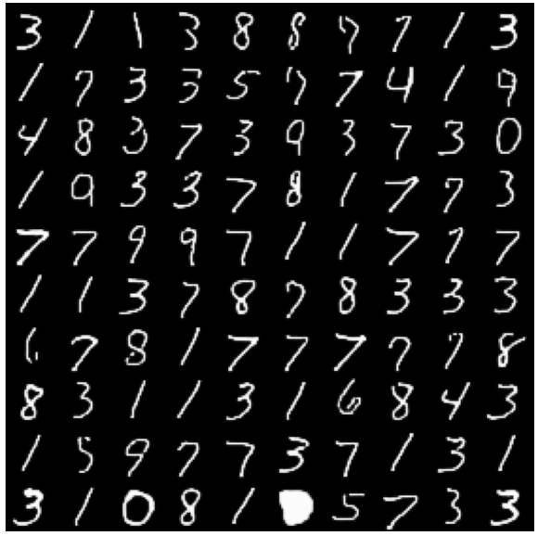
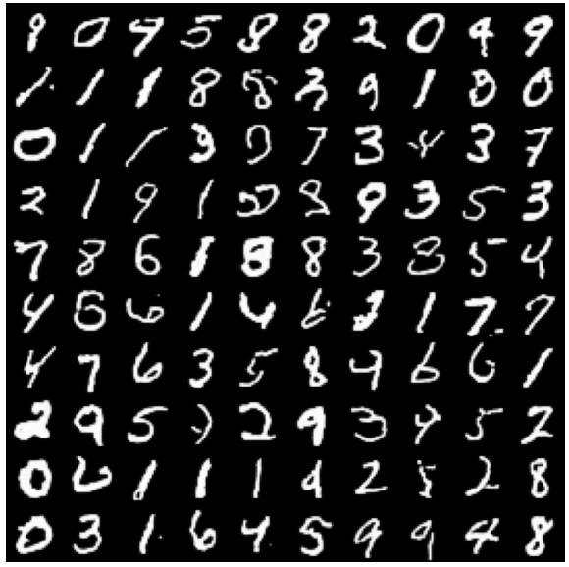
Summary of three backward optimization - 2
$$θ^{∗}=argmin𝔼_{x_{0}∼p_{data}\left(x\right),t∼U\left(1,T\right),x_{t}∼q\left(x_{t} | x_{0}\right)}{\left\|ℱ_{θ}(x_{t},t)−x_{0}\right\|}_{2}^{2}$$
$$x_{T}∼𝒩(0,I)$$
$$ℱ_{θ^{∗}}\left(x_{T},t\right)={\overline{x}}_{0}$$

Slide 56

Summary of three backward optimization - 2
$$θ^{∗}=argmin𝔼_{x_{0}∼p_{data}\left(x\right),t∼U\left(1,T\right),x_{t}∼q\left(x_{t} | x_{0}\right)}{\left\|ℱ_{θ}(x_{t},t)−x_{0}\right\|}_{2}^{2}$$
$$x_{T}∼𝒩(0,I)$$
$$ℱ_{θ^{∗}}\left(x_{T},t\right)={\overline{x}}_{0}$$
Forward Process
Backward Process
What was the clean string?
$$x_{t}→x_{0}$$

Slide 57
Summary of three backward optimization - 3
$$θ^{∗}=argmin𝔼_{x_{0}∼p_{data}\left(x\right),t∼U\left(1,T\right),ε∼𝒩(0,I)}{\left\|ε_{θ}(x_{t},t)−ε\right\|}_{2}^{2}$$
$$x_{T}∼𝒩(0,I)$$
$$\hat{ε}=ε_{θ^{∗}}(x_{t},t)$$

Slide 58


Summary of three backward optimization - 3
$$θ^{∗}=argmin𝔼_{x_{0}∼p_{data}\left(x\right),t∼U\left(1,T\right),ε∼𝒩(0,I)}{\left\|ε_{θ}(x_{t},t)−ε\right\|}_{2}^{2}$$
$$x_{T}∼𝒩(0,I)$$
$$\hat{ε}=ε_{θ^{∗}}(x_{t},t)$$
$$x_{T}∼𝒩(0,I)$$
$$\hat{ε}=ε_{θ^{∗}}(x_{t},t)$$
Introduce some noise

Slide 59
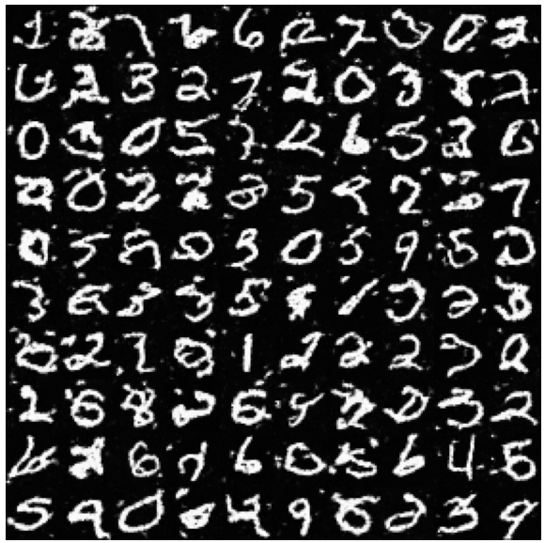
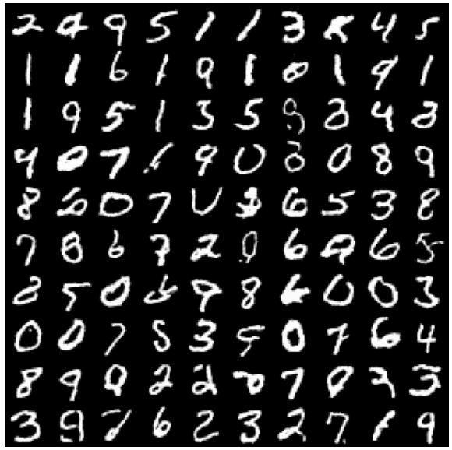
Summary of three backward optimization - 3
$$θ^{∗}=argmin𝔼_{x_{0}∼p_{data}\left(x\right),t∼U\left(1,T\right),ε∼𝒩(0,I)}{\left\|ε_{θ}(x_{t},t)−ε\right\|}_{2}^{2}$$
$$x_{T}∼𝒩(0,I)$$
$$\hat{ε}=ε_{θ^{∗}}(x_{t},t)$$

Slide 60


Summary of three backward optimization - 3
$$θ^{∗}=argmin𝔼_{x_{0}∼p_{data}\left(x\right),t∼U\left(1,T\right),ε∼𝒩(0,I)}{\left\|ε_{θ}(x_{t},t)−ε\right\|}_{2}^{2}$$
$$x_{T}∼𝒩(0,I)$$
$$\hat{ε}=ε_{θ^{∗}}(x_{t},t)$$
Forward Process
Backward Process
$$x_{t}→σ$$

Slide 61
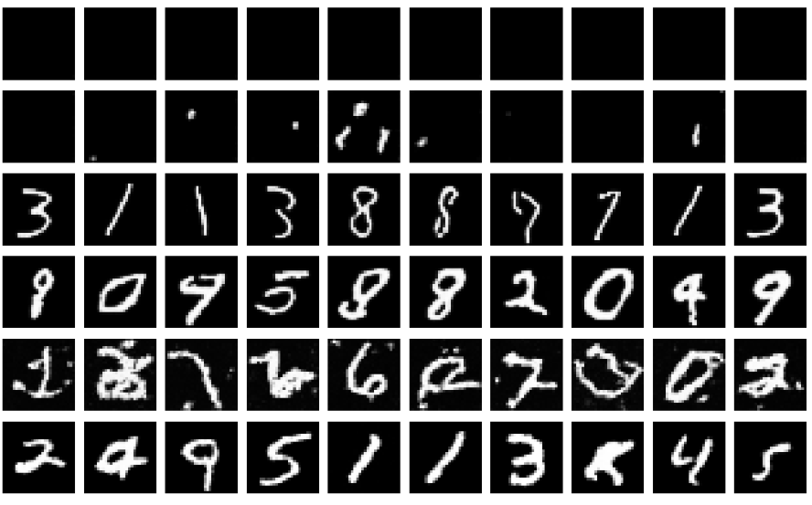
Summary

Slide 62
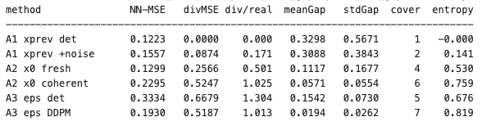

Summary

Slide 63
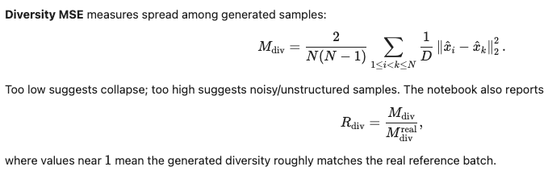
Summary

Slide 64
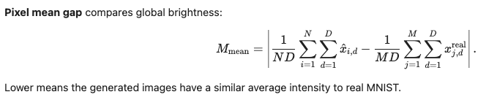
Summary

Slide 65
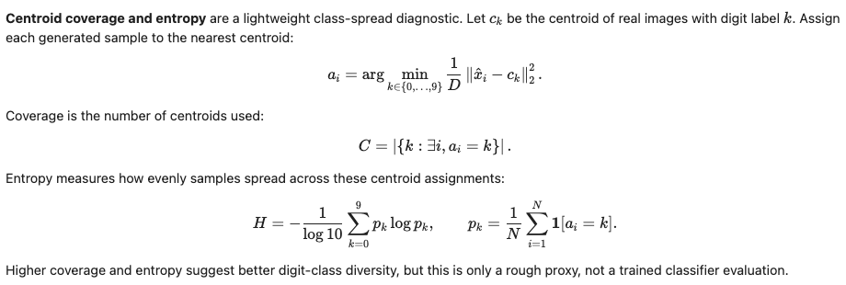
Summary

Slide 66

QA

