Slide 1
Innovative Solutions for imbalanced Data in Diabetes Prediction: A Multifaceted Machine Learning Approach
TEAM:
Srikanth Thota (00887643)
Dinesh Reddy Jetta (00886296)
Rishikeshwar Kankurthyshetty (00854211)
Sesha Sai Veerla (00877627)

Slide 2
Statement of Project objectives:
The objective of this project is to predict clinical risk factors of diabetes using multiple machine learning techniques while resolving class imbalance. This includes identifying the most significant risk factors and developing a predictive model with high accuracy, sensitivity, and specificity.

Slide 3
Outlines
Introduction
What is Diabetes?
Motivation
Overall workflow
Dataset preprocessing
Risk factors analysis
Best methodologies and Results
Future scopes
Conclusion

Slide 4
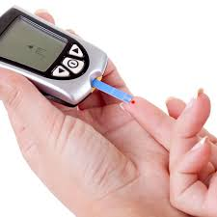
Introduction
Keywords:
Clinical Risk Factors
Diabetes
Prediction
Class Imbalance
Sample Image of diabetes testing

Slide 5

What is Diabetes?
Diabetes is recognized as one of the most frequent and rapidly growing diseases worldwide
It increases the blood sugar level significantly
Diabetes enhances the chances of other long term complications like heart attack, kidney failure, cardiovascular disease etc
What is Diabetes?

Slide 6
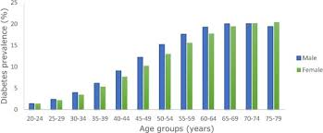
Motivation
Most frequent and rapidly growing diseases worldwide
Patients also suffer from different severe damage to nerves, vital organs and blood vessels
People with ages in the range from 20 to 80 years are at high risk of being impacted by diabetes
Age statistics of diabetes affected people

Slide 7
Motivation
About 465 million grown-ups are affected by this disease which increases to 700 million by 2045
High mortality rate because of other severe complications
Delayed diagnosis increases the death rates
Early diagnosis can reduce the impacts
This increases the importance of early diagnosis

Slide 8
Motivation
Existing Problems:
Purpose:
Still no effective solution
Time consuming clinical analysis
High cost
Experienced Manpower
To develop a intelligent system to classify patients
To contribute in Medical sector
Reduce the cost of overall clinical analysis
Diagnose patient in early stages
Reduce mortality rate
To employ our proposed model which will produce better performances than the existing ones

Slide 9
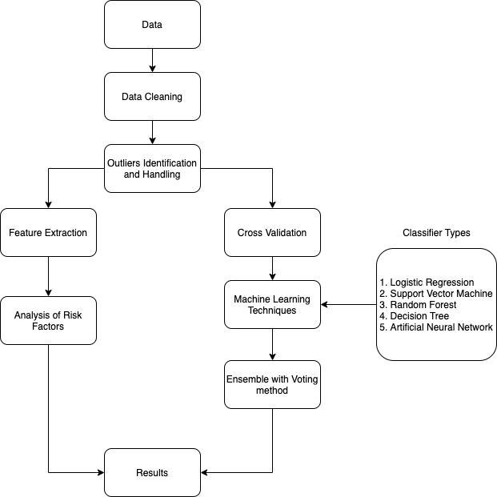
Overall workflow

Slide 10
Dataset Description
The dataset used in this research was obtained from the National Health and Nutrition Examination Survey (NHANES).
The assembled version NHANES data from 1999-2000 to 2015-2016 was utilized for this study.
The dataset has responses of 37079 people with 51 types of different attributes.
There is a total of 37079 respondents in this dataset containing 4852 diabetes patients and 32227 normal patients.

Slide 11
Data Preprocessing
Outliers handling: IQR method
Assigning Class weights: The class imbalance problem is handled by assigning class weights (Class 0: 0.52, Class 1: 0.47) to the classes using scikit-learn tool.
Data Standardization: Scikit-learn tool

Slide 12
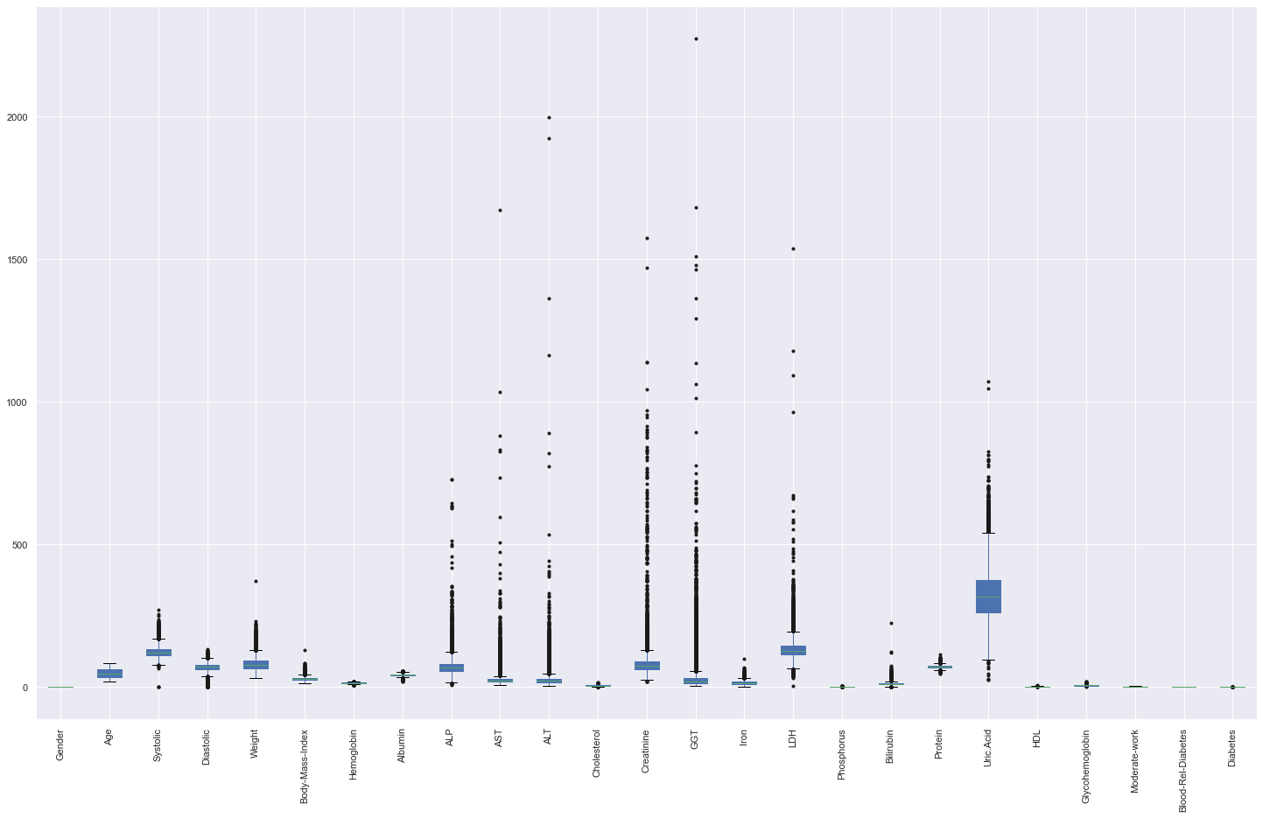
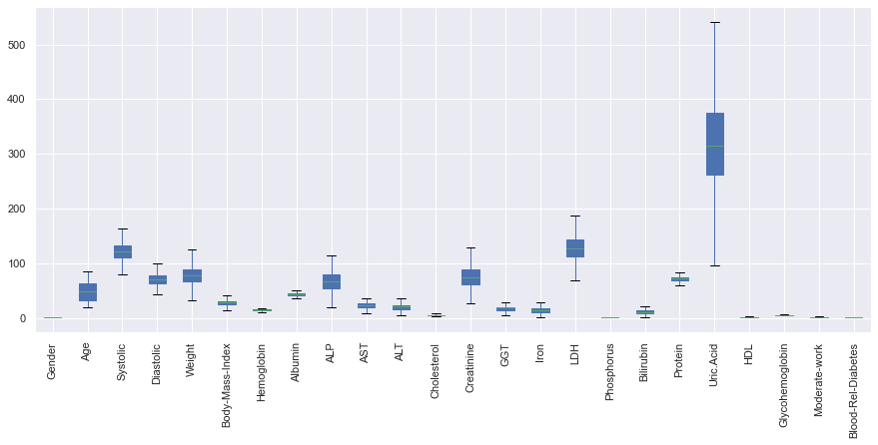
Data Preprocessing
Visuals of before and after handling the outliers

Slide 13
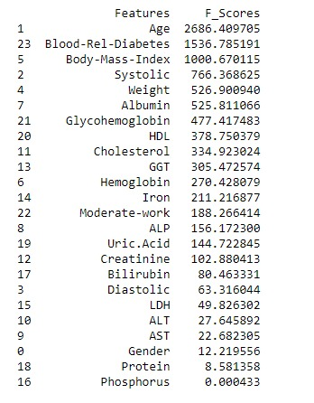
Risk Factor Analysis
The potential clinical risk factors were identified and investigated using Logistic Regression and ANOVA methods.
As a result, age, blood related diabetes, cholesterol and BMI attributes are found as the most significant risk factors associated with diabetes.
Risk factors and their F scores

Slide 14
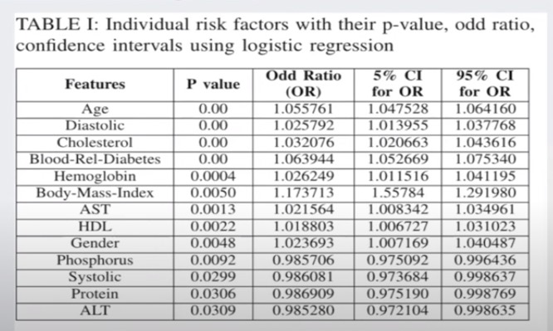
Risk Factor Analysis
The statsmodels tool was used to measure and identify the relative risk factors in our dataset
According to Table, age, diastolic, cholesterol, blood-related diabetics are the most significant risk factors along with the risk factors associated with diabetes disease.
Risk factors with their P values

Slide 15
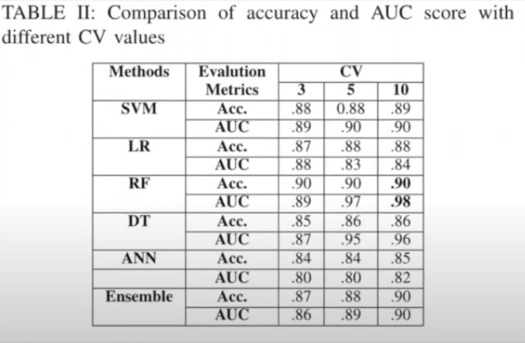
Best Methodologies and Results
Best results were achieved with CV =10 and Random forest and Ensemble approaches.
Hard voting method was applied for ensembling in this research

Slide 16
Future Scopes
Providing a web server for our method.
Apply our process on more datasets and diseases.
Conclusion
Proposing a system that can distinguish the patients effectively.
It can assist specialists to determine the appropriate treatment.
Reduces other clinical complications along with Diabetes

Slide 17


