Slide 1

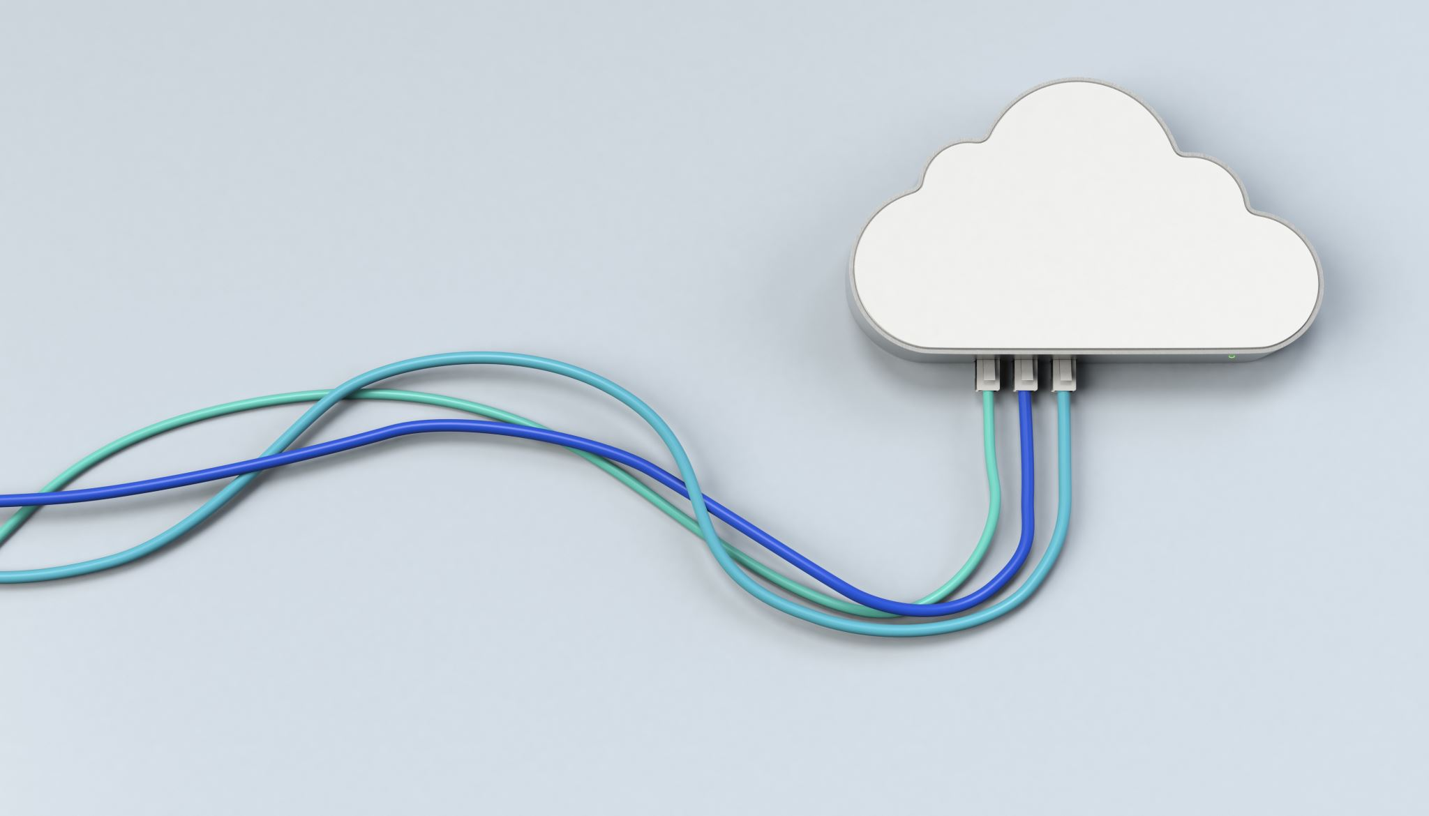
Cloud Computing
Lecture 1 – CS838
Introduction
K. V. Subramaniam

Slide 2
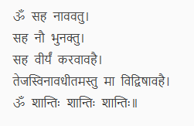
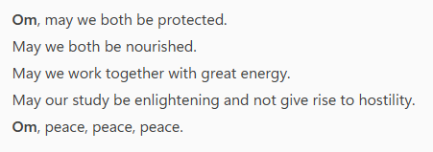
From the Taittriya Upanishad – Krishna Yajur Veda

Slide 3

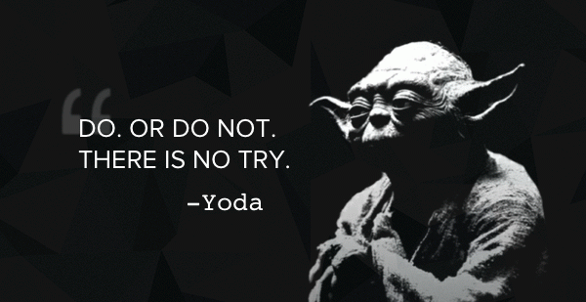
Class Rules
Ask questions
Make mistakes – learn
Focus on learning

Slide 4
Evaluation
Item | Marks
Mid Term | 20
Final Exam | 50
Project and Assignments | 30

Slide 5
Overview
Trends in the datacenter
What is Cloud Computing?
Technical Challenges

Slide 6
Trends in the Datacenter
Cloud Computing is supposed to be bringing about a revolution.
What is the revolution???????????

Slide 7
Impact of Technology Change
Clearing of Gangetic forests
Rise of Magadh
Rise of Indus Valley and other civilizations
Rise of Indian software industry
AI?
Time
Time
Invention of Agriculture
Discovery of Iron and
Steel
Invention of Internet
Invention of Cloud Computing

Slide 8
The data centre
Google’s first data centre. Courtesy: Jeff Dean – Keynote on Building Large Scale Information Systems

Slide 9

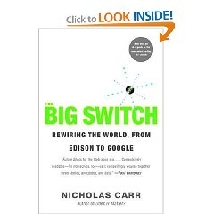



Background to the Cloud Explosion
Henry Burden
Manufacturer of nails, horseshoes and railroad spikes
Built the “Niagara of Water wheels”
60 foot 250 ton wheel to generate electricity
Tourist attraction
Abandoned

Slide 10
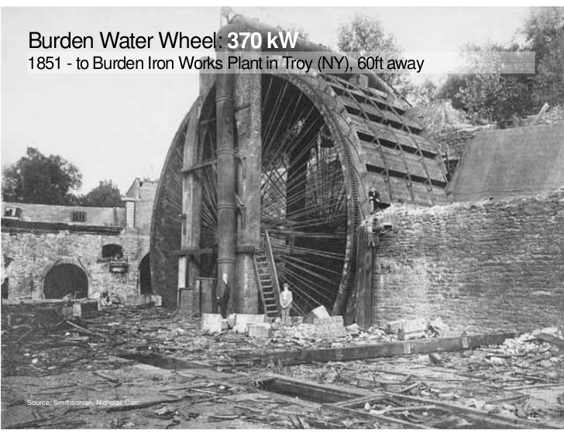

Cloud Motivation: Revisiting Burden’s waterwheel
Electricity drawn from a Grid
Treated as a utility
Cloud computing converts electricity in the same way
Is this correct?

Slide 11
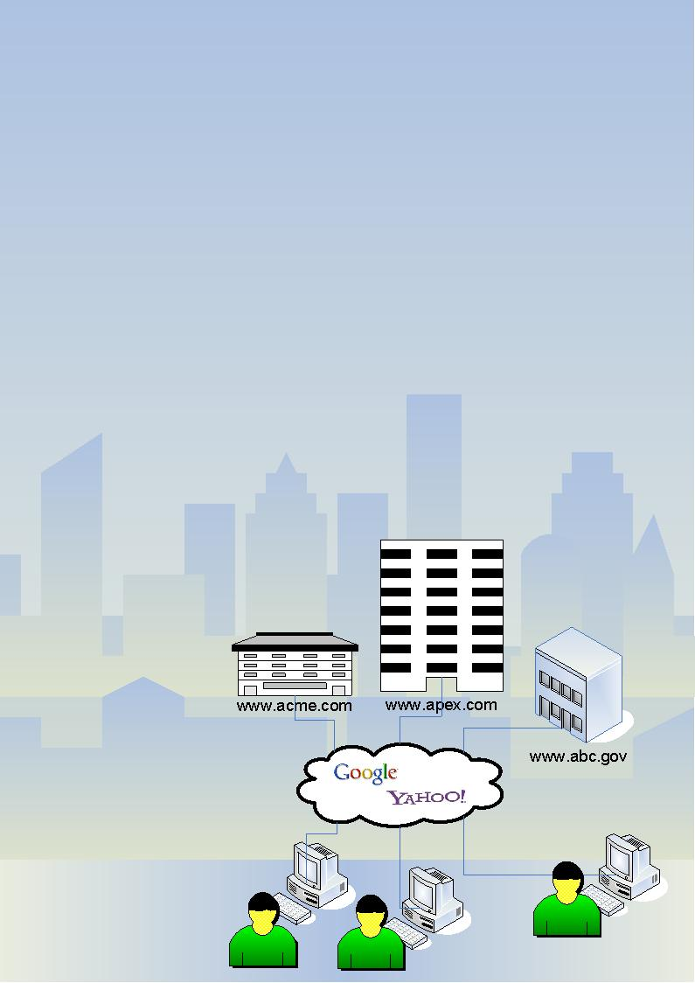
Web 1.0
Read-only or static pages
The Web is a global library
Content delivery from the server’s file system

Slide 12

Social networking in Germany
Uploading video in the US
Researching in China
Chatting in India
Blogging in Brazil
Web 2.0: Explosion in new modes of Communication and Collaboration

Slide 13
Web 2.0: Digital information is doubling every 18 months

Slide 14
Web 2.0: Of the 6.6 billion people in the world, only 1.6 billion are online.

Slide 15
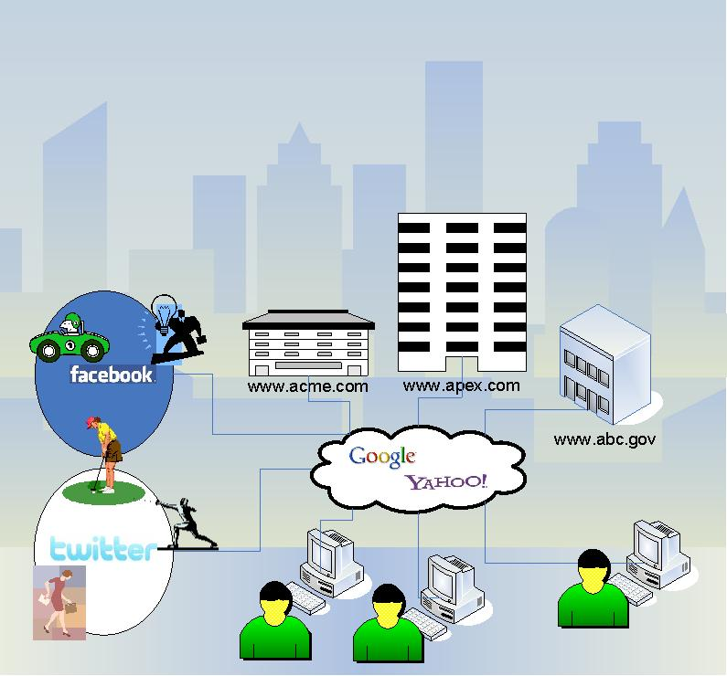
Web 2.0
Read-write access to web
Dynamic content that is responsive to user input
Users upload personal data
Information flows between site owner and site users by means of evaluation and online commenting (Participative social web)
Facebook: 750 million members ~10% of world population
January 25th 2011 Tahrir square protest
Digital Activism
Digital world = physical world
Cloud Technology
Notes:
Tahrir square – over 100GB of video was shot.
https://en.wikipedia.org/wiki/Egyptian_revolution_of_2011

Slide 16
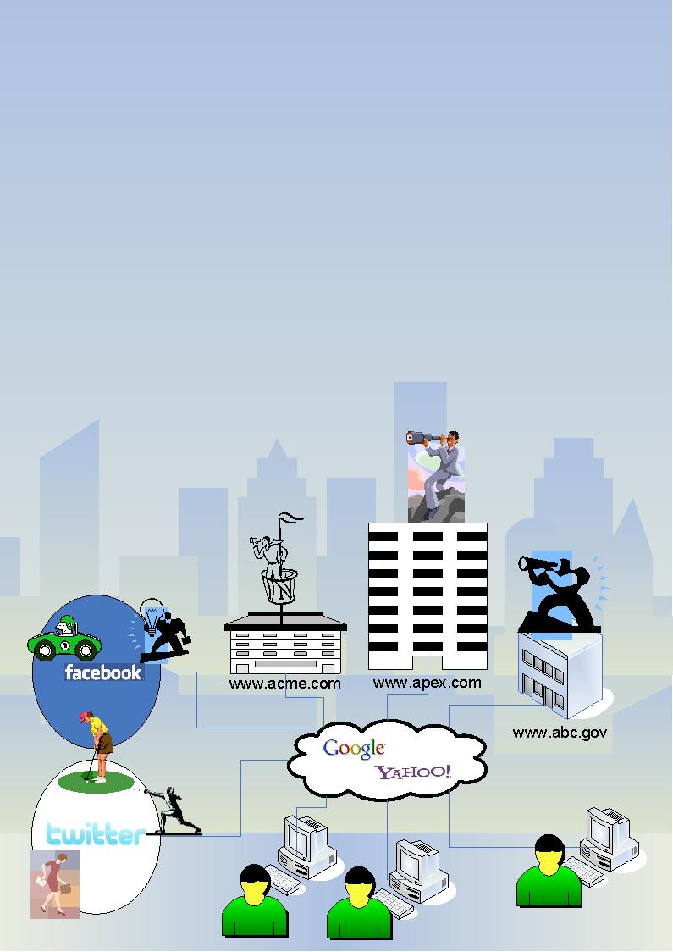
Web 3.0:Cyberspace looks at You
Londoner
Average Londoner is photographed by CCTV 300 times per day
Steve Rambam
Email address, name
500 pages of data on Web in 4 hours
Places person lived
Cars he drove
Fraudulent use of SS no. for 20 years!
Wisdom of crowds
Hollywood Stock Exchange online game
$2M; predicts revenues of movies
Betting (cricket)
Notes:
Rambam was going to discuss how he dug up -- in just 4.5 hours of searching private and public databases -- more than 500 pages worth of data on HOPE attendee Rick Dakan, who agreed to be the guinea pig for the project.
"All I had given him was my e-mail and name. He knew everywhere I'd lived, every car I had driven, and even someone else in Alabama who was using my Social Security number since 1983," said Dakan, who said he is attending this conference for a book he is working on about hacker conferences. "He found all my friends, pictures of friends, knew about my brother's criminal history."

Slide 17
Cloud Motivation: Revisiting Burden’s waterwheel
Cloud computing isn’t just a new technology
Computation happens “somewhere in the cloud” (no particular server)
Like Google and Facebook
Has major impact
Social Computing
Web looks at you
Big Data

Slide 18
Cloud Motivation: Revisiting Burden’s waterwheel
Electricity drawn from a Grid
Treated as a utlility
Can computing be treated the same way?
More like a Smart Grid

Slide 19
What is Cloud Computing?
A technology
Enables a new style of computing
Computation happens “somewhere in the cloud” (not particular server)
Highly scalable, elastic and responsive
Like Google and Facebook
Enables new applications
Social Computing
Web looks at you
Big Data, AI

Slide 20
COURSE OBJECTIVES

Slide 21
Course Objectives
Why is Cloud Computing important?
Develop an intuitive understanding of Cloud Computing
Develop hands-on familiarity with Cloud Computing
Understand Cloud Computing technology

Slide 22
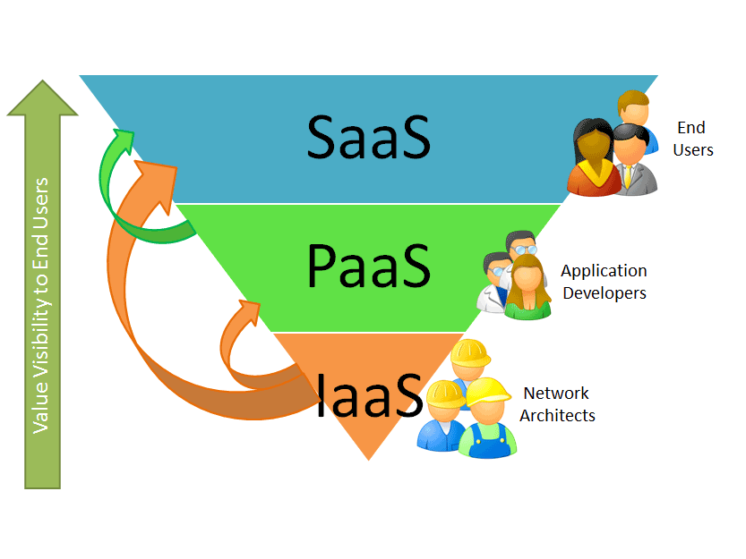
Part 1: Hands on experience with Cloud Systems
IaaS: Study of Openstack, Amazon, HP Cloudsystem
PaaS: Study of Windows Azure, Docker
SaaS: Salesforce.com

Slide 23
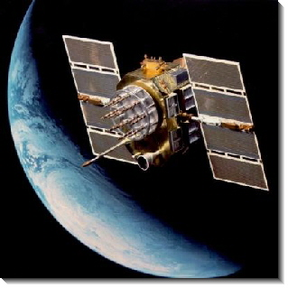
Part 2: Cloud Technologies
Virtualization/Containers
Scaling compute
Open source: Kubernetes, Open Stack, …
Scaling storage
Consistency issues
Alternatives to relational
Security
Multi-tenancy

Slide 24
Cloud Computing Models

Slide 25
Overview of class
Cloud computing definition
Cloud classification
Technology Challenges
Business Benefits

Slide 26
What is the Cloud ?
"Cloud computing is a model for enabling ubiquitous, convenient, on-demand network access to a shared pool of configurable computing resources that can be rapidly provisioned and released with minimal management effort or service provider interaction.“
- NIST (National Institute of Standards Technology)
Notes:
26

Slide 27
Salient Features
On Demand Self Service
Broad Network Access
Resource Pooling
Rapid Elasticity
Measured Service

Slide 28
Cloud Service Salient Features
Ubiquitous Network Access
Services are accessible over the network from a wide range of devices (e.g., phones, laptops, tablets).
On-Demand Self-Service
Users can provision computing resources as needed automatically, without requiring human interaction with service providers.
Resource Pooling
Computing resources are pooled to serve multiple consumers using a multi-tenant model, with resources dynamically assigned and reassigned according to demand.
Rapid Elasticity
Capabilities can be elastically provisioned and released, often automatically, to scale rapidly outward and inward commensurate with demand.
Measured Service
Cloud systems automatically control and optimize resource use by leveraging a metering capability.

Slide 29

Cloud Computing: Classification

Slide 30
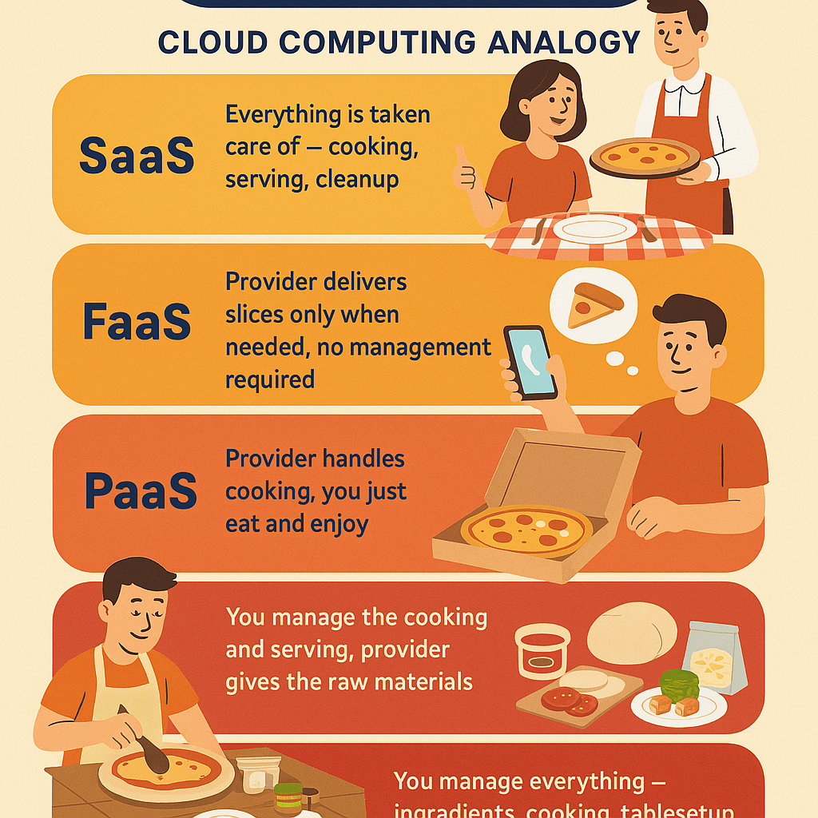
Cloud Service Models
Consider Eating Pizzas as an analogy
What are various alternatives for having Pizza?

Slide 31
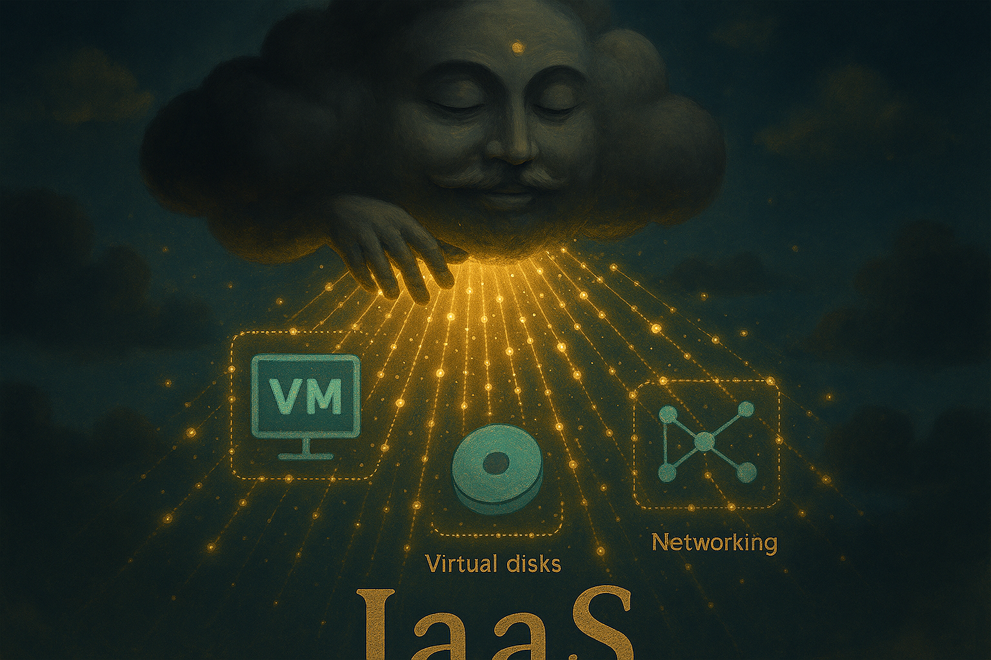
Infrastructure as a service
Infrastructure
Compute
Storage
Networking
Virtual Machines

Slide 32
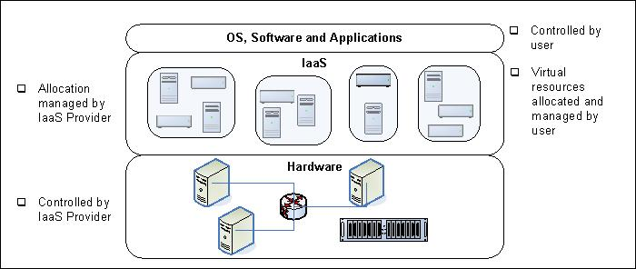
Infrastructure as a Service (IaaS)
NIST definition: The capability provided to the consumer is to provision processing, storage, networks, and other fundamental computing resources where the consumer is able to deploy and run arbitrary software, which can include operating systems and applications

Slide 33
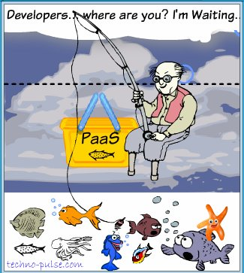
What do developers really want?
Let’s go back to BookKarts
We need a database and an App Server
Developer needs to install these to get started with IaaS
With PaaS, these are provided as part of the offering

Slide 34
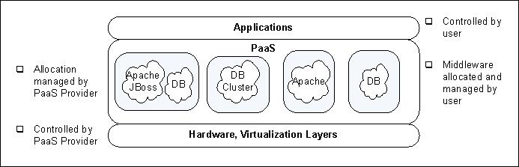
Platform as a Service (PaaS)
NIST definition: The capability provided to the consumer is to deploy onto the cloud infrastructure consumer-created or acquired applications created using programming languages and tools supported by the provider.

Slide 35
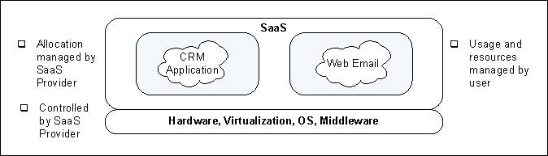
Software as a Service (SaaS)
NIST definition: The capability provided to the consumer is to use the provider’s applications running on a cloud infrastructure. The applications are accessible from various client devices through a thin client interface such as a web browser.

Slide 36
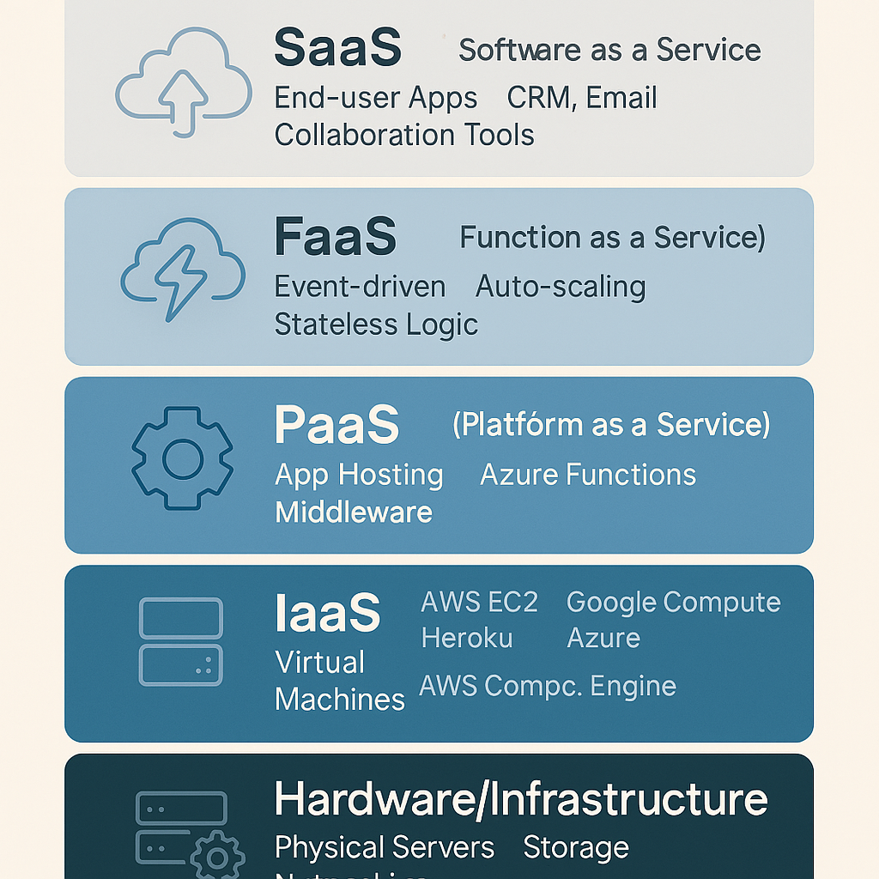
Comparison: Cloud Service Models
Automation
Flexibility
36

Slide 37
A Spectrum of Cloud Models
Amazon AWS
VMs Look Like Hardware
No Limit on App Model
User Must Implement Scalability and Failover
Microsoft Azure
.NET CLR/Windows Only
Choice of Language
Some Auto Failover/ Scale
Force.Com
SalesForce Biz Apps
Auto Scaling/ Provisioning
IaaS: Suited for customers who want control over OS, software and develop application
PaaS: Suited for customers who want to develop application
SaaS: Suited for customers who simply want to use application
Notes:
37

Slide 38
Class Exercise (5 mins)
You are the software architect for a very successful product that has been in the market for more than 15 years. Your company has decided to move your application to the cloud ASAP
Which cloud model will you choose and why?

Slide 39
Exercise - Solution
You are the software architect for a very successful product that has been in the market for more than 15 years. Your company has decided to move your application to the cloud.
IaaS – legacy systems may need support + no coding required

